Slide 1

HACKSPARROW
TERNA ENGINEERING COLLEGE
Team Name : Techrunners
Domain : AI/ML
Team Members:
Rahul Nair
Shreeram Sawant
Vighnesh Rane

Slide 2
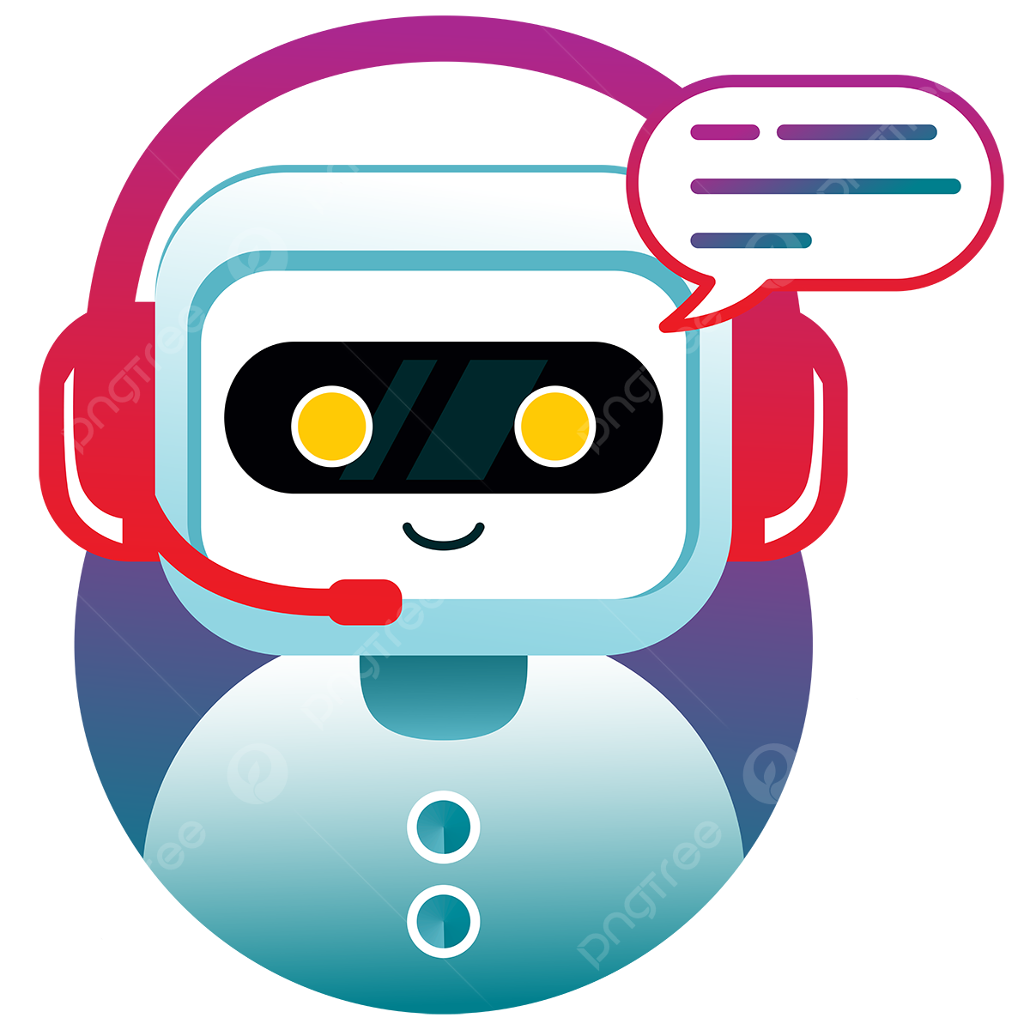
PS- AM4 :
AI for Personalized Customer Service Chatbots: Develop AI-powered chatbots that provide personalized customer service experiences. Train the chatbots on customer conversation history and product knowledge to answer questions, offer relevant product recommendations, and resolve common issues efficiently. Integrate sentiment analysis features (avoid core NLP) to adapt communication style based on customer emotions and improve overall customer satisfaction.

Slide 3
Technology Used
Python3
Django Framework
Tensorflow
NLTK
Numpy
HTML, CSS
JavaScript

Slide 4
Key points
Customer History Analysis: Train the chatbots to analyze customer conversation history to understand preferences, past issues, and interactions, enabling personalized responses.
Product Knowledge Integration: Integrate extensive product knowledge databases to enable chatbots to offer accurate and relevant product recommendations and assistance.
Sentiment Analysis Implementation: Incorporate sentiment analysis features to gauge customer emotions and tailor responses accordingly, enhancing customer satisfaction.
Efficient Issue Resolution: Equip chatbots with the ability to efficiently resolve common customer issues by providing accurate solutions and escalating complex problems to human agents when necessary.

Slide 5
Bonus point
Seamless Integration with CRM Systems: Integrate chatbots with customer relationship management (CRM) systems to access comprehensive customer profiles and provide highly personalized assistance based on individual preferences and past interactions.

Slide 6
Additional Features
Input can be in the form of images.
Knowledge of users past purchases.
Response on past experience.
Can surf images.

Slide 7
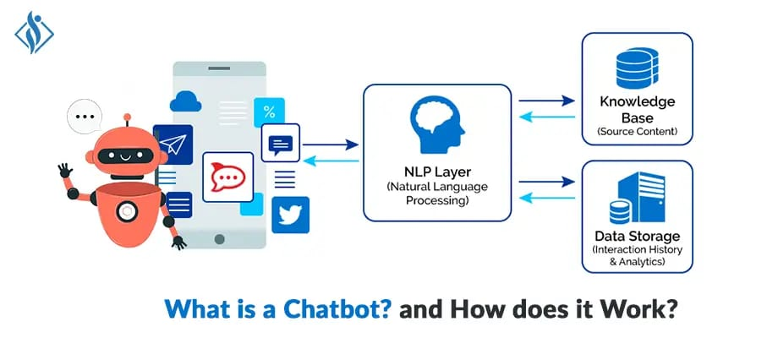
System Architecture

