Slide 1


FINANCIAL FRAUD AND RISK PREDICTION SYSTEM
INSTITUTE OF AERONAUTICAL ENGINEERING
(Autonomous)
Dundigal, Hyderabad - 500 043
ELECTRONICS AND COMMUNICATION ENGINEERING

Slide 2
TEAM MEMBERS : MOHAMMED ABDUL SOHAIL – 23951A04A4
RAHUL NALLURI – 23951A04C7
BRANCH : ELECTRONICS AND COMMUNICATION ENGINEERING
SUBJECT : AI SPECIALIST
Topic : FINANCIAL FRAUD AND RISK PREDICTION SYSTEM

Slide 3
Problem statement:
Design an explainable AI system that detects fraudulent transactions and predicts loan default risk using customer history, transaction patterns, and machine learning models in real time.

Slide 4
Abstract:
Financial fraud and loan default risks pose significant challenges to modern financial systems, leading to substantial economic losses and reduced trust in digital transactions. This project presents FinRisk AI, an intelligent financial risk assessment platform designed to detect fraudulent transactions and predict loan approval risk using a hybrid approach that combines machine learning models with rule-based validation and customer history analysis. The system integrates a Random Forest–based fraud detection model and a Gradient Boosting–based loan risk prediction model to evaluate transaction behavior and borrower eligibility in real time. In addition to model predictions, the platform incorporates realistic transaction-type limits and dataset-driven customer fraud history to improve reliability and decision accuracy. A customer profiling module retrieves transaction patterns, fraud ratios, and historical activity to generate explainable risk insights. The system also provides transparent outputs such as risk scores, confidence levels, and decision explanations through an interactive dashboard interface. By combining predictive analytics with practical banking constraints and explainable decision support, the proposed solution enhances fraud detection accuracy and supports safer loan approval processes, making it suitable as a prototype for intelligent financial risk management systems.

Slide 5
Objectives:
Collect and preprocess real-world financial transaction and loan risk datasets for fraud detection and credit risk analysis.
Build and train machine learning models (Random Forest and Gradient Boosting) for transaction fraud detection and loan default prediction
Improve prediction reliability by integrating customer transaction history and dataset-based fraud behavior analysis
Implement transaction-type validation limits (UPI, ATM, Card, Wire, NEFT) based on realistic banking constraints
Provide explainable risk assessment using confidence scores, fraud reasons, and customer risk profiling insights
Develop an interactive web-based dashboard using Flask for real-time fraud detection and loan approval prediction

Slide 6
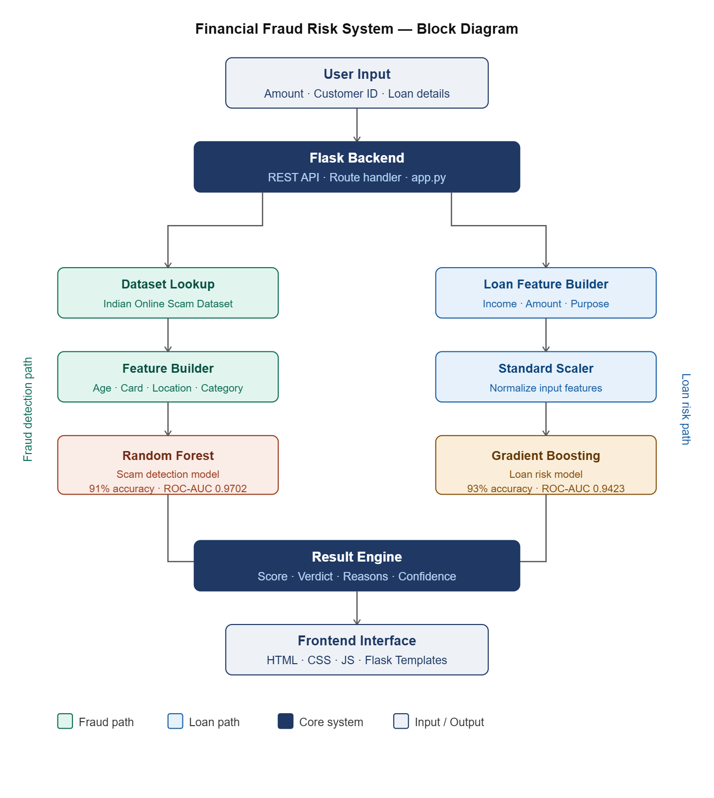
Block diagram

Slide 7
Old vs Proposed :
Aspect | Traditional Financial Risk Systems | Proposed FinRisk AI System
Fraud detection | Manual monitoring or basic rule-based alerts; slow response and error-prone detection. | Automatic real-time fraud detection using Random Forest machine learning model.
Loan approval assessment | Manual evaluation using simple scoring techniques. | Automated loan risk prediction using Gradient Boosting machine learning model.
Processing speed | Slow processing due to manual verification and delayed response to suspicious transactions. | Real-time automated prediction using machine learning models for faster fraud detection and loan risk assessment.
User interface | Limited or no interactive visualization support. | Interactive dashboard displays transaction results, customer risk and loan prediction insights.
Technology | Basic rule engines or manual banking workflows without intelligent automation. | Uses Machine Learning models, customer history intelligence, and Flask-based dashboard.

Slide 8
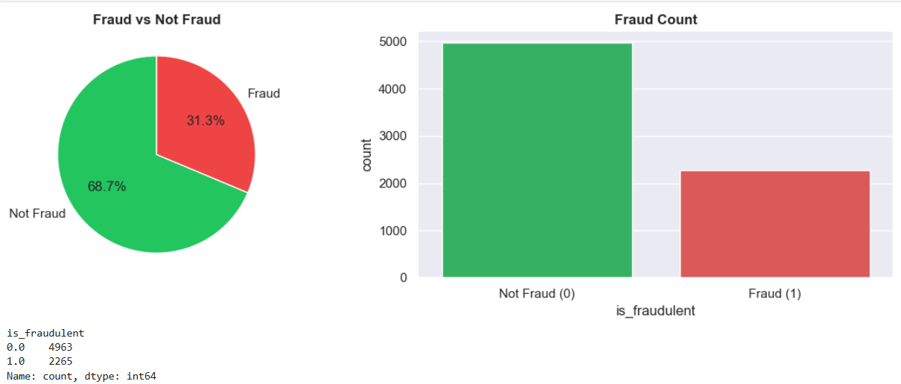
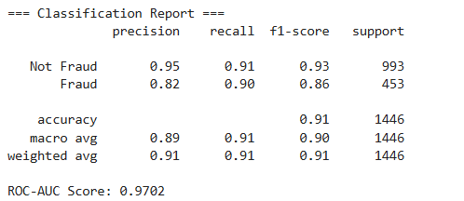
Metrices of Fraud Detection Model

Slide 9
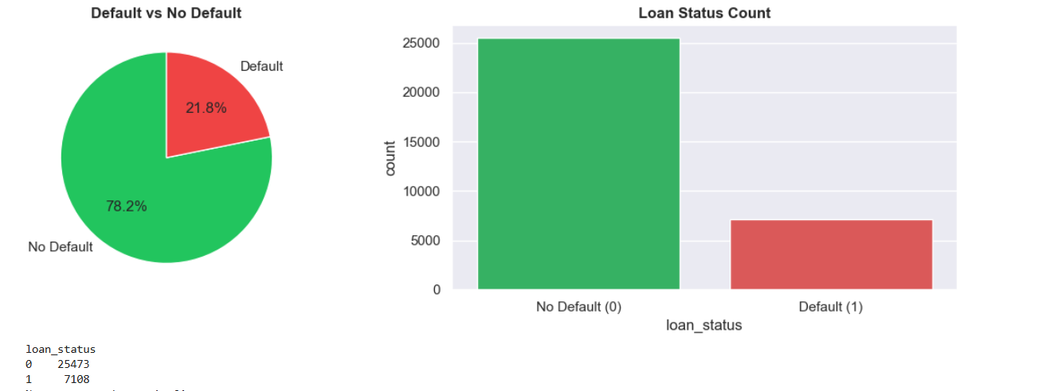
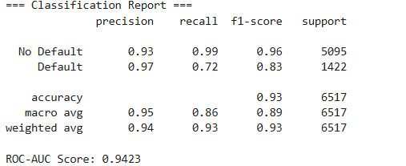
Metrices of Loan Model

Slide 10
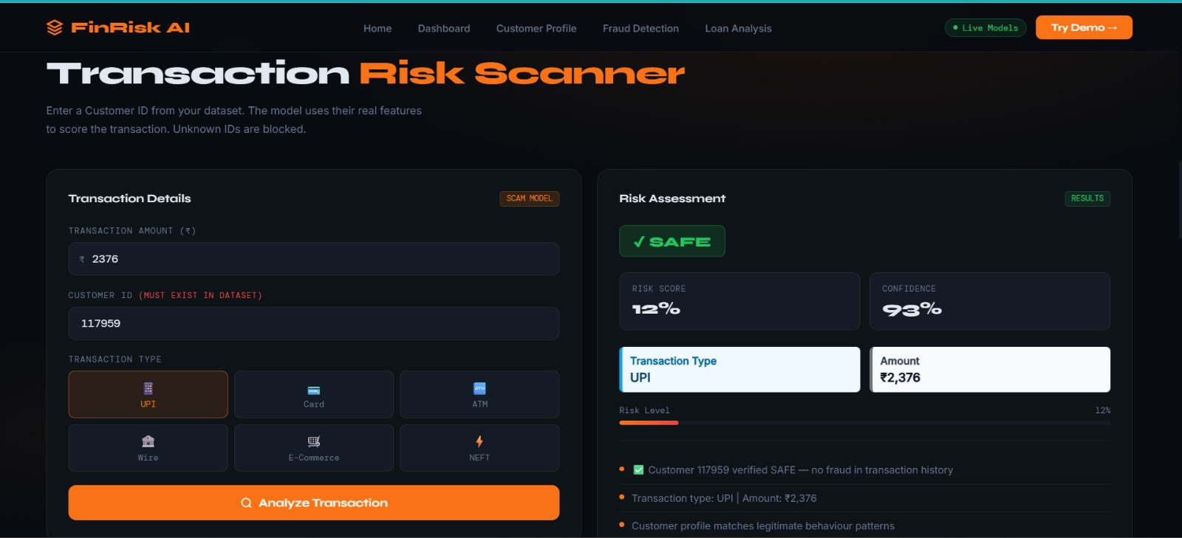
Outputs:

Slide 11
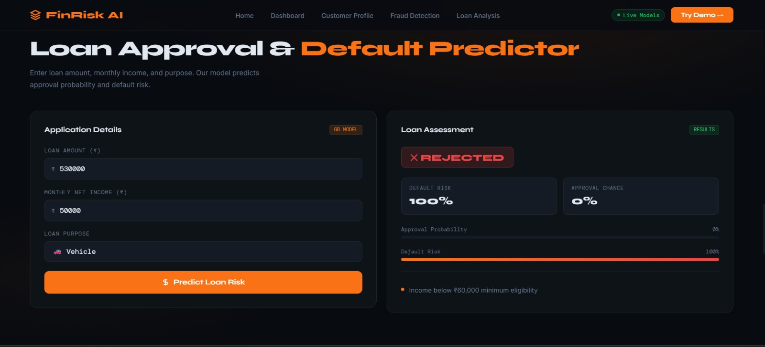
Outputs:

Slide 12
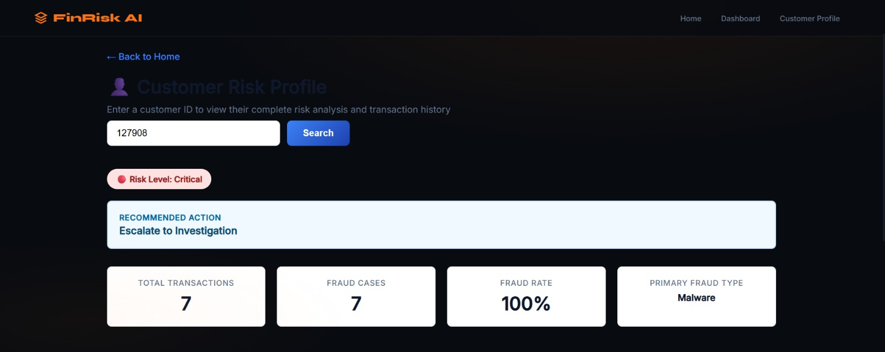
Outputs:

Slide 13
References:
[1] C. Phua, V. Lee, K. Smith, and R. Gayler, "A comprehensive survey of data mining-based fraud detection research," arXiv preprint arXiv:1009.6119, 2010.
[2] S. Bhattacharyya, S. Jha, K. Tharakunnel, and J. C. Westland, "Data mining for credit card fraud: A comparative study," Decision Support Systems, vol. 50, no. 3, pp. 602–613, 2011.
[3] A. Dal Pozzolo, O. Caelen, R. A. Johnson, and G. Bontempi, "Calibrating probability with undersampling for unbalanced classification," in Proc. IEEE Symposium Series on Computational Intelligence, 2015, pp. 159–166.
[4] S. Patil and S. Sherekar, "UPI based financial fraud detection using machine learning techniques," International Journal of Computer Applications, vol. 183, no. 27, pp. 1–6, 2022.
[5] S. Jha, M. Ghahramani, and A. Choudhary, "Federated learning for financial fraud detection: A privacy preserving approach," IEEE Transactions on Neural Networks and Learning Systems, vol. 34, no. 8, pp. 4021–4033, 2023.
[6] N. Carneiro, G. Figueira, and M. Costa, "A data mining based system for credit-card fraud detection in e-tail," Decision Support Systems, vol. 95, pp. 91–101, 2017.

