Slide 1
Variety descriptives

Slide 2
Question
The data for the year 2024-25 is missing the weeks from Week02 to Week34 – why?
None of the stores have more the 54 weeks’ worth of data
Likely reason – ABFRL only wants to give us a years worth of data (Starting with Week 35 in 2024 to Week 35 in 2025)

Slide 3
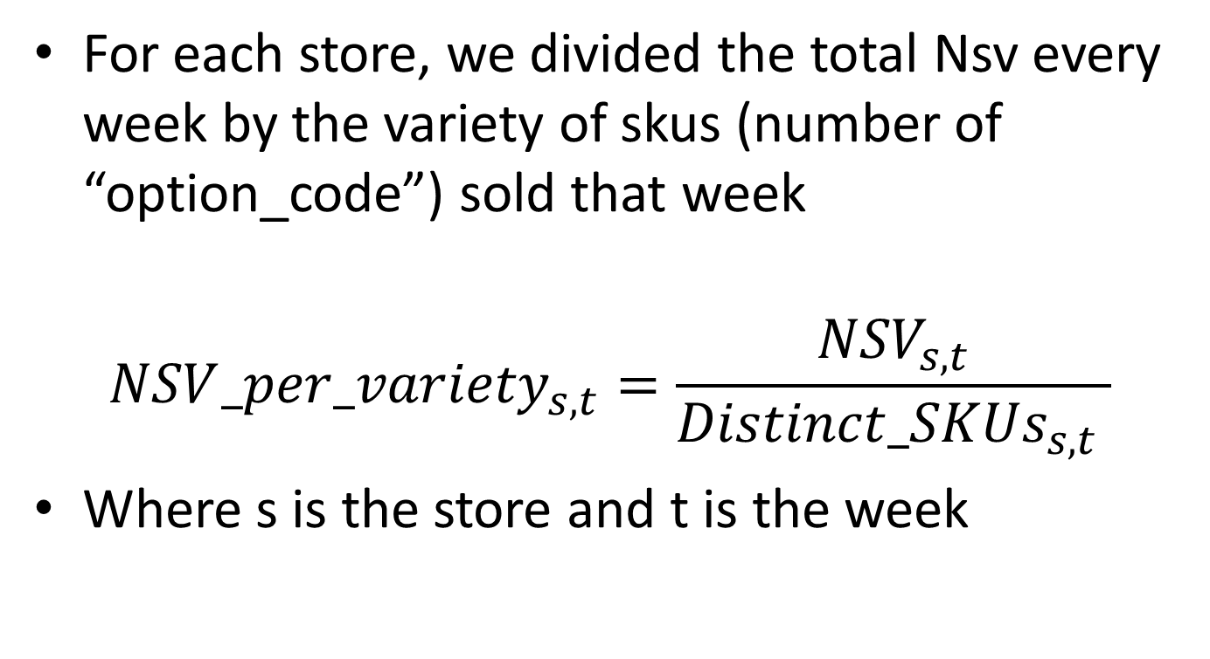
Nsv per variety calculation
For each store, we divided the total Nsv every week by the variety of skus (number of “option_code”) sold that week
$${NSV_per_variety}_{s,t}=\frac{{NSV}_{s,t}}{{Distinct_SKUs}_{s,t} }$$
Where s is the store and t is the week

Slide 4
Nsv per variety calculation
This gets us 54 Nsv_per_variety metrics for each store – one per week.
Take the mean of all 54 to get the mean Nsv_per_variety for each store

Slide 5
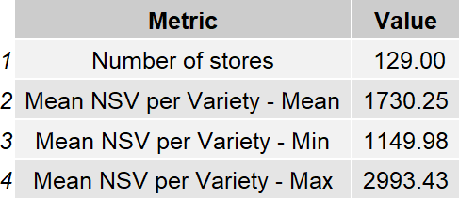
Nsv Per Variety Summary

Slide 6
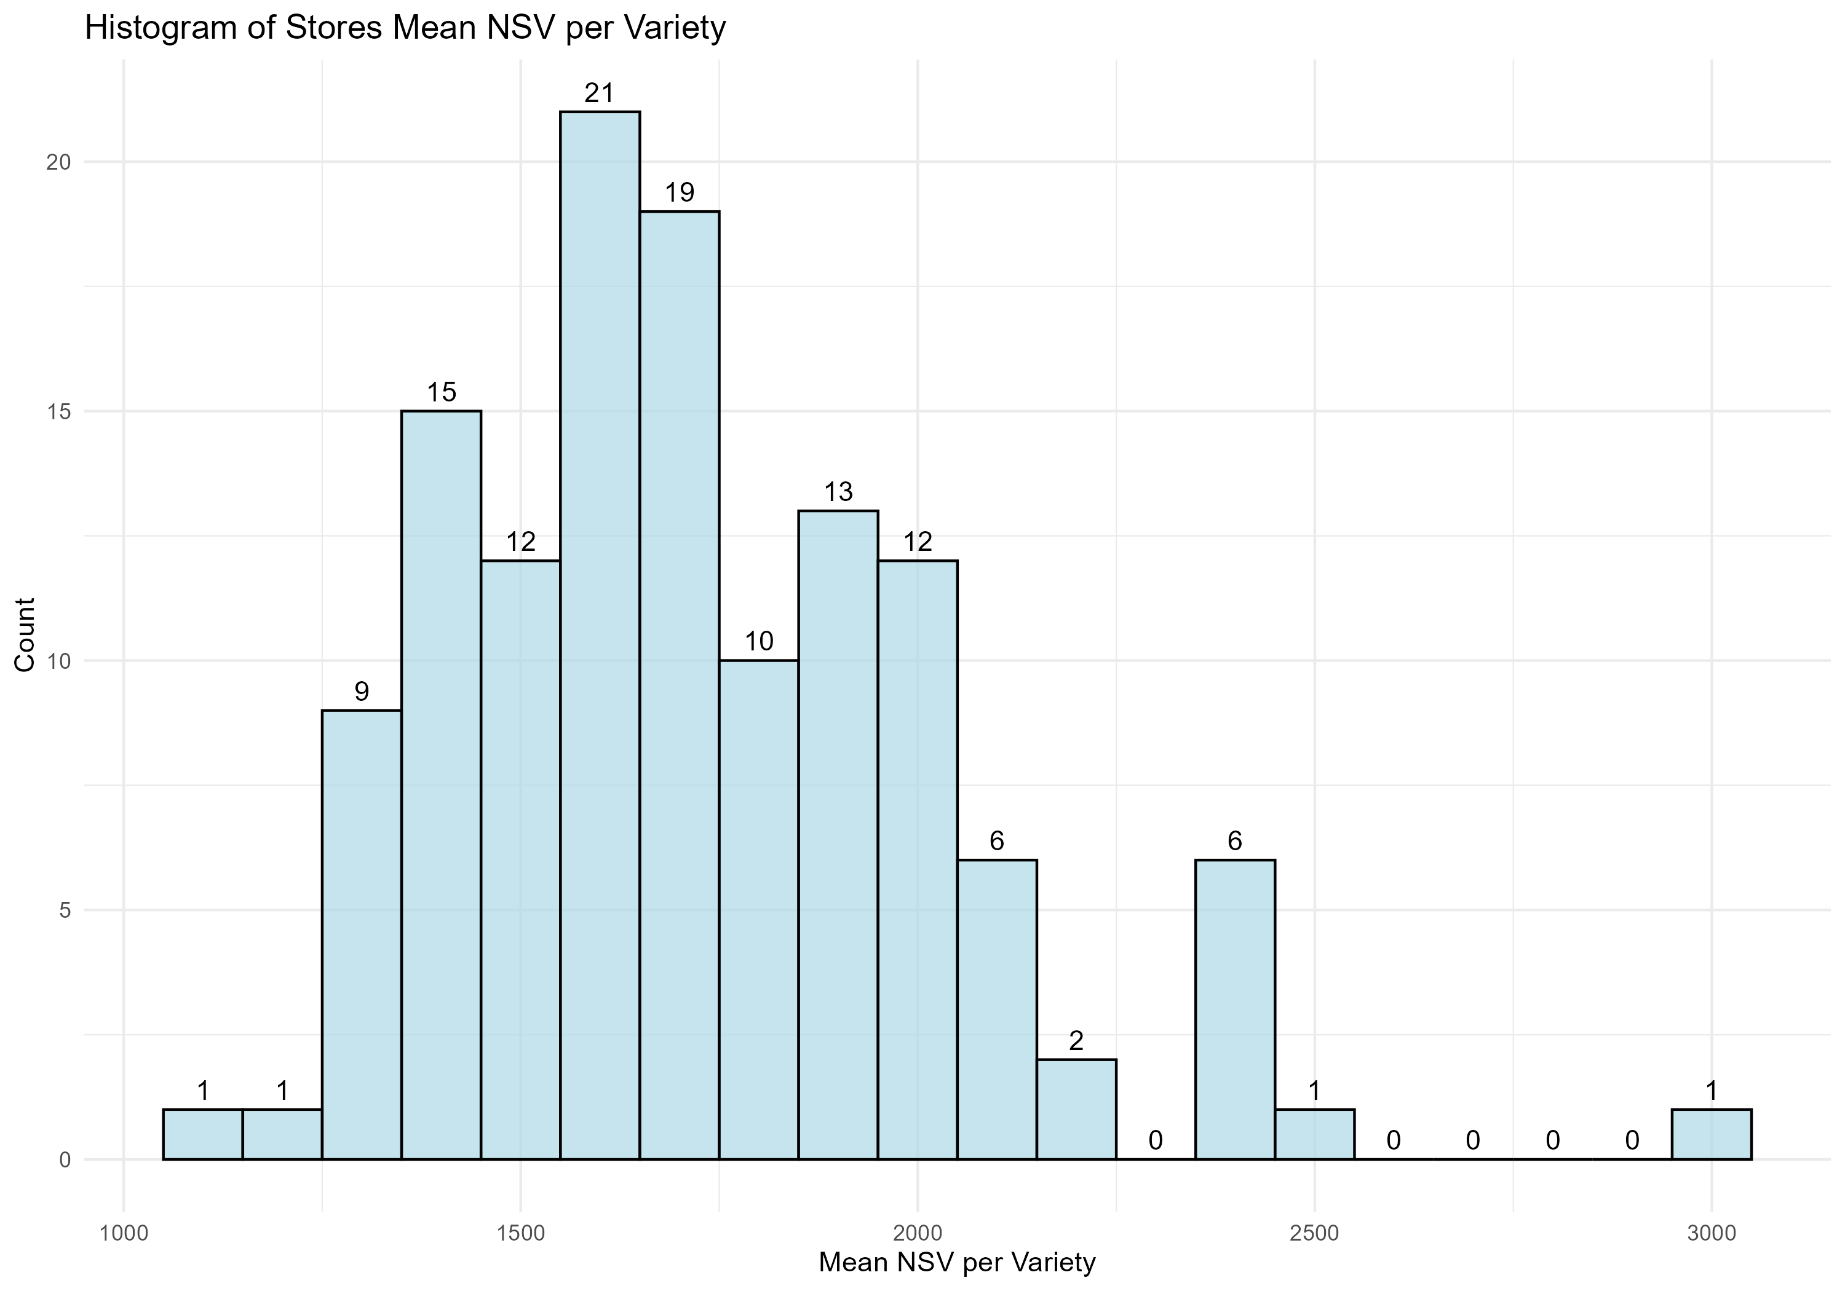
Histogram Of Stores Mean Nsv Per Variety

Slide 7
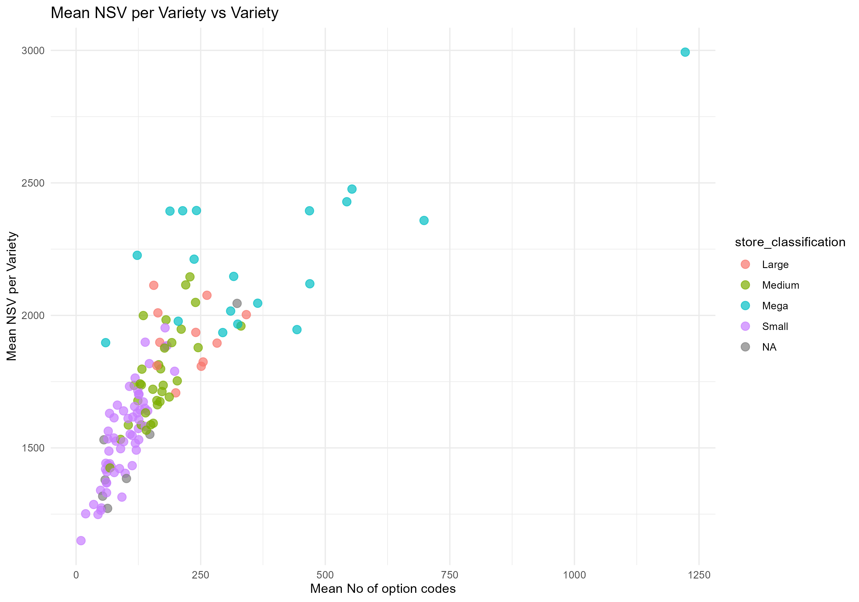
Mean Nsv By Variety Vs Variety
Each point represents a store

Slide 8
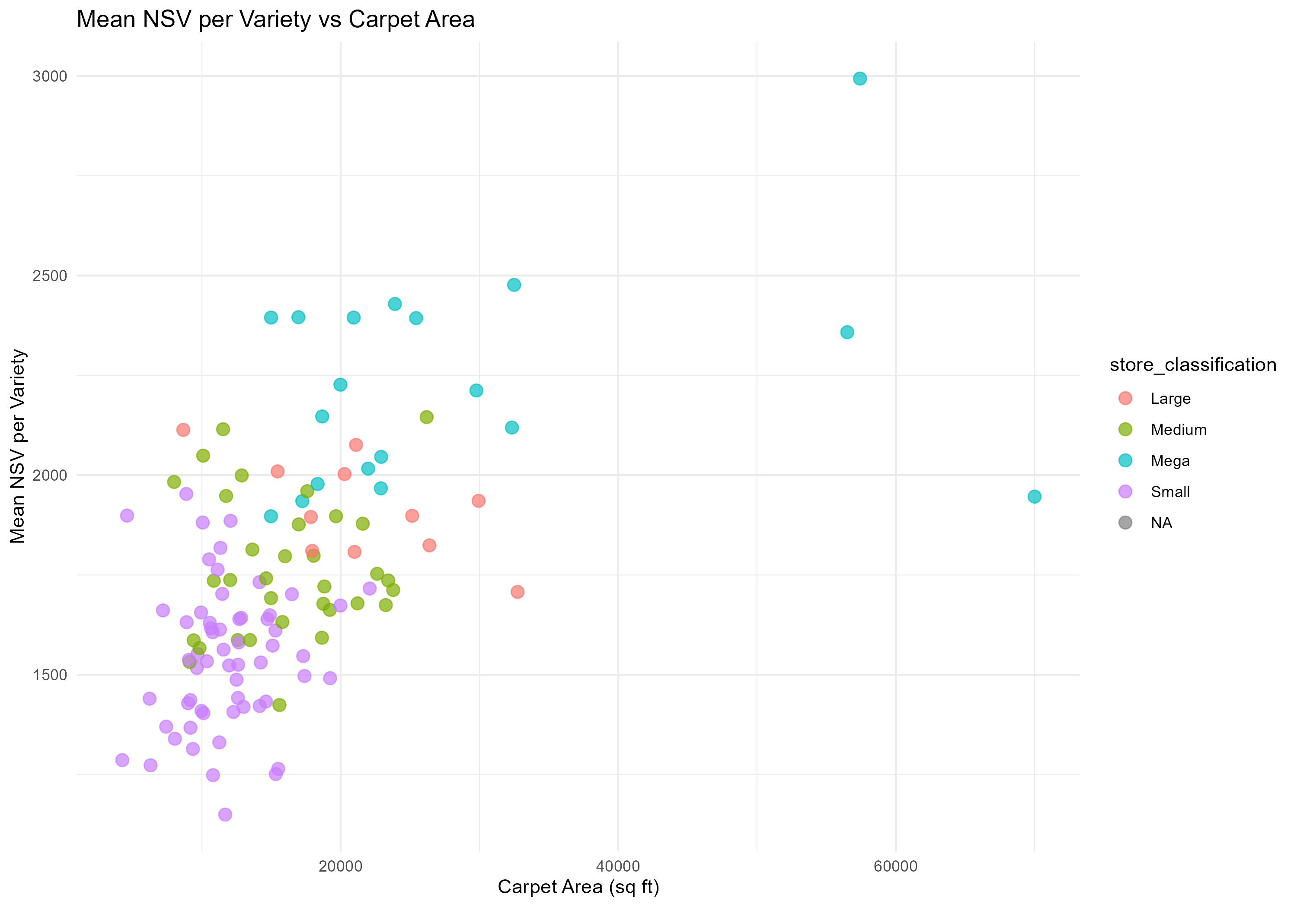
Mean Nsv By Variety Vs Carpet Area
Each point represents a store

Slide 9
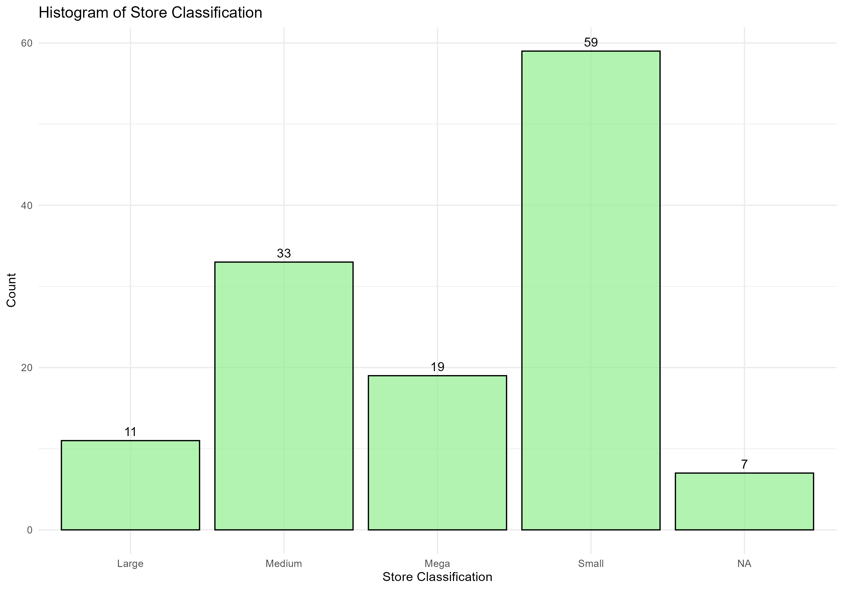
Histogram Of Store Classification

Slide 10
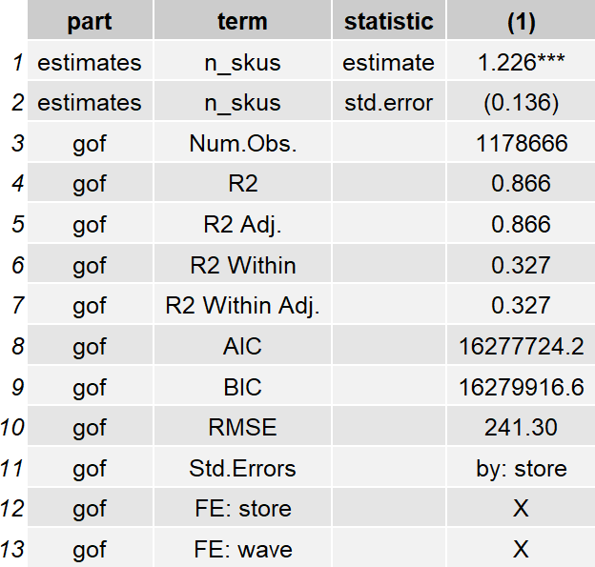
Regress Nsv Per Variety Vs Variety

Slide 11
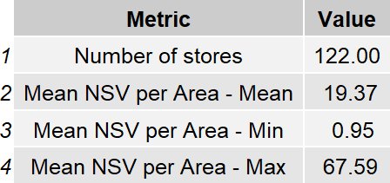
Nsv Per Area Summary

Slide 12
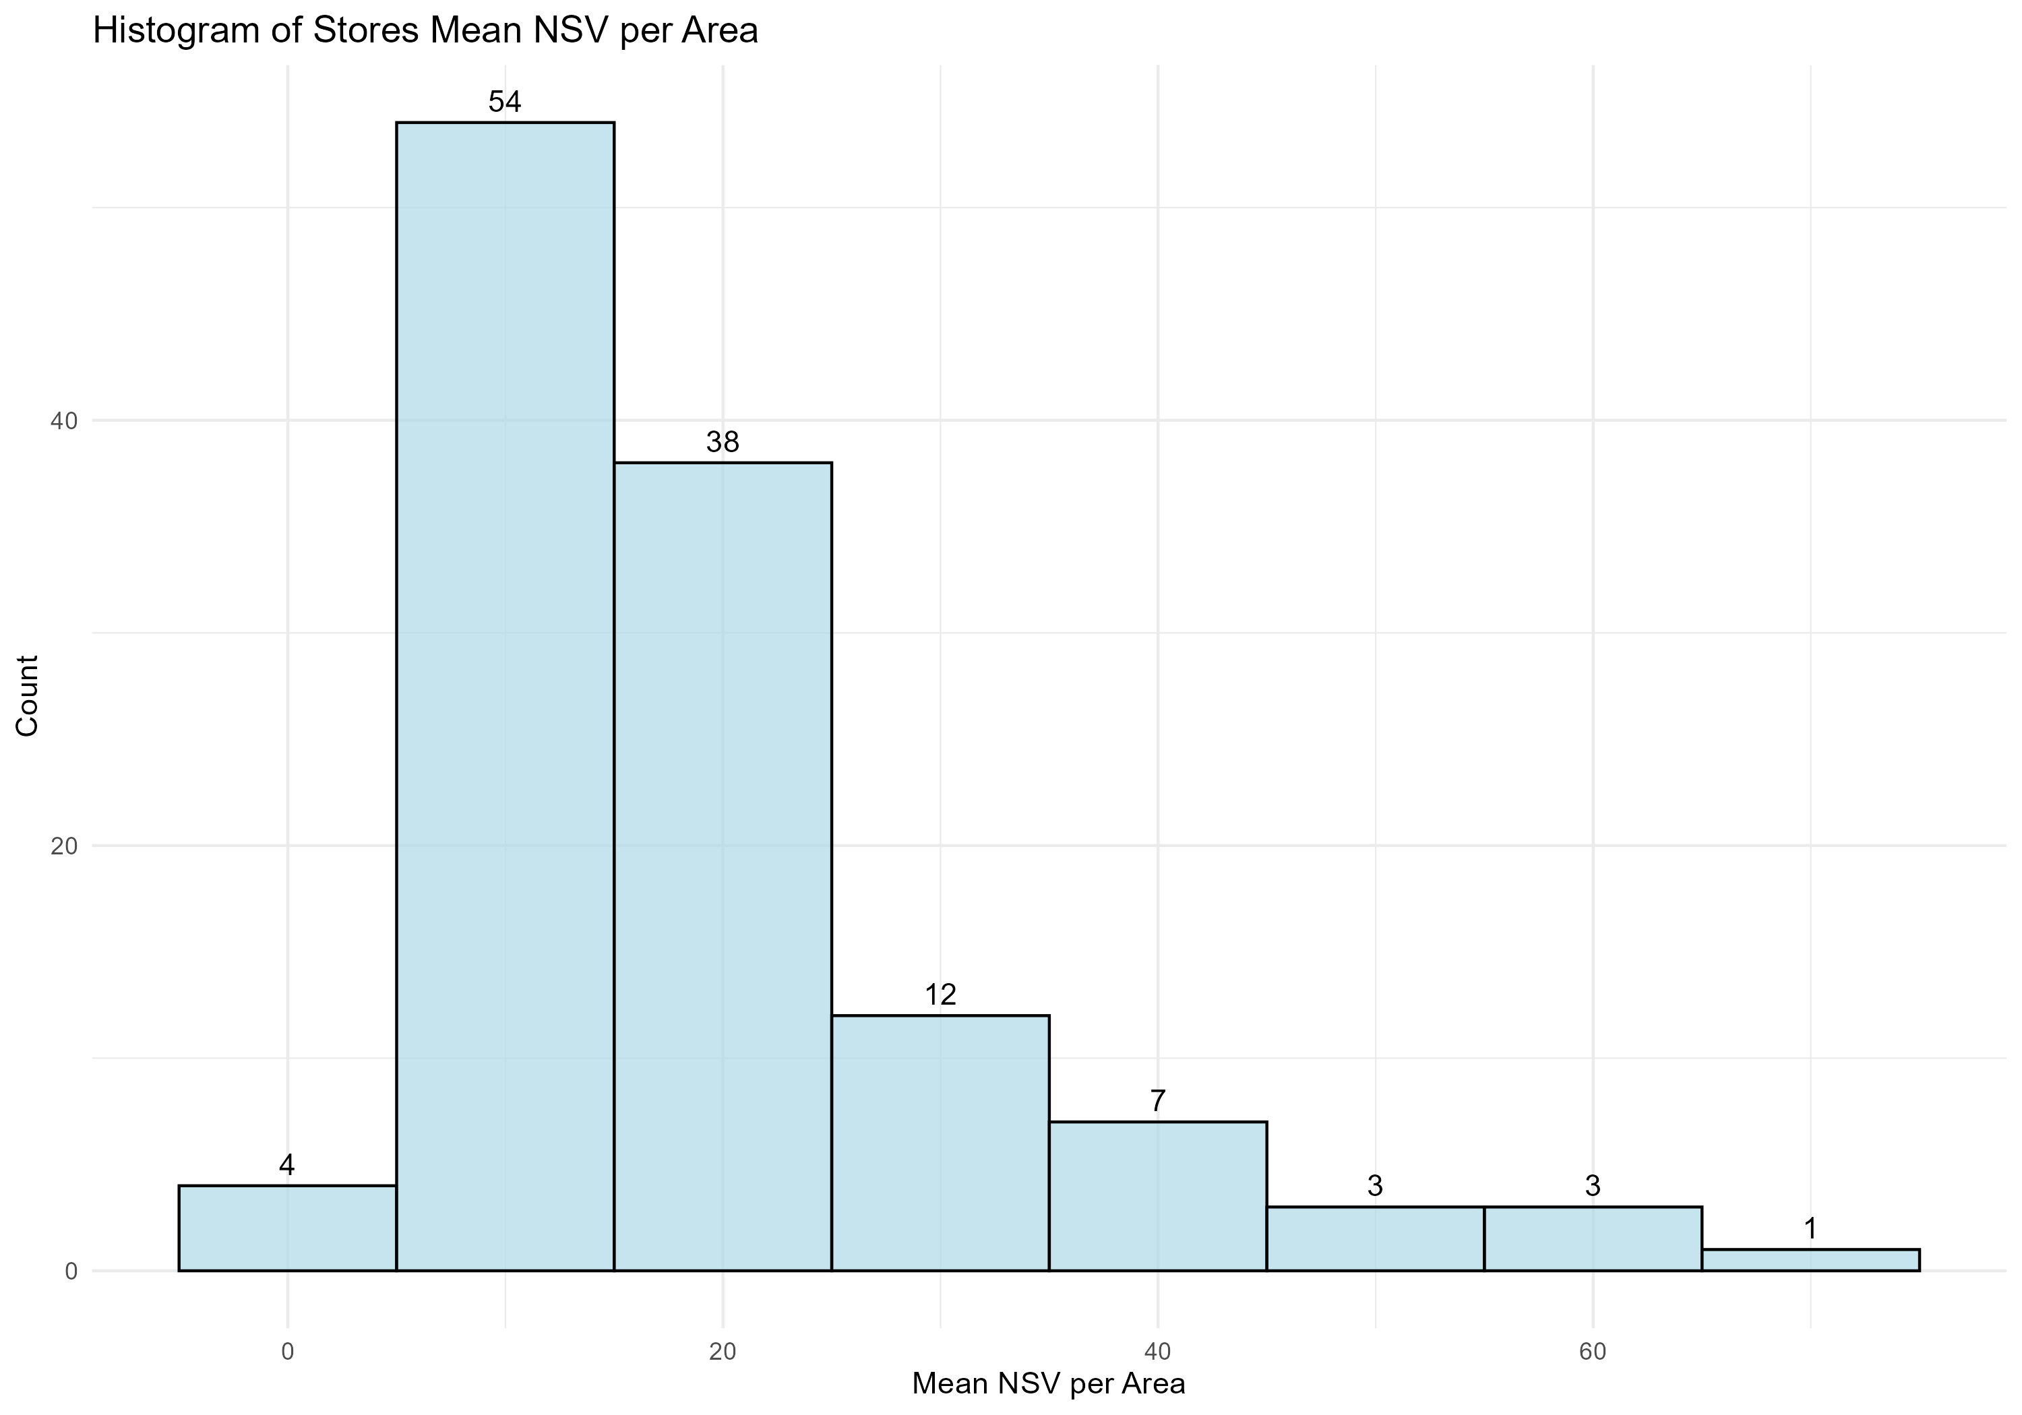
Histogram Of Stores Mean Nsv Per Area

Slide 13
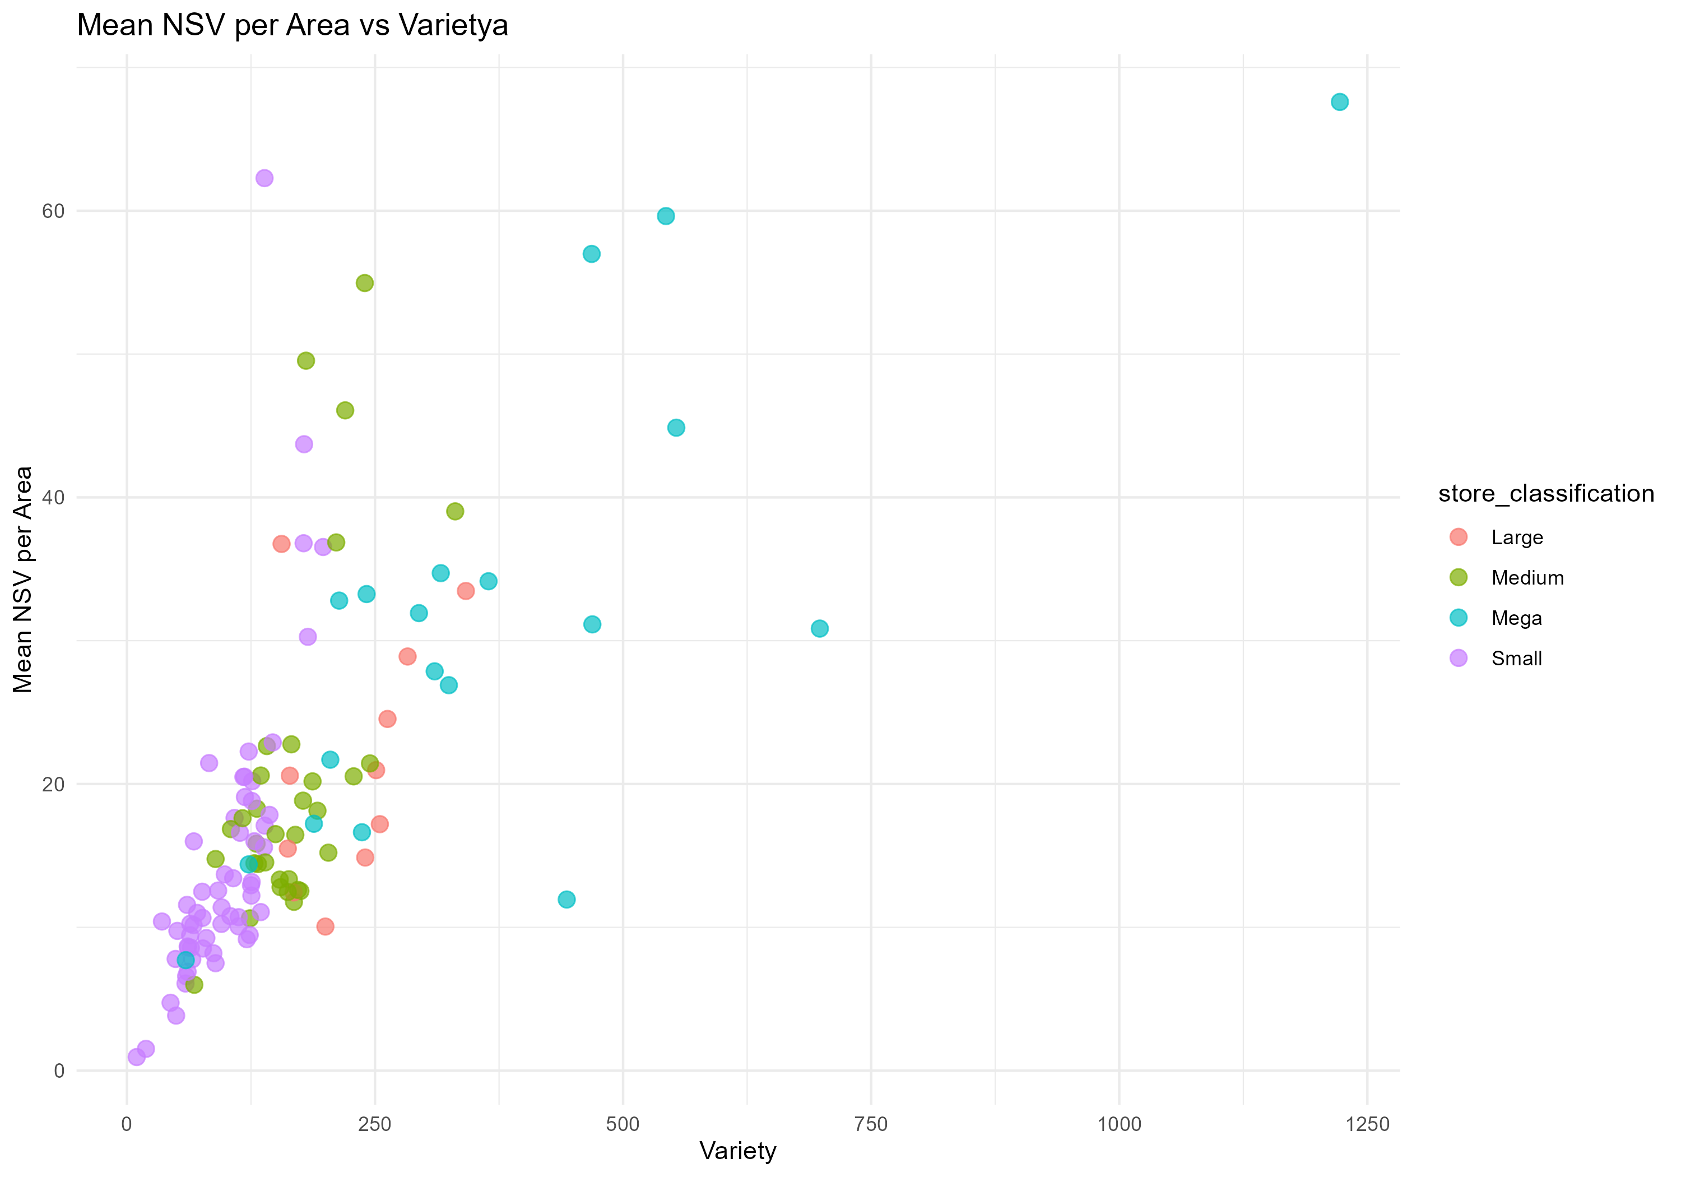
Mean Nsv By Area Vs Variety

Slide 14
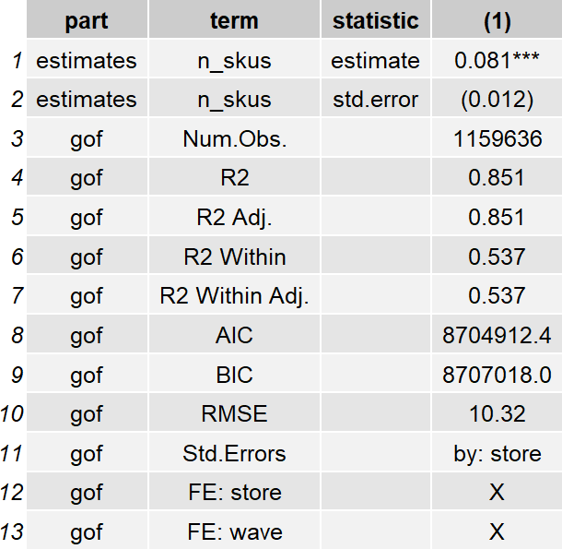
Reg Nsv Per Area Vs Variety

Slide 15
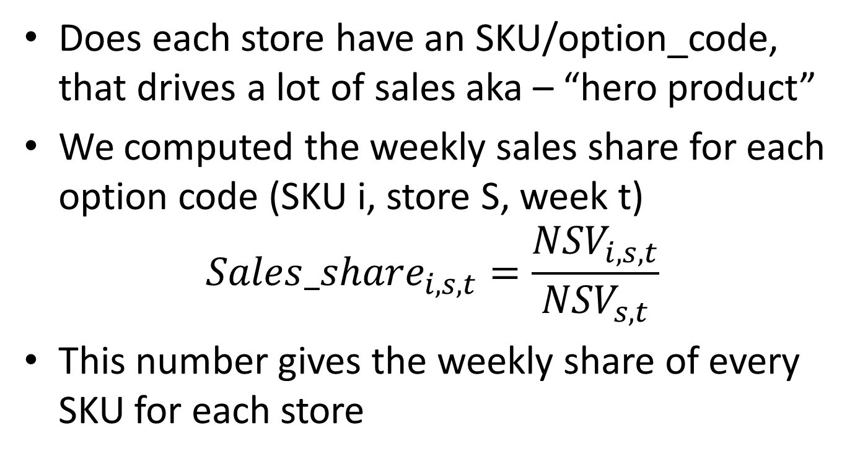
“Hero product”
Does each store have an SKU/option_code, that drives a lot of sales aka – “hero product”
We computed the weekly sales share for each option code (SKU i, store S, week t)
$${Sales_share}_{i,s,t}=\frac{{NSV}_{i,s,t}}{{NSV}_{s,t}}$$
This number gives the weekly share of every SKU for each store

Slide 16
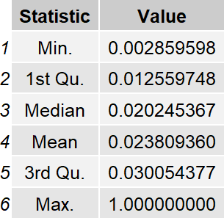
Weekly store topper
From the sales share, we calculate the weekly store topper – the option code with the highest sales $ share every week in each store
Here are the descriptives of weekly_store_topper’s share

Slide 17
Weekly store topper
At first glance, it doesn’t seem like hero products occur frequently. (Third quartile is still 3%)
But note that this table is from (129 Stores X 87 weeks) i.e., 6550 store-week combinations

Slide 18
Weekly store topper
I checked to see how many of the weekly store combinations (out of 6550) have a weekly store topper with >10% share
317 store-week combinations corresponding to 67 stores

Slide 19
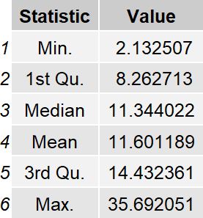
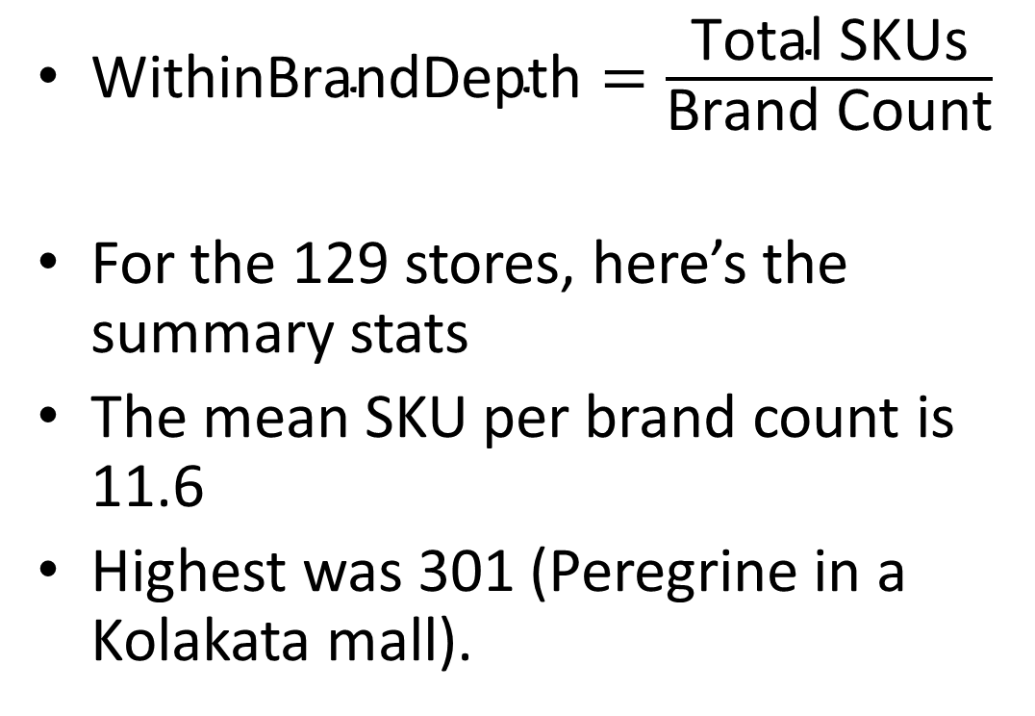
Within Brand depth
$\text{WithinBrandDepth}=\frac{\text{Total} \text{SKUs}}{\text{Brand} \text{Count}}$
For the 129 stores, here’s the summary stats
The mean SKU per brand count is 11.6
Highest was 301 (Peregrine in a Kolakata mall).

Slide 20
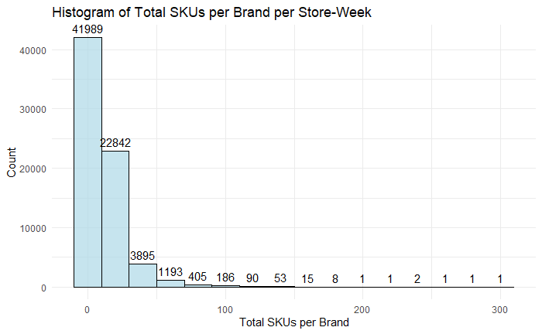
Histogram – brand depth

Slide 21
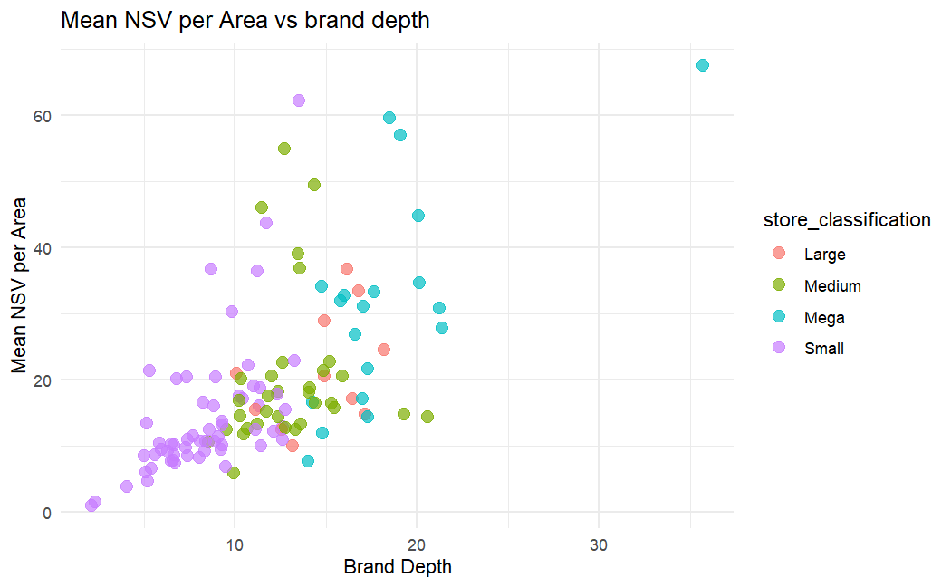
Sales per area vs brand depth

Slide 22
Causal inference strategy
Quasi-experimental approach: Identify an exogenous shock in a fashion retail setting—ideally a state-level or region-specific disruption (e.g., logistics interruptions, regulatory changes, policy interventions) that generates clear pre–post variation with well-defined treatment and control groups.
Feasibility challenge: Such shocks are difficult to find and defend as truly exogenous in fashion retail, given endogenous assortment responses, managerial discretion, and correlated demand shocks.

Slide 23
Causal inference strategy
Instrumental variables alternative: Adopt an IV / 2SLS strategy to address the inherent endogeneity of assortment variety choices driven by unobserved demand and managerial optimization.
Instrument design - Explore two broad classes of instruments for variety:
Spatial instruments: Assortment variety in other, economically linked but non-competing locations (e.g., same retailer in different cities), capturing common supply-side constraints. Variety in a different city
Cost-side instruments: Exogenous upstream or downstream shocks (e.g., input prices, supplier disruptions) that affect feasible variety but do not directly impact local demand outcomes. Can’t think of any (hint: price of sugar)

Slide 24
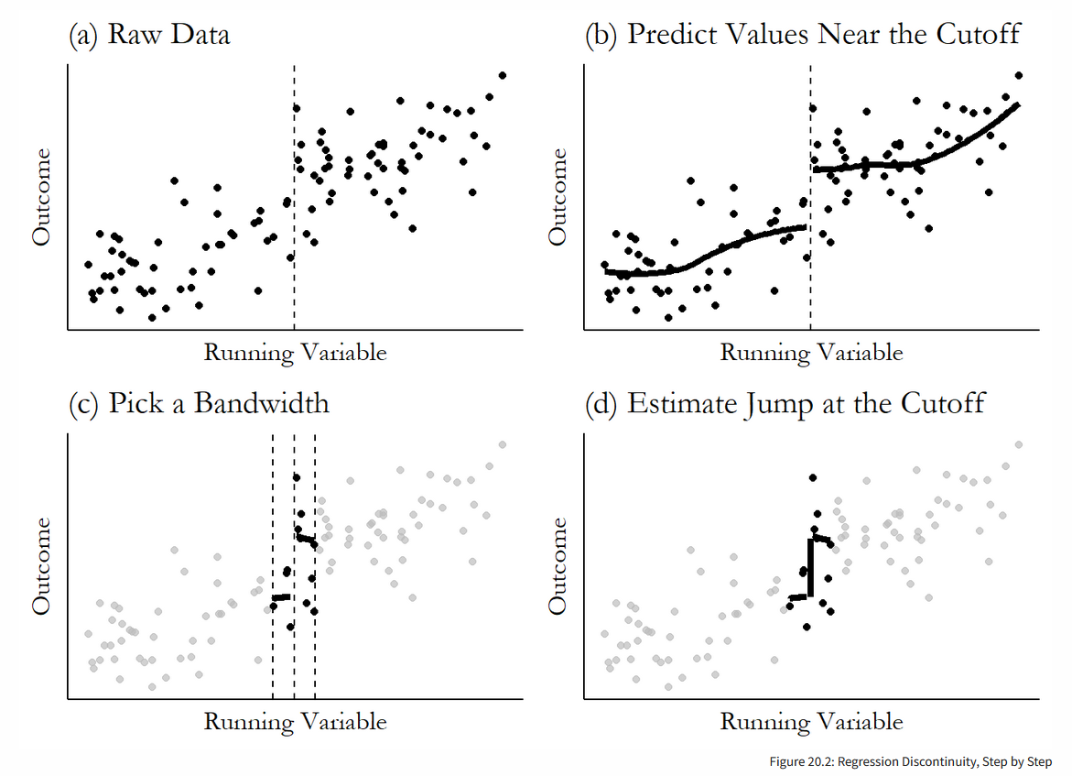
Regression discontinuity

Slide 25
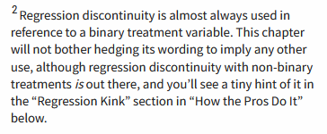

Slide 26
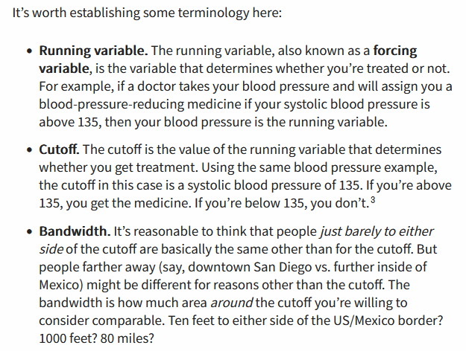
Regression discontinuity
Notes:
Source: https://theeffectbook.net/ch-RegressionDiscontinuity.html – Dr. Nick Huntington-Klein

