Slide 1
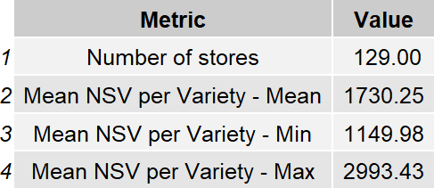
Nsv Per Variety Summary

Slide 2
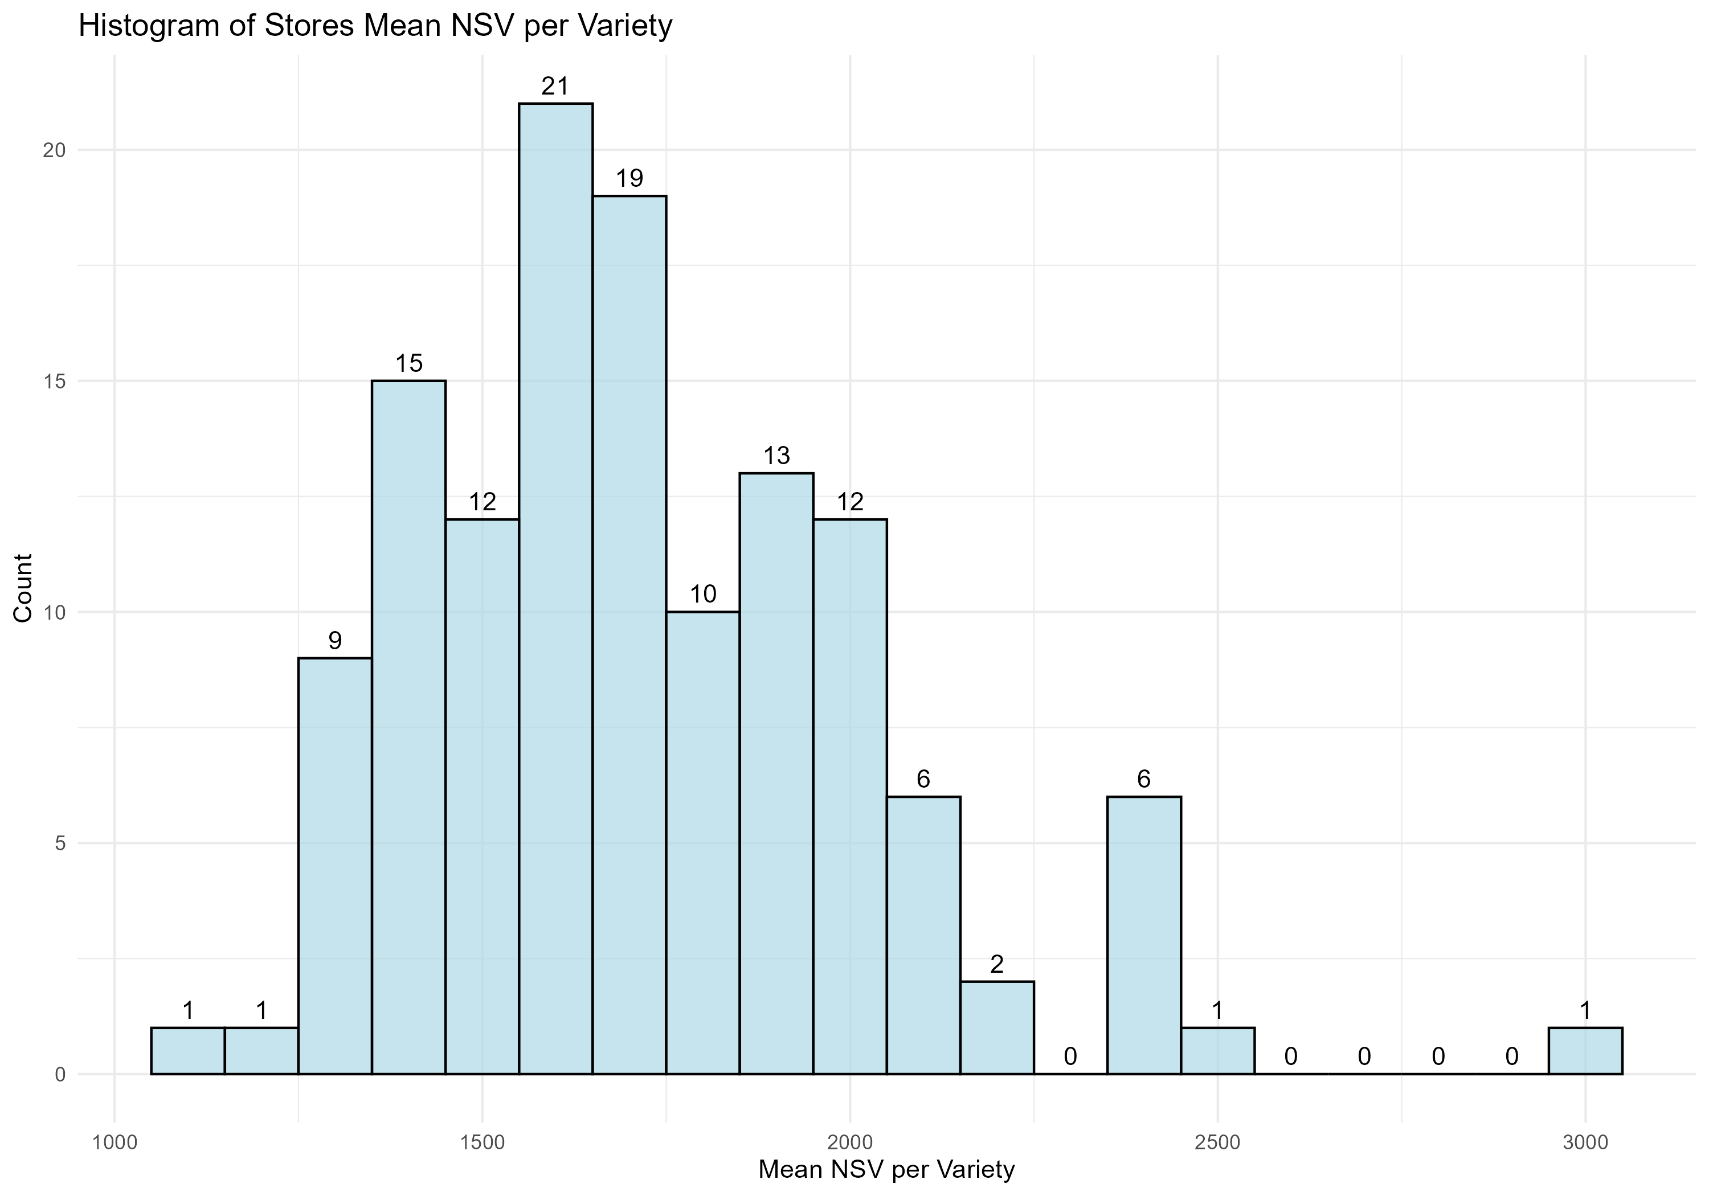
Histogram Of Stores Mean Nsv Per Variety

Slide 3
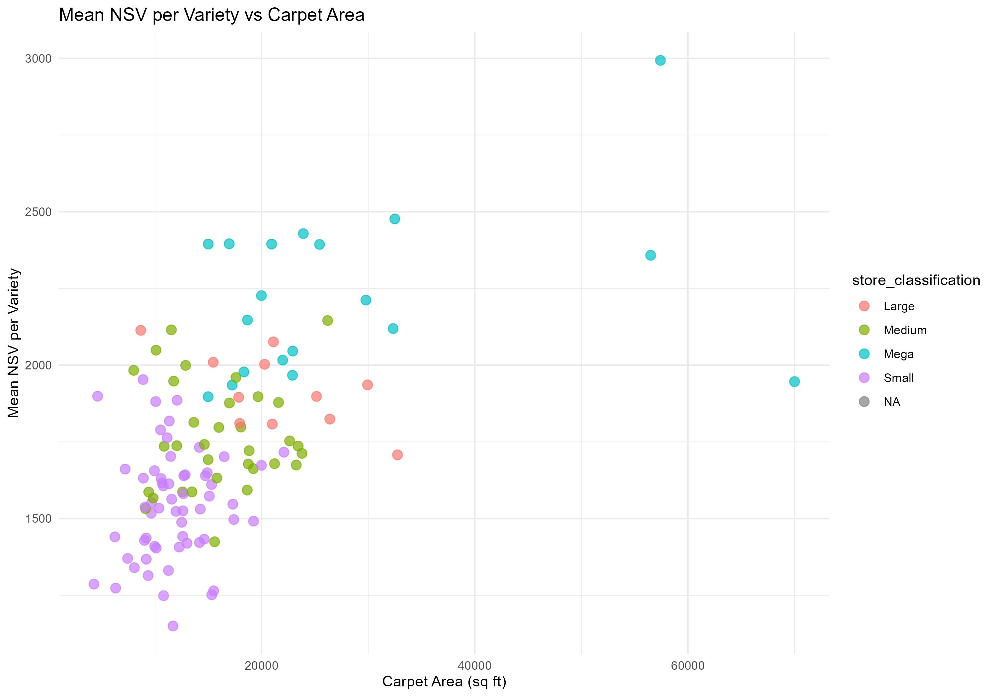
Mean Nsv By Variety Vs Carpet Area

Slide 4
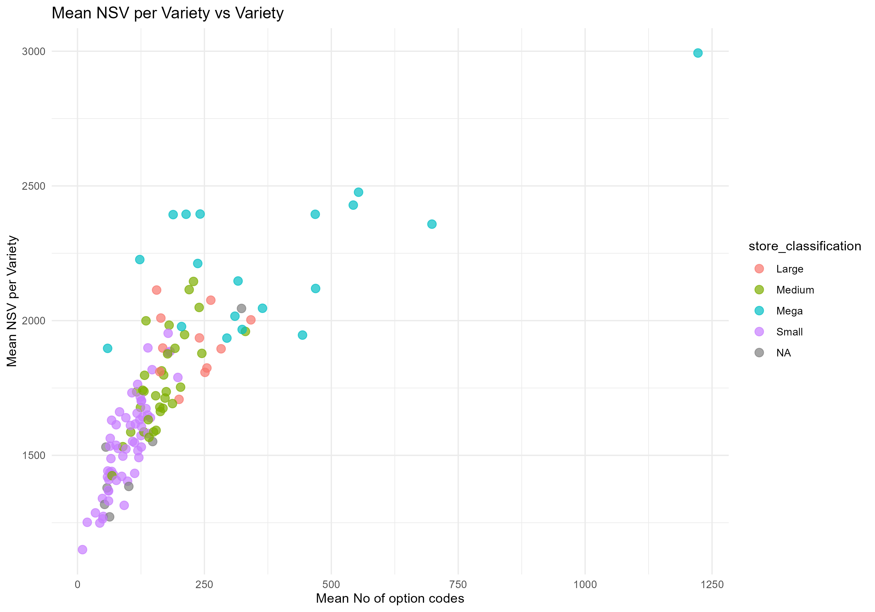
Mean Nsv By Variety Vs Variety

Slide 5
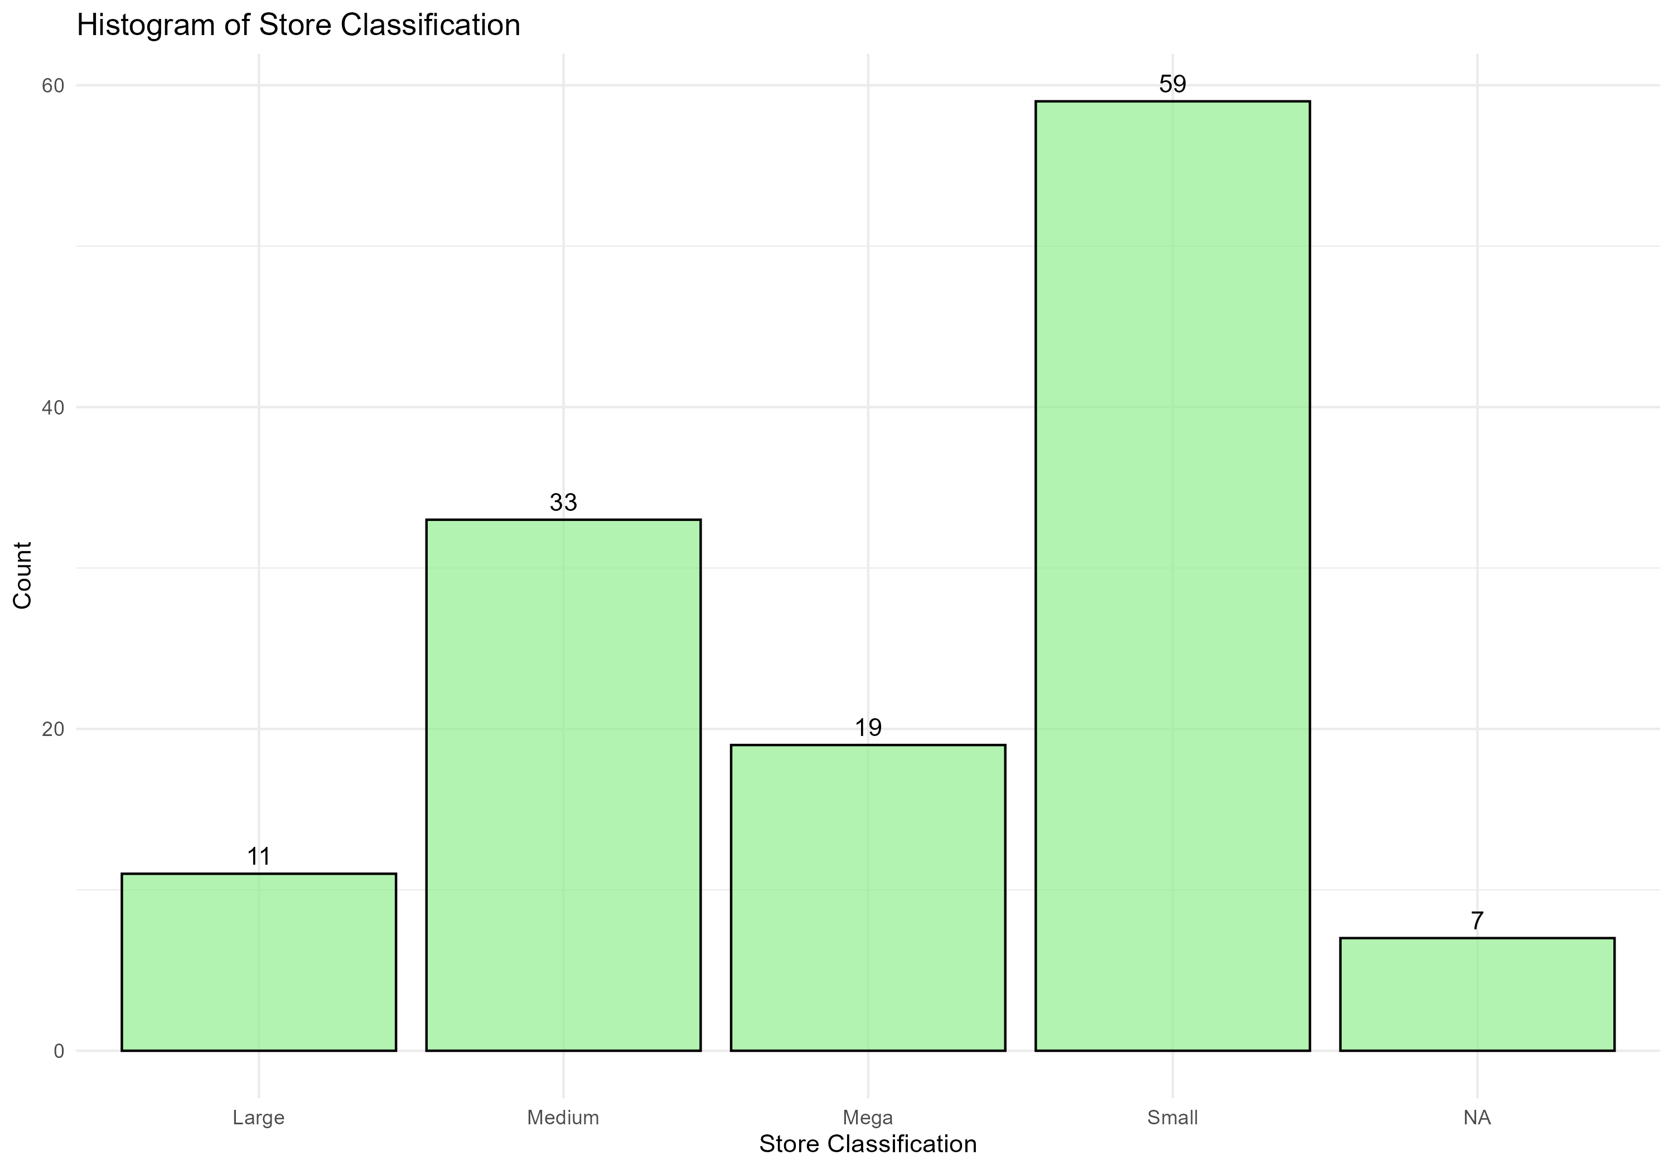
Histogram Of Store Classification

Slide 6
Mean Nsv By Variety Vs Variety

Slide 7
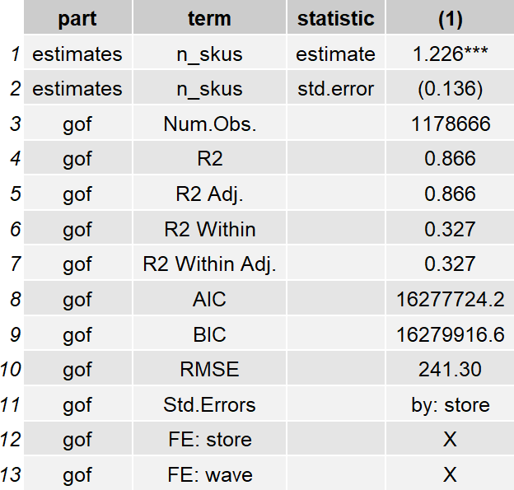
Reg Nsv Per Variety Vs Variety

Slide 8
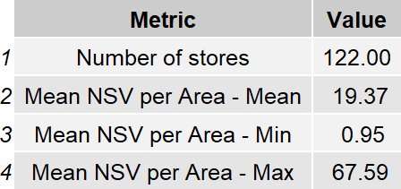
Nsv Per Area Summary

Slide 9
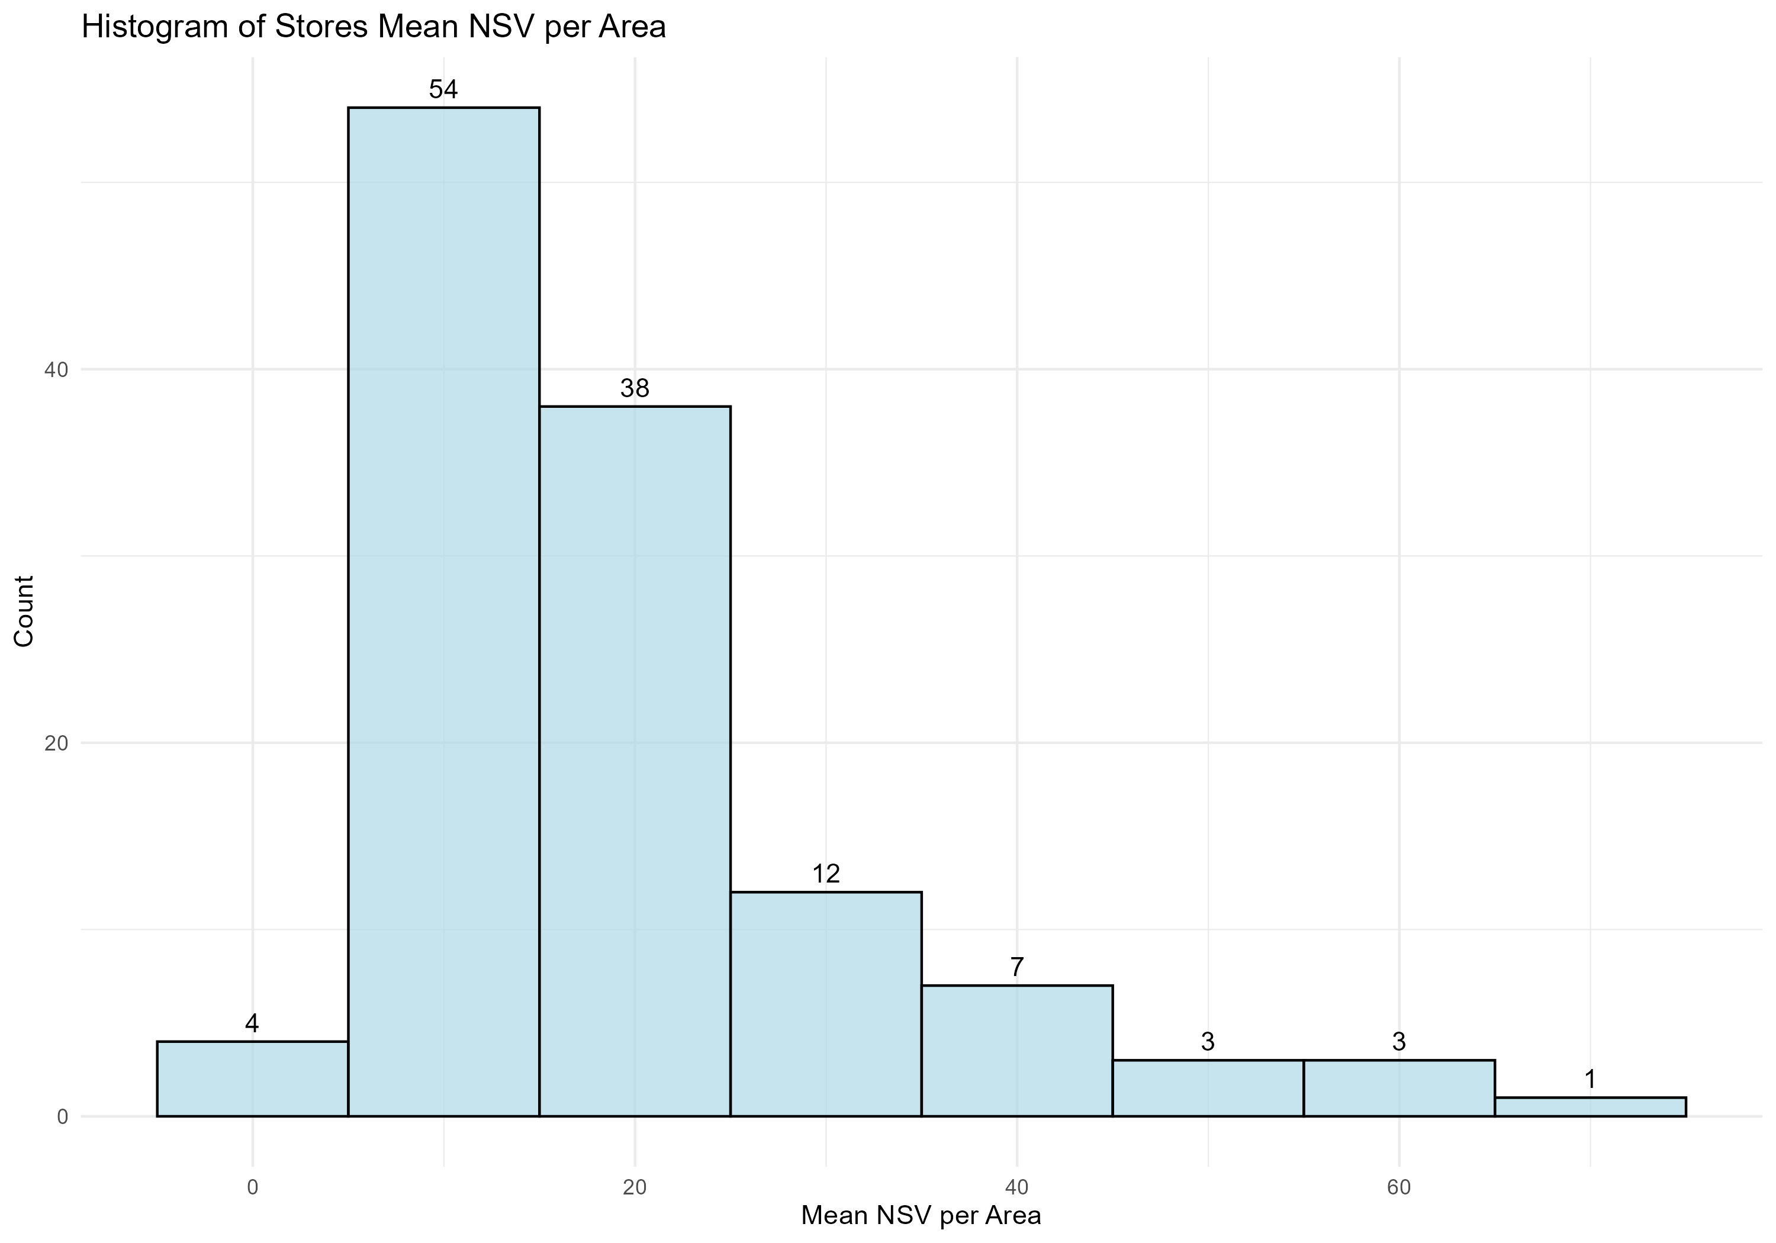
Histogram Of Stores Mean Nsv Per Area

Slide 10
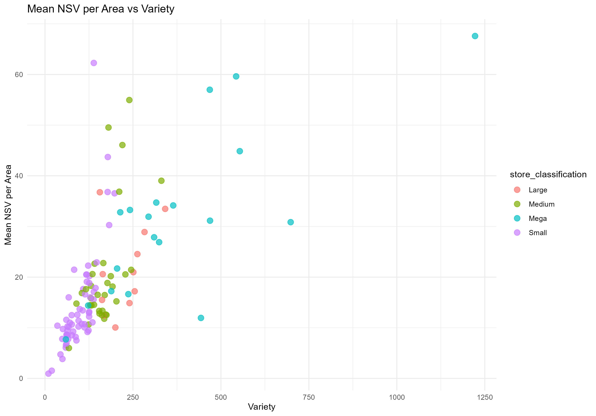
Mean Nsv By Area Vs Variety

Slide 11
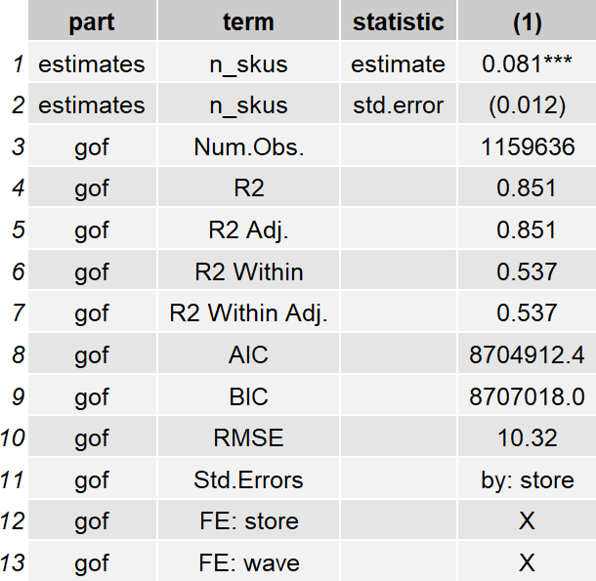
Reg Nsv Per Area Vs Variety

Slide 12
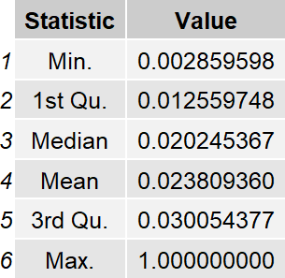
Weekly Store Topper Summary

Slide 13
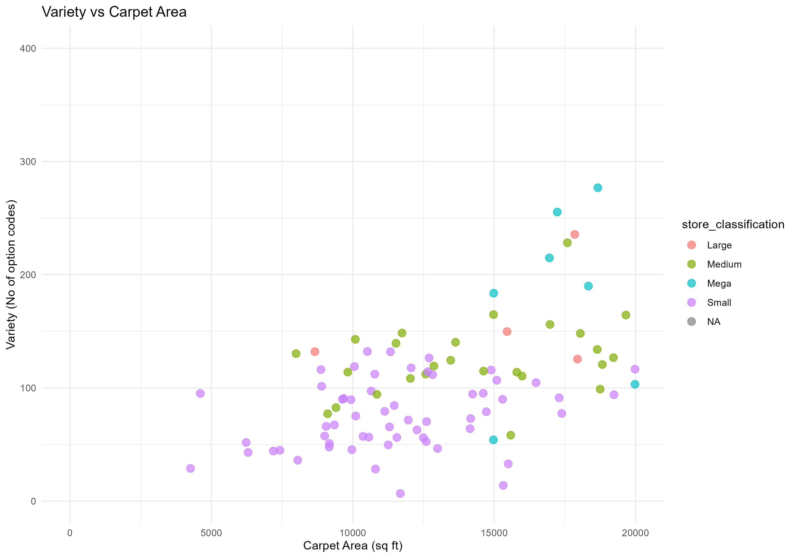
Variety Vs Carpet Area

Slide 14
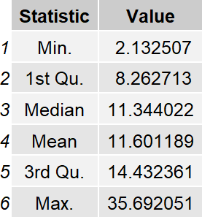
Skucount By Brandscount Eachstore

Slide 15
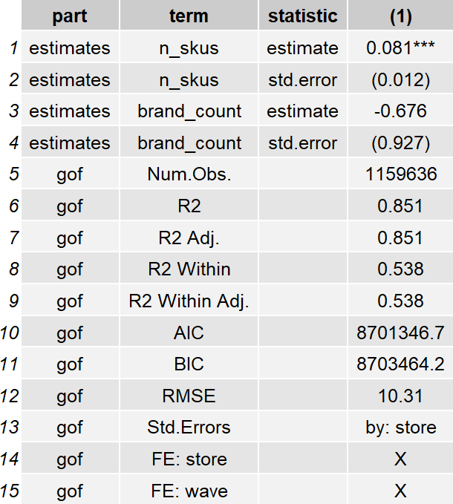
Reg Nsv Per Area Vs Variety And Brand

