Slide 1
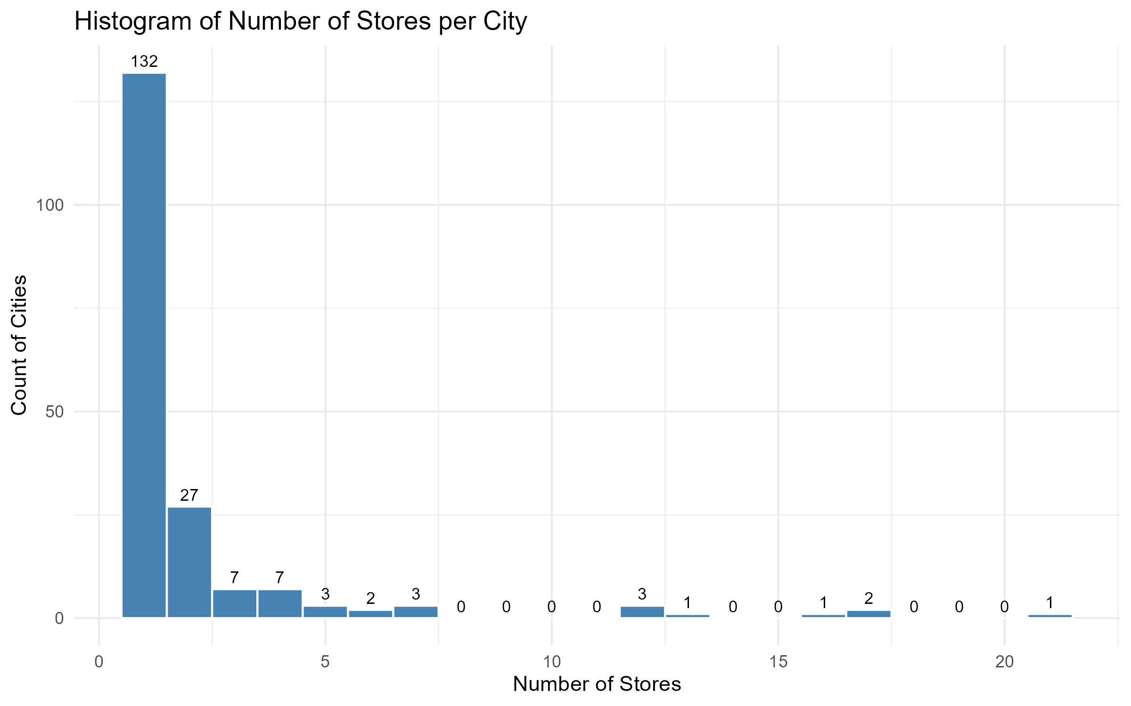
Hist Num Stores

Slide 2
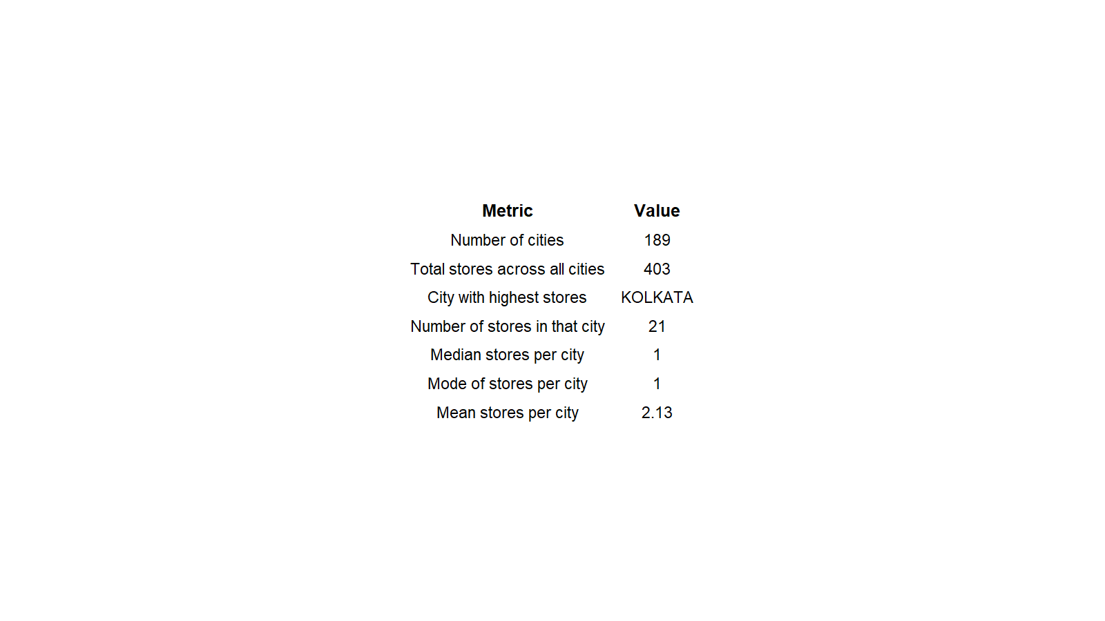
City Summary Metrics

Slide 3
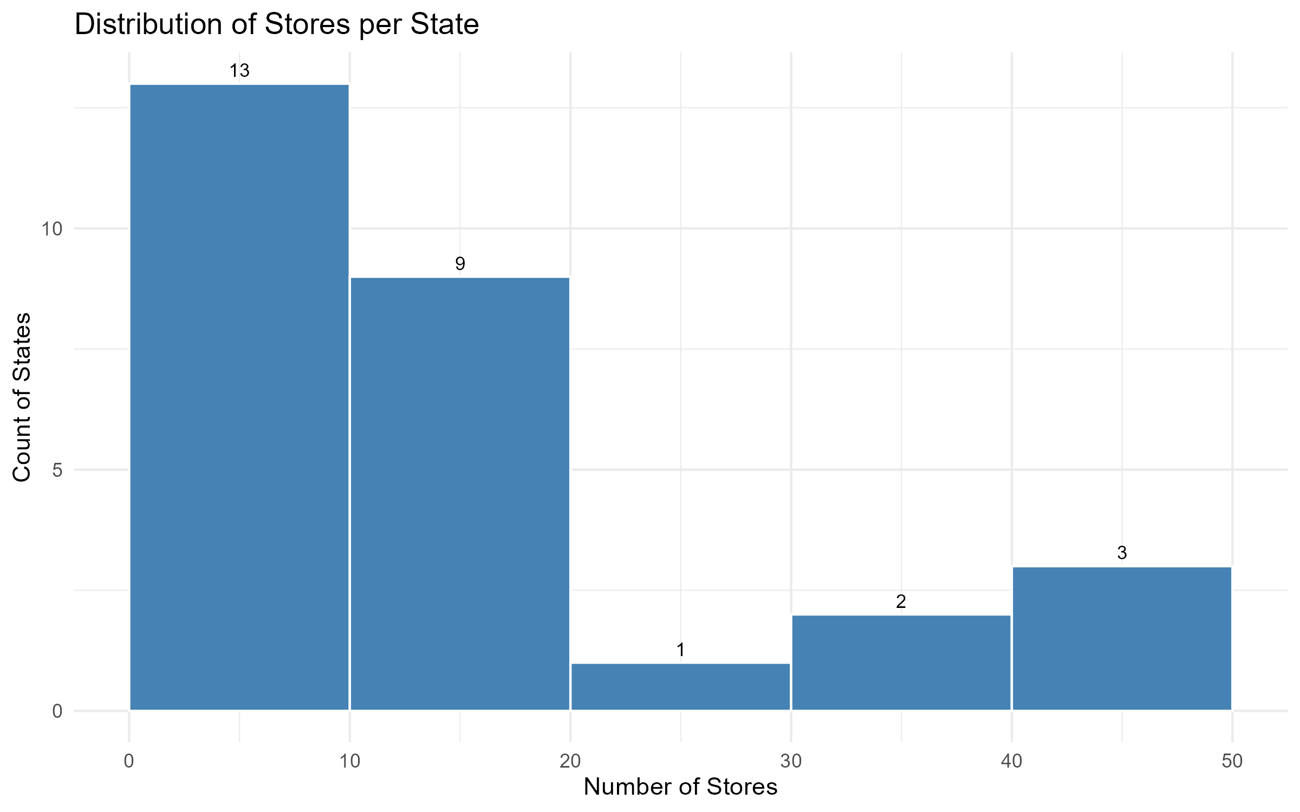
Hist Stores Per State

Slide 4
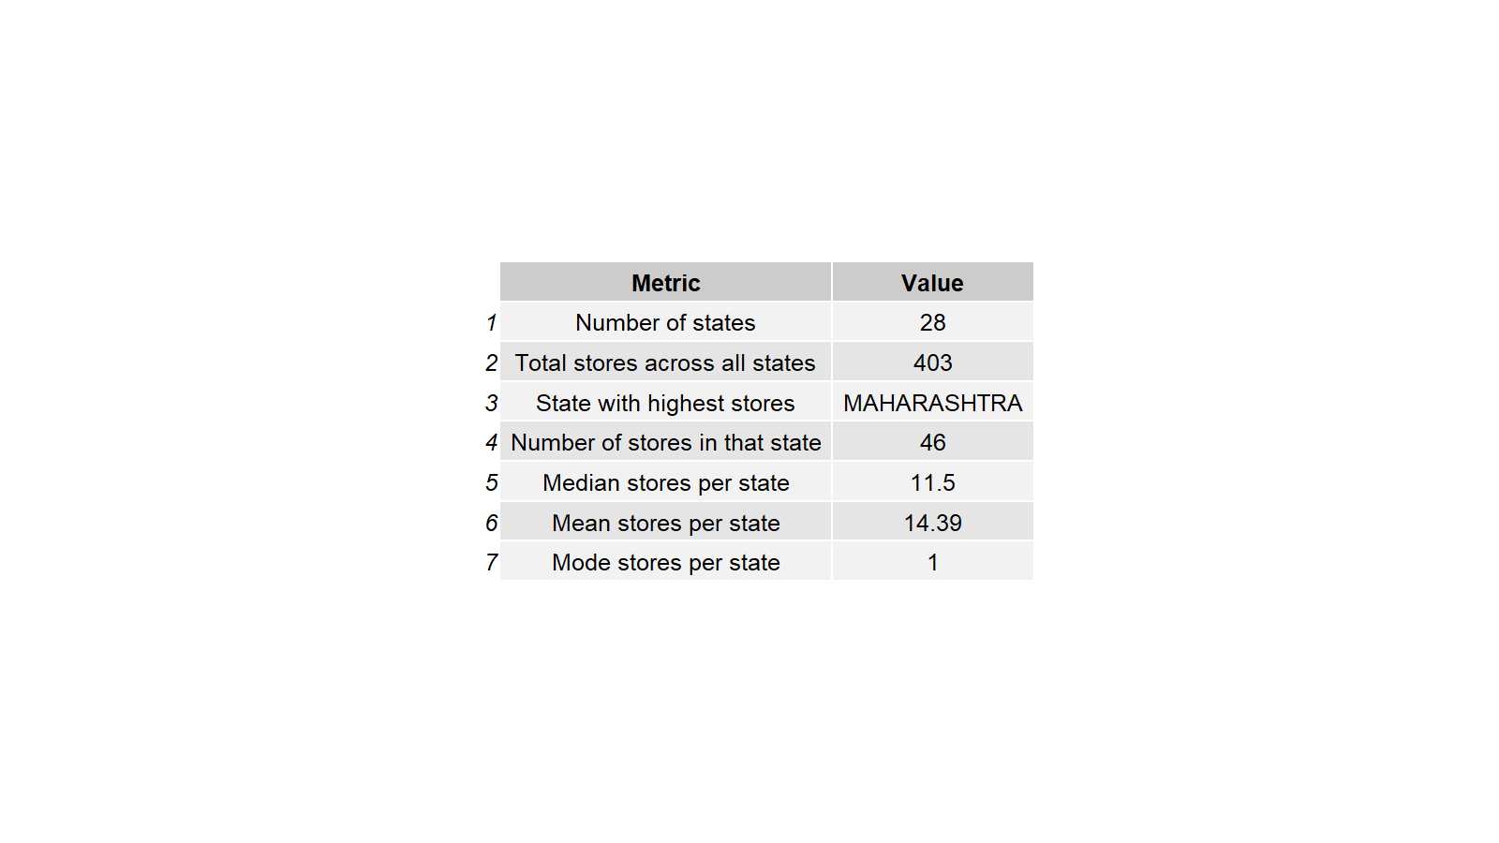
State Summary Metrics

Slide 5
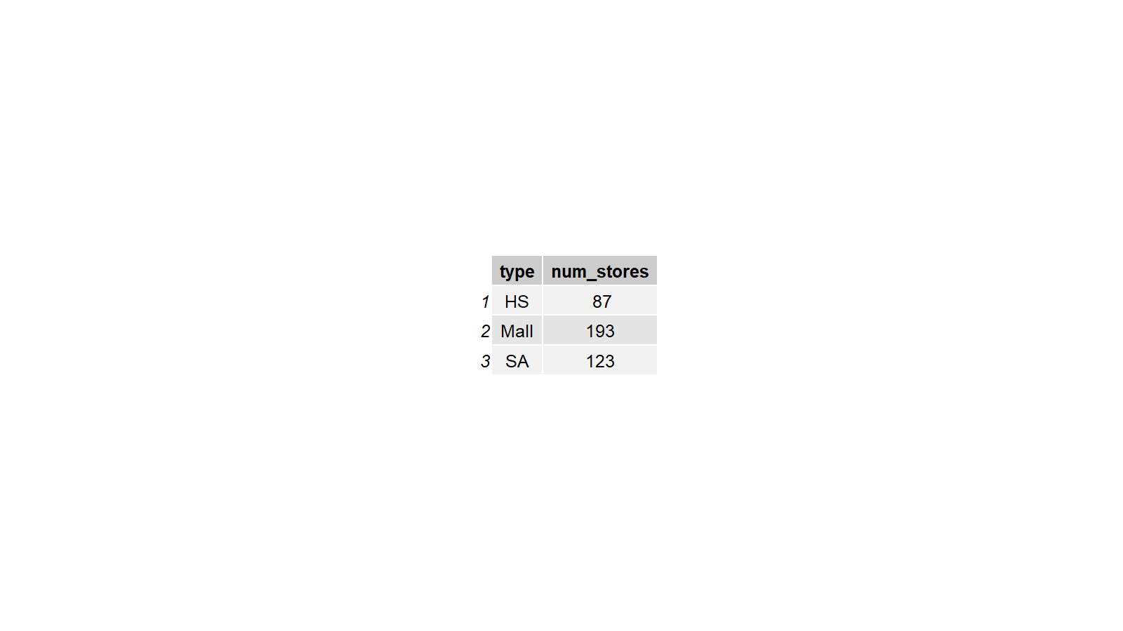
Type Summary Table

Slide 6
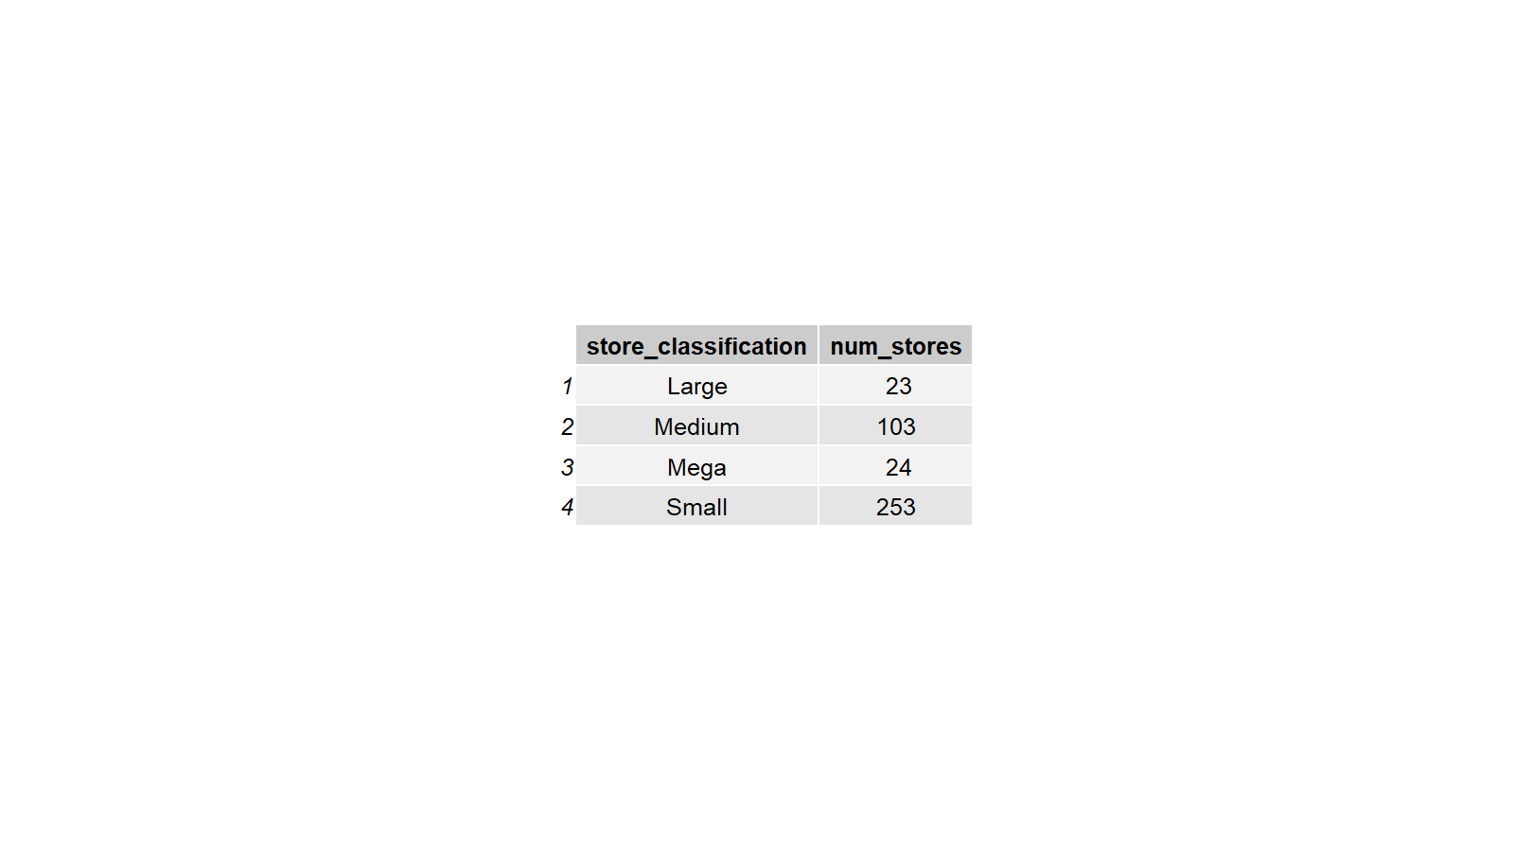
Classification Summary Table

Slide 7
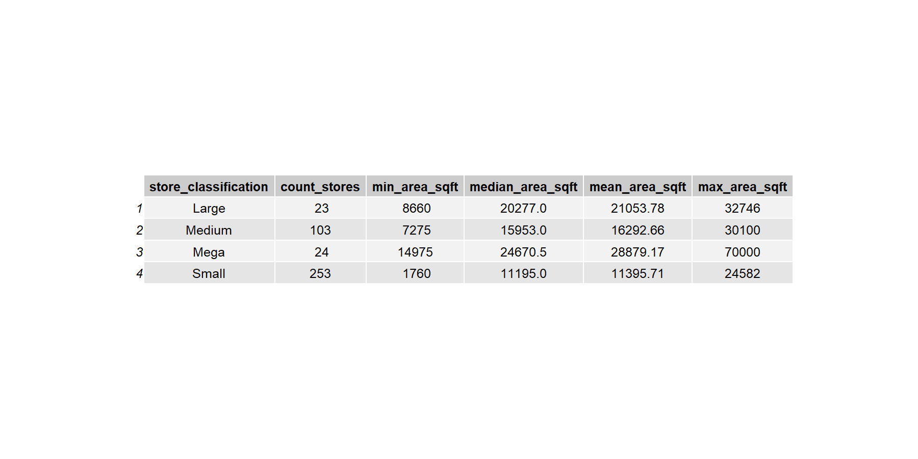
Classification Vs Area Table

Slide 8
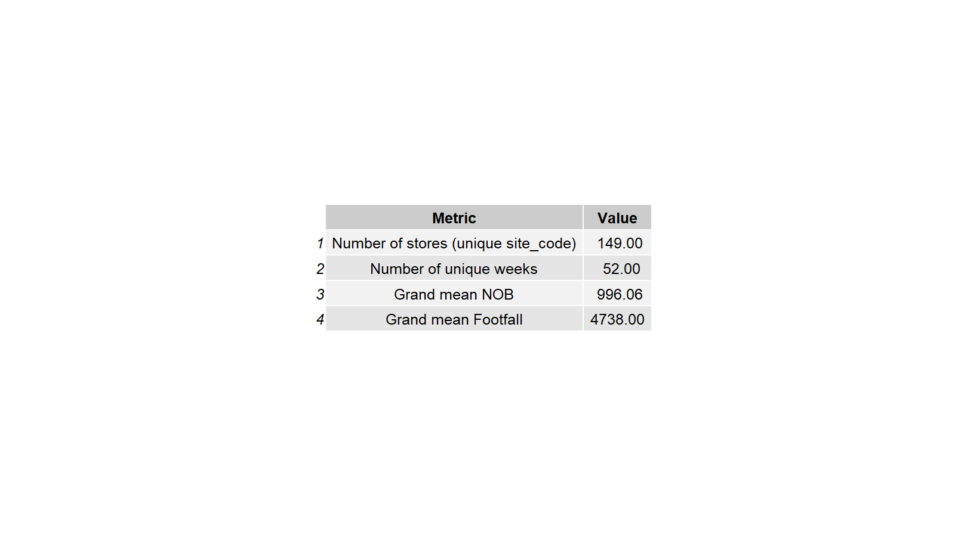
Overall Metrics Table

Slide 9
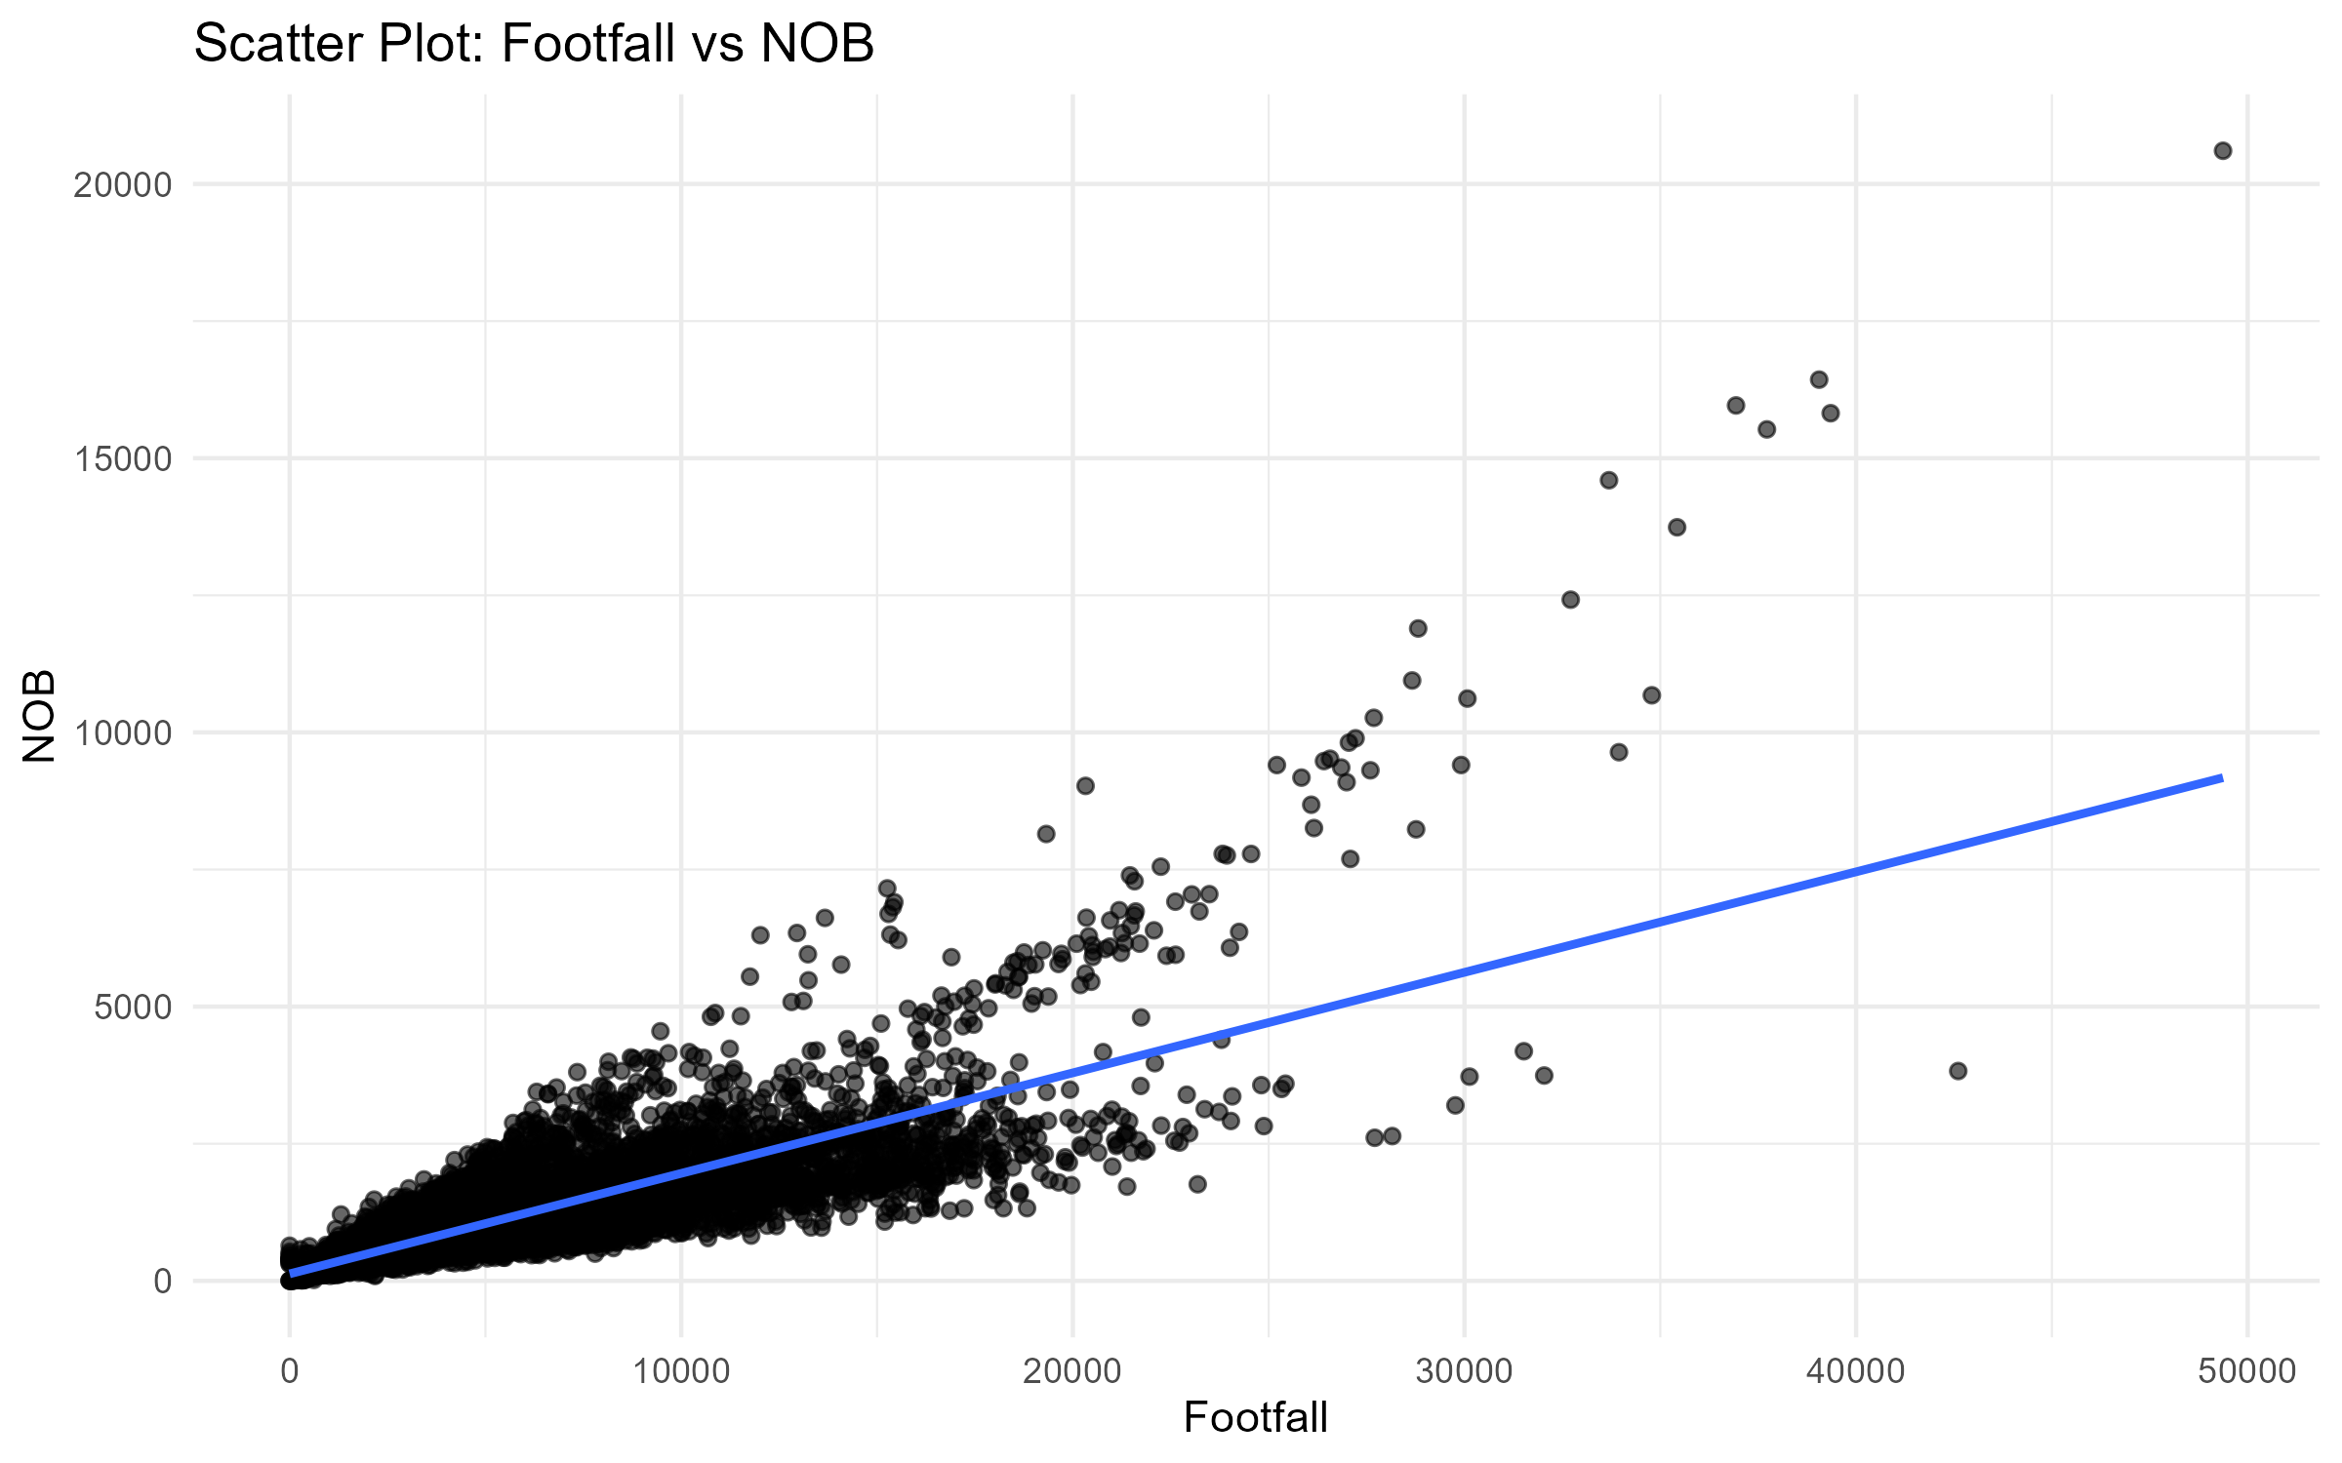
Scatter Nob Vs Footfall

Slide 10
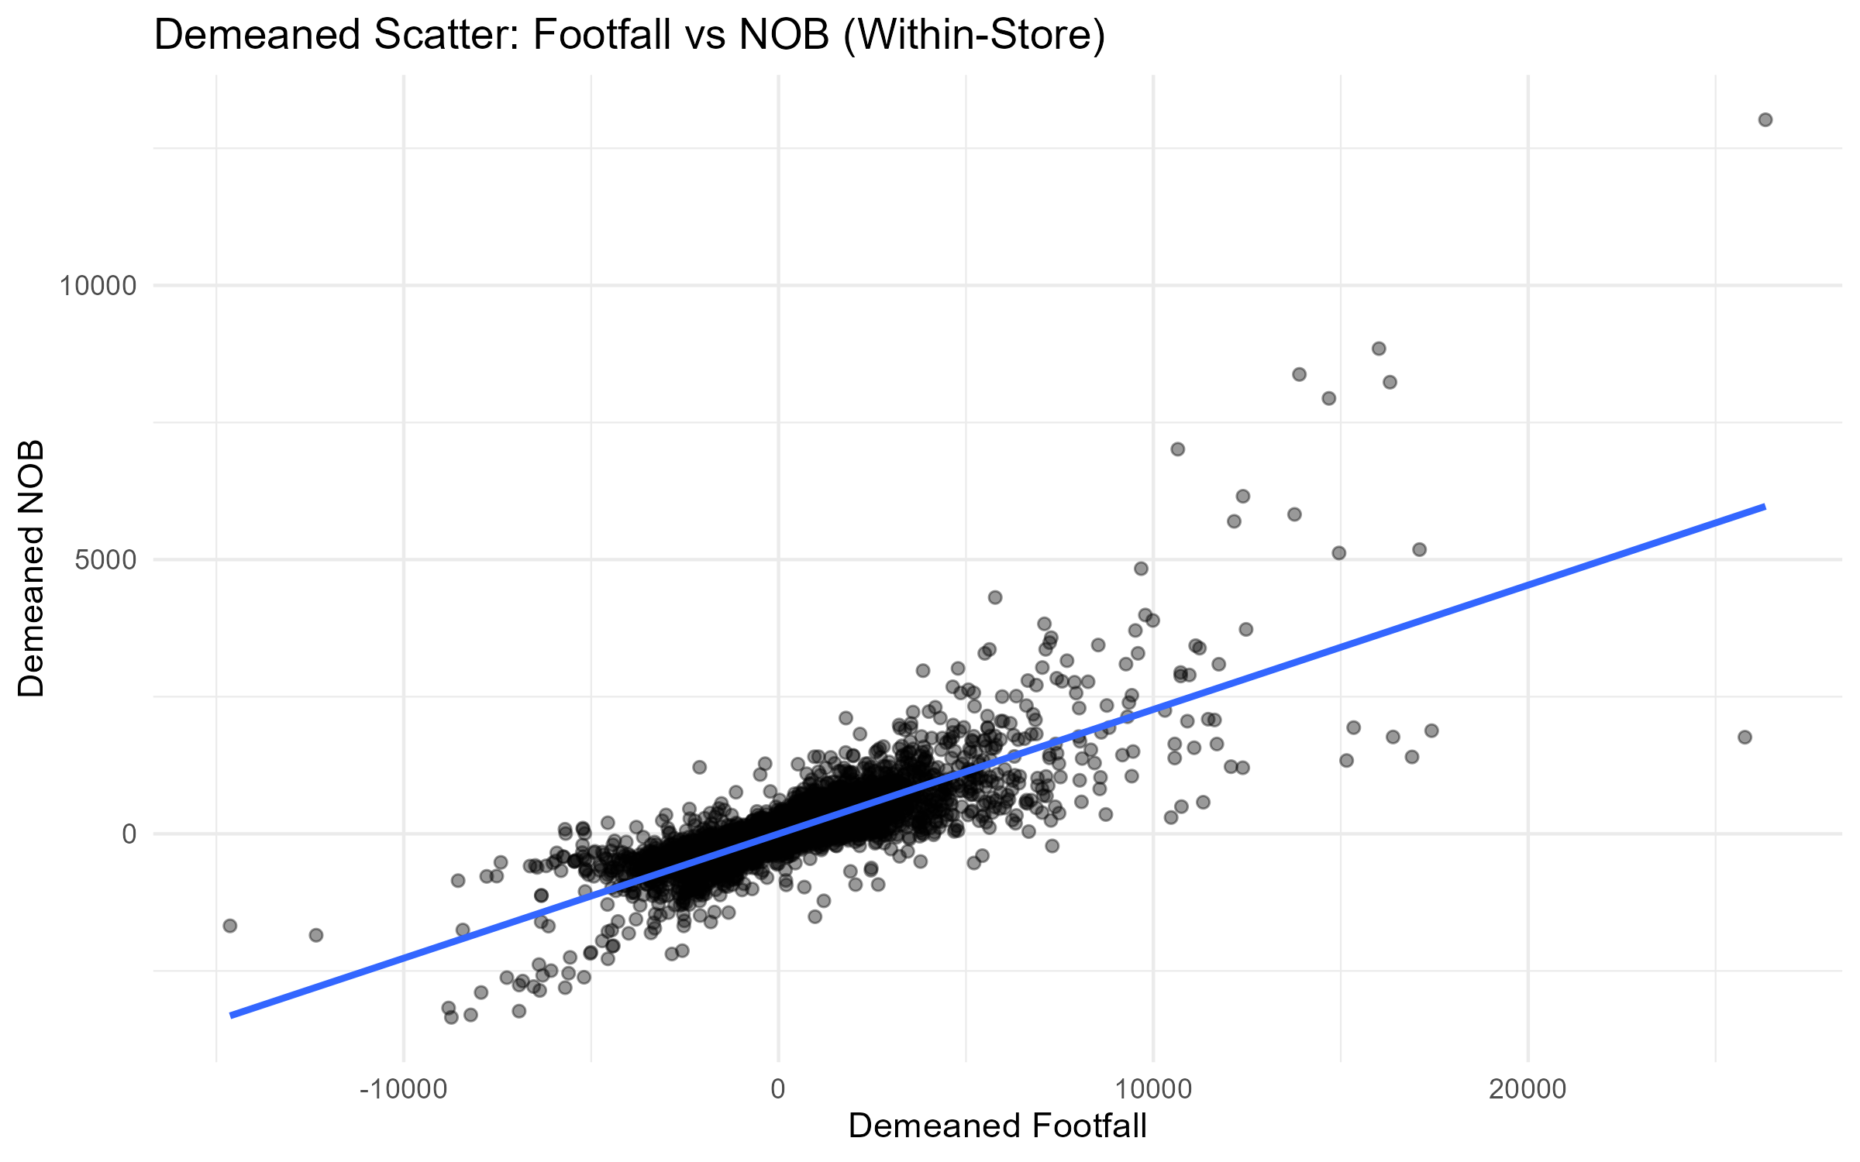
Demeaned Scatter Footfall Vs Nob

Slide 11
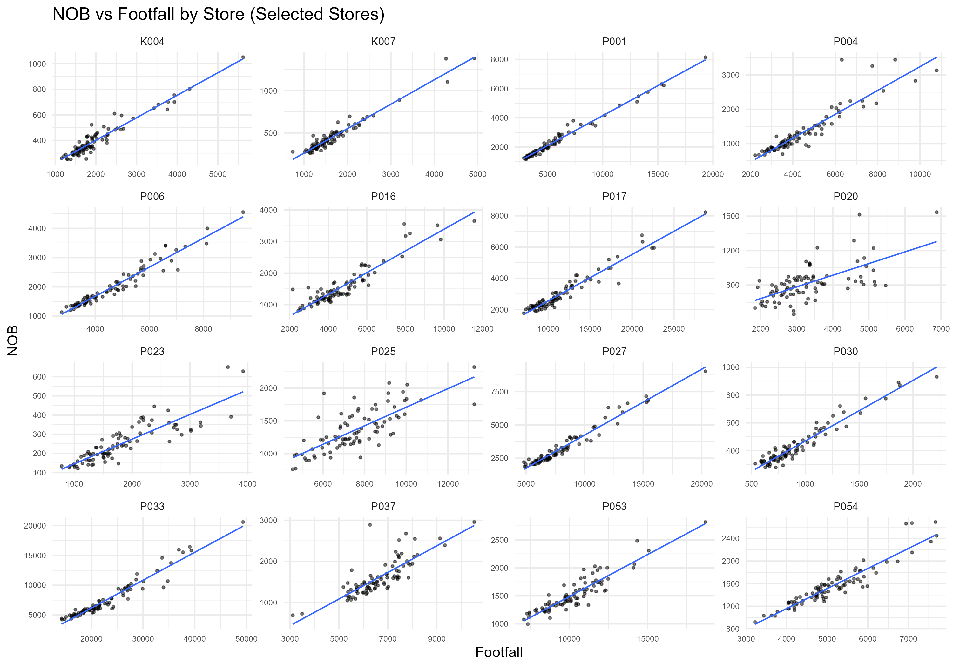
Nob Vs Footfall Store Panels

Slide 12
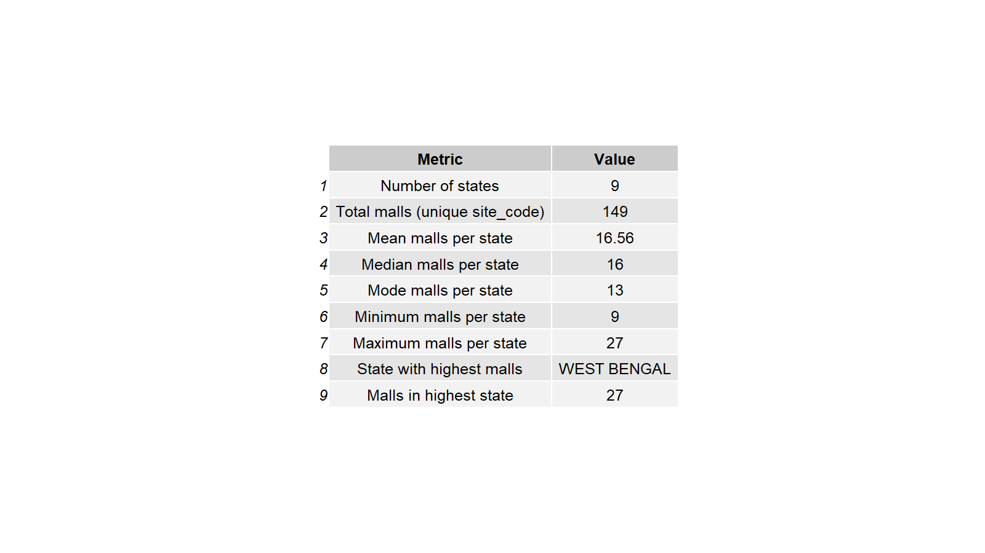
State Mall Metrics Table

Slide 13
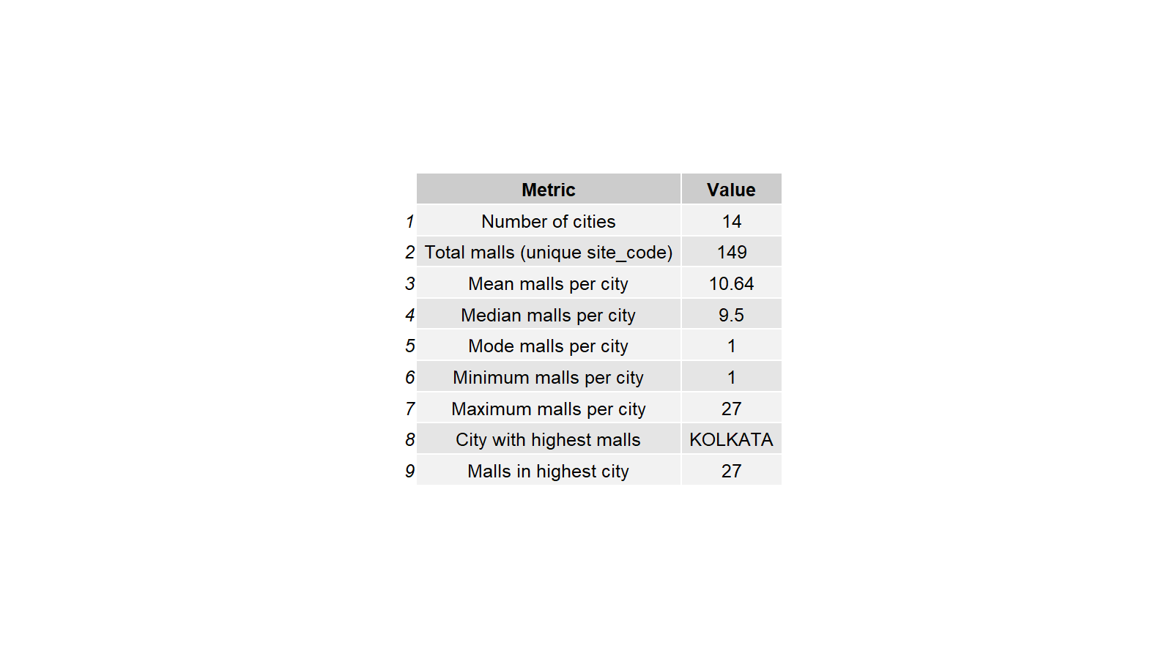
City Mall Metrics Table

Slide 14
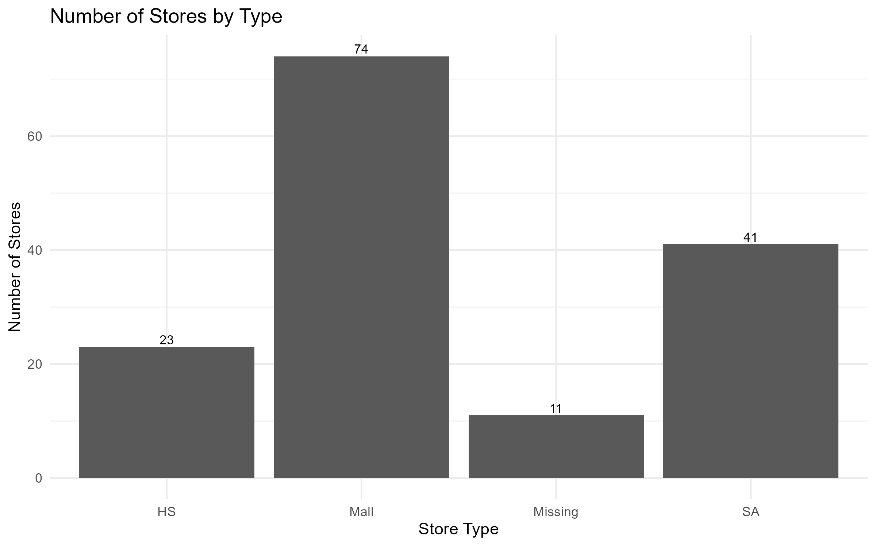
Store Type Distribution

Slide 15
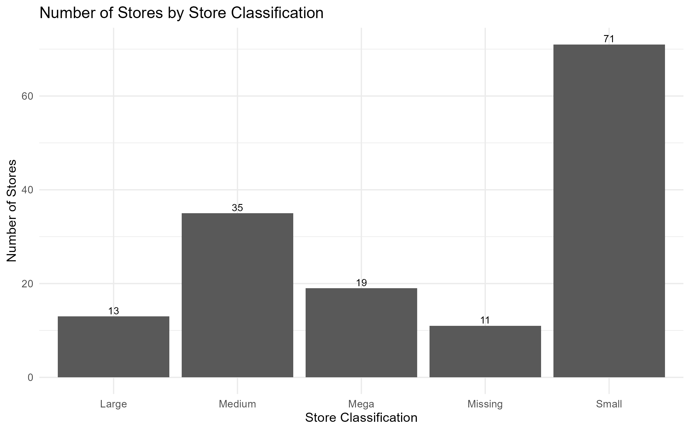
Store Classification Distribution

Slide 16
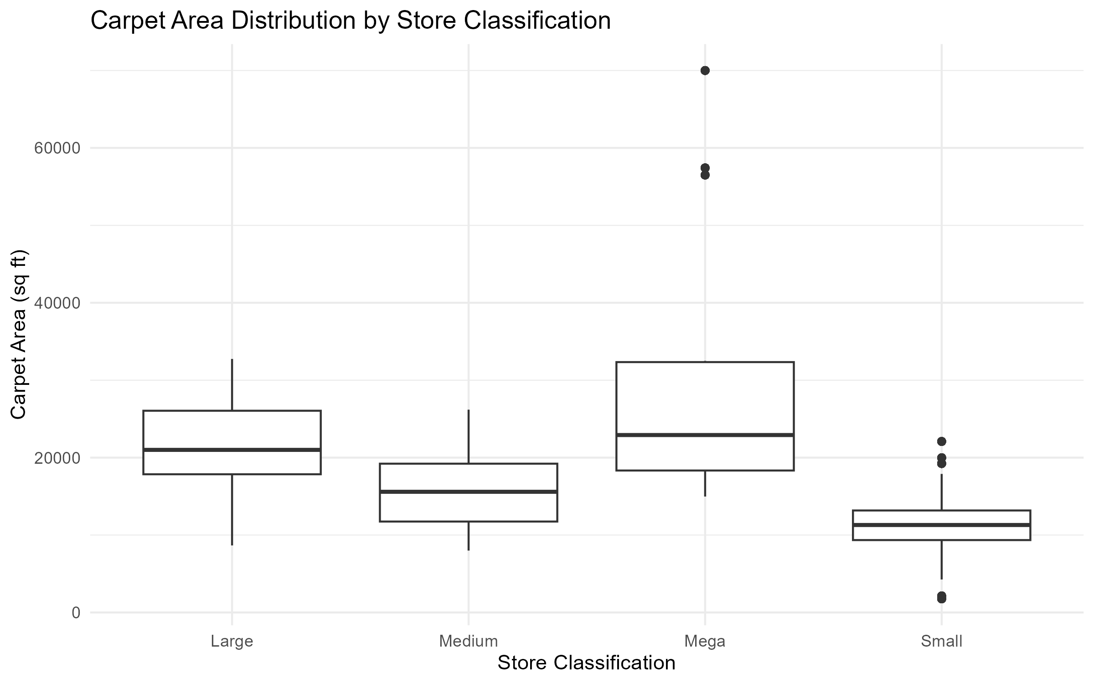
Area By Store Classification Boxplot

Slide 17
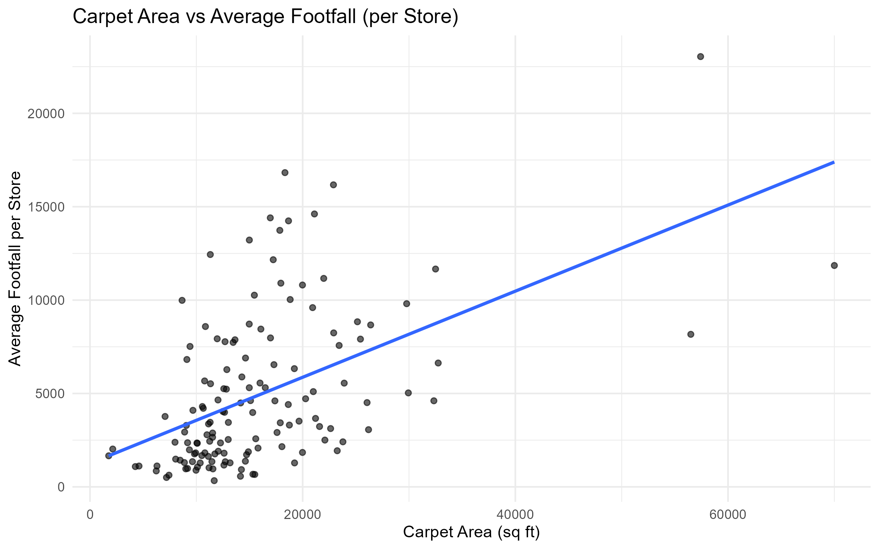
Carpet Area Vs Avg Footfall

Slide 18
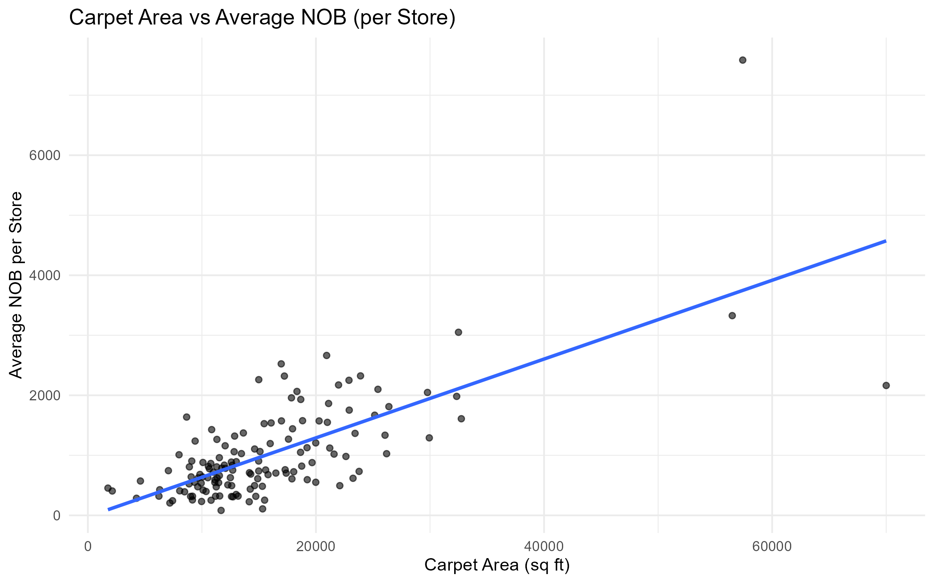
Carpet Area Vs Avg Nob

Slide 19
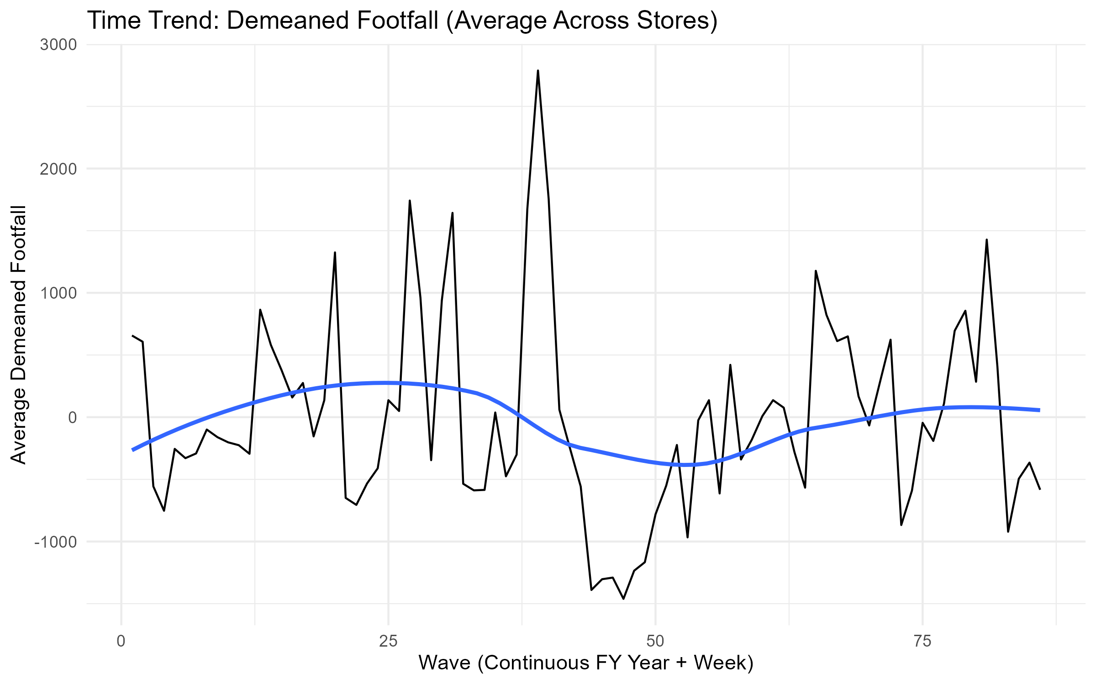
Wave Vs Demeaned Footfall

Slide 20
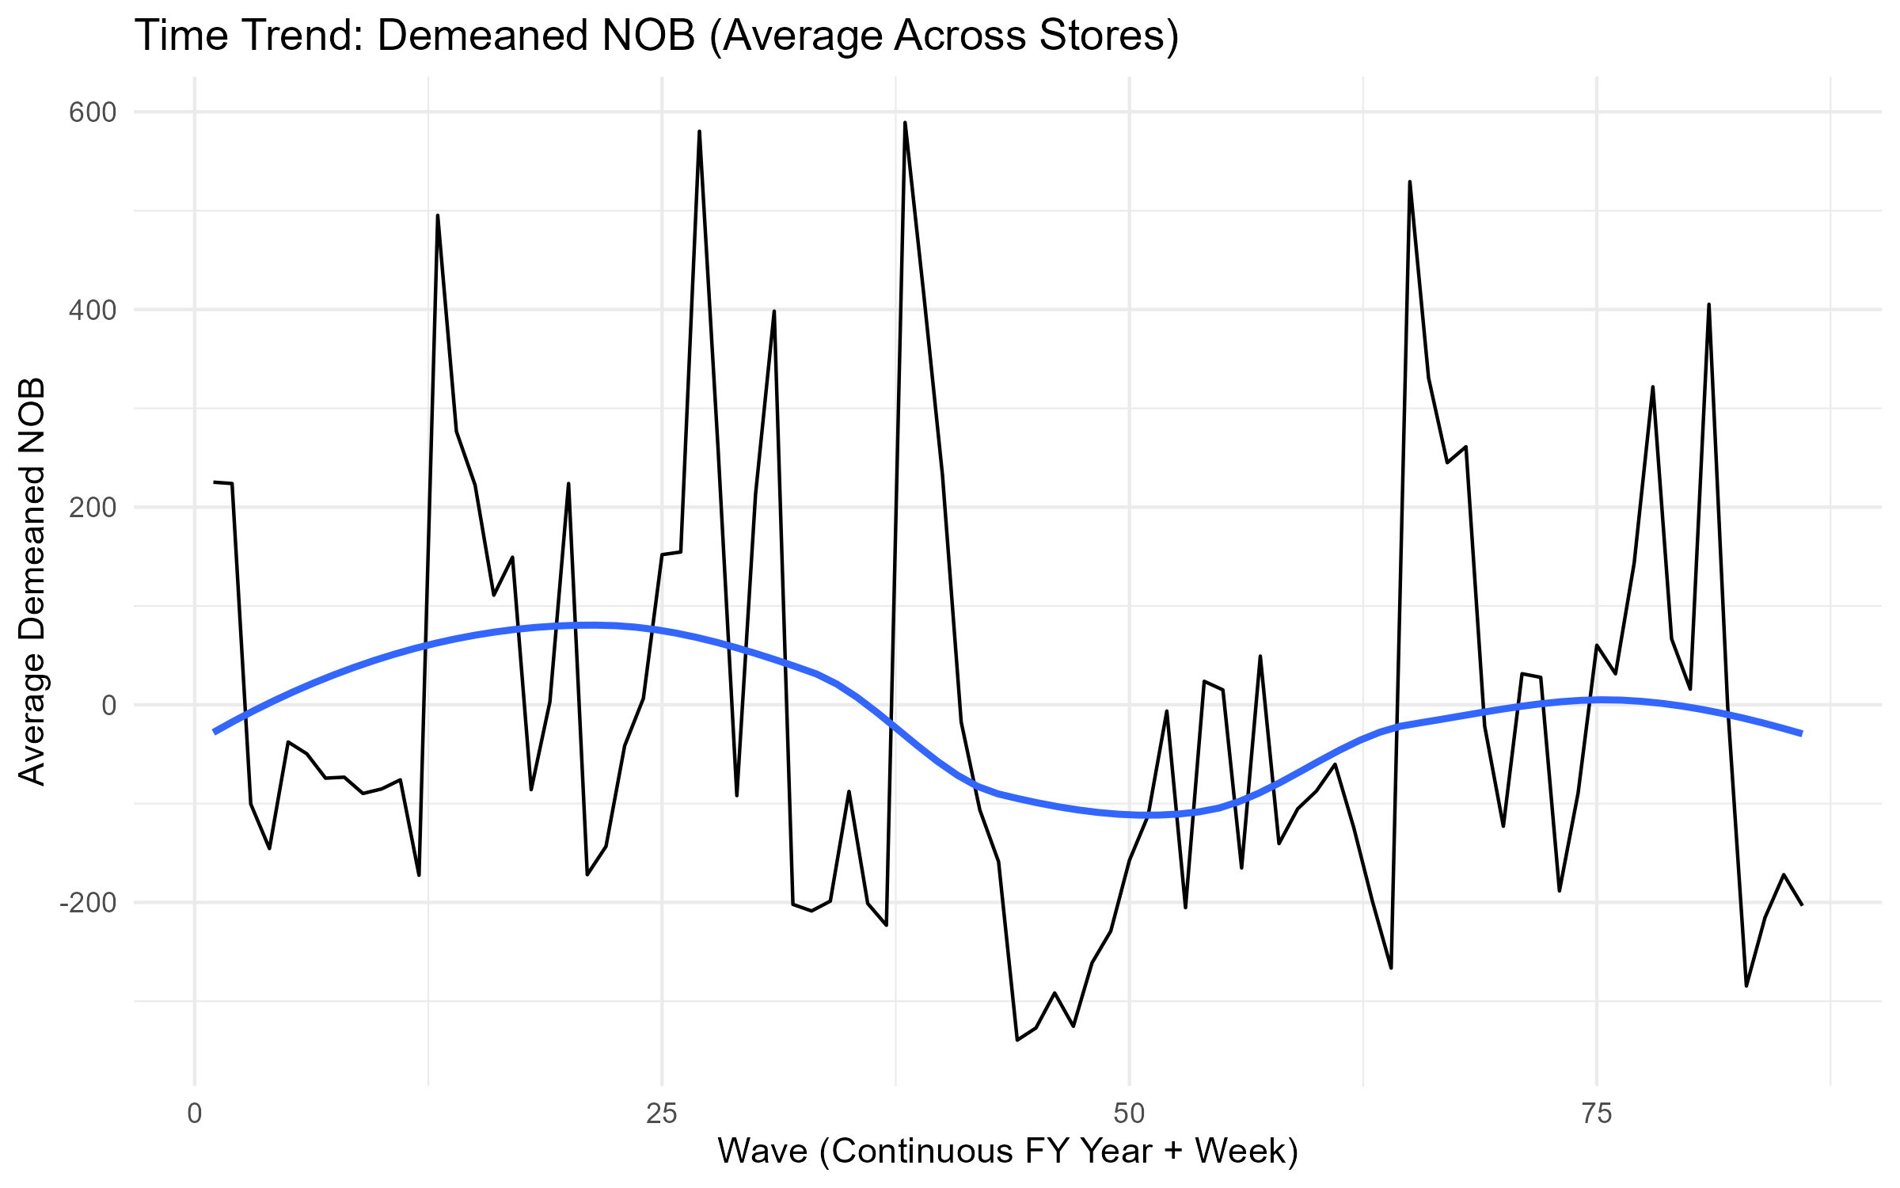
Wave Vs Demeaned Nob

Slide 21
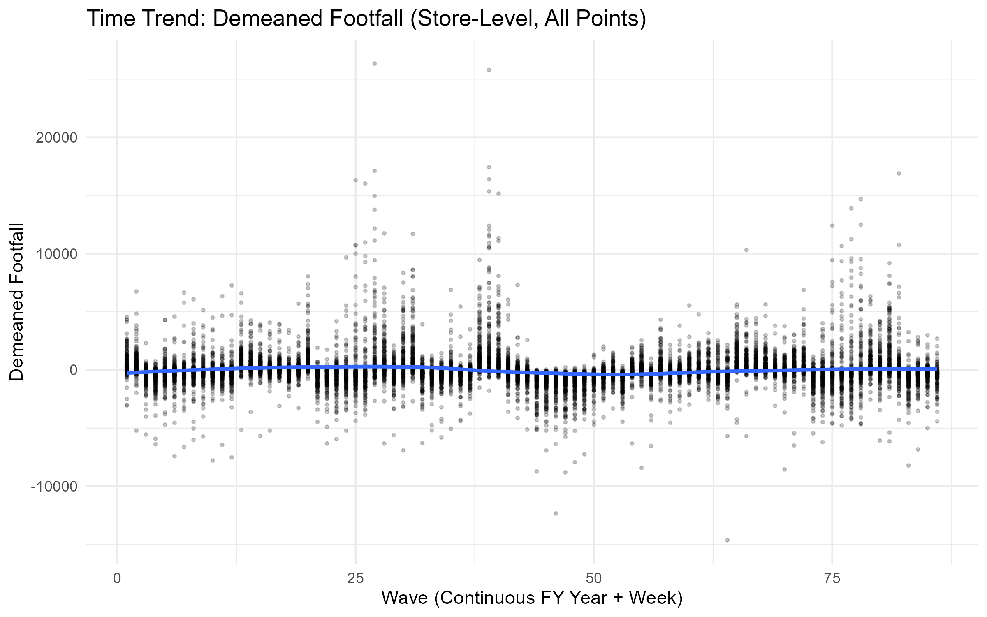
Wave Vs Demeaned Footfall Points

Slide 22
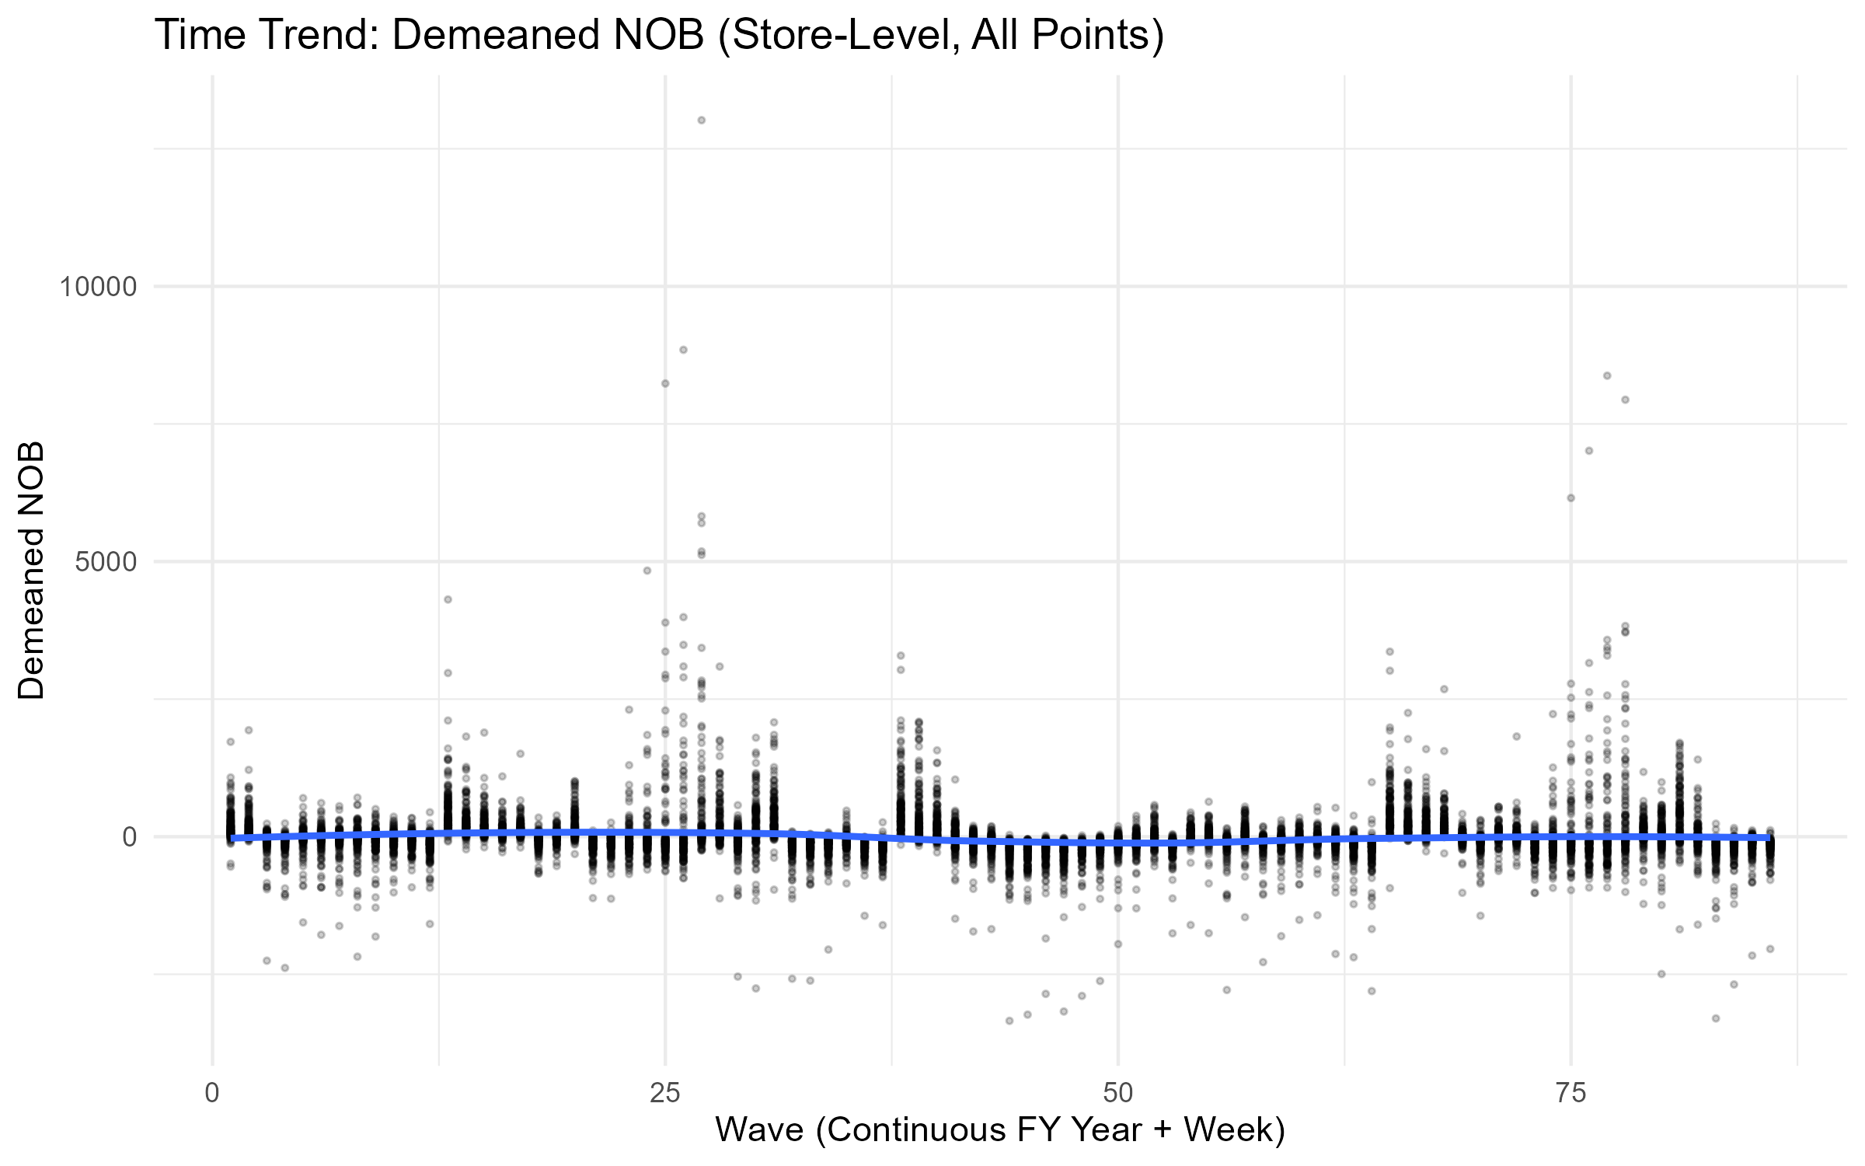
Wave Vs Demeaned Nob Points

Slide 23
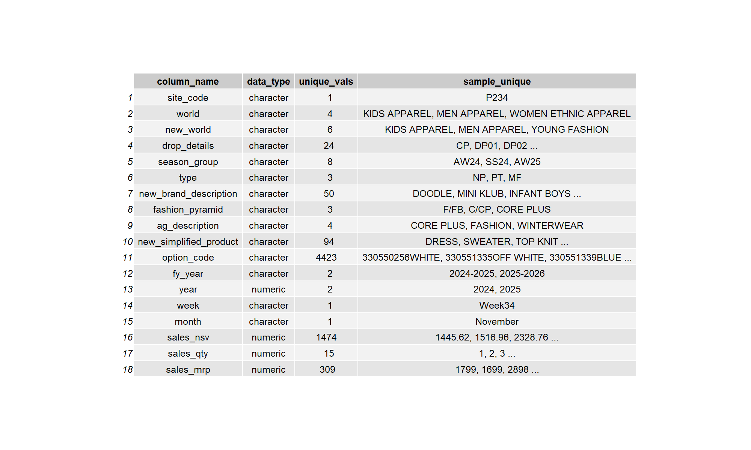
Col Summary

Slide 24
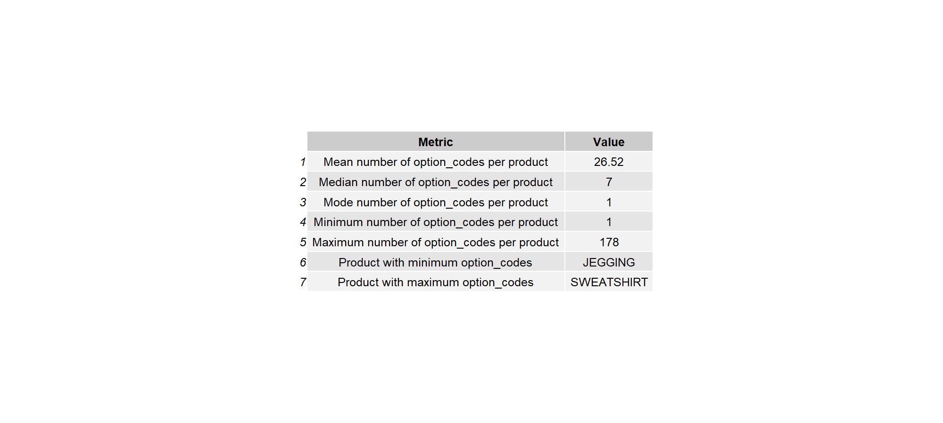
Product Option Descriptives 2025

Slide 25
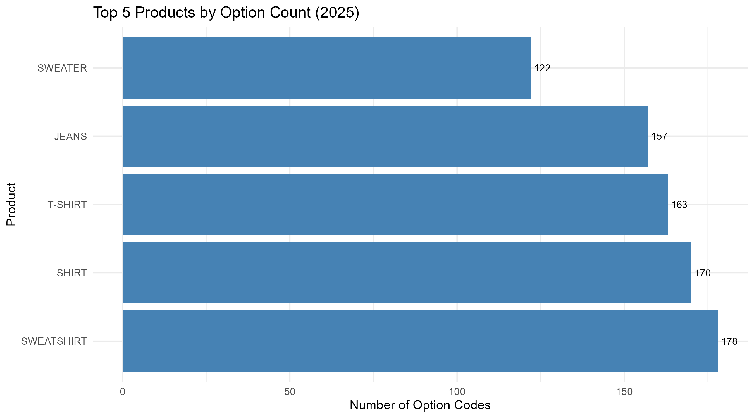
Top5 Products Option Count

Slide 26
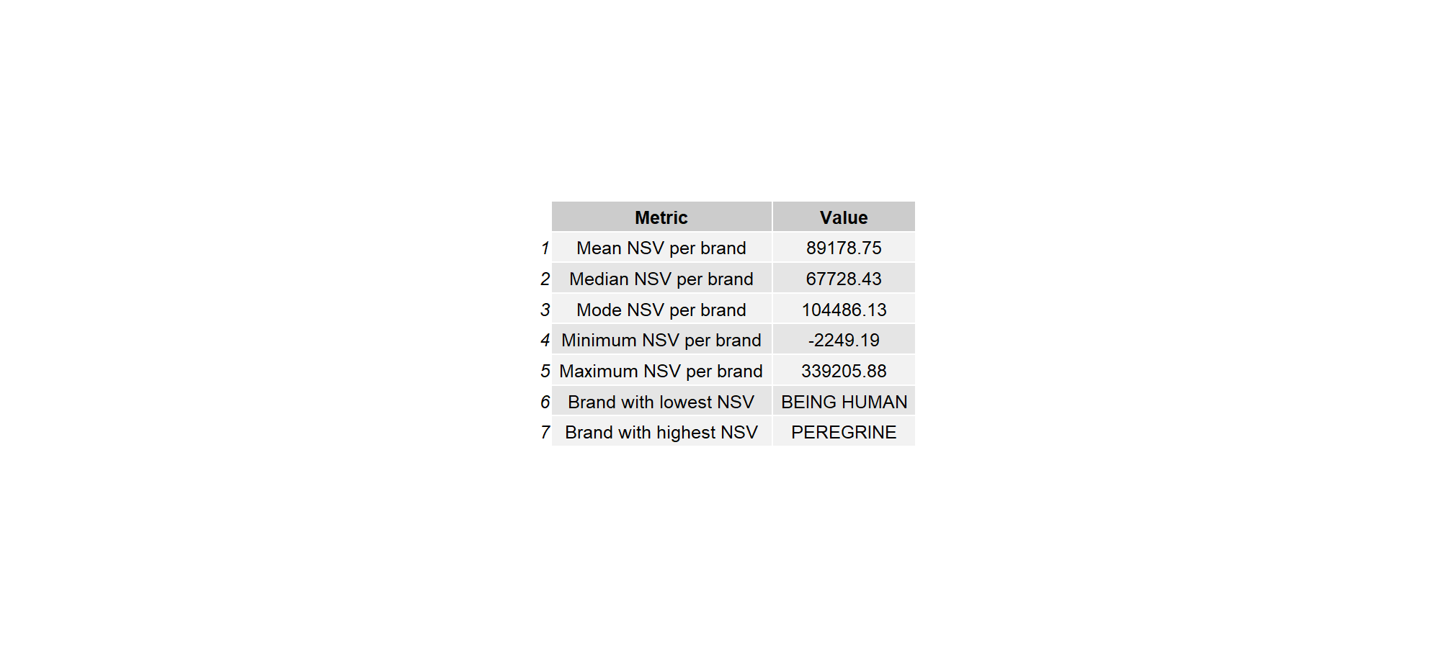
Brand Nsv Summary

Slide 27
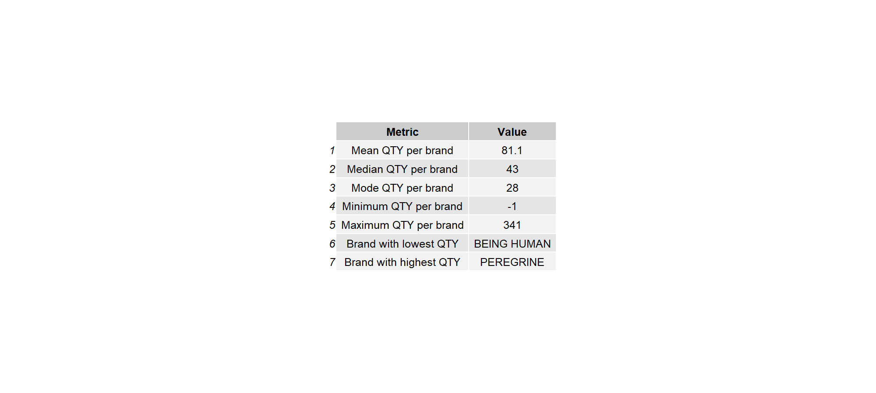
Brand Qty Summary

Slide 28

Type Vs Sales Summary

Slide 29
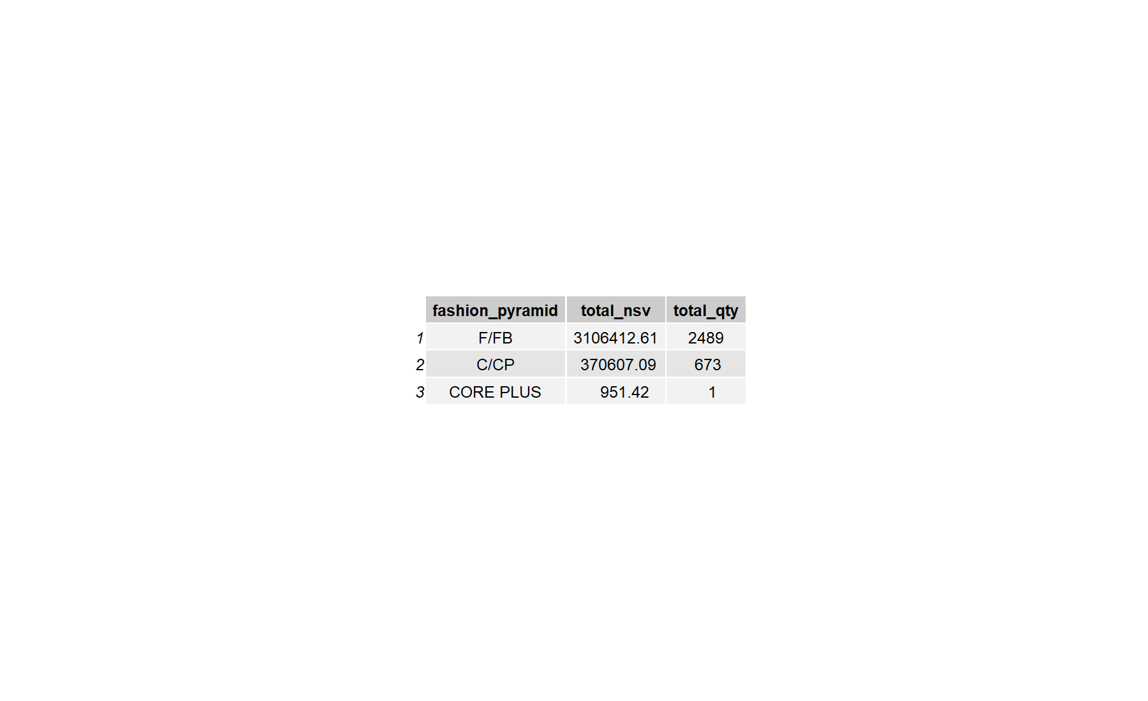
Fashion Pyramid Vs Sales Summary

Slide 30

Ag Description Summary

Slide 31
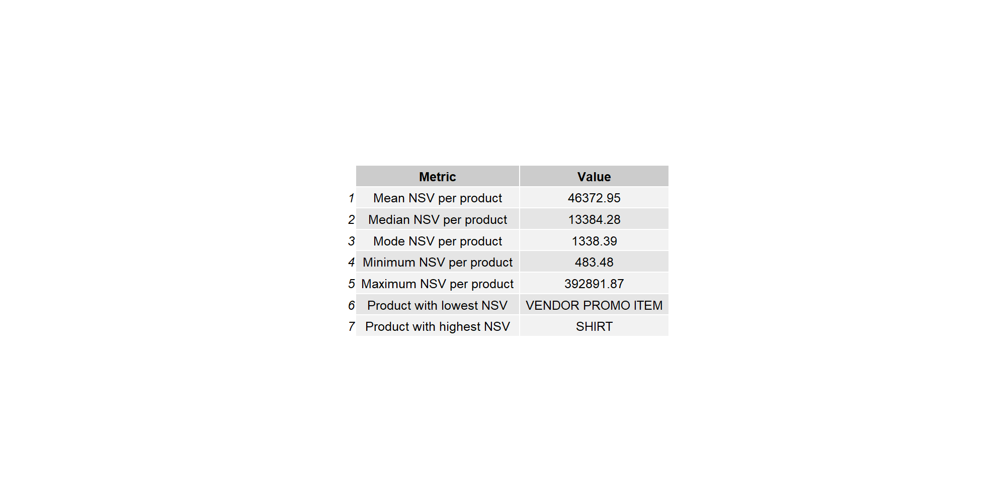
Newsimplifiedproduct Nsv Descriptives

Slide 32
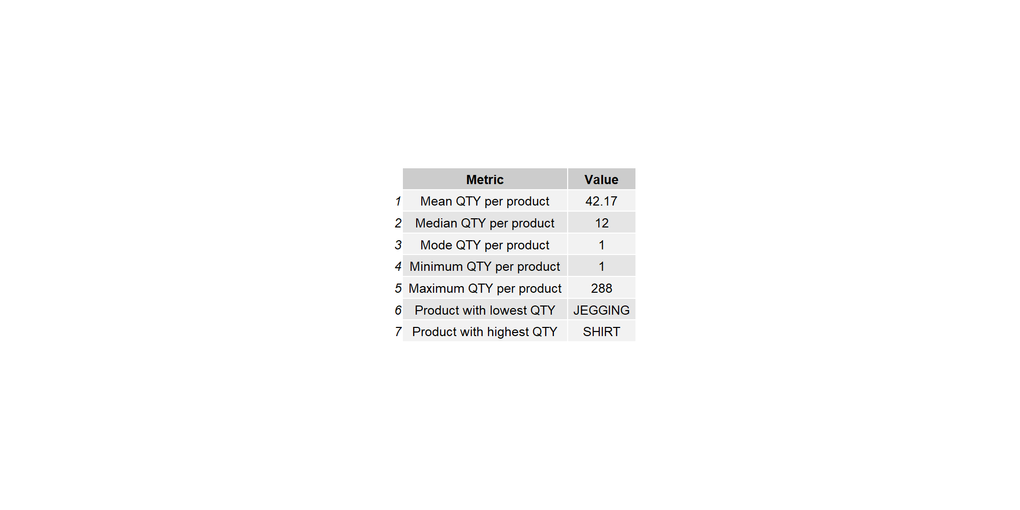
Newsimplifiedproduct Qty Descriptives

Slide 33
Test

