Slide 1

MINOR PROJECT · NIE MYSURU · CSE(AIML)
MLingo
Machine Learning, Frame by Frame.
An Interactive Learning Platform for Understanding Machine Learning Through Training, Visualization, Experimentation and Guided Projects
TEAM MEMBERS
GUIDE
Rahul Panchal — 4NI24CI082
Pratham Rampurmath — 4NI24CI078
Shashwat Prasad — 4NI24CI098
Nishit Prakash — 4NI24CI072
Ms. Sahana KJ
CO-GUIDE
Dr. Mayura Tapkire

Slide 2
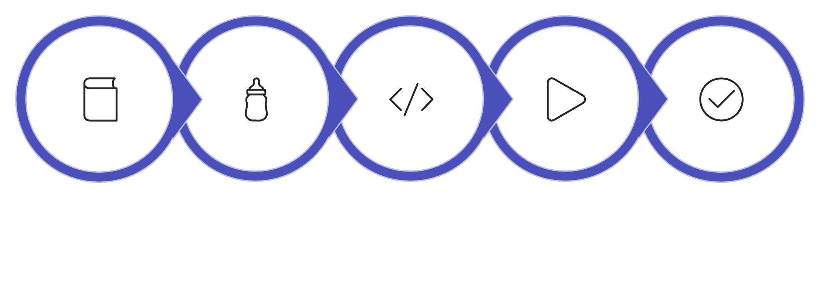

INTRODUCTION
Why Is Machine Learning Hard to Learn?
MLingo's Approach
Traditional ML Learning
Traditional
Train → Wait → Final Model
MLingo
Train → Scrub → Inspect → Understand
Theory
Formula
Code
Train
Final Result
The learner sees the beginning and the end — but rarely the training process itself.
MLingo makes the training process visible.

Slide 3

LITERATURE SURVEY
Existing Approaches & the Design Opportunity
Approach | Strength | Limitation
Video Courses | Structured explanations | Passive learning
Jupyter / Notebooks | Hands-on coding | Training inspected after execution
Interactive ML Demos | Visual intuition | Isolated concepts
MLingo | Timeline + inspection + experimentation + projects + AI Tutor | —
Design Opportunity: Combine training visualization, state inspection, experimentation, guided workflows, and contextual learning in one environment.

Slide 4
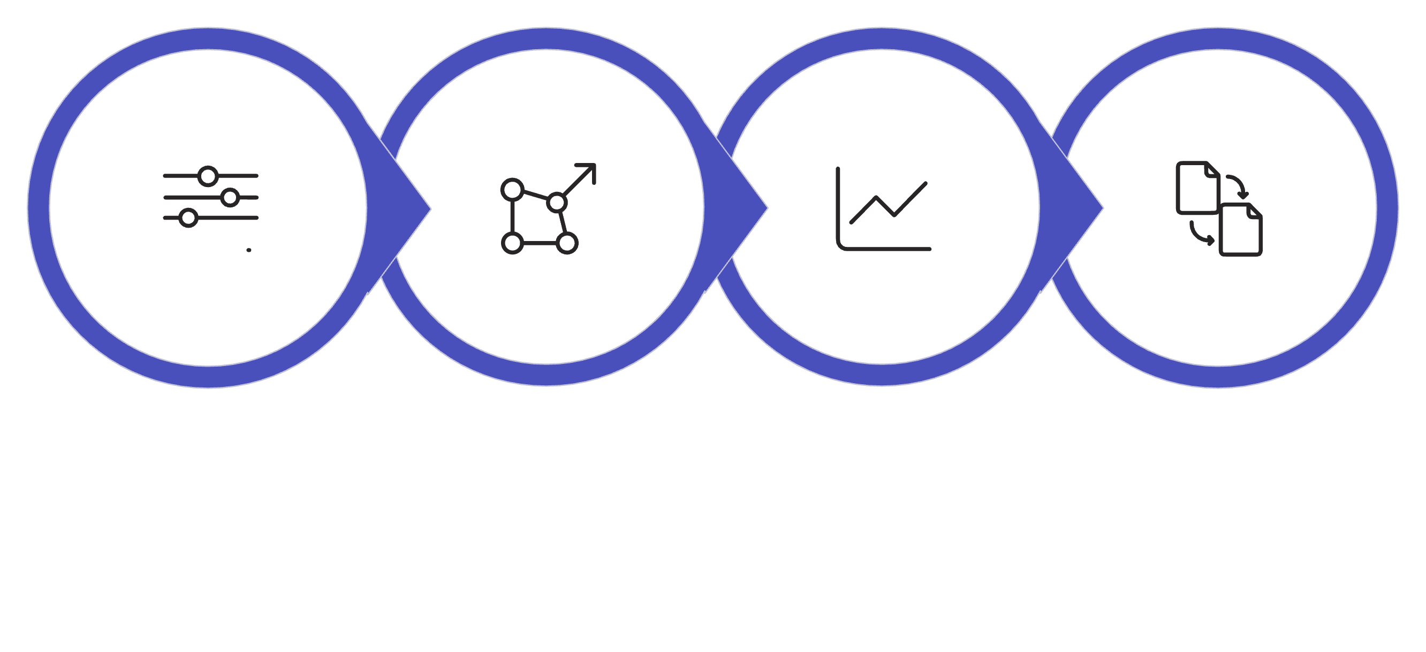
PROBLEM STATEMENT
The Hidden Training Process
"Students can learn the formulas and code of machine learning algorithms, yet still struggle to understand what actually happens during training."
Parameters
Gradients
Loss
Update
Training Dynamics
Hyperparameter Effects
Theory ↔ Code ↔ Behavior
Difficult to visualize step-by-step
Difficult to reason about intuitively
Difficult to connect all three

Slide 5
OBJECTIVES
What MLingo Sets Out to Do
Visualize Training
Inspect Model State
Experiment
Observe model training frame by frame.
Expose weights, gradients, predictions, and loss.
Change parameters and compare training behavior.
Connect Theory to Practice
Build Real ML Projects
Link visualization with mathematics and code.
Guide learners through complete data-science workflows.
From understanding algorithms → to building with them.

Slide 6
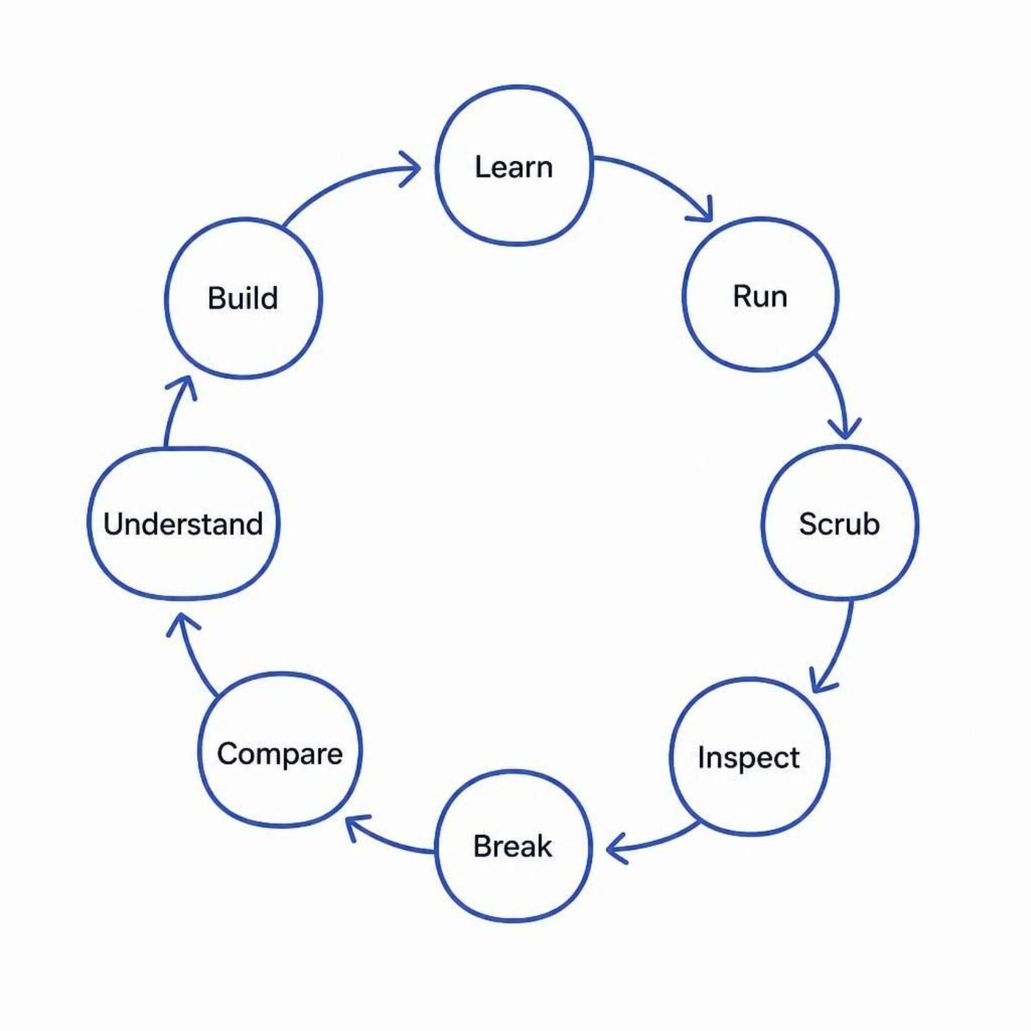
OUR SOLUTION
Introducing MLingo
MLingo transforms ML from something you read into something you can observe and interact with.
Training Timeline
Model X-Ray
Scrub through every training step
Inspect internal model state
Experiment Explorer
Project Studio
Compare runs and parameters
Build complete ML projects
AI Tutor
Context-aware learning support

Slide 7
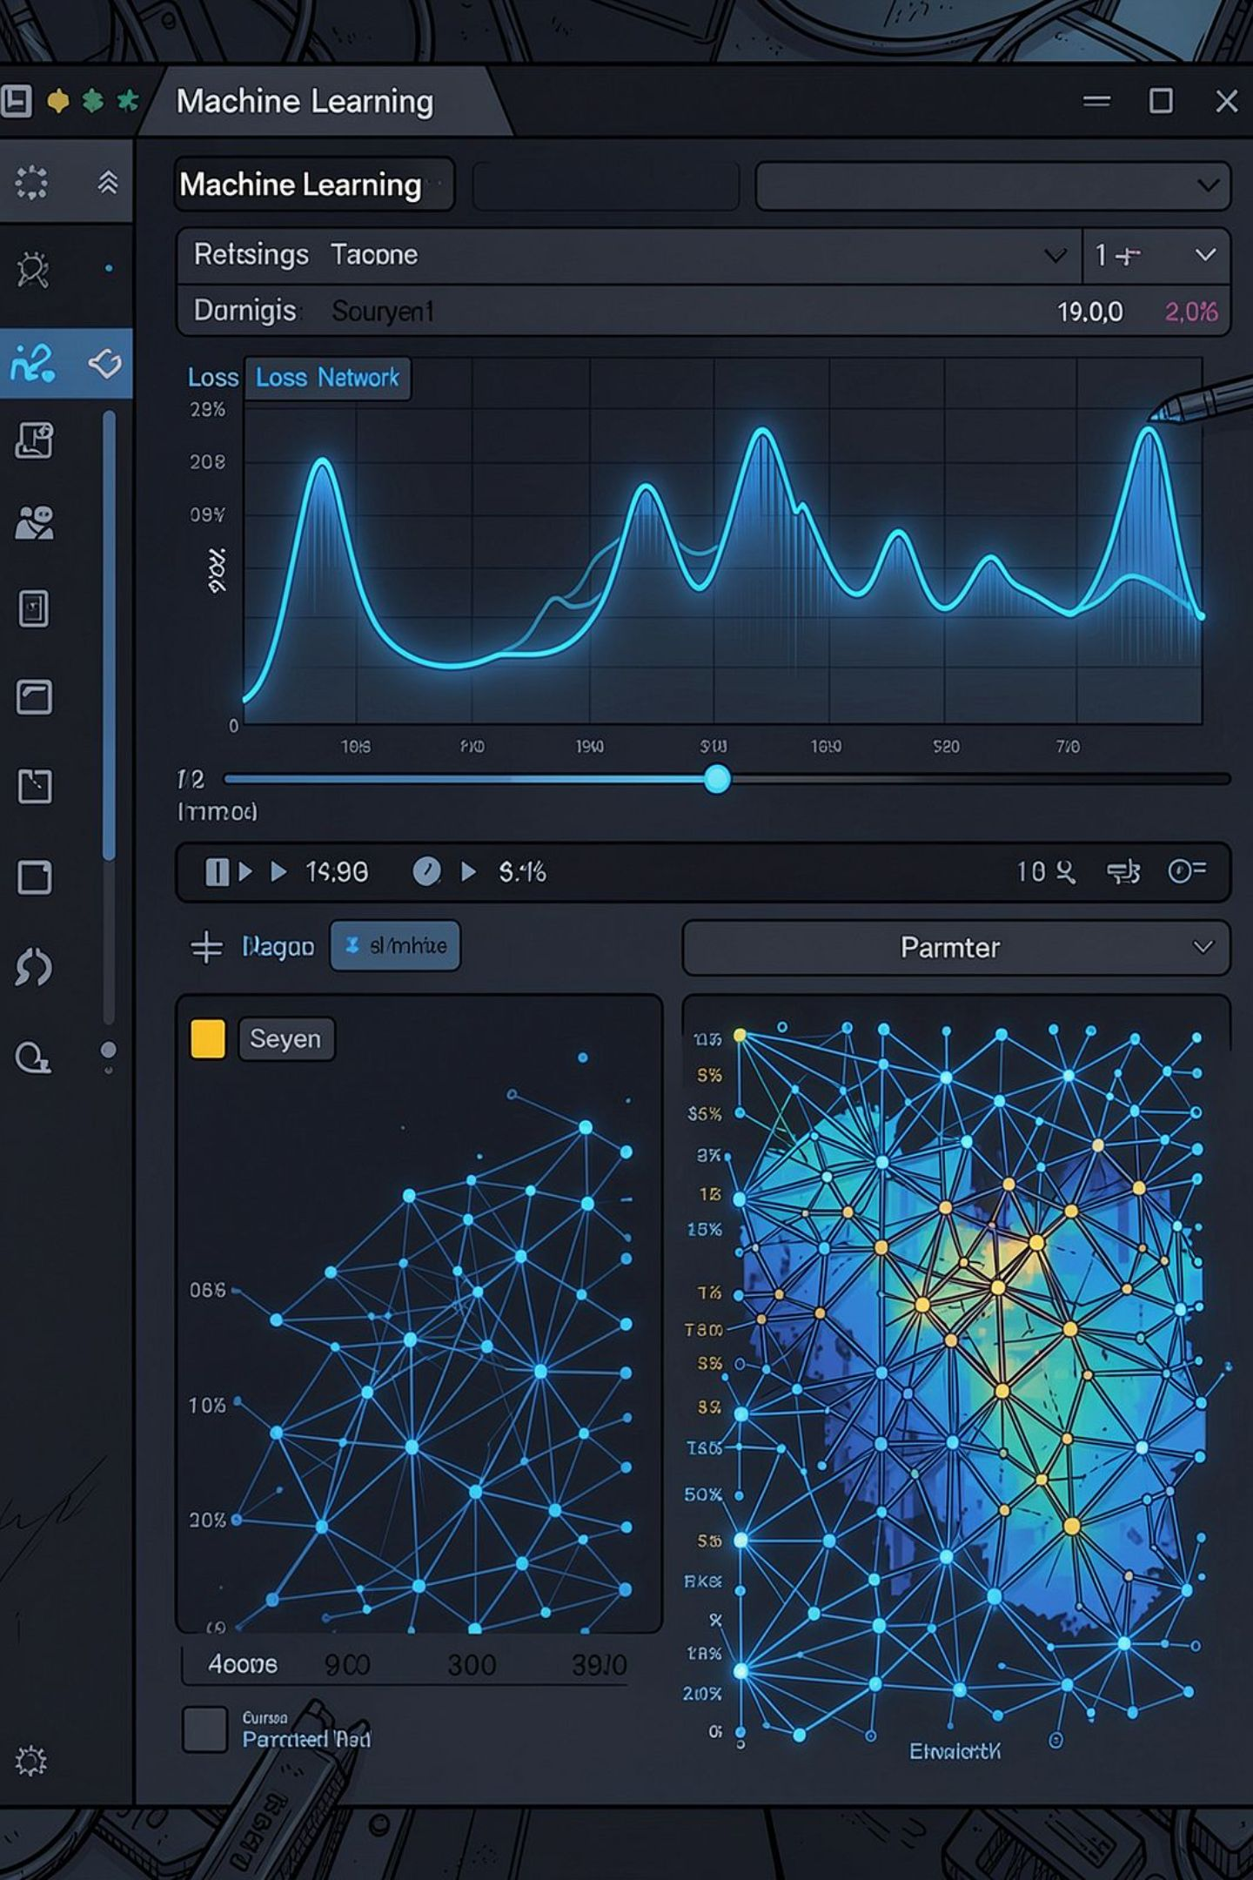
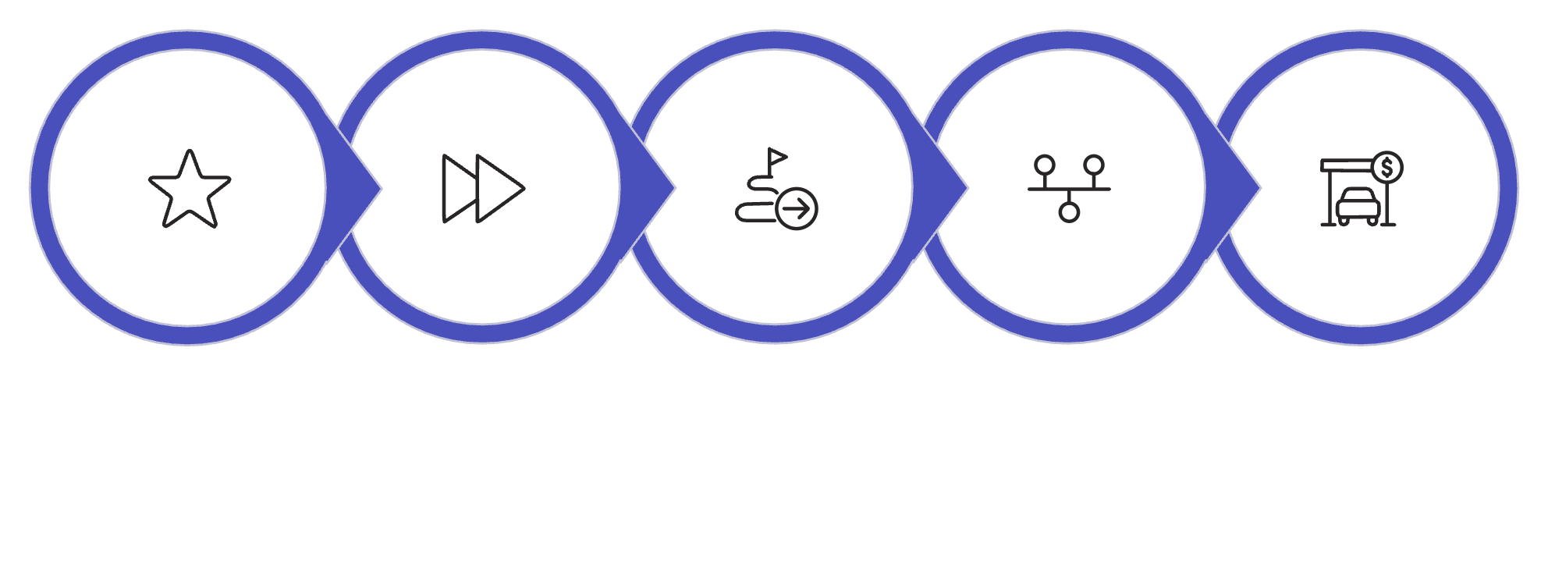
CORE INNOVATION
The Core Idea — Training as a Timeline
STEP 0
STEP 10
STEP 20
STEP 30
STEP 40
Every frame represents a real model state — weights, gradients, loss, and predictions at that exact training step.
Run
Scrub
Start training
Move through steps
Inspect
Examine model state

Slide 8
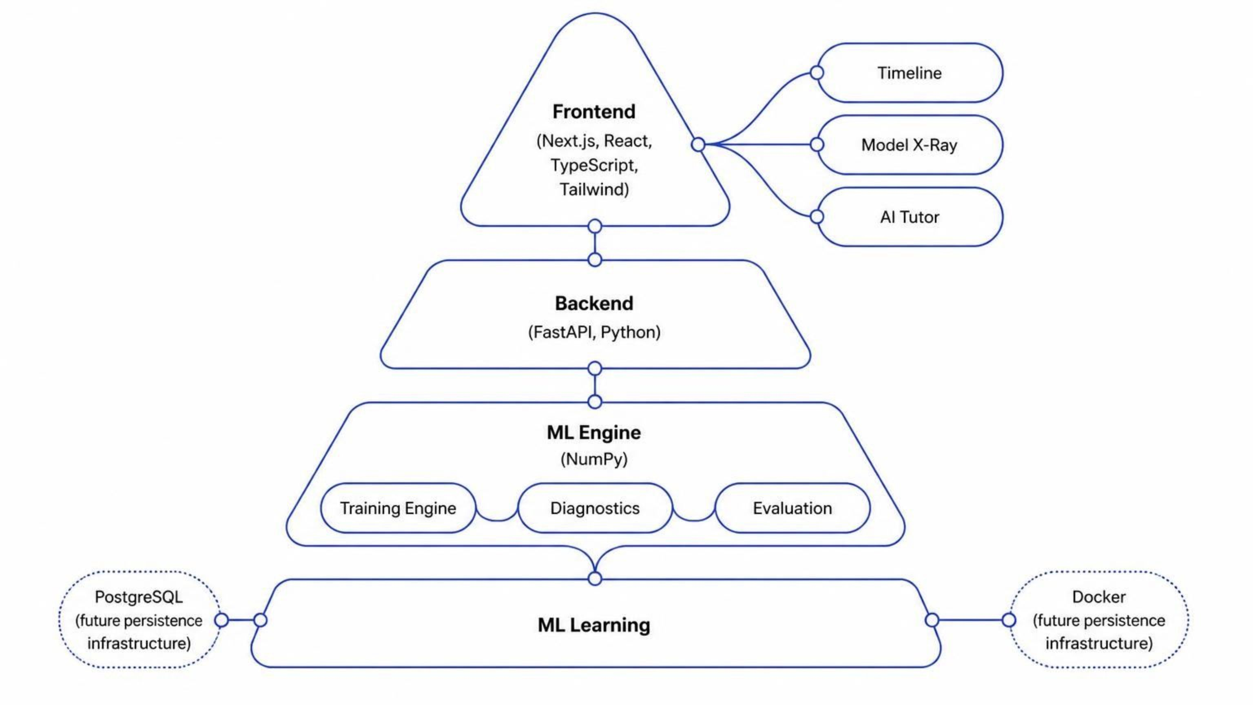
SYSTEM DESIGN
Architecture Overview
Infrastructure
PostgreSQL / Docker (future) · Local persistence (MVP)

Slide 9
SYSTEM REQUIREMENTS
Technology Stack
Software Requirements
Core Technologies
Windows / Linux / macOS
Node.js · Python
Git / GitHub
Docker
Frontend
Backend
Next.js + React + TypeScript
FastAPI + Python
Deployment
Vercel · Render
ML Engine
Visualization
NumPy
SVG / Interactive Charts

Slide 10
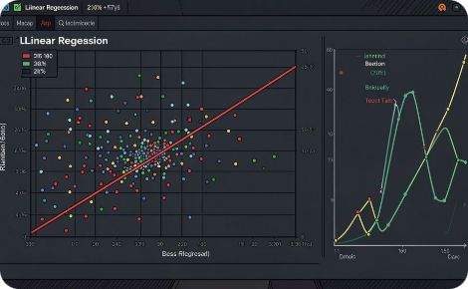
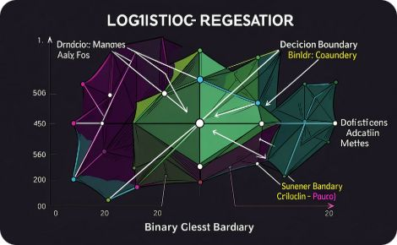
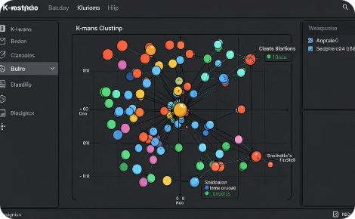
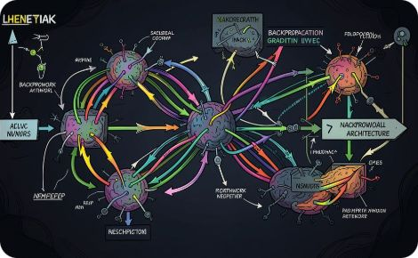
IMPLEMENTED SYSTEM
What We Have Built
Linear Regression
Logistic Regression
K-Means Clustering
Neural Network + Backprop
Gradient descent, loss visualization, parameter inspection
Sigmoid function, decision boundary, probability output
Centroid movement, cluster assignment, iteration tracking
Layer-wise gradients, weight updates, activation visualization
Training Timeline
Model X-Ray
Experiment Explorer
Data Science Workbench
AI Tutor
Project Studio

Slide 11
Thank You

