Slide 1
Logistic Regression
Models the probability of an event occurring depending on values of independent variable

Slide 2
Examples of Binary Outcome
Will a person default on credit card payment or not?
Whether a customer will buy a product or not?
Will the person be admitted in the school or not?
Whether a transaction is fraudulent or not?
Whether a person will vote for a specific party or not?

Slide 3
Binary Outcome Representation
Two Outcome: YES | NO
Dummy Variable Creation
YES(y=1)
NO (y=0)
We can code it the other way around too, and then coefficients will have same magnitude but opposite sign
Whatever helps me in buying the product will have the opposite effect in helping me not buy the product

Slide 4
Example: Customer Magazine Subscription
Sample data of 1000 customers from a city. We aim to find what determines their decision to subscribe to magazine
Dependent Variable(Subscribe): Indicates is a person subscribed or not
Age: Age of person. We will see how age impacts customer’s choice
We ignore other variables for now like Gender..
Why can’t we use Simple Linear Regression Model here??

Slide 5

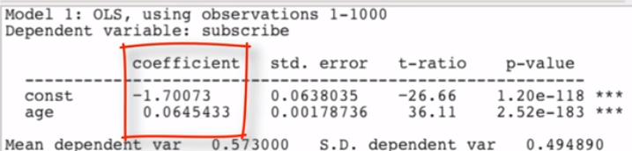

Using Simple Linear Model
Apart from ‘y’ being binary it looks like the same problem we tackled earlier
Its value is higher (from a 0 to 1) if a customer subscribes, so whatever makes it higher increases the likelihood of subscription
We can then run
Sample Result

Slide 6
Result Interpretation
If our dependent variable is binary, then we want to see what makes it change from 0 to 1
We can also interpret it as, what increases the likelihood of subscription or P(Subscribe=1), lets denote that by ‘p’
The results can then be written as:
Since 0.064 is the slope of model, we can also interpret it as every unit increase in age increases the probability of subscription by 6.4%

Slide 7
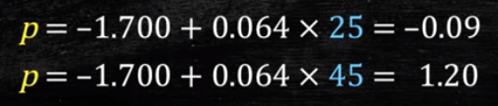
Problems with this Approach?
Probabilities are bounded between [0.1] i.e. 0<= p <=1
In our data we had Age in range of [20,55]
The probability that a 35 year old person subscribes is
What about a 25 years old and a 45 years old person:
Since probability cannot be less than 0 or > 1 we see invalid values above

Slide 8
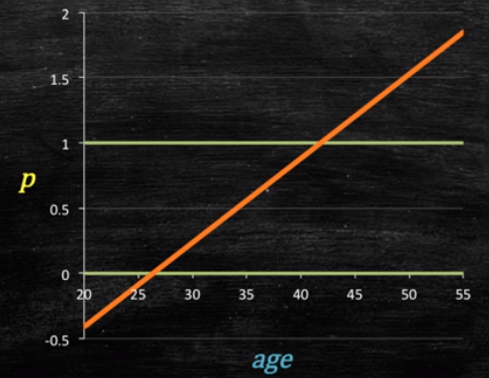
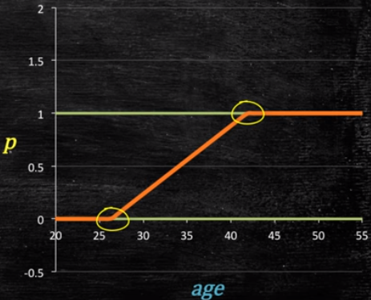
Let’s look at the Plots
We can cut off the values above 1 and below 0 but that looks engineered.
We need to somehow constrain p such that 0 <= p <= 1
We know p =f(Age), but the linear function did not work
So what must this function f(*) satisfy to produce reasonable forecast?

Slide 9

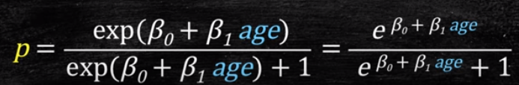
Create a Better Function
F(*) must satisfy 2 things
It must always be positive (p>=0)
It must always be less than 1 (p<=1)
Always positive (p>=0)
Always less than 1 (p<=1)

Slide 10

Linear Thinking Still Exists
The previous expression by doing some algebra can be re-written as
So, even though the probability of customer subscribing is not a linear function of age, the above transformation is still a linear function of Age
The above equation is used in logistic regression

Slide 11
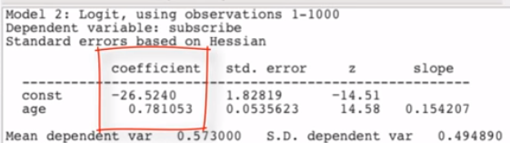

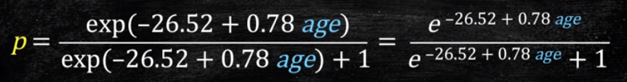
Regression Output to Probability
Assume the following output
The estimated model becomes:
Written in terms of probability ‘p’ we have:

Slide 12
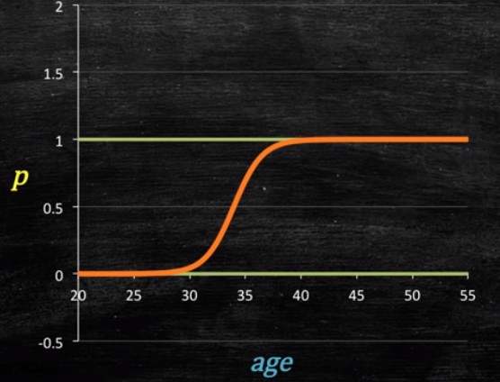
Probability Plot vs Age
If we now plot the computed ‘p’ against Age, we realize
At higher Age the curve flattens and continues to remain below 1
At lower Age the curve flattens and continues to remain positive (above 0)
This is the Logistic Model Plot

Slide 13

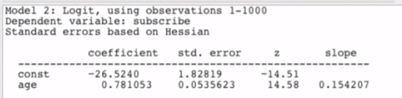

Similarities with Linear Regression
Let’s call y* = ln (p/(1-p)). Then model looks very similar to linear regression
Assume the model output as
Sign of Coefficient still means a positive or a negative impact
Standard error can still be used to compute confidence interval
There are however other changes compared to linear regression

Slide 14

What has Changed?
We cannot interpret the magnitude of coefficient in a manner we did in linear regression
What is the meaning of 0.78 in our model?
For every unit increase in Age, ln(p/(1-p)) increase by 0.78 units
Instead of modeling the outcome, Y, directly, the method models the log odds(Y) using the logistic function.
But what is ln(p/(1-p)) or y*?
Our aim is to find ‘p’, so that we can better interpret the model

Slide 15
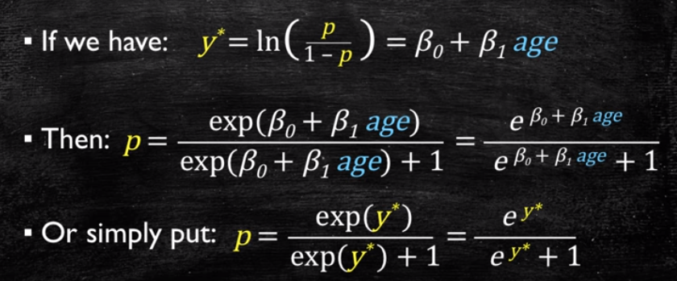
From y* to p
Computing the y* and p in excel manually
A unit increase in Age does not change the probability linearly

Slide 16

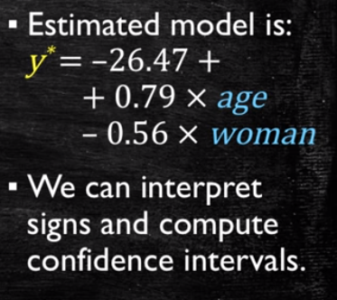
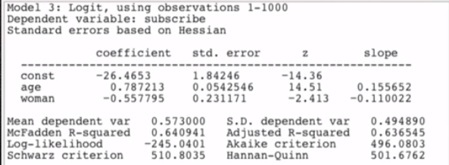
Simple to Multiple Logistic Regression
Moving from a simple to multiple logistic regression is very simple and work sin the similar way like multiple linear regression
Lets add a dummy variable of ‘Gender’ in model and re-run the analysis
Model Result
Again, Our aim is to find ‘p’, so that we can better interpret the model

Slide 17
From y* to p in Excel
We see probability of buying increases by 11.9% for a man compared to a woman in 35Yrs Age
However, for 36Yrs category, we see probability increases by 7.8% for a man compared to a woman
Again, this suggests that change is not linear

Slide 18
Idea of Maximum Likelihood
Flipped a fair coin 10 times:
T, H, H, T, T, H, H, T, H, H
What is the Prob(Heads) given the data?
1/100? 1/5? 1/2? 6/10?
Most reasonable data-based estimate would be 6/10.
In fact,
is the ML estimator of p.

Slide 19
Maximum Likelihood
We want to choose β’s that maximizes the probability of observing the data we have:
Assumption: independent y’s

Slide 20
Relationships among probability, odds and log odds
Measure | Min | Max | Name
Pr(Y=1) | 0 | 1 | prob
 | 0 | ∞ | odds
 | -∞ | ∞ | log odds

