Slide 1

Project Report: Customer Shopping Behavior Analysis
Understanding customer behavior is crucial for enhancing business strategy, optimizing offerings, and boosting revenue.
Customer Behavior

Slide 2
Introduction: Why Analyze Customer Behavior?
Improved Strategy
Enhanced CX
Tailor business decisions to real customer needs and trends.
Create seamless and satisfying customer experiences.
Optimized Offerings
Increased Revenue
Develop and present products customers truly want.
Drive sales through targeted approaches and better engagement.
Customer Behavior

Slide 3
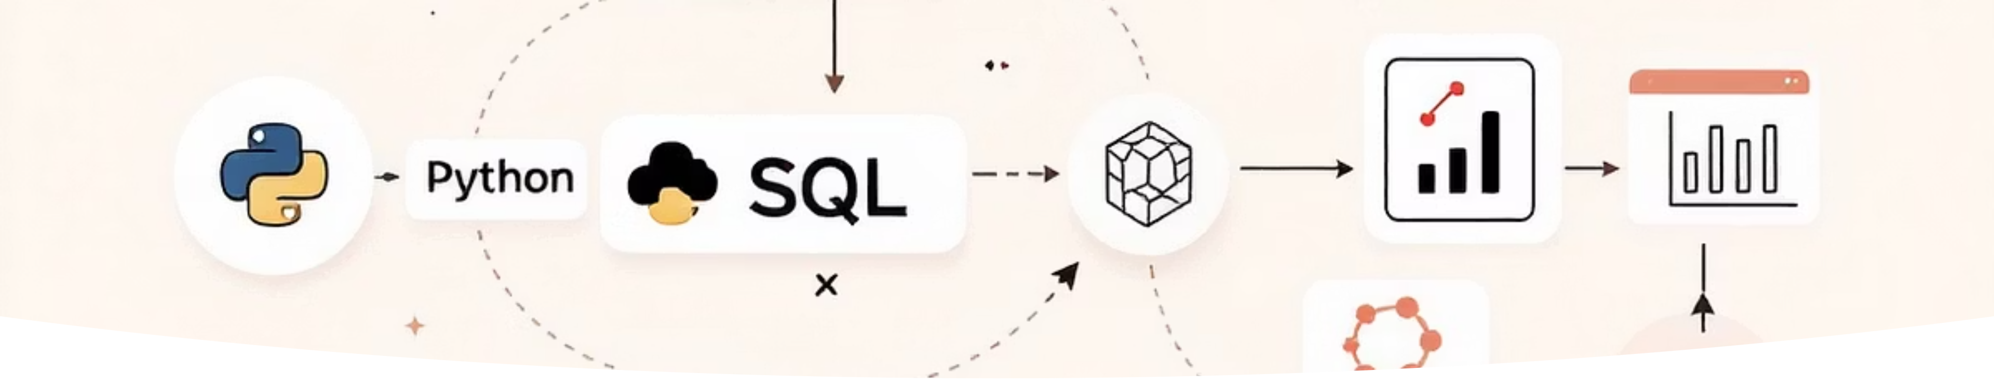
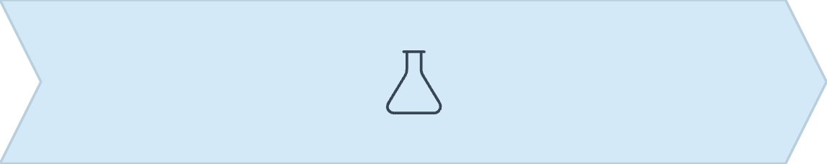
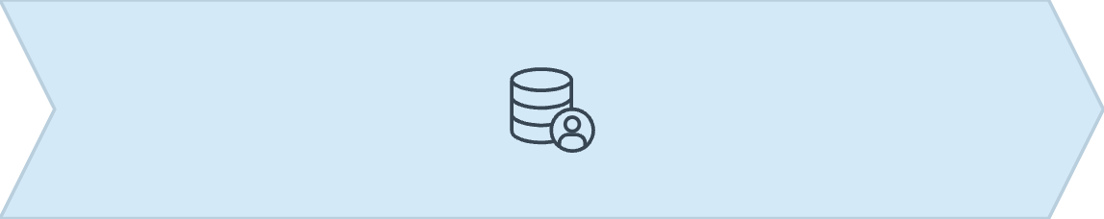
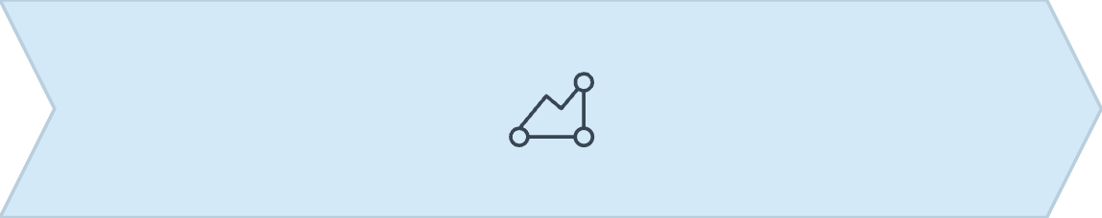
Our End-to-End Analysis Pipeline
This project uses a comprehensive data pipeline to deliver actionable insights.
Python EDA
SQL Analysis
Power BI Dashboards
Initial data loading, exploration, and verification.
Deep dives, aggregations, and customer segmentation.
Interactive visualizations for informed decisions.
Customer Behavior

Slide 4
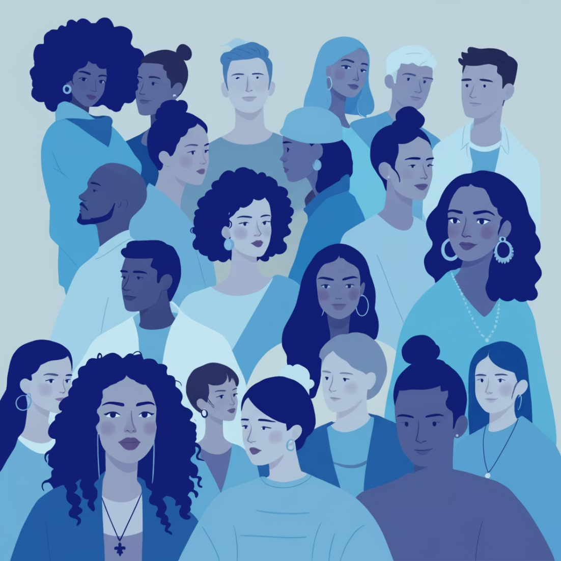
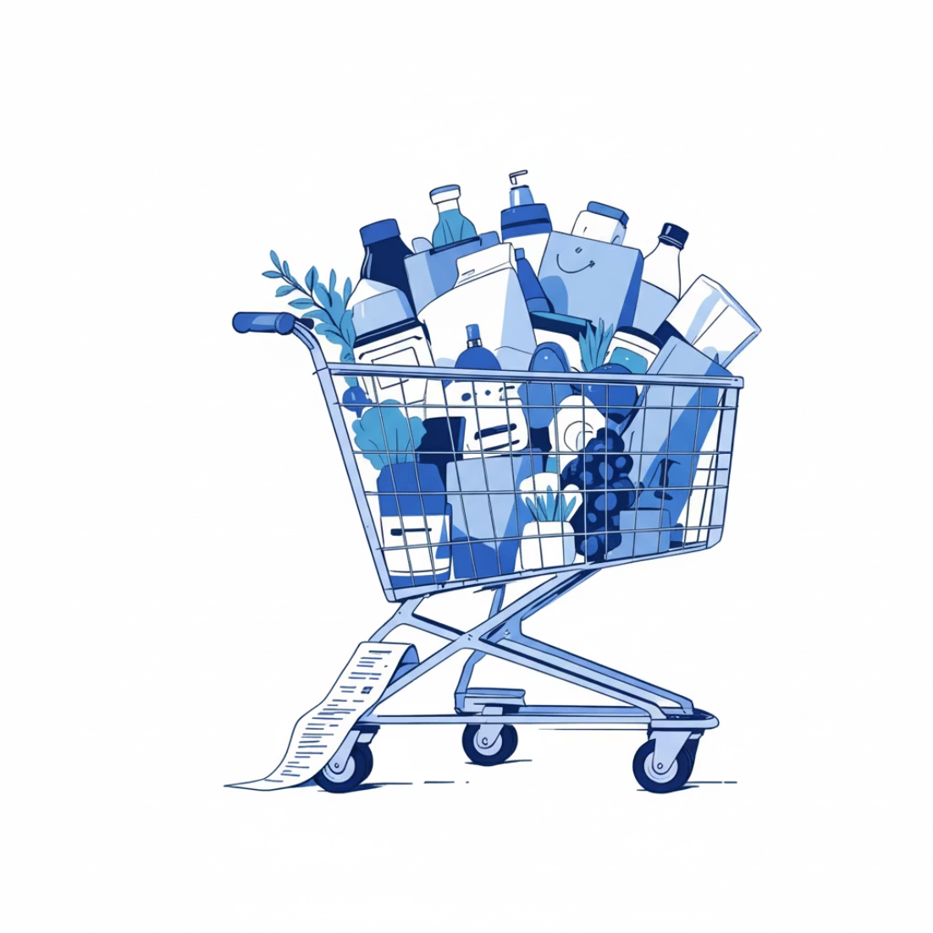
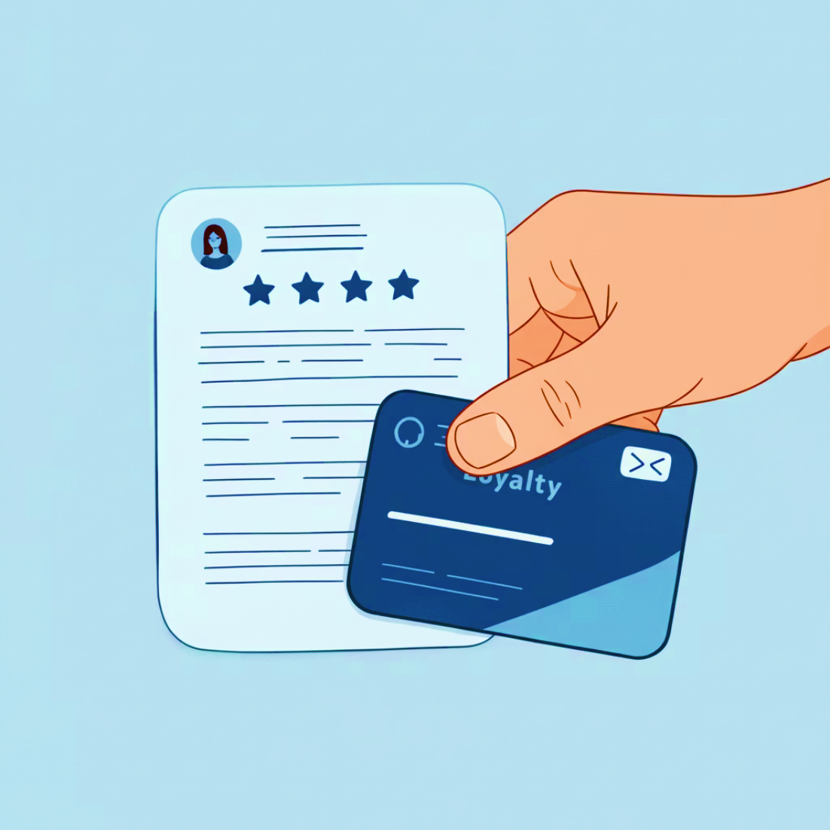
Dataset Overview: Rich Customer Insights
Our analysis is built on 3,900 transaction records with 18 columns of diverse data.
Demographic
Transactional
Behavioral
Customer ID, Age
Item Purchased, Category
Review Rating, Previous Purchases
Gender, Location
Purchase Amount (USD)
Subscription, Shipping Type
Transaction Date
Discount, Promo Code
Payment Method, Frequency
Customer Behavior

Slide 5
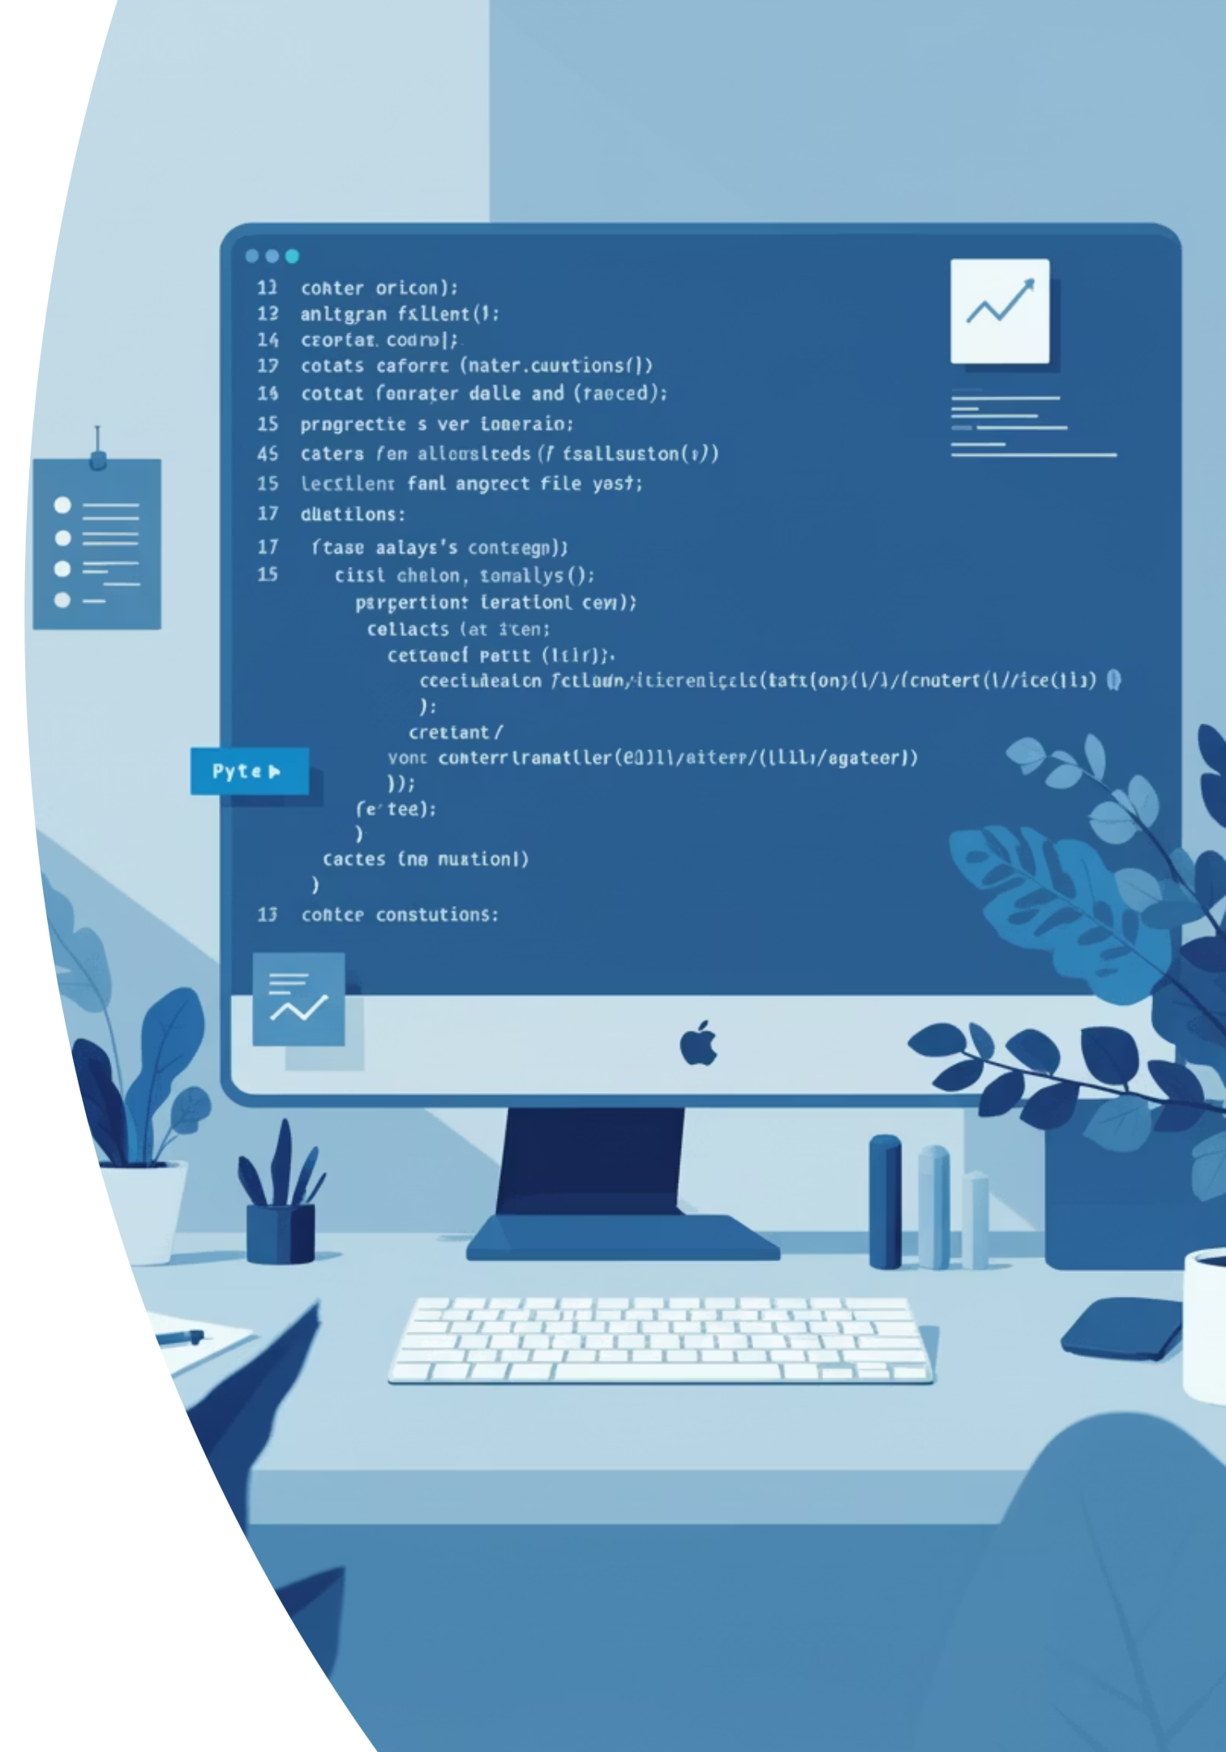
Step 1: Python Exploratory Data Analysis (EDA)
Our Jupyter Notebook revealed a clean dataset ready for advanced analytics.
Data Loaded
1
3900 records, 18 columns, no major missing values.
Structural Overview
2
Clean datatypes: object, integer, float. No quality issues.
Meaningful Distributions
3
Age, purchase amount, and categories show rich variety.
Ready for SQL
4
Minimal preprocessing needed for database upload.

Slide 6

Step 3: SQL Deep Dive - Key Insights
Structured queries revealed significant patterns in customer spending and preferences.
1
2
3
Revenue by Age Group
Category-Wise Revenue
Top Spenders
25-45 age group generates highest revenue.
Electronics highest revenue, Clothing highest volume.
Identified high-value customers for loyalty programs.
4
5
Payment Methods
Loyalty Patterns
Debit/Credit Card & Online Wallet dominate.
High-frequency customers show higher lifetime value.
Customer Behavior

Slide 7
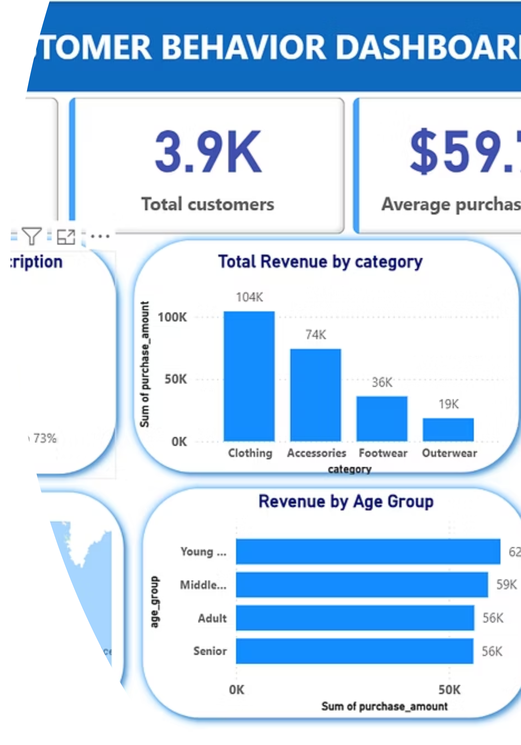
Step 4: Power BI Dashboard Visuals
Interactive dashboards transform data into actionable business insights.
Key Visuals:
Subscription Status & Revenue by Category
Most Purchased Items & Revenue by Region
Payment Method Usage, Frequency/Loyalty

Slide 8
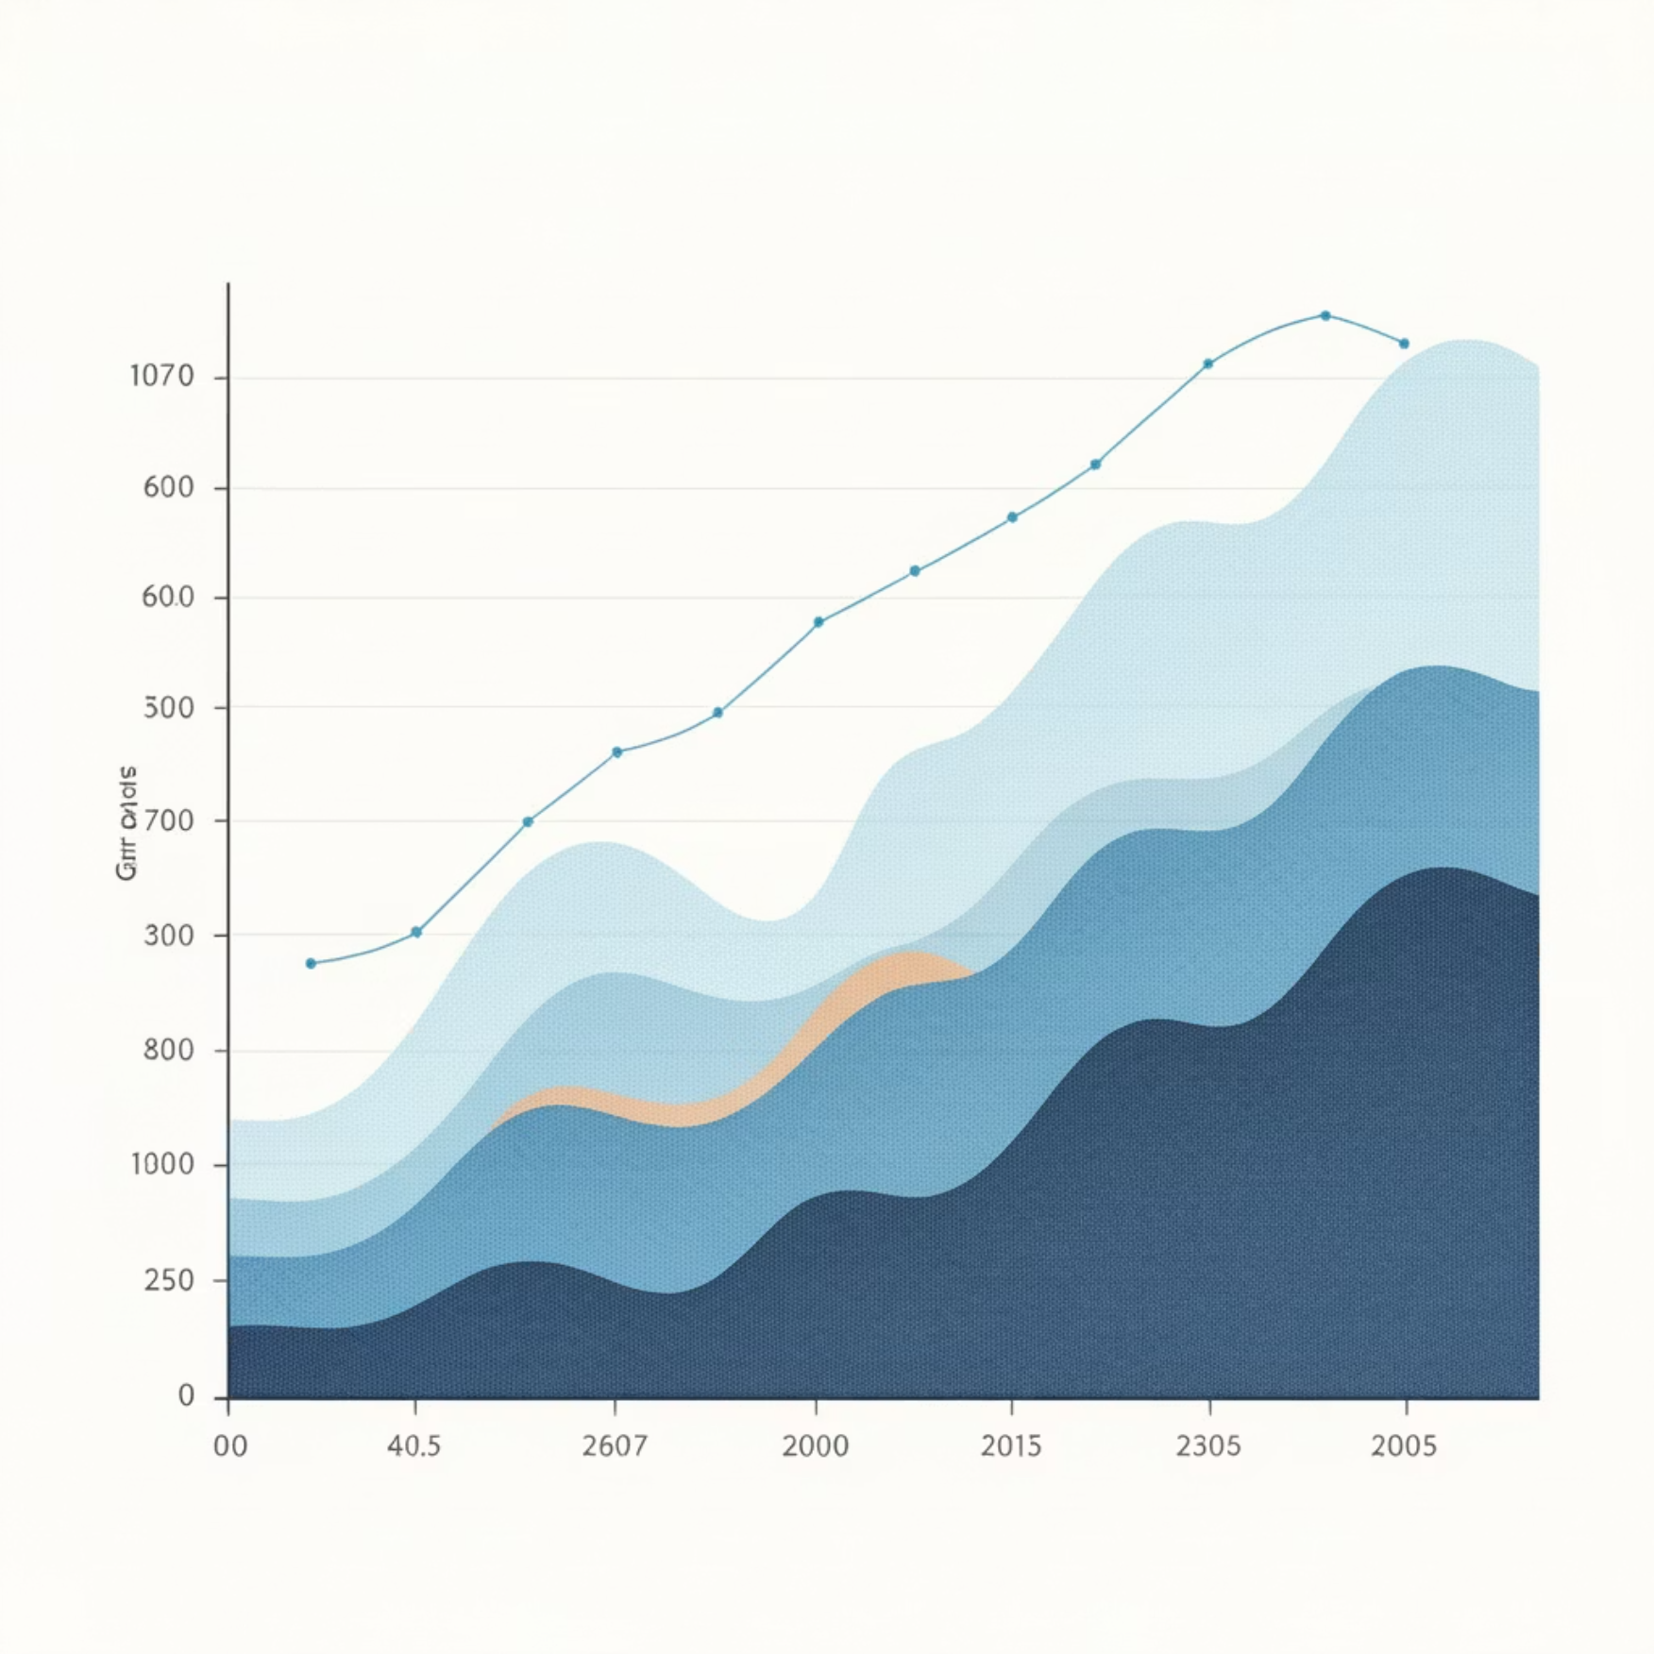
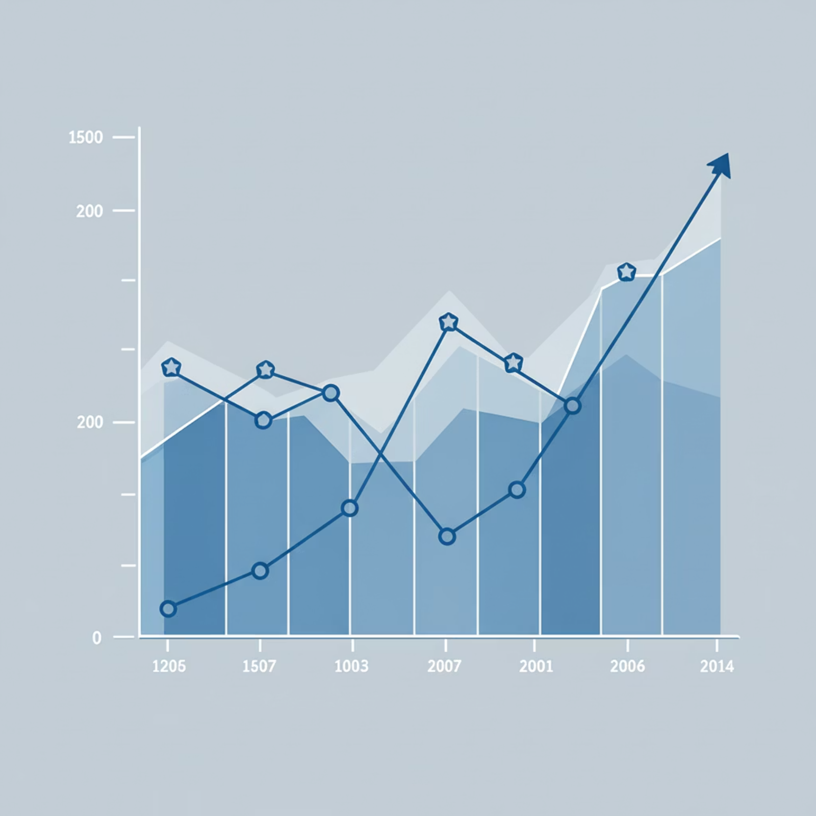
Key Insights: Demographics, Spending & Behavior
Demographic Snapshot
Spending & Behavioral Trends
Age 25-45 drives revenue & purchases.
Electronics = high revenue; Clothing = high frequency.
Balanced gender split across customer base.
High-frequency buyers give higher ratings.
Diverse geographic locations represented.
Discount seekers make lower-value, more frequent purchases.
Online payments preferred over cash.

Slide 9
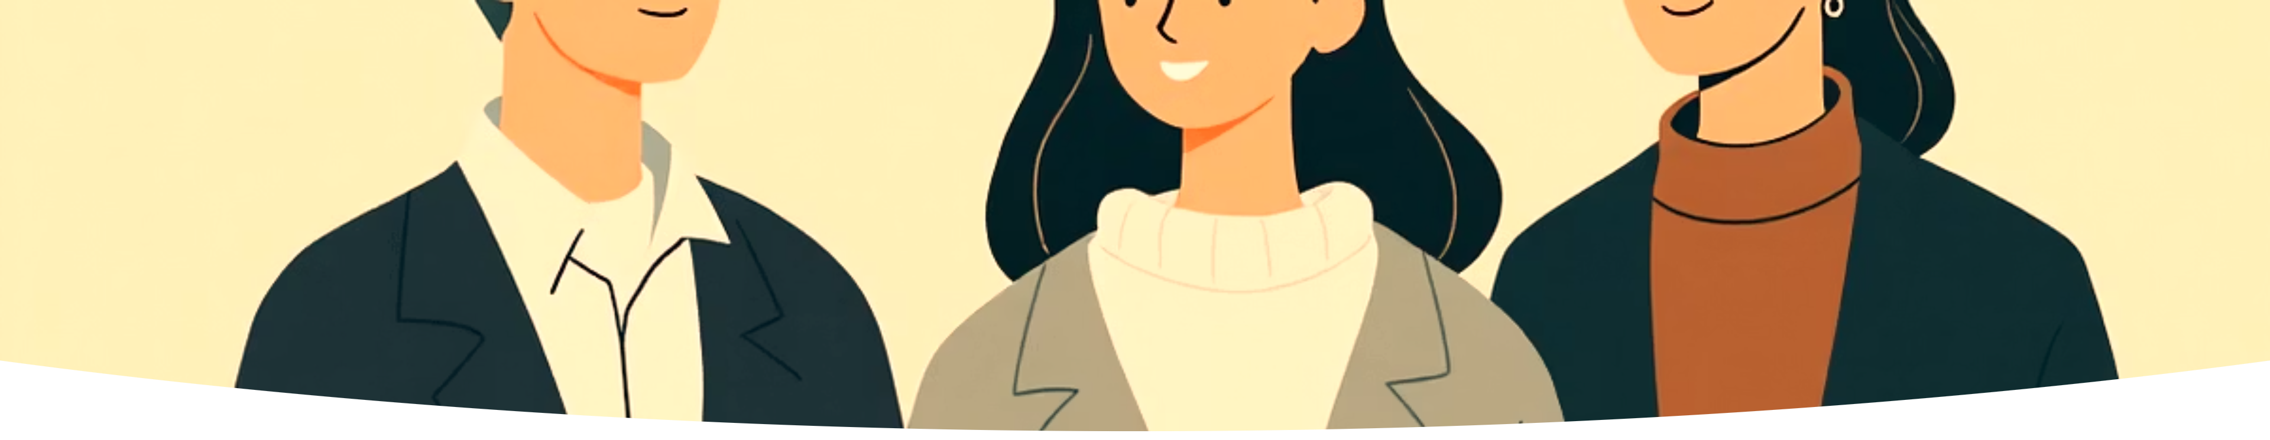

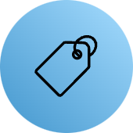




Customer Segmentation for Targeted Strategies
Understanding distinct customer groups allows for personalized engagement.
High-Value Loyal
Discount Seekers
Occasional Shoppers
High purchase amount, high frequency, many previous purchases.
Utilize promotions, lower average order value.
Low frequency, typically low-priced product purchases.
Customer Behavior

Slide 10
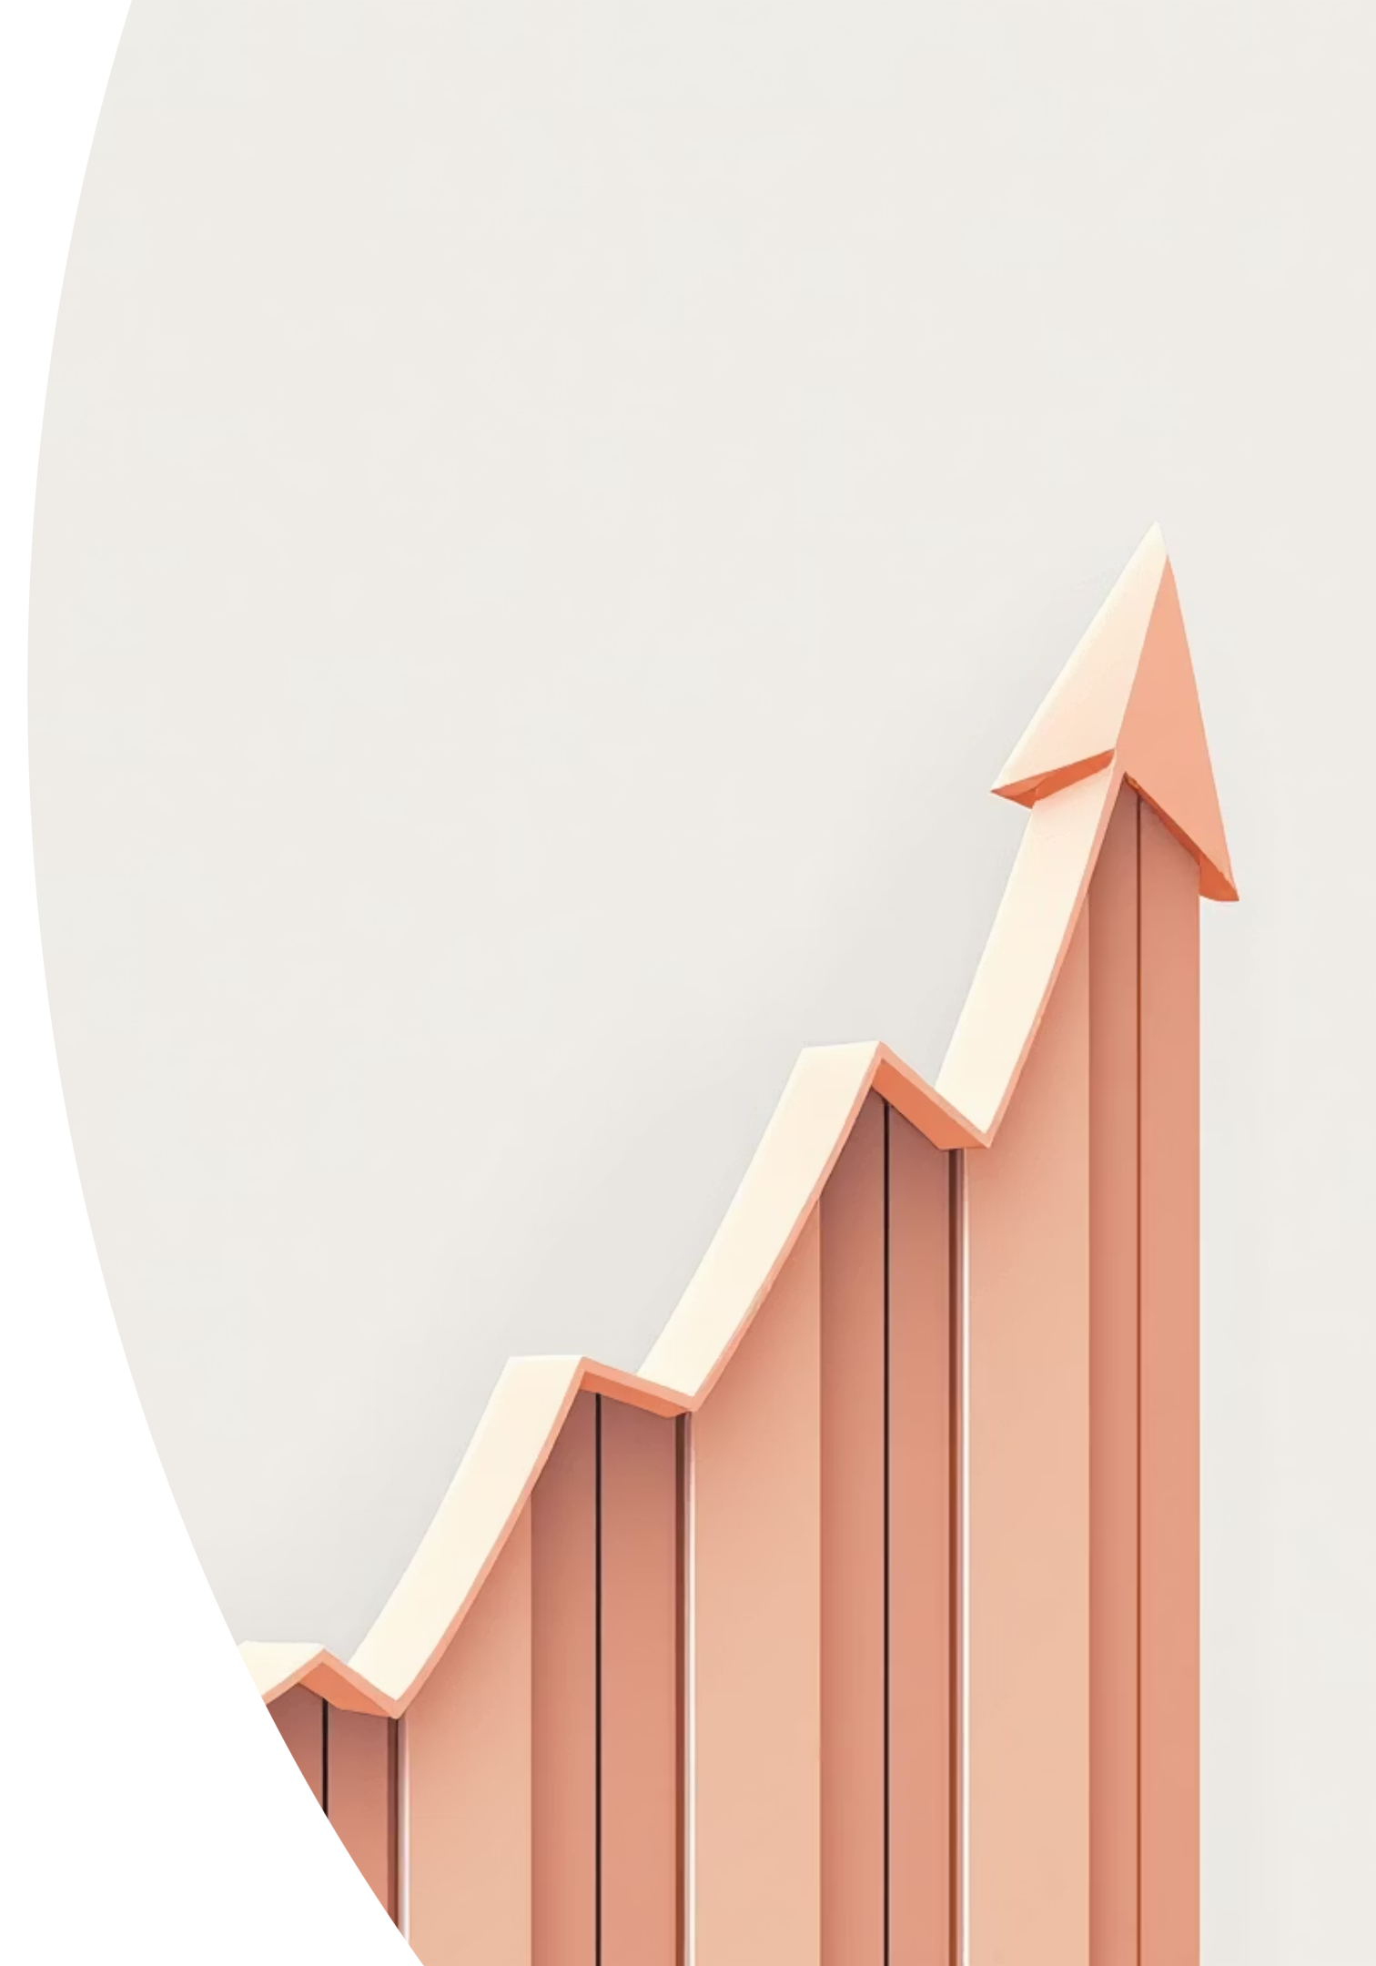
Strategic Recommendations for Growth
Leverage insights to optimize marketing, product, and customer experience.
Retain Loyal Buyers
1
Premium programs, early access, reward points.
Convert Occasional Shoppers
2
First-time discounts, bundled offers, targeted emails.
Boost Popular Categories
3
More stock in Electronics/Clothing, personalized recommendations.
Improve CX & Payments
4
Faster shipping, cashback on digital payments, monitor feedback.

Slide 11
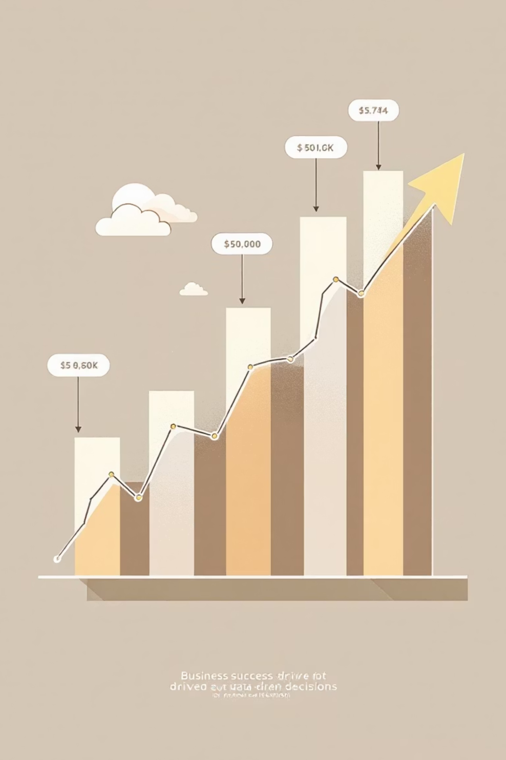
Conclusion: Driving Growth Through Data
This project successfully delivered an end-to-end customer behavior analysis, providing a roadmap for strategic growth.
"The analysis revealed crucial insights into customer demographics, preferences, spending behavior, and loyalty patterns. These findings can help businesses improve product strategy, optimize targeted marketing, and enhance customer satisfaction."

