Slide 1
ONLINE MUSIC PORTAL
RINKY KANJANI
(19BECE30162)
RAHUL PRANAMI
(19BECE30159)
VIDHYESH SHAH
(19BECE30203)

Slide 2
TABLE OF CONTENTS
-Introduction
-Features of this project
-Technologies
-Project Modules
-Discover View
-Around You
-Conclusion

Slide 3
Introduction
Online Music Application is a website that contains variety of genres, artists and their Songs.
User can listen to songs as well as view the top charts , top artists ,etc.
Songs are fetched from API backend in Shazam Core API.
Reduces storage space and load for user.
Makes the website quick , responsive.

Slide 4
FEATURES OF THIS PROJECT
Discover , View Top charts.
Top artists View.
Search and Play a song.
Around You View.
Works Without Login.
Responsive.

Slide 5
Technologies
FRONT-END
  ReactJS
  ViteJS
BACK-END
  Shazam Core API

Slide 6
PROJECT MODULES
Music Player
Discover Page
Search Module
Genre View

Slide 7
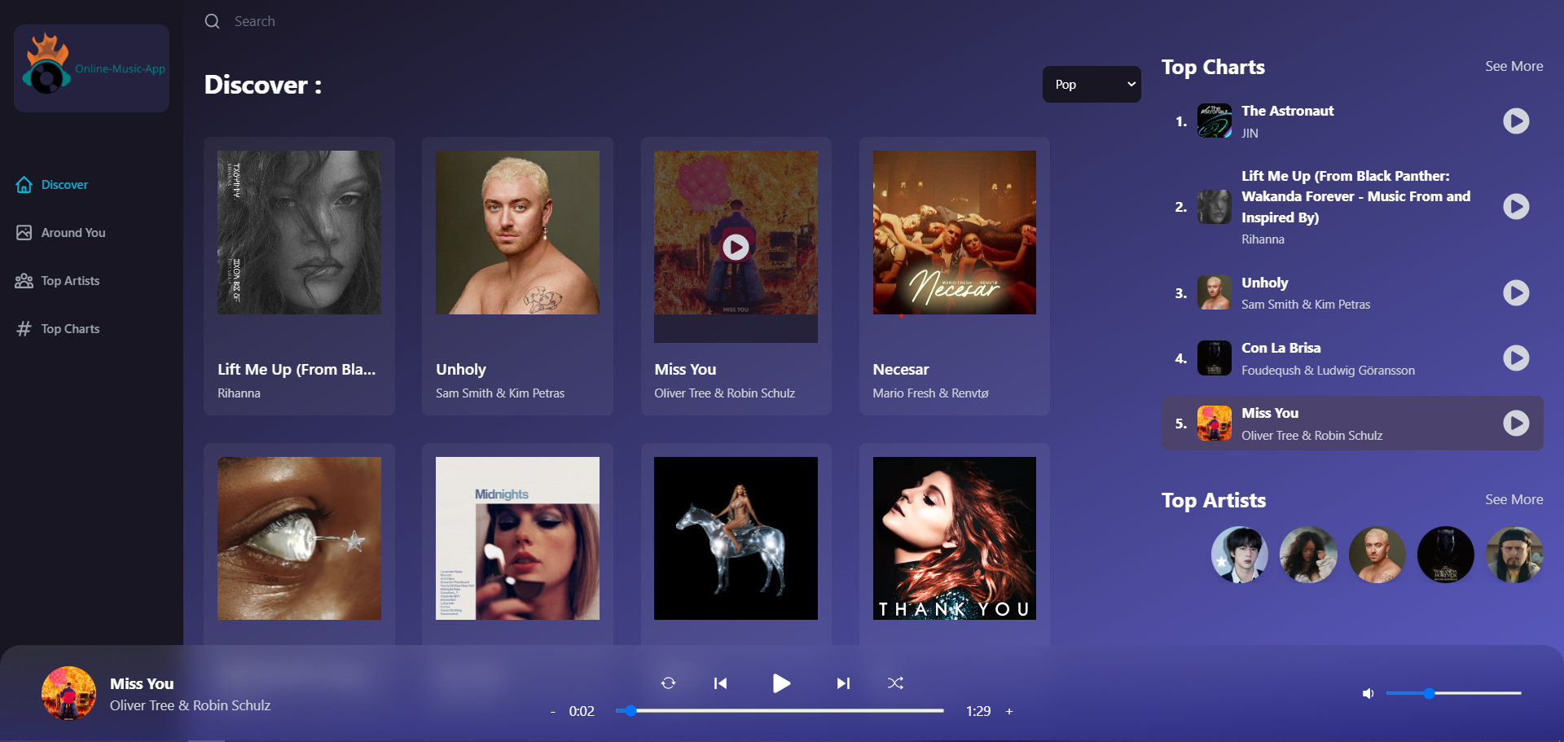
Discover View

Slide 8
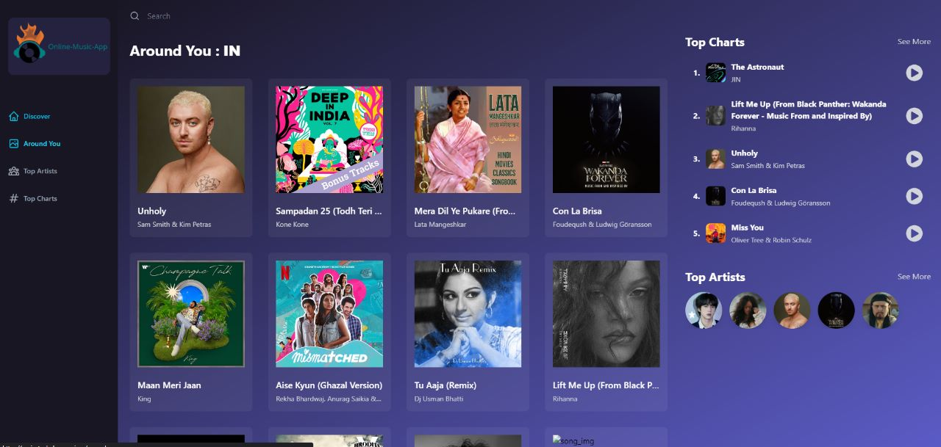
PLAYLISTS-VIEW

Slide 9
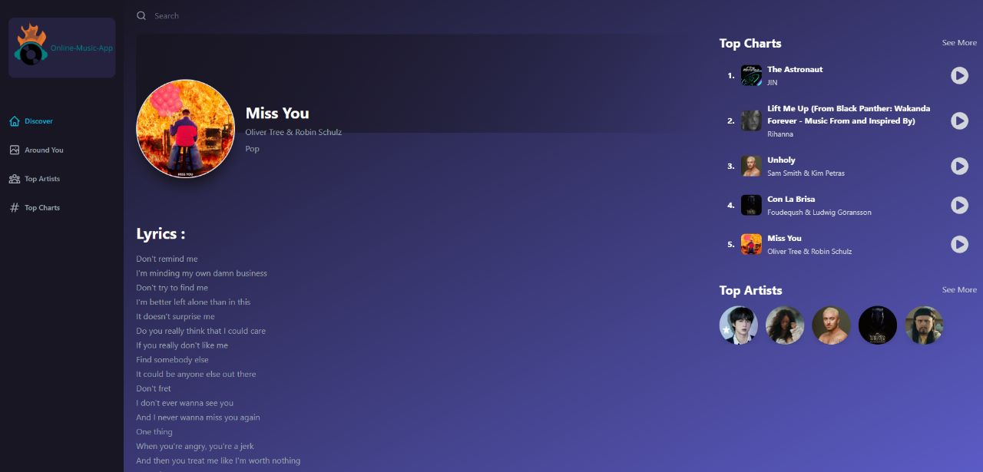
LYRICS-VIEW

Slide 10
CONCLUSION
Proper availability of new Top Charts on the website.
Ability to listen and view Top Charts songs.
Effective use of API to Fetch songs and Top Charts.
Finally a quick and responsive website has been created.

Slide 11


