Slide 1

Rahul Purbhoo
Week 5

Slide 2
College Student Enrolment
Create student profile
Create temporary Student ID
Log in
Admissions Log in
Submit application
Assess Student’s application
Student
View application status
Add in Student’s application status
Admissions team
Edit information
Review Student’s application
Log out

Slide 3
Student Information
Students Grades
StudentID: Varchar
StudentSurname: Char
StudentName: Char
+AssignValues()
StudentID: Varchar
StudentSurname: Char
StudentName: Char
Algebra: Int
Calculus: Int
Programming: Int
Databases: Int
+AddStudentGrades()
+DivideByFour()
+AssignGrade()
Class Diagram
Students Account to Create
StudentID: Varchar
StudentName: Char
StudentEmail: VarChar
StudentClass: VarChar
SendNotiToStudent()
CreateAccount()
RecordToStudentInfo()
SendNotiToStudent()
Grades
StudentID: Varchar
Average: Int
Grades: Char
+AssignAverage()
+AssignGrades()

Slide 4
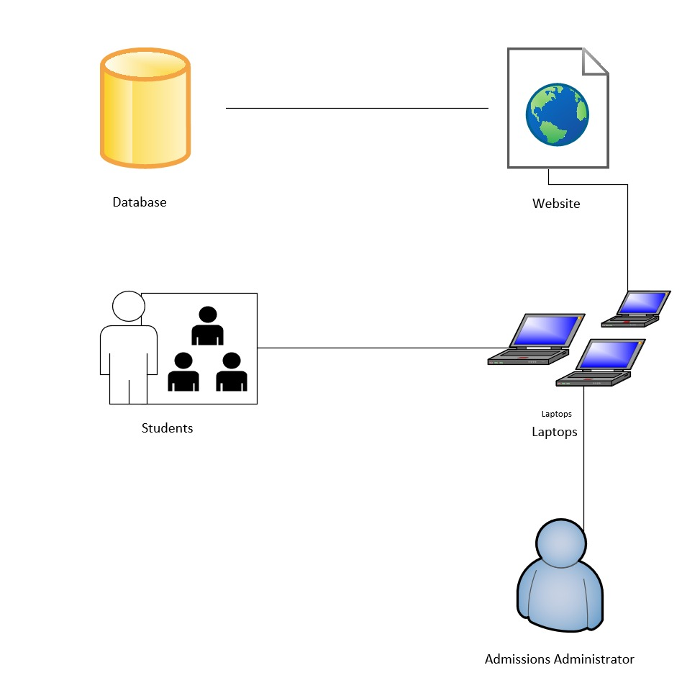
System design

Slide 5
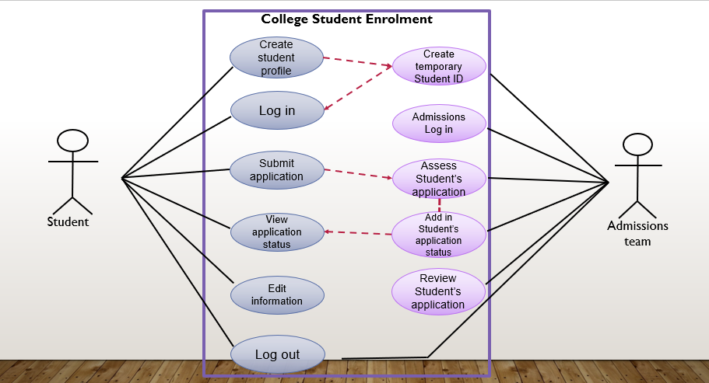
Use cases explaining the process of what a student does when applying to a college.
Use cases explaining what admission teams do.
Primary Actor: Person who is using the system to apply and check whether or not their application was successful or not.
Secondary Actor: Retrieves application, assesses the application and responds.
Shows the relationship between the student and admissions team.

Slide 6
Stores the data of applications and students.
Access applications via the website of the college.
Medium of accessing their applications and connecting to the website.
Submits an application and checks whether or not they have been accepted.
Retrieves the applications, assesses it and responds to the applications.

Slide 7
College Enrolment System
Feature: Allows applicant to check whether they have been accepted of not.
Benefit hypothesis: Admissions administer can retrieve and respond to student.
Acceptance Criteria: Given that the student logs into the their account, they will be directed to their application to check whether they have been accepted or not.
User Story
As a student that has applied to the college, I would like to check the application status, to find out whether I have been accepted or not.
Enabler story
As the admissions team, we would like to retrieve, access the student’s applications and respond to it.

