Slide 1

“Smart Water Tank Monitoring System”
Real-time Monitoring and Quality Sensing for Improved Water Tank Efficiency and Health Safety.
By: Rahul R

Slide 2




Problem Statement
No visibility
Unsafe water goes unnoticed
Overhead and underground tanks are checked physically — problems are found only after they happen.
pH imbalance and rising turbidity are invisible to the eye until water is already unsafe to use.
Overflow & wastage
No remote power option
Tanks overflow silently, wasting pumped water and electricity, especially in unattended installations.
Traditional monitoring setups need mains power and Wi-Fi, ruling out farms, rooftops and remote sites.
AquaTracker

Slide 3




Where AquaTracker Fits
Homes & apartments
Agriculture
Industrial sites
Remote / rural areas
Rooftop / sump tank overflow prevention and drinking water quality checks.
Irrigation tanks and farm ponds monitored for level and turbidity, off-grid on solar.
Process water and effluent tanks tracked continuously without manual rounds.
No mains power or broadband needed — solar + GSM covers areas Wi-Fi can't.
AquaTracker

Slide 4




Why AquaTracker Is Convenient
Fully solar powered
12V battery charged by a solar panel — works continuously with no mains electricity dependency.
Alerts come to you
No app or dashboard to check — SMS alerts land directly on any basic mobile phone via GSM.
Call-and-check
Anyone can call the device's SIM number and instantly get an SMS back with live readings.
Low-cost, simple hardware
Built entirely on an Arduino UNO with off-the-shelf sensors — easy to replicate and maintain.
AquaTracker

Slide 5

Aligned with the UN Sustainable Development Goals
Safe drinking water monitoring
Continuous pH and turbidity tracking helps catch unsafe or contaminated water early, supporting SDG target 6.1 on safe and affordable drinking water.
Reducing water wastage
Overflow alerts prevent silent tank overflow, cutting down on wasted treated water in line with SDG target 6.4 on water-use efficiency.
GOAL 6
Sustainable, off-grid operation
Clean Water
and Sanitation
Solar power keeps monitoring running without adding to grid electricity demand, keeping the solution itself low-impact.
Extending access to underserved areas
United Nations
Sustainable Development Goal
Low-cost, GSM-based alerts bring quality monitoring to rural and remote communities that lack smart water infrastructure.
AquaTracker

Slide 6
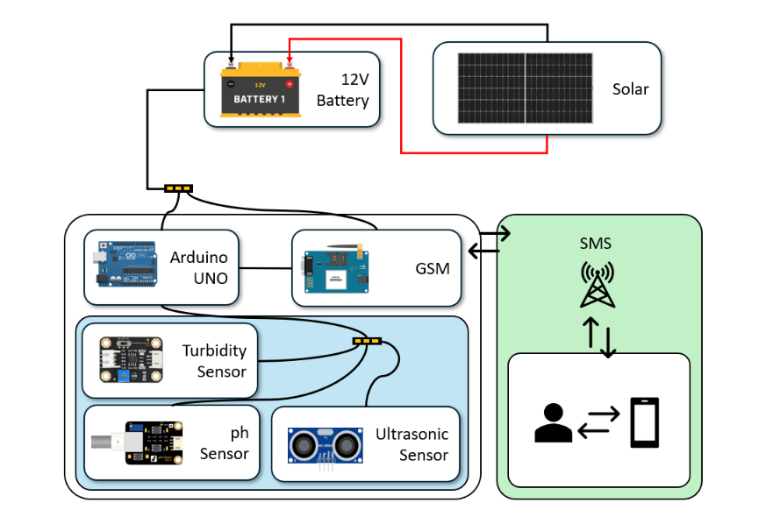
System Architecture
Solar-charged battery → Arduino UNO → sensors → GSM → SMS to user
AquaTracker

Slide 7
Hardware Components
Component | Role in the system
Solar panel + 12V battery | Off-grid power source; keeps the unit running continuously without mains electricity
Arduino UNO | Central controller — reads all sensors, runs the logic, drives the display and GSM module
pH sensor (analog) | Measures acidity/alkalinity of the water sample
Turbidity sensor (analog) | Measures water clarity / suspended particles
HC-SR04 ultrasonic sensor | Measures distance to the water surface to calculate tank level
SIM800/900 GSM module | Sends SMS alerts and replies to incoming calls with live readings
SSD1306 OLED display | Shows live pH, level and quality readings on-site
AquaTracker

Slide 8
How It Works
1
2
3
Power up
Read sensors
Compute readings
Solar panel keeps the 12V battery topped up; Arduino & GSM run off it directly.
pH, turbidity and ultrasonic level are sampled and noise-filtered every cycle.
Calibrated formulas turn raw voltages into real pH, NTU, °C and level %.
4
5
6
Classify quality
Debounce check
Alert via SMS
Readings are classified as Poor / Fair / Good / Excellent, shown on the OLED.
An issue must repeat for 3 consecutive cycles — filters out one-off noise spikes.
GSM module texts the user; a cooldown timer stops repeat spam alerts.
AquaTracker

Slide 9
Sensor Accuracy: Calibration Formulas Used
Reading | Formula / Method | Why it matters
pH | 2-point buffer calibration: pH = slope × (V − V₇) + 7.0 | Matches the probe to real pH 4/7 buffer solutions for lab-accurate readings
Temperature | Steinhart-Hart thermistor equation (NTC physics model) | Converts resistance to temperature with real thermal physics, not a guess
Turbidity | Voltage → NTU polynomial: NTU = aV² + bV + c | Matches the sensor's true non-linear response curve
Water level | Median-of-5 filter + temperature- compensated speed of sound | Removes echo noise and adjusts for how temperature affects sound speed
Quality bands | Contiguous Poor / Fair / Good / Excellent thresholds | Every reading maps cleanly to one clear quality category
AquaTracker

Slide 10






Reliability & Alert Features
Non-blocking operation
Debounced alerts
Sensor readings and GSM call handling run on independent timers, so an incoming call is never missed.
An issue must show up for 3 consecutive readings before triggering an SMS — filters out one-off sensor noise.
SMS cooldown timer
Battery/solar monitoring
A 15-minute cooldown between alerts prevents the system from repeatedly spamming the same warning.
A voltage-divider reading on the 12V line means low charge is itself an SMS-worthy alert.
Median filtering
Clear quality classification
Every analog and ultrasonic reading is median-filtered to reject single-sample spikes before it's used.
Readings map to well-defined Poor / Fair / Good / Excellent bands with no ambiguous overlap.
AquaTracker

Slide 11
Results & Future Scope
Advantages Achieved
Future Scope
Calibrated, real-world-accurate pH, temperature and turbidity readings
EEPROM-stored calibration so pH/turbidity constants persist across power cycles
Fewer false SMS alerts thanks to debouncing and cooldown timing
Cloud dashboard (via GSM GPRS/NB-IoT) alongside SMS for historical trends
Fully solar powered — deployable anywhere with GSM signal
Auto motor/valve control to shut off inflow once tank reaches capacity
Low-cost, replicable hardware built entirely on Arduino UNO
Multi-tank support with a single GSM hub for larger sites
AquaTracker

Slide 12
Thank You
AquaTracker

