Slide 1
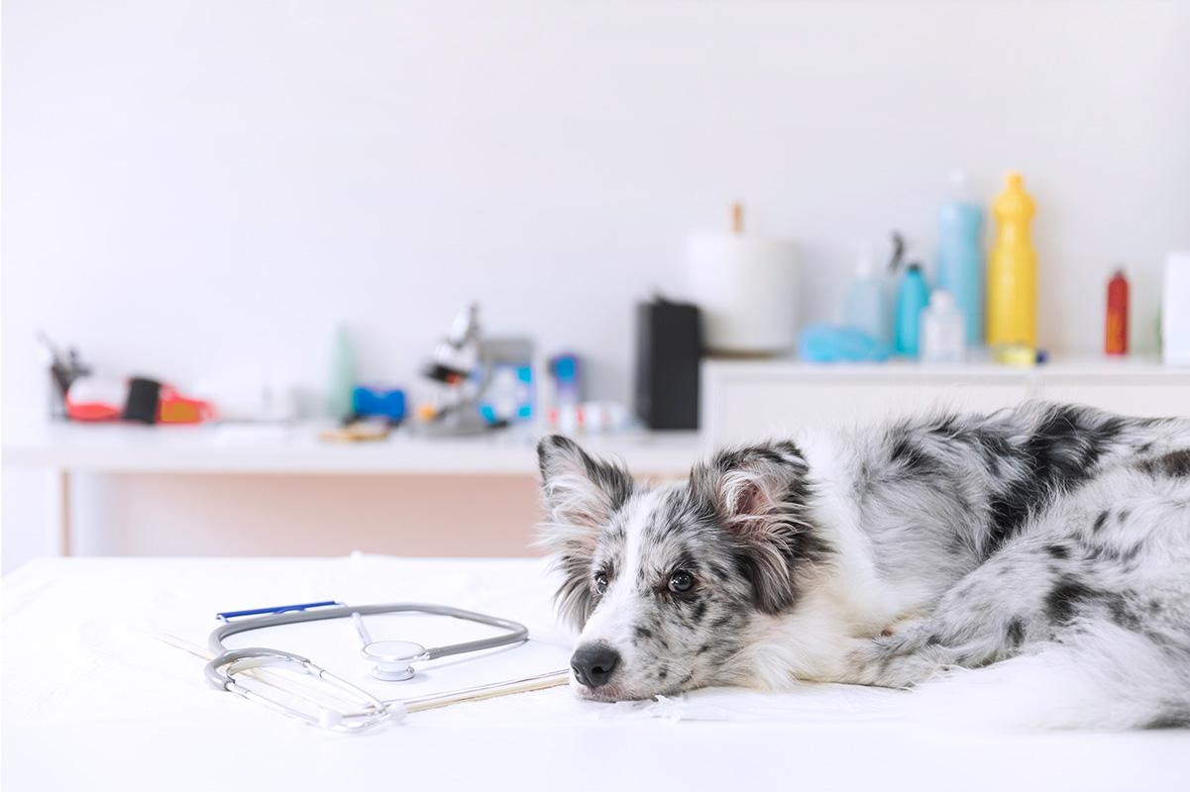
Welcome To PetxHub

Slide 2
0
Introduction

Slide 3
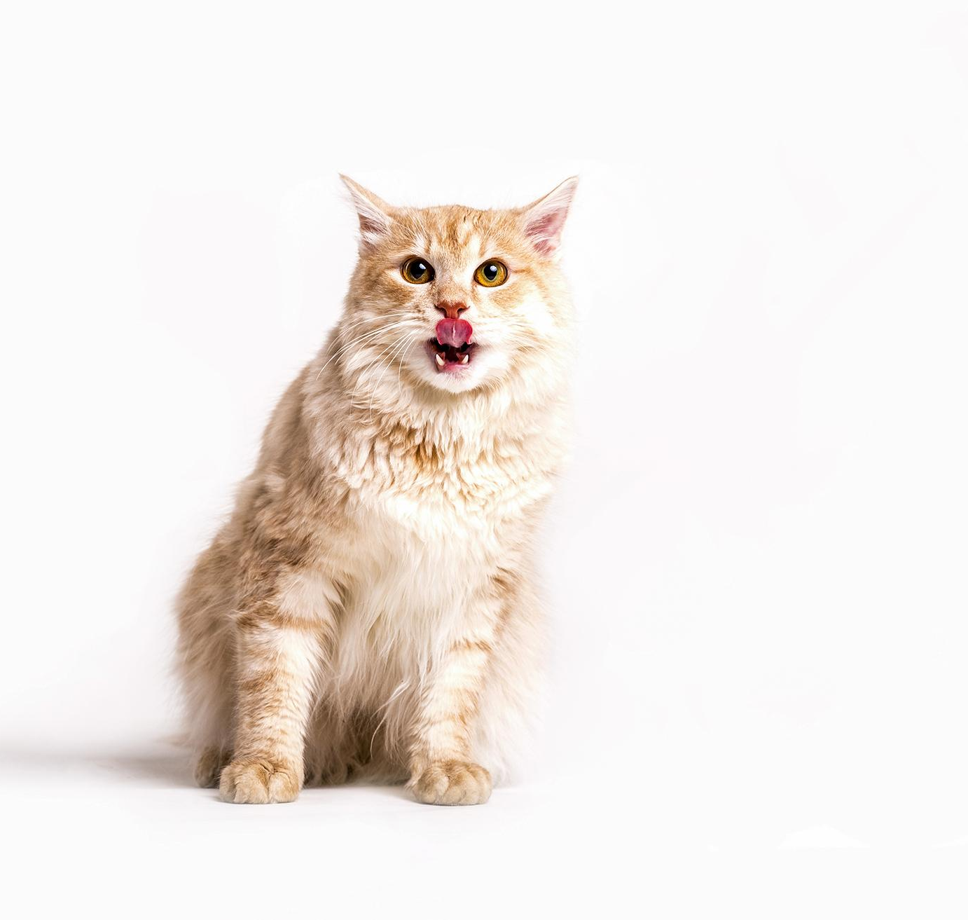
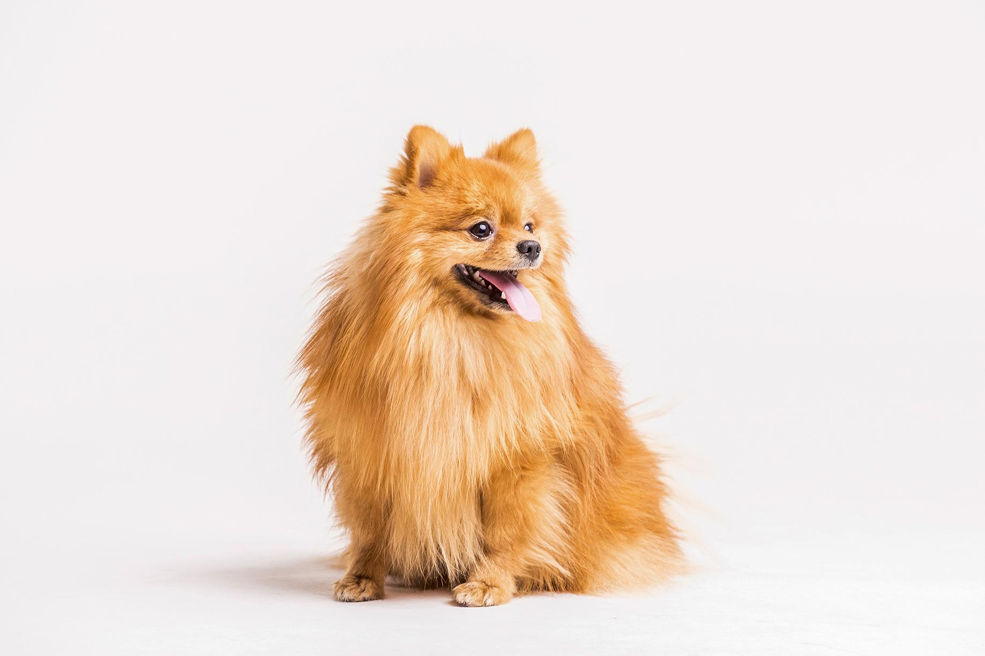
INTRODUCTION
Welcome to Petxhub. We provide a range of services including vet booking, a directory of nearby pet shops and shelters, helpline numbers, and rescue center information. Join us in promoting animal welfare through adoption and donations.Let us present our website which includes some interesting and helpful features.

Slide 4
01
Title

Slide 5
PetxHub
(Animal Health and Care services
providing web application)

Slide 6
02
Tools and Technologies

Slide 7
Tools :
Visual studio code
Pycharm
Browsers(Chrome/Explorer/Firefox)
Python Interpreter
Frontend technologies :
Html5
CSS3
JS (javascript)
Bootstrap 4 or 5
Jquery
Sass
Backend Technologies :
Python
Django (Framework)
Database :
SQLITE3 OR MYSQL

Slide 8
03
Hardware and Software Requirements

Slide 9
Client Side Requirements :
Hardware :
PC / Laptop :- Client System with a minimum of 2GB RAM.
Processor :- Processor clocked at 1GHz or higher.
Hard Disk :- Capacity of minimum 2GB Free Space.
Software :
Operating System: Windows 8 or above, macOS, or Linux..
Web Browser: Google Chrome, Mozilla Firefox, Safari, or Microsoft Edge.
Internet connectivity (Wi-Fi or cellular data) to access the web application.

Slide 10
2. Server-side Requirements :
Hardware :
RAM : Server machine with a minimum of 8GB RAM.
Processor : Processor clocked at 2GHz or higher.
Storage : Sufficient storage capacity based on the expected traffic and workload.
Software :
Database Management System: SQLITE OR MYSQL to store and manage data.
Server-side Scripting Language: Python for server-side processing.
Frameworks and Libraries: Django (Python).

Slide 11
04
Objective

Slide 12
The main objective of our animal health/care services provider web App is to provide a one-stop platform for Users to access a range of services conveniently.
Our website aims to provide various range of services like booking of veterinary appointments, enable users to search for nearby pet shops, animal shelters, helpline numbers, and rescue centers, and offer routine check-ups and other animal-related services.
Our platform also allows users to participate in animal adoption and donation programs.
Additionally, In our platform there is also a portal for animals education.

Slide 13
05
Existing System

Slide 14
The current system for managing pet care services is primarily manual and offline.
Many times peoples have to face very difficult in case of finding reliable service provider, expert vet , veterinary center, nearby pet shops, and shelters.
The process of participating in animal adoption is time-consuming and involves multiple phone calls or visits.
Many times the owners of pets do not even know about the common and basic things of their pets such as Animal Behavior, Nutritional Needs, Body Language, Health and Disease, Grooming and Hygiene, Exercise and Physical Activity etc..

Slide 15
07
Proposed System

Slide 16
Creating User-friendly interface for users to book veterinary appointments, search for nearby pet shops and shelters, and access essential information.
Providing reliable services , experts Animal Doctors , and veterinary center.
Integration of helpline numbers and rescue centers for immediate support in times of emergency.
Providing Animals Education web page which gives information about their habits, their diets, behaviors and their basic needs.
Centralized database for storing and managing information related to pet care services, ensuring easy access and retrieval.

Slide 17
Also adding the adoption and donation portal.
The proposed Animals health and care System aims to address the limitations of the existing system and provide a comprehensive and efficient solution.

