Slide 1
EFW COURSE PROJECT
Contactless Voltage Detector
Name: Rahul R Chheda
Roll No: 426
Division : D
USN : 01FE20BEC210

Slide 2
Introduction:
Electricity can cause serious injury or even death which is why safety must come first when working with electricity or electrical devices. In order to avoid injury, prior to starting work on an electrical box such as an AC main switch-board or a power supply.
The above situation can be handled if we use a voltage detector to detect voltage flowing in a wire or a component before working on it.

Slide 3

Components Required:
SL No. | Components | Quantity
1. | IC 555 | 1
2. | Capacitor 4.7µF | 1
3. | Resistors: 220 Ω,10kΩ | 1 each
4. | Buzzer | 1
5. | LED | 1
6. | Battery | 1
7. | Wires | assorted

Slide 4
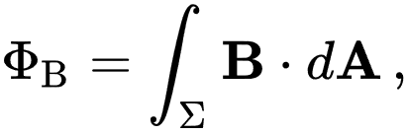
Principle:
ELECTROMAGNETIC INDUCTION: Electromagnetic or magnetic induction is the production of an electromotive force across an electrical conductor in a changing magnetic field.
Faraday's law of induction makes use of the magnetic flux ΦB through a region of space enclosed by a wire loop. The magnetic flux is defined by a surface integral:
where dA is an element of the surface Σ enclosed by the wire loop, B is the magnetic field. The dot product B·dA corresponds to an infinitesimal amount of magnetic flux. In more visual terms, the magnetic flux through the wire loop is proportional to the number of magnetic field lines that pass through the loop

Slide 5
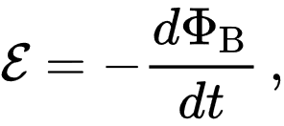
where ɛ is the EMF and ΦB is the magnetic flux.
The direction of the electromotive force is given by Lenz's law which states that an induced current will flow in the direction that will oppose the change which produced it. This is due to the negative sign in the previous equation. To increase the generated EMF, a common approach is to exploit flux linkage by creating a tightly wound coil of wire, composed of N identical turns, each with the sam

Slide 6
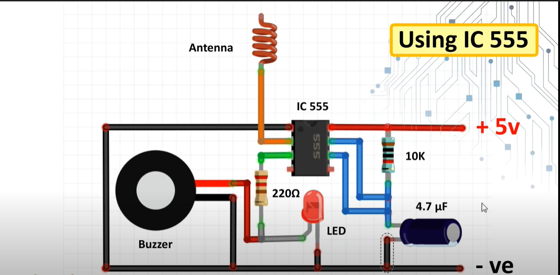
Design/Circuit Diagram:

Slide 7
Working:
When an AC/DC Power Supply Source is moved near to the Antenna of the circuit. There is a small current induced in the coil by Electromagnetic Induction. This current is amplified using the circuit to light up an LED or even a Buzzer.

Slide 8
Applications:
Detect any small amount of Voltage present in a wire
Useful while handling many live wires.

Slide 9
Thank you

