Slide 1
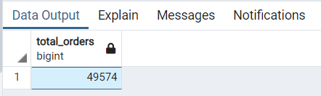
Retrieve the total number of orders placed.
select sum(quantity) as Total_Orders from order_details;

Slide 2
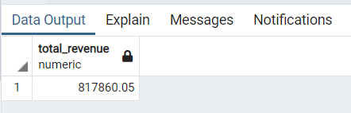
Calculate the total revenue generated from pizza sales.
select sum(o.quantity *p.price) as total_revenue
from pizza p
join order_details o
on o.pizza_id=p.pizza_id;

Slide 3
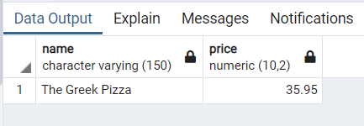
Identify the highest-priced pizza.
select pizza_types.name,pizza.price
from pizza
join pizza_types on pizza.pizza_type_id=pizza_types.pizza_type_id order by price desc limit 1;

Slide 4
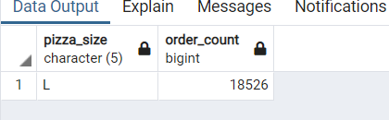
Identify the most commonly ordered pizza size.
select pizza.pizza_size,count(order_details.order_id) as order_count
from pizza join order_details on pizza.pizza_id=order_details.pizza_id
group by pizza.pizza_size
order by order_count desc limit 1;

Slide 5
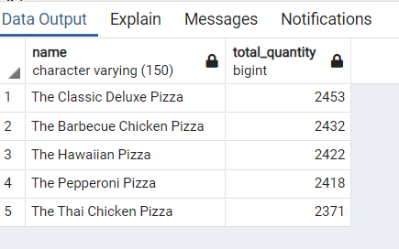
List the top 5 pizza types along with their quantities.
select pizza_types.name,sum(order_details.quantity) as total_quantity
from pizza join pizza_types on pizza_types.pizza_type_id=pizza.pizza_type_id
join order_details on order_details. pizza_id=pizza.pizza_id
group by pizza_types.name order by total_quantity desc limit 5;

Slide 6
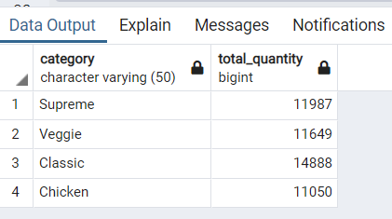
Join the necessary tables to find the total quantity of each pizza category ordered.
select pizza_types.category,sum(order_details.quantity) as total_quantity
from pizza join pizza_types on pizza_types.pizza_type_id=pizza.pizza_type_id
join order_details on order_details.pizza_id=pizza.pizza_id
group by pizza_types.category ;

Slide 7
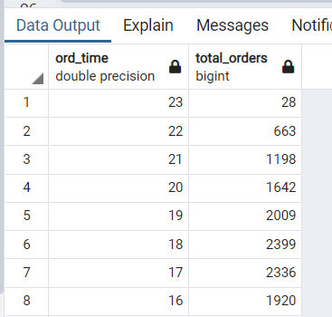
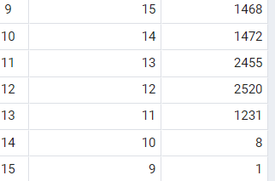
Determine the distribution of orders by hour of the day.
SELECT EXTRACT(HOUR FROM order_time) AS ord_time,
COUNT(order_id) AS total_orders
FROM orders
GROUP BY ord_time
ORDER BY ord_time desc;

Slide 8
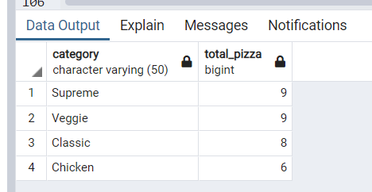
Join relevant tables to find the category-wise distribution of pizzas.
select category,count(name) as total_pizza
from pizza_types group by category;

Slide 9
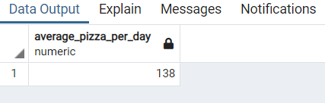
Group the orders by date and calculate the average number of pizzas ordered per day.
select round(avg(total_quantity),0) as average_pizza_per_day from
(
select orders.order_date,sum(order_details.quantity ) as total_quantity
from order_details join orders on orders.order_id= order_details.order_id
group by orders.order_date
) as order_quantity;

Slide 10
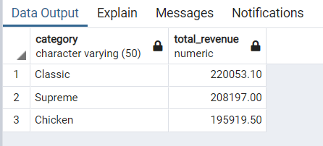
Group by: Determine the top 3 most ordered pizza types based on revenue.
select pizza_types.category,sum(order_details.quantity *pizza.price) as total_revenue
from pizza
join order_details
on order_details.pizza_id=pizza.pizza_id
join pizza_types on pizza_types.pizza_type_id=pizza.pizza_type_id
group by pizza_types.category order by total_revenue desc limit 3;

Slide 11
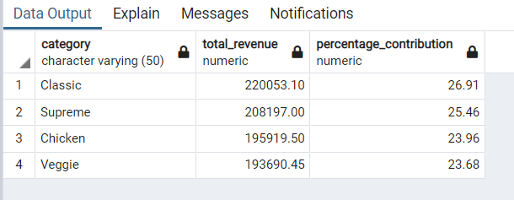
Calculate the percentage contribution of each pizza type to total revenue.
SELECT
pizza_types.category,
SUM(order_details.quantity * pizza.price) AS total_revenue,
ROUND(
(SUM(order_details.quantity * pizza.price) * 100.0 / SUM(SUM(order_details.quantity * pizza.price)) OVER ()),
2
) AS percentage_contribution
FROM pizza
JOIN order_details ON order_details.pizza_id = pizza.pizza_id
JOIN pizza_types ON pizza_types.pizza_type_id = pizza.pizza_type_id
GROUP BY pizza_types.category
ORDER BY total_revenue DESC;

Slide 12
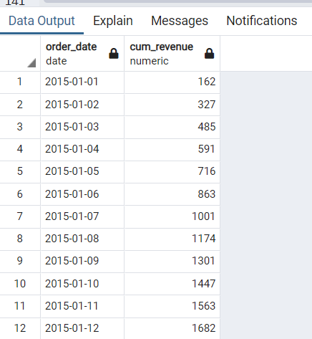
Analyze the cumulative revenue generated over time.
select order_date, sum(revenue) over(order by order_date) as cum_revenue from
(select orders.order_date,sum(order_details.quantity ) as revenue,
sum(order_details.quantity ) as total_quantity
from order_details join orders on orders.order_id= order_details.order_id
group by orders.order_date order by orders.order_date) as sales;

Slide 13
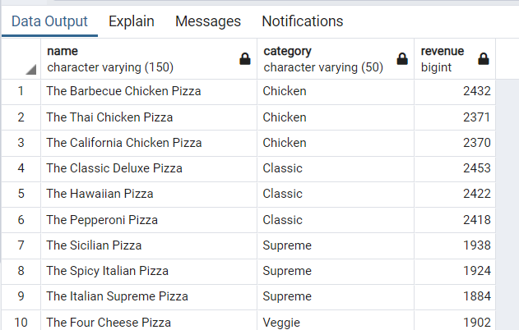
Determine the top 3 most ordered pizza types based on revenue for each pizza category
select name, category, revenue from
(select category, name, revenue,
rank() over(partition by category order by revenue desc) as rn from
(select pizza_types.category,pizza_types.name, sum(order_details.quantity) as revenue,
sum(order_details.quantity *pizza.price) as total_revenue
from pizza
join order_details
on order_details.pizza_id=pizza.pizza_id
join pizza_types on pizza_types.pizza_type_id=pizza.pizza_type_id
group by pizza_types.category,pizza_types.name order by total_revenue desc )as a) b where rn <=3;

