Slide 1

JOB HUNTING PORTAL

Slide 2
YEH DIL MANGEY MORE
TEAM MEMBERS:- MENTOR:-
ANSHIKA SAHNI PROF. SWAMY AYYAPPA
RAHUL RANJAN
SAGARIKA MONDAL
SHIVAM TIWARI

Slide 3
THINGS TO BE COVERED
PROBLEM STATEMENT
OBJECTIVES
PROJECT OVERVIEW
APPLICATION FLOW
ARCHITECTURE
TECHNOLOGY AND TOOLS USED
SCREENSHOTS
CONCLUSION

Slide 4
PROBLEM STATEMENT
IT IS NOT POSSIBLE FOR EVERY FREELANCER TO VIEW THE NEWSPAPER DAILY AND THE RESULT IS MANY OF THEM BECOME UNAWARE OF THE PROJECTS. ORGANIZATIONS HAVE TO ADVERTISE ABOUT THEIR PROJECTS IN NEWSPAPERS AND PEOPLE ALSO HAVE TO VISIT DIFFERENT PLACES FOR THE JOBS WHICH IS TIME-CONSUMING.

Slide 5
OBJECTIVES
IN THIS PORTAL DIFFERENT ORGANISATION, INSTITUTIONS, ETC. ADVERTISE THEIR PROJECTS ACCORDING TO THEIR REQUIREMENTS SO THE FREELANCERS CAN VIEW DIFFERENT KINDS OF PROJECTS UPLOADED BY THE ORGANIZATION AND CAN APPLY ACCORDING TO THEIR INTERESTS.
ORGANISATIONS CAN ALSO CHECK THE APPLICATIONS FILLED BY FREELANCERS. IF HE/SHE FULFILL THE REQUIREMENTS OF THE PROJECTS THEY CAN CONTACT THEM FOR THEIR RESPECTIVE PROJECT.

Slide 6
PROJECT OVERVIEW
RECRUITER MODULE:-
CAN REGISTER
UPDATE PROFILE
DELETE PROFILE
VIEW PROFILE
UPLOAD PROJECTS
UPDATE PROJECT DETAIL
APPROVE OR REJECT THE APPLICATION
DELETE PROJECTS

Slide 7
FREELANCER MODULE:-
CAN REGISTER
DELETE PROFILE
UPDATE PROFILE
CAN APPLY FOR PROJECTS
VIEW PROJECTS
CAN VIEW THE STATUS OF APPLICATIONS
DELETE APPLICATION
VIEW ALL APPLIED APPLICATIONS

Slide 8
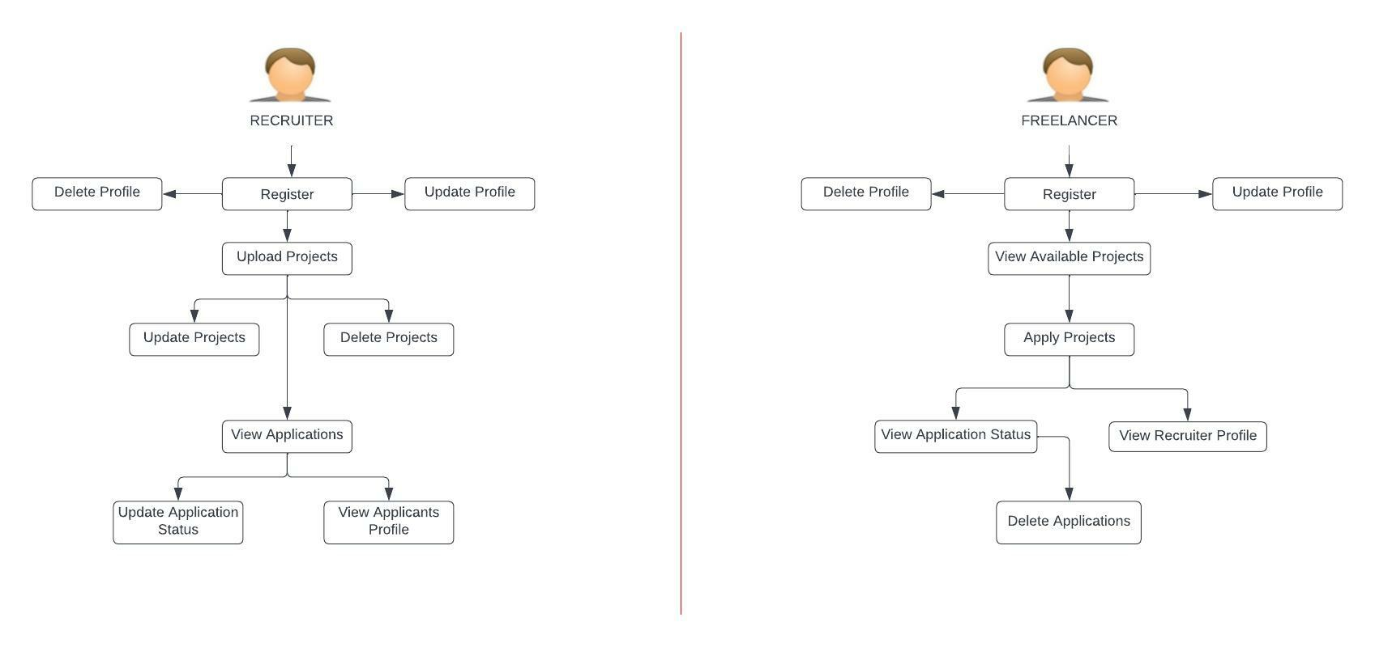
APPLICATION FLOW

Slide 9
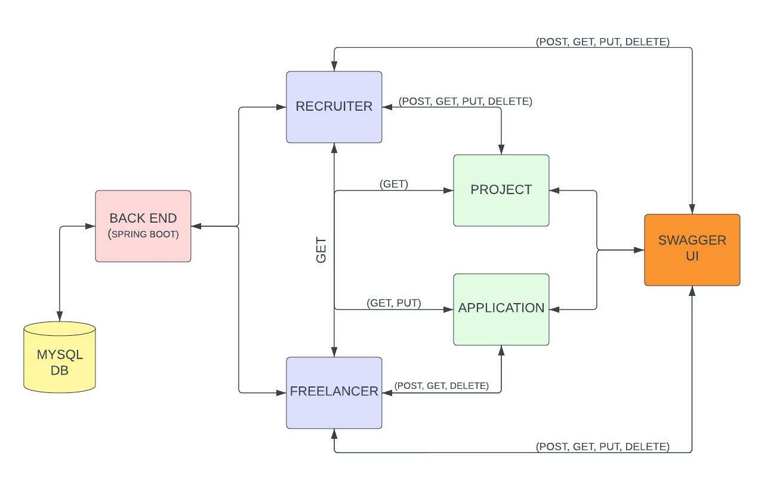
ARCHITECTURE

Slide 10






TECHNOLOGY AND TOOLS USED

Slide 11
SCREENSHOTS

Slide 12
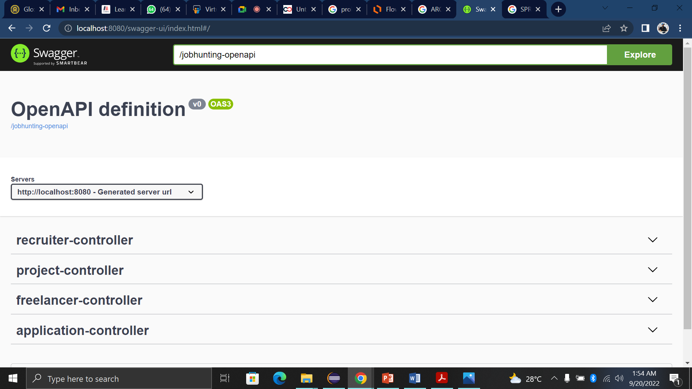

Slide 13
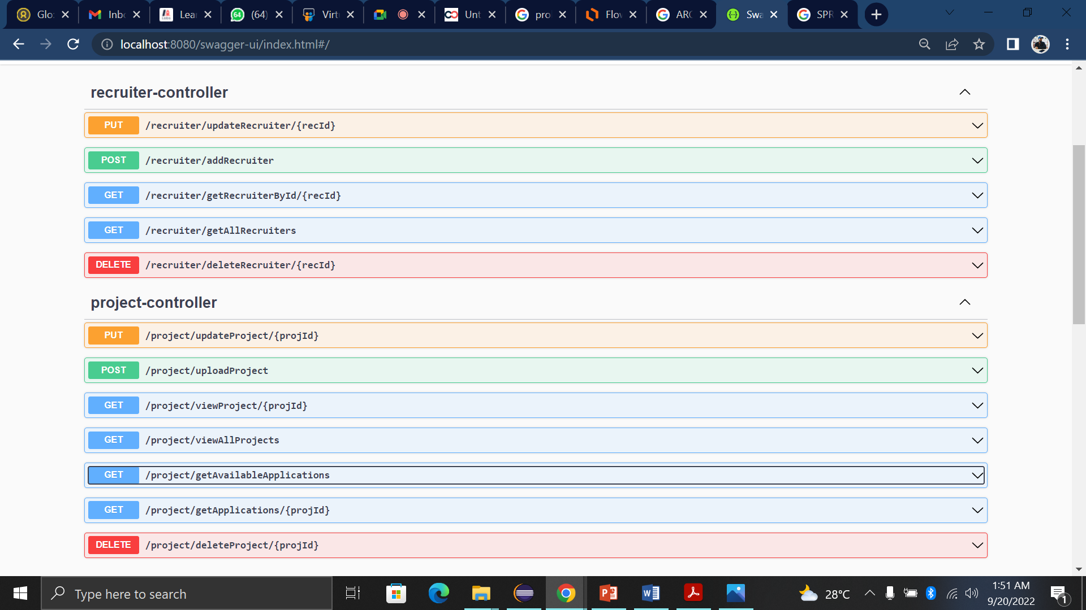

Slide 14
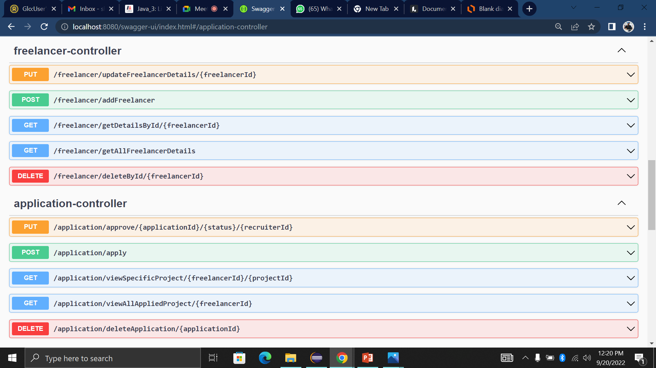

Slide 15
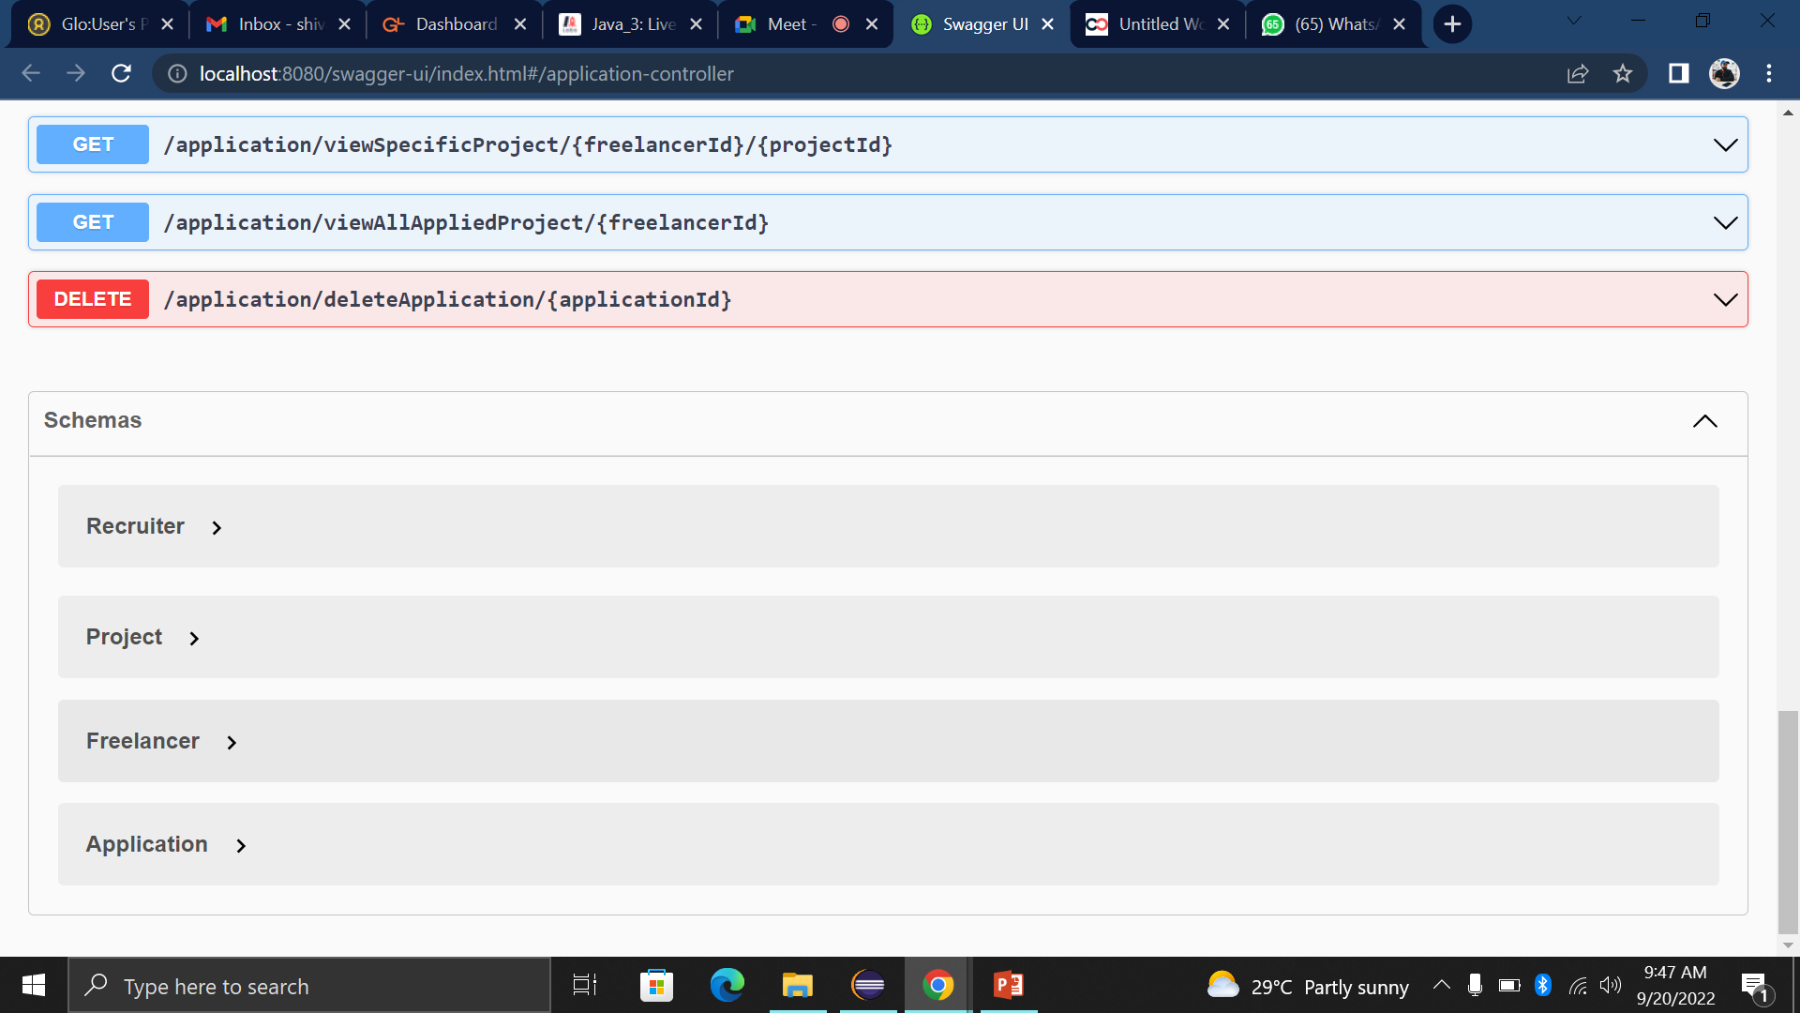

Slide 16
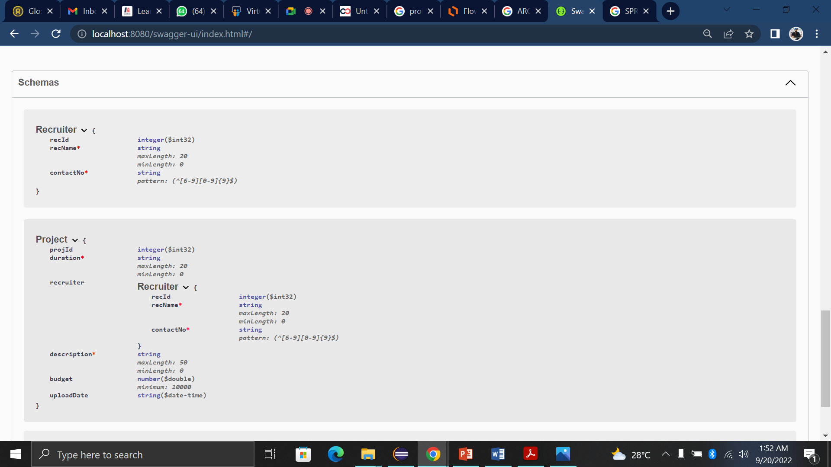

Slide 17
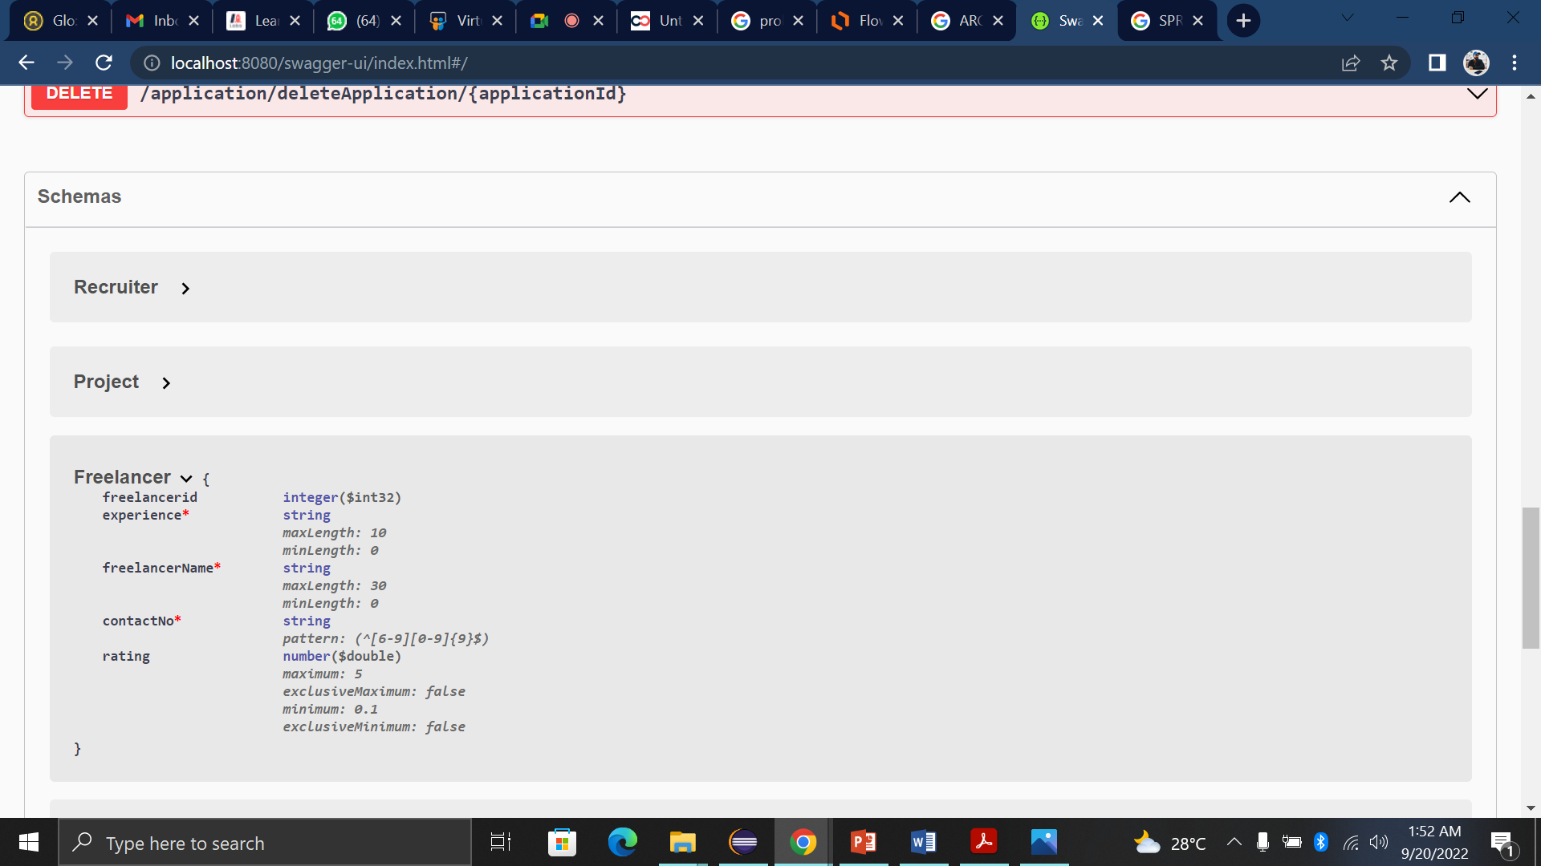

Slide 18
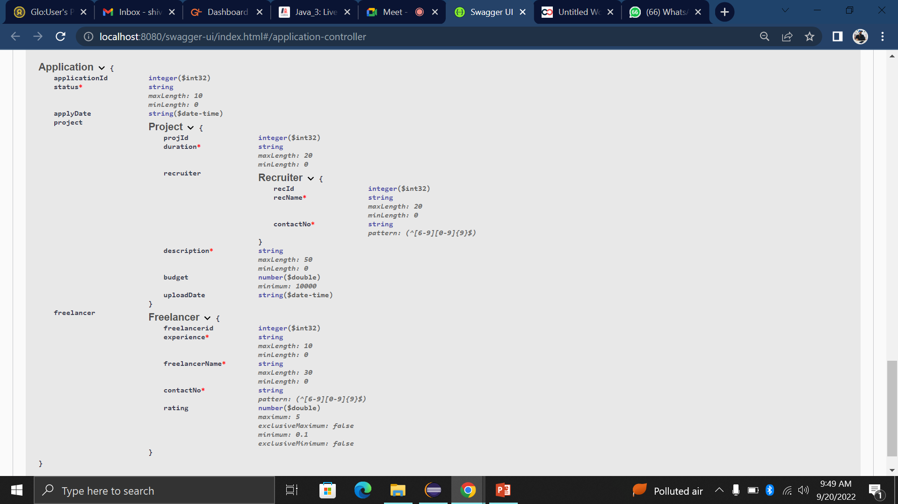

Slide 19
CONCLUSION
Job Hunting Portal stands as a revolutionizing element in the sphere of recruitment. It acts as a communication bridge between applicants and recruiters facilitating their requirements. This application helps organizations to have greater exposure to the candidate pool and also job seekers facilitate a wide search of jobs matching their interests.
This project taught us some best practices in the technology stack like Spring MVC, Spring Boot, JPA, and RESTful web services.

Slide 20
Thank you!

