Slide 1
INTRODUCTION

Slide 2
TOPIC
CAD DESIGN

Slide 3
What is cad design ?
Cad design is also known as (computer aided design)
Computer-aided design (CAD) is the technology use of computers to aid in the creation, modification, analysis, or optimization of a design

Slide 4
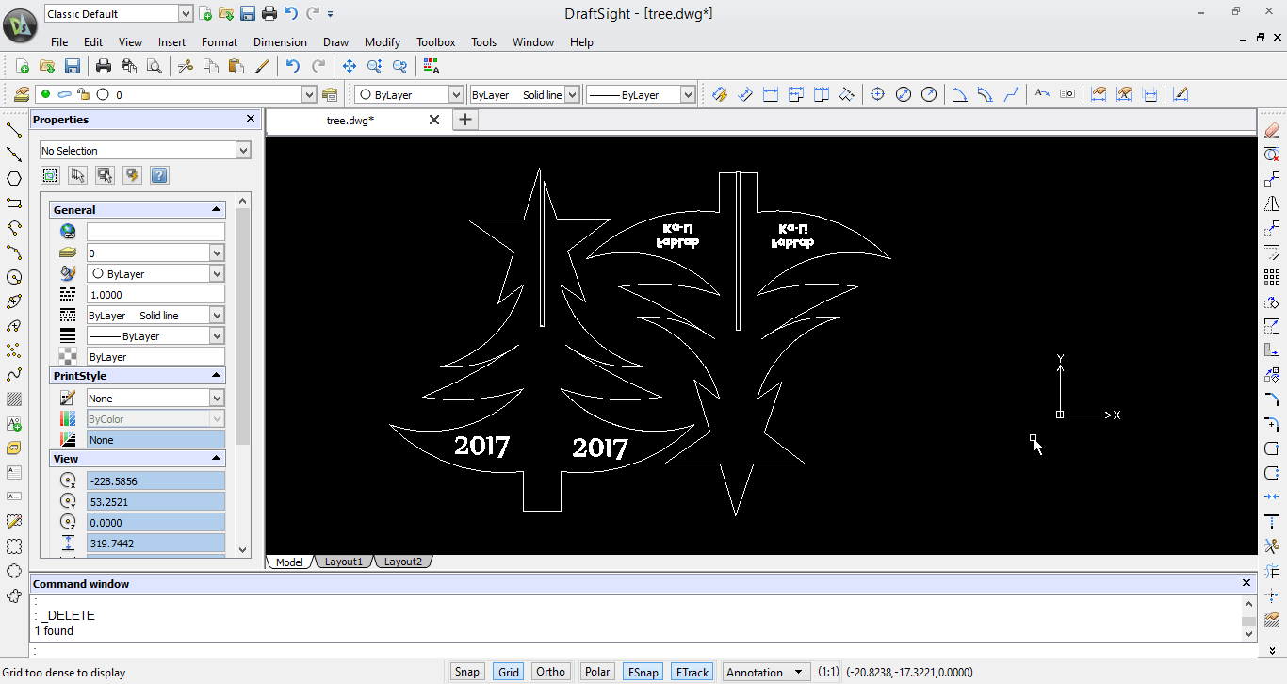
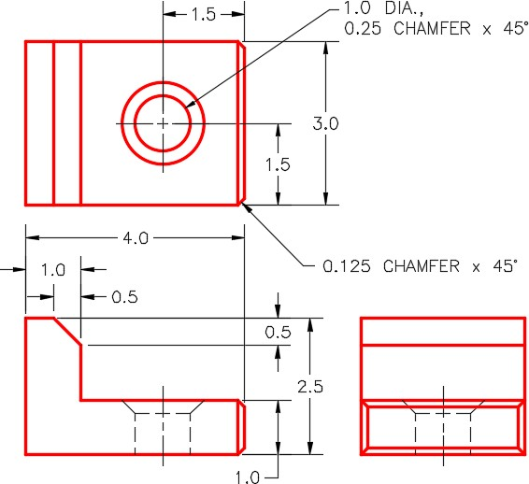
Creating drawings on a computer

Slide 5
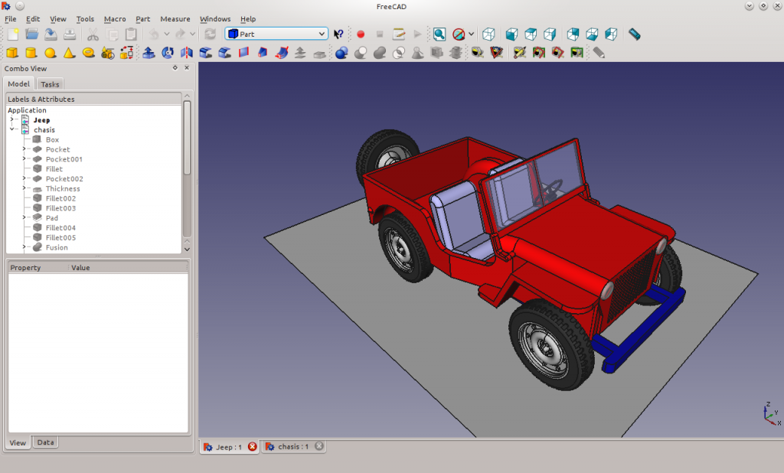
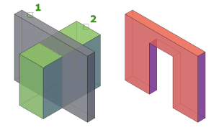
Creating 3d shapes on a computer

Slide 6
How many type of cad design
2d cad
3d cad
3d wireframe
Surface modelling

Slide 7
What is the meaning of 2d , 3d
ba

