Slide 1

UIDAI Hackathon
Team Reference ID: W0eNDWo2FC
Team Member Details
Sl No | Name | E Mail ID
1 | Rahul KR | rahul.k.ravishankar@gmail.com
2 | Shubham Gupta | shubhamgupto@gmail.com
3 | Gaurika Poplai | gaurikapoplai@gmail.com
4 | Prithwish | prithwish.nag@gmail.com
5 | Rikesh Kumar | rickz.kumar@gmail.com

Slide 2
About the Problem Statement
Theme : Address Update
Problem Statement: Address Update Challenge in Urban Areas
Whenever a person moves to a new location, he/she could land up in a situation, wherein he/she would need to provide his/her updated Aadhaar to apply for a Broadband connection. When there is no supporting documentation to prove his/her current address, as per the current policy, Aadhaar requires a supporting Proof of Address (PoA) document or an Introducer who can lend his address to update the person’s address in Aadhaar. We intend to solve this problem.

Slide 3
Approach
We intend to use the following frameworks to develop the application:
Front-end:
React.js
Axios for making API calls
HTML, CSS, Bootstrap
Back-end:
Java Spring Boot
Apache Derby

Slide 4
Approach
We will make a web application for this problem statement.
There are two stakeholders in this application:
Requester: requesting the address update.
Introducer: who can lend his address to update the aadhaar. Referred to as Landlord in the Architecture diagram
We will have a separate login component for each stakeholder using the Auth API.
The following below will be the event flow of our solution:
After logging in, on the landing page for Requester, we will have the UI component for him to request for an address update which will inturn ask him to input the Introducer's phone number/Aadhaar/VID.
After submission of the same, the Introducer will get a notification on his phone as SMS.

Slide 5
Approach
The Introducer has to login on our web app where he can give his consent to update the address by clicking on the suitable buttons in the UI.
There are two scenarios possible here:
If he doesn't give his consent, then Requester will receive a notification on the web app about the same. The application ends here.
If he does give the consent Introducer will be redirected to another page where he will request for an offline ekyc. The application continues.
After the Introducer receives response from the offline ekyc, he will then proceed to click on a button that will send the required details to the Requester who requested for address update.

Slide 6
Approach
After the Introducer receives response from the offline ekyc, he will then proceed to click on a button that will send the required details to the Person who requested for address update. The Introducer can log out after this.
The Person's dashboard will display the status of his request at all times. If the Introducer has given his consent then the status will be "consent provided". Once the Ekyc response has been sent the status will be "Address verification Processed". Once everything is done, the status will be "Completed".
After this stage, where address update state is "Address verification processed", the Person will have the option to edit the address. The web app will have a form to do so.
After the form completion there will be a button on the UI (called verify address button) for validating the edited address and the address provided by the Introducer. This will inturn call the Geocode API.

Slide 7
Approach
The response of the Geocode API will either be accepted if the locations are matching otherwise it will generate a pop-up which notifies the Requester that the edited address does not match. The Requester will again have the option to edit the address in the form in that case.
The form can only be submitted once the two addresses match using the Geocode API call generated by clicking on the verify address button.
Once the form is submitted, this data goes back to the UIDAI servers.
After successful address update, the Requester can logout.

Slide 8
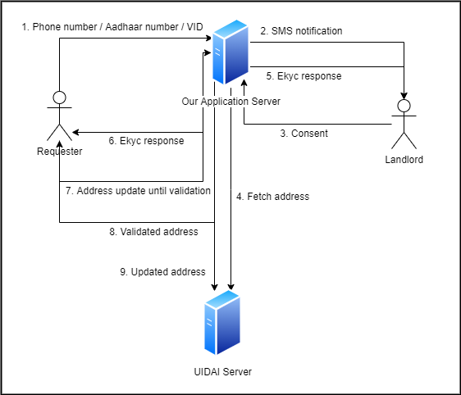
Architectural Diagram

Slide 9
API Usage
Auth API - This API will be used to authenticate the Requester/Introducer while logging in.
OTP API - This API will be used to generate OTP for Requester/Introducer whose mobile number is registered with his/her Aadhaar number. The generated OTP will then be used for authentication.
Offline e-KYC API - This API will be used to retrieve the address of the Introducer from the CIDR. This will then be previewed by the Introducer before giving his/her consent.
GeoCode API - This API will verify address provided by the Introducer and modified address by the Requester.

Slide 10
Security Considerations
Use default data binding to avoid XSS attacks.
Use URL validations to avoid executing Javascript embedded in links.
Utilize dompurify module to sanitize rendered HTML content.
Use ESLint React Security Config to detect security issues in the codebase.
Use JWT / OAuth for Authentication purposes.
Rate-limit APIs to avoid DDoS attacks.
Implement 2-factor authentication, if possible.
Utilize the Spring-Security module.

