Slide 1
Data Management, Protection and Governance(By Veritas)
VERITAS Confidential: Internal Use Only
Notes:
This PPT template was created to assist in the creation of engineering feature TOIs. The audience is primarily VERITAS Technical Support, however other consumers include pre-sales System Engineers, consultants, and VERITAS Education and Enablement Services (VEES).

Slide 2
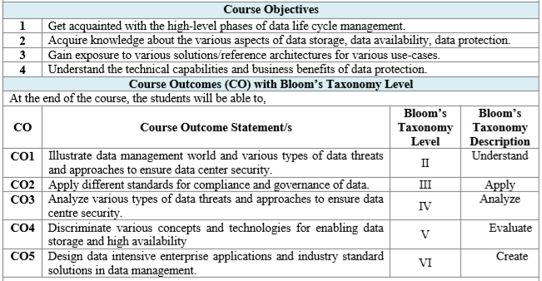

Slide 3
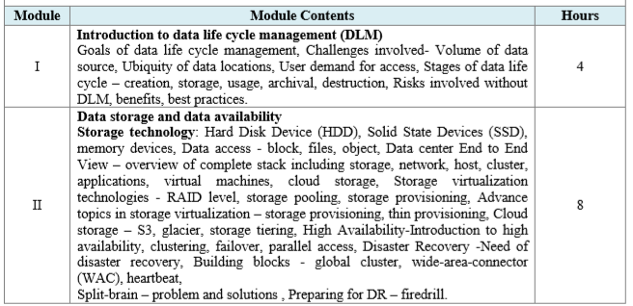

Slide 4
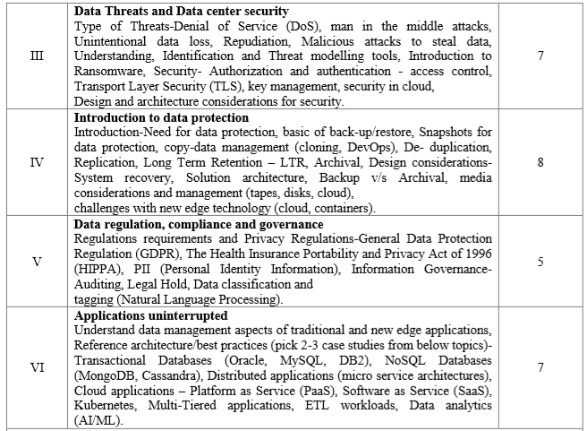

Slide 5
Data Lifecycle management

Slide 6
Content
What is Data and where it is stored ?
Data sources
Understanding Data life cycle Management
Need of DLM
Stages
Best practices
Q & A

Slide 7


What is Data?
18.48660, 73.81591

Slide 8
Data
Quantities
Information
Graphs
Measurements
Observations
Facts
Numbers

Slide 9
Data sources for organization
HR Data: Employee personal records, Salary
Business data: Generated from various devices, surveys, audit reports, customer data
Product data: Marketing reports, product reports, research data, feedback data
Communication data: email, chat messages, phone records
Finance: bank loans, Shares, Investments, Assets, invoices, taxation data
IT: IT infrastructure data., network streaming and server monitoring tools
External sources: Media, Web, IoT, Social media, activity generated data, Legacy documents
Notes:
IT experts and researchers expect amount of data to be doubled every 2 years. Data comprising both structured[Data that does not require processing] (Names, geographic location, credit card numbers, stock information) and unstructured [Data that requires processing to be understood](email, social media data, communication data. etc)
With the evolution of IoT and AI the amount of data that is generated every day is accelerated by many folds and because of this it has become most essential for everyone to store, manage, maintain, process/operate and destroy the data that is being generated.
Many applications generate different sort of data

Slide 10
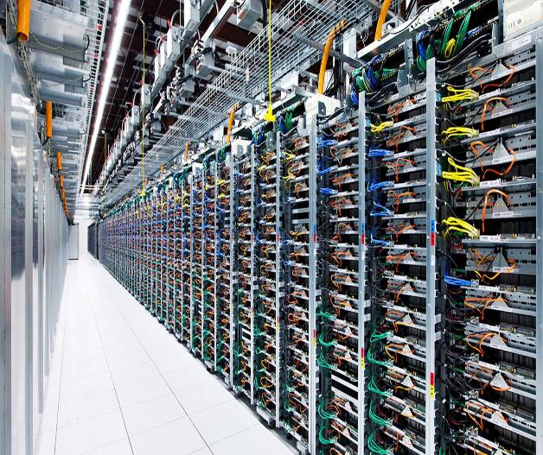
Where is this data stored ?
Data centers have components like,
routers, switches, firewalls, storage systems, servers.
On premise and In cloud data centres
Data centres should provide,
Data security
Ensure data integrity
High availability of the data
Resiliency
Notes:
The Data is stored in data centers where we have Racks with processors, disks which have redundant network and power connectivity to make sure the data centers and ultimately the data is available all the time
The data center provide
Network security appliances. These include firewall and intrusion protection to safeguard the data centre.
Application delivery assurance. To maintain application performance, these mechanisms provide application resiliency and availability via automatic failover and load balancing.
They provide
Fault tolerance, resiliency, high availability

Slide 11
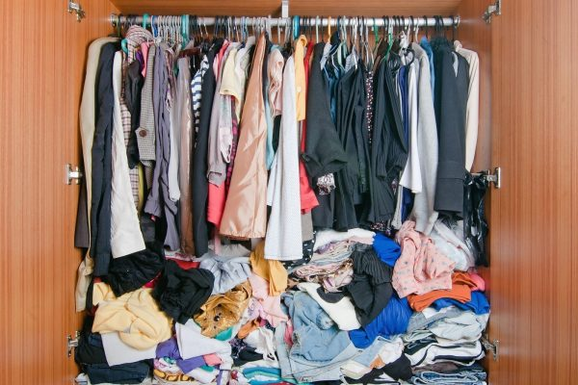
World without DLM
Organizations without effective DLM
Insecure data
Compliance issues
Legal issues
Unwanted and unpredictable cost on data storage
Loss of business and productivity
Unavailability of data on timey manner
Notes:
Insecure data – Due to uncontrolled access
Compliance issues – Not adhering to rules and regulation around data compliance.
Legal issues – delayed ediscovery requests would attract penalty and might lead to legal actions
Unwanted and unpredictable cost on data storage – Since the data is not classified, tagged. Organization might end up storing older data as high cost storage, obsolete data is not deleted
Loss of business and productivity – Due to high availability of unstructured and unclassified data, organizations wind difficulty in running analytical tools and train the Machine learning model
Unavailability of data on timey manner

Slide 12
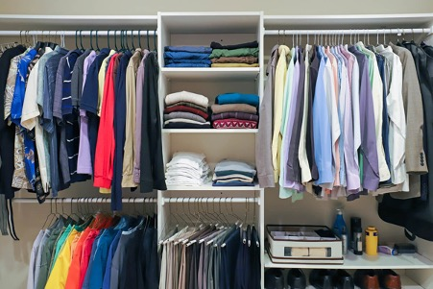
After having effective DLM policy in place
Organizations with effective DLM
Limited redundancy with more accurate identification of duplicate records
Reduced data bottlenecks and ways to identify them
Control unwanted changes to data
Reliable and consistent data
Tracing data lineage
Managing historic data
Notes:
Newly bought – which are supposed to be wore in some events
Daily used – the ones which are used daily, frequently accessed
Rarely used - Old but we love to use them once in the year.
Trash – The ones which are not fitting the size or are out of fashion.
Every [unless it’s not a partyware ;)] newly bought cloth is going to be moved to daily used, used sometimes, rarely used before getting trashed.
To extend the analogy, a policy would help decide when should I start using a newly bought T-shirt daily? And if the clothes are used frequently, where should I store them, so they are easily accessible.
So, to make space for frequently used clothes should I move the rarely used ones to bottom of the cupboard that will give me easy access to the ones which are accessed regularly. And to make space at the bottom, I need to trash the old clothes which I am not going to use anymore.

Slide 13
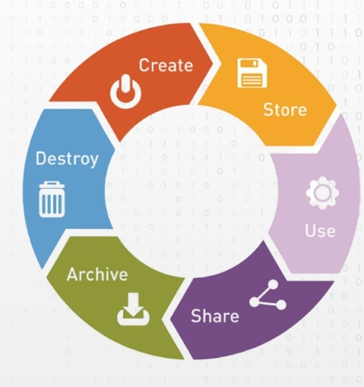
Data lifecycle Management
This policy driven approach to the data management is Data lifecycle management, which defines the way how and when the data should move from one phase to another.
Notes:
The computer industry is helping solve these problems with products in the areas of cloud, cloud and on prem storage, backup, analytics, machine learning which are also integrated with data originators and a policy driven approach can decide the future of the data.
This policy driven approach to the data management is Data lifecycle management, which defines the way how and when the data should move from one phase to another.
DLM defines and automates the process for migration of data depending on its usefulness and prioritization. It basically decides the strategy to push the data from one phase to another by simply answering few questions like,
Is this required? How frequently its accessed? has it become obsolete?

Slide 14
Benefits of DLM in enterprise world
Data Protection
Compliance and Governance
Efficiency
Controlled and predictive cost
Data Security
Notes:
In the enterprise world it becomes obligation to have data lifecycle management in place due to various reasons.
1. Data Protection:
To make sure data is safe in the event of emergency and businesses are not impacted. Also to make sure that we are maintaining and managing unique data and not the redundant one.
2. Compliance and Governance:
With increasing compliance regulations like European union’s Gross Data Protection Regulations (GDPR) or California Compliance Privacy Act (CCPA) it has become mandator to have DLM policy that will adhere to these rules and regulations to keep the organization compliant
3. Efficiency:
To make sure only accurate, useful and clean data is being circulated in the system.
4. Controlled and predictive cost
With the huge data being generated every day, it becomes more important to make sure the data in concern is worth spending. An effective and up to date DLM strategy helps keep a check on expenses towards the data management.
5. Data Security:
Organizations with effective DLM policy are less prone to security breaches.

Slide 15
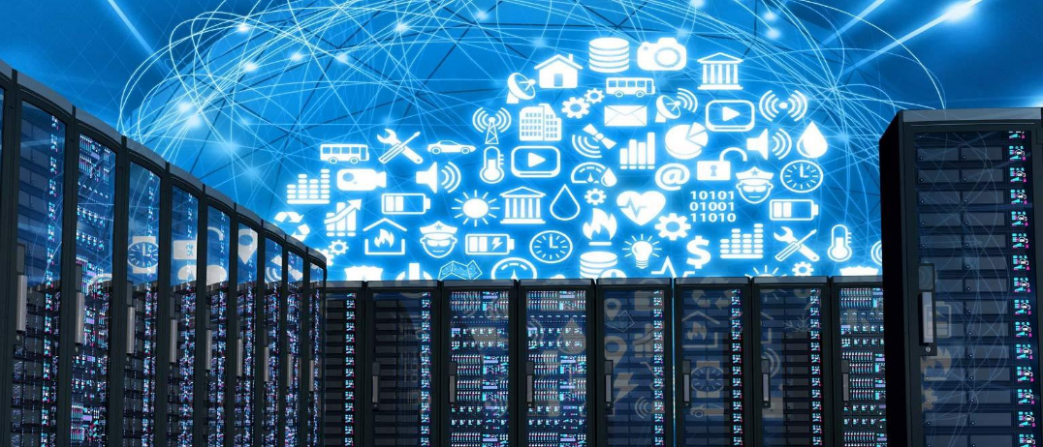
Stages of DLM

Slide 16
1. Data acquisition
Data seen for the first time
In any form: images, email, files, application specific data, etc
Scrutinise the data
Classify on arrival based on published guideline
Criticality
Value
Sensitivity
Notes:
There are no industry defined standards for DLM, it roughly has following stages
Data acquisition:
This is the first stage in the lifecycle where the data is captured when organization sees the data for the first time.
It might have been created internally within the organization, by third party, some tool and can be in any form factor (image, pdf, email, texts, documents, application specific, etc).
The data will be scrutinized before it enters and will be staged in infrastructure where its accessible to few roles.
One common code of conduct is to classify the data on arrival, which is started with establishing common and published set of guidelines depending on the criticality, value and sensitivity of the data

Slide 17
2. Storage
Before storing
Perform redundancy check
Security check
Define storage infrastructure
Frequency of access
Value
Define access
Classified data access defined by tags set in stage 1
Notes:
Storage, backup and recovery:
Once the active data enters the system its mandatory to perform redundancy and security checks and also have defined storage infrastructure and access to the same to protect any unwanted alteration to it.
The already classified data is accessible to predefined set of users depending on its classification tag set in stage 1.
The data storage need to be defined depending on frequency of its access and its value.
In this stage its also important to have backup and recovery plan in place for the data to make sure of its availability and integrity in advent of any accident.
Veritas has products like NBU, VRP that help backup and recovery
Hard Disk Device (HDD), Solid State Devices (SSD), memory devices
Data access - block, files, object
Data center End to End View – overview of complete stack including storage, network, host, cluster, applications, virtual machines, cloud storage
Storage virtualization technologies - RAID level, storage pooling, storage provisioning
Advance topics in storage virtualization – storage provisioning, thin-provisioning
Cloud storage – S3, glacier, storage tiering

Slide 18
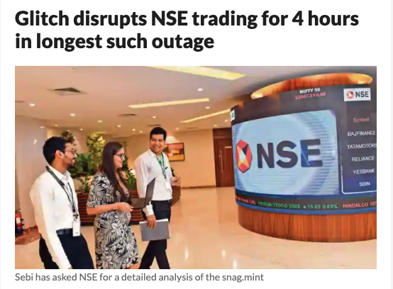
3. Backup and recovery
Need of backup and recovery
Hardware or software failure
Data corruption
Human caused events
Malicious attacks
Accidental deletion of data
Natural calamity
Plan for disaster management
Data integrity
Availability
Notes:
Backup and recovery
Eg. Reliance data center unavailable
Storing the copy of the data on separate medium is critical to protect against primary data loss or corruption. This additional medium can be as simple as an external drive or USB stick, or something more substantial, such as a disk storage system, cloud storage container, or tape drive. The alternate medium can be in the same location as the primary data or at a remote location. The possibility of weather-related events may justify having copies of data at remote locations.
For best results, backup copies are made on a consistent, regular basis to minimize the amount data lost between backups. The more time passes between backup copies, the more potential for data loss when recovering from a backup. Retaining multiple copies of data provides the insurance and flexibility to restore to a point in time not affected by data corruption or malicious attacks.

Slide 19
4. Data management / sharing
Define access and validation to data before its published
Defined Data sharing policy
Purpose is to reuse the data effectively
Use of iPaas for integrated solutions
Notes:
Data management:
The stored data when accessed need to be validated before its published to the requestor who has already verified identity or required access. DLM helps define access and validation to the data
This stage also involves data sharing policy, since the data can be requested from outside of the organization access to it need to be verified and scrutinized along with the content privacy.
Some organizations use iPaas (Integration platform as service) in this stage, which help provide unified view by integrating different software used by organization (like different for sales, marketing, service, admin, etc) for better sharing of data within organization.
For example, say you sell a scheduling software that helps hairstylists book, manage, and send appointment reminders to their clients. After developing your product, you realize that stylists also want their clients to be able to leave reviews and make payments through your software. To meet your customers’ needs, you could either build out and add these features to your product, or you could use iPaaS to connect your software to existing review and payment software. The latter allows you to save time and money while also expanding your service offering and providing your clients with what they want.

Slide 20
5. Data usage
Data analytics and data recompilation
Because organisations can locate data easily data can be reused
Analysis helps forecasting, based on historic data
Data can also be reused for test and Dev purpose of internal applications
Notes:
Eg. A climate forecast this year says this summer will be hotter by 2 degrees. So the Air-condition manufacturing company will check the historic data to see how sales will grow in that case and depending on that will estimate and decide sales and production strategy
An organization with effective DLM in place would be able to locate and effectively use this data.

Slide 21
6. Data retention and destruction
Retention for regulatory requirements
Defined retention policies.
Idle and unused data must be purged
Destruction policy need to be defined
Need to revisit the retention and destruction policy every 12 -18 months

Slide 22
Best practices of DLM
Deploying automated solution for DLM
Organization wide shared DLM strategy
Defining data types
Robust recovery plan
File naming process
Revisiting compliance guidelines and strategies periodically

Slide 23
Achieving compliance and e-discovery requirements through
Defining where to store data as it moves through its lifecycle, including production, backup, replication, archiving and destruction.
Ensuring that data is properly tagged, categorized and indexed so that it can be easily found when needed, even if it hasn’t been used in years.
Ensuring that once data has been found, it can be easily accessed in a timely manner whether it is on- premises, in the cloud, in an off-site tape vault or anywhere else.
Setting enforceable policies and procedures for data retention and destruction that meet regulatory requirements and provide lawyers and judges with proof that the data provided to them is complete and has not been tampered with.

Slide 24
So far we learnt,
What is DLM and its need
Stages of DLM
Effective way of deploying DLM
Benefits of DLM

Slide 25
Abhay Ghanghav

