Slide 1
Disaster Recovery
Dipak Jogle
Principal software engineer

Slide 2

Agenda
1 | Introduction
2 | Need of Disaster Recovery
3 | Disaster recovery plan (DRP)
4 | Building blocks of disaster recovery
5 | Split-brain–problem and solutions
6 | Preparing for DR–firedrill

Slide 3

Disaster Recovery
Introduction
Type of disasters
Natural disasters
Human-made and technological disasters
Disasters to plan for
Application failure
VM failure
Host failure
Rack failure
Communication failure
Data center disaster
Building or campus disaster
Citywide, regional, national, and multinational disasters
This Photo by Unknown Author is licensed under CC BY-SA

Slide 4

Need for disaster recovery
Risks to mitigate
Reputation loss
Out of budget expenses
Data loss
Negative impact on your clients and customers
Recovery Point Objective (RPO) –Backup frequency
Recovery Time Objective (RTO)-Maximum downtime amount
Things to consider
Disk backup appliance performance
Time for restoration
Failback
This Photo by Unknown Author is licensed under CC BY-SA

Slide 5
Disaster recovery plan (DRP)
Structured, documented approach with instructions to respond to unplanned incidents.
Step-by-step plan of precautions put in place to minimize a disaster’s effects.
Before generating a detailed DRP, organization should perform a risk analysis(RA) and business impact analysis(BIA). It should also establish RTO and RPO.

Slide 6
Disaster recovery plan (DRP)
Recovery Strategies
Begins at business level
It defines organizations plan for responding to incidents, while DRP describes details.
Issues considered while determining recovery plan
Budget
Resources available such as people and physical facilities
Management’s position on risk
Technology
Data
Suppliers
Third-party vendors

Slide 7
Disaster recovery plan (DRP)
Risk analysis(RA) and Business impact analysis(BIA) helps to determine areas to focus in DRP.
BIA is useful in identifying the impacts of disruptive events.
RA identifies vulnerabilities and threats that could disrupt the normal operations of processes.
Disaster Recovery Planning Steps
Establishing the activity scope
Gathering the relevant network infrastructure documents
Identifying severe threats and vulnerabilities as well as the organization’s critical assets
Reviewing the organization’s history of unplanned incidents and their handling
Identifying the current DR strategies
Identifying the emergency response team
Having the management review and approve the DRP
Testing the plan
Updating the plan
Implementing a DR plan audit

Slide 8
Disaster recovery plan (DRP)
Creating a DRP
Statement of intent
The DR policy statement
Plan goals
Authentication tools such as passwords
Geographical risks and factors
Tips for dealing with the media
Legal and financial information
Plan history

Slide 9
Disaster recovery plan (DRP)
DRP Scope and Objectives
Checklist of goals
Identifying critical IT networks and systems
Prioritizing the RTO
Outlining the steps required to restart, reconfigure, or recover systems and networks

Slide 10
Disaster recovery plan (DRP)
Types of Disaster Recovery Plans
Virtualized DRP
Create new virtual machines(VMs) instances immediately and provide high availability application recovery.
Plan must include validation ability to ensure applications can run faster in DR mode and return to normal operations within RTO and RPO.
Network DRP
Plan to recover network complications.

Slide 11
Disaster recovery plan (DRP)
Types of Disaster Recovery Plans
Cloud DRP
From file backup to complete replication.
Time, Space and Cost efficient.
IT manager must know the location of both physical and virtual servers.
Plan must address security issues related to cloud.
Data Center DRP
Operational risk assessment with key components such as building location, security, office space and power systems and protection.

Slide 12
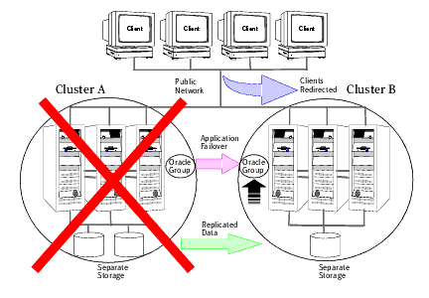
Disaster recovery plan (DRP)
Building blocks of disaster recovery
Global cluster

Slide 13
Disaster recovery plan (DRP)
Building blocks of disaster recovery
Wide-area-connector (WAC)
Failover application resource that ensures communication between clusters.
WAC process runs on one system in each cluster and connect with peers in remote clusters.
It receives and transmits information about cluster status, service groups and systems.
Also manages wide area heart beating to determine health of remote clusters.
Also transmits commands between clusters and result will be gathered on originating clusters.

Slide 14
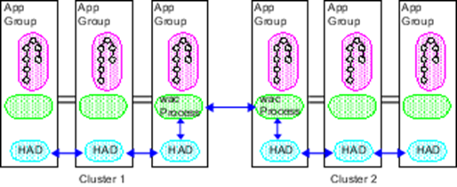
Disaster recovery plan (DRP)
Building blocks of disaster recovery
Wide-area-connector (WAC)

Slide 15
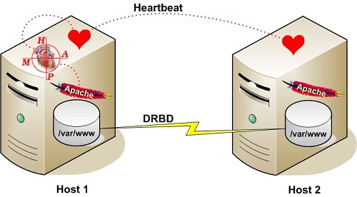
Disaster recovery plan (DRP)
Building blocks of disaster recovery
Heartbeat
Used to transmit cluster status and
Configuration info. Between nodes.
Managing s/w sends/receives updates
Private network-cluster communication
Configuration
This Photo by Unknown Author is licensed under CC BY-NC

Slide 16
Disaster recovery plan (DRP)
Building blocks of disaster recovery
Disaster Recovery-as-a-Service (DRaaS)
Cloud based DR method
Lower cost
Easy to deploy
Allows regular testing
Flexible
Shared infrastructure so saves money
Service level agreement (expectations and requirements)
Useful for small scale organizations
This Photo by Unknown Author is licensed under CC BY-SA

Slide 17
Disaster recovery plan (DRP)
Building blocks of disaster recovery
Disaster Recovery Sites
It allows to recover and restore technology infrastructure and operations when primary data center is unavailable.
Can be internal or external
Internal site is more expensive than external site.
External sites are owned and operated by third party vendors.
Hot
Warm
Cold

Slide 18
Disaster recovery plan (DRP)
Building blocks of disaster recovery
Disaster Recovery Sites
Hot
Fully functional data center complete with hardware and software, staff available and contains personal and customer data.
Warm
Data center with no customer data. Clients can install additional equipment's or introduce customer data.
Cold
Infrastructure to support data and IT systems.
No technology until client organizations active DR plans and install equipment.
Used as supplements to warm and hot sites during long-term disasters.

Slide 19
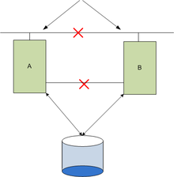
Split-brain problem and solutions
Introduction
Prevention
Private Heartbeat
Low-Priority Heartbeat
Disk Heartbeat
SCSI II Disk Reservations
IP Checking
I/O Fencing SCSI III Reservations
This Photo by Unknown Author is licensed under CC BY-SA

Slide 20
Preparing for DR – Firedrill
Testing for disaster recovery
Zero downtime test that mimics configuration, application data, and fail over behavior of critical service groups.
It tests the fault readiness of configuration by mimicking a failover from primary site to secondary site.
Verification of
Replication for an application works correctly.
DR service group can be brought online successfully
DR testing
Plan review- Detailed discussion of DRP and looks for any missing elements
Tabletop test-DR team members know their duties in emergency
Simulation test-uses backup systems and recovery sites without an actual failover
Long term test-running in disaster mode for certain period

Slide 21
Demo
Daemon and monitor program
RAID Levels
Raid 0
Raid 1
Raid 5
Raid 10
Heartbeat

Slide 22
Few thing to tryout
Daemon and monitor program
RAID levels implementation using Linux LVM
File replicator

Slide 24
Dipak Jogle
dipak.jogle@veritas.com

