Slide 1
High Availability
Dipak Jogle
Principal software engineer

Slide 2

Agenda
1 | Introduction
2 | Clustering
3 | Failover
4 | Application availability
5 | Parallel access

Slide 3
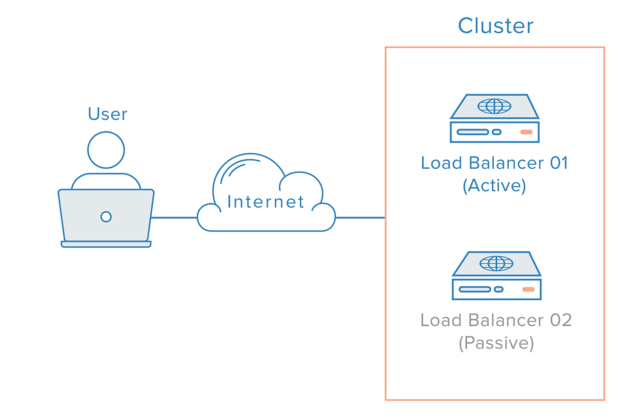
High Availability
Introduction
Availability
Accessibility
Response
Properties
Performance
Quality
Time period
This Photo by Unknown Author is licensed under CC BY-SA-NC

Slide 4
High Availability
Clustering
Definition
Multiple nodes connected for increased avaialbility.
Nodes with own OS
Software for failover and control
Components
Nodes
Cluster interconnect
Public network
Shared storage

Slide 5
High Availability
Failover
Failure detection of application
Detection using specific commands, tests or scripts to monitor overall health of an application.
Health of resources using file system and network interfaces.
Heartbeat- for communication loss between systems
SCSI3- based membership coordination and data protection can be used for detecting failure on a node.
Processes used for bringing up application services on a different node in a cluster.
Switchover –Orderly shutdown of an application and its supporting resources on one server and a controlled startup on another server.
Failover-Same as switchover but only orderly shutdown of applications may not be possible due to hardware issue.

Slide 6
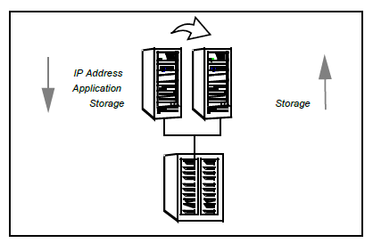
High Availability
Application availability
IP addresses and system names are virtualized to ensure application availability.
Procedures for application availability
Start procedure
Start command
Required resources in order
Stop procedure
Individual instance must be capable of
being stopped without affecting other resources.
Monitor procedure
Checking application status

Slide 7
High Availability
Application availability
Application restart

Slide 8
High Availability
Parallel access
Complex
Better resource utilization
Flexible data sharing
Application isolation

Slide 10
Dipak Jogle
dipak.jogle@veritas.com

