Slide 1


PREDICTION OF DIABETIC PATIENT READMISSION
Post Graduate Program in Data Science Engineering
Location: Bengaluru Batch: JAN/ 2022
Submitted by
Atul Mathdhari
Partha Konch
Muhammed Harshad KM
Rahul Singha
Rahul Rao
Mentored by
Mr. Jatinder Bedi

Slide 2

PROBLEM STATEMENT
Hospital readmission is a high-priority health care quality measure and target for cost reduction. Here we are trying to find the readmission rate of diabetic patients that significantly contribute a large portion in the cost and burden to the hospitals.
Predicting the possibility of readmission so that hospitals can be ready with the resources and also find the possible ways to reduce the reduces the rate of readmission

Slide 3
DATA INFORMATION
This data is described from diabetic data. After studying the data set we got to know that there are 50 variables and 101766 observations. Domain of this project is “Health care sector” , Publishing of this data set on “03-05-2014”.
The file contains 13 integer datatypes and 37 object datatypes.
The dataset does not have any standard missing values but contains missing value in no-standard form like “ ? “ etc.
Data Source:- https://archive.ics.uci.edu/ml/datasets/diabetes+130-us+hospitals+for+years+1999-2008

Slide 4
DATASET DESCRIPTION
Description | Variables
Unique Id's | Encounter, Patient_nbr,
Physical /Social characters | Race, Gender, Age , Weight
Medical categories | admission_type_id,discharge_disposition_id ,admission_source_id ,
Time | time_in_hospital,
Mode of payment | payer_code
Medical departments | medical_specialty
Medical procedures & wards | num_lab_procedures,num_procedures ,num_medications,number_outpatient ,number_emergency ,number_inpatient
Medical diagnosis & count | diag_1,diag_2,diag_3,number_diagnoses,A1Cresult
Medical Drugs | metformin,repaglinide,nateglinide,chlorpropamide ,glimepiride,acetohexamide,glipizide glyburide,tolbutamide,pioglitazone,rosiglitazone,acarbose,miglitol ,troglitazone,tolazamide,examide citoglipton,insulin,glyburide-metformin,glipizide-metformin,glimepiride-pioglitazone,metformin-rosiglitazone,metformin-pioglitazone
Medication details | change,diabetesMed
Target variable | readmitted

Slide 5
DATA PRE-PROCESSING
MISSING VALUE TREATMENT
INSIGNIFICANT FEATURES
We have organized the missing values present in the variable ‘Race’ and merged them into a new category named as “Others” since it has large number of missing values.
There was very less missing values in the “Gender” , so we have imputed them with the “Female” category since the count of female is more.
We have imputed the missing values for the variables “diag_1”,” diag_2”,” diag_3” with -1.
Variables which have no variations and unique ID’s are considered as insignificant features.
Example - encounter_id', 'patient_nbr’ etc are unique ID’s ‘ and 'examide', 'citoglipton’, etc are variables that has no variations.
We have dropped the insignificant features / variables present in the dataset which includes 21 variables in total.

Slide 6
DATA PRE-PROCESSING
Duplicate entries and their treatment
There are many duplicate entries in the dataset.
We have checked for unique values with respect to “patient_nbr”.
We found out 30248 duplicate entries.
We have dropped / deleted the duplicate entries.

Slide 7
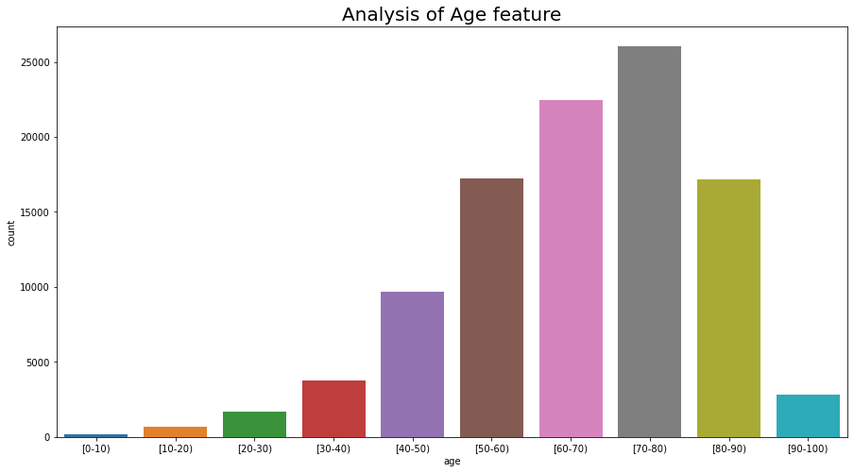
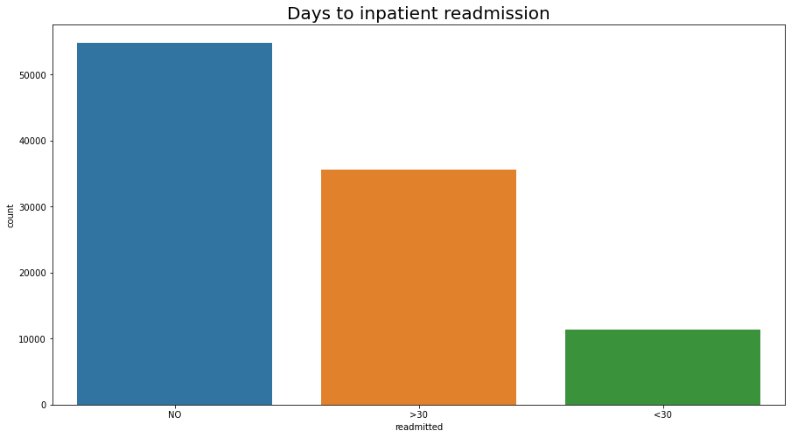
EXPLORATORY DATA ANALYSIS
Univariate Analysis :
Count of readmission increases with age.
The number of readmission is highest for the age group 70-80
Count of re-admission is low for less than 30 days as compared to more than 30 days.
Count of no re-admission is relatively higher.

Slide 8
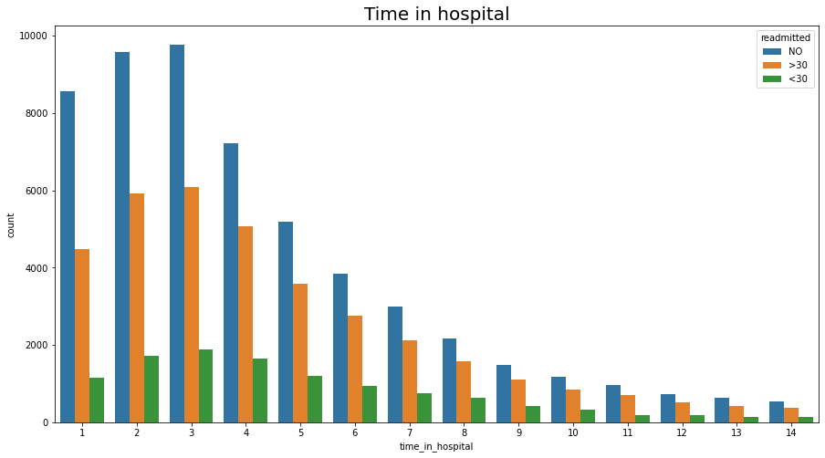
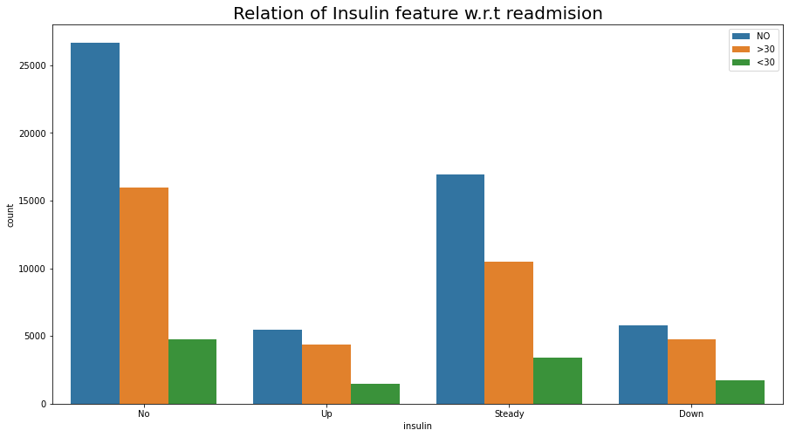
EXPLORATORY DATA ANALYSIS
Bivariate Analysis :
Average time spend by a patient can be seen 14 days.
Most number of days spend in hospital is 1 to 6.
Most patients are admitted generally for 3 days.
Readmission is inversely related to insulin intake.

Slide 9
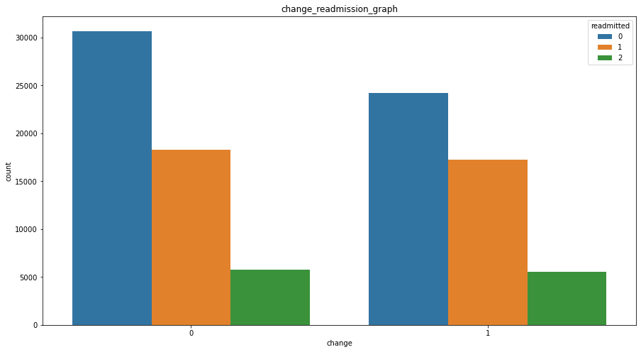
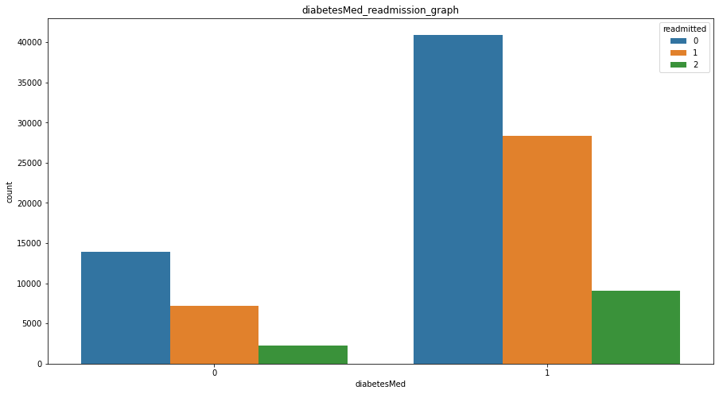
EXPLORATORY DATA ANALYSIS
Bivariate Analysis :
Readmission is low when medication is not changed.
Count of readmission is less for ones with medication prescribed.

Slide 10
DATA ANALYSIS & FEATURE ENGINEERING
discharge_disposition_id
It has a lots of distinct values using domain knowledge we have converted them into small number of categories.
Category 1 :- 6, 8, 9, 13
admission_source_id
Admission Type ID can be converted into small number of categories.
Category 1 :-2,7
max_glu_serum
Max_glucose_serum is encoded into 4 categories.
None = 0
Category 2:- 3, 4, 5, 14, 22, 23, 24
Category 10:- 12, 15, 16, 17
Category 11:- 19, 20, 21
Category 18:- 25,26
Category 5:- 6,8
Normal= 1
> 200 = 2
> 300 = 3

Slide 11
DATA ANALYSIS & FEATURE ENGINEERING
A1 Cresult
A1C test is a blood test that reflects your average blood glucose levels over the past 3 months.
None = 0
Race Feature
We have imputed the nan values in the race feature to a new variable “Others”.
We have imputed a new variable since the number of missing values was much higher.
Gender Feature
We have done encoding for the gender column, They are as follows-
Male = 1
Normal =1
>7 =2
>8 =3
Female =0

Slide 12
DATA ANALYSIS & FEATURE ENGINEERING
Change Feature
We have categorised the medication changed done for the patients as follows -
No change =0
DiabetesMed Feature
We have categorised the patients with diabetes medication as follows -
Yes =1
Drugs Features
We have 7 drugs & the change in the patient's dosage of a specific drug, during hospital encounter are encoded as follows-
No = 0
Change =1
No =0
Steady =2
Down =1
Up =3

Slide 13
DATA ANALYSIS & FEATURE ENGINEERING
Target Feature
Readmitted column has values like '>30' that is patient readmitted after 30 days and 'NO' that is patient not readmitted and '<30' that is patient readmitted before 30 days
- We have replace 'NO’ as 0
- Replaced the '>30’ &‘<30’ as 1.

Slide 14
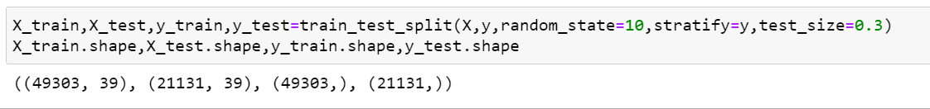
Data Processing for Model:
First changed the categorical columns into the numerical through one-hot encoding.
Creating 2 different databases from the processed dataset named as x and y for train test split.
- X is the cleaned dataset after excluding target variable.
- Y is the cleaned dataset’s having only the target variable (“readmitted”)
We have done a train test split of 70-30 ratio respectively.

Slide 15
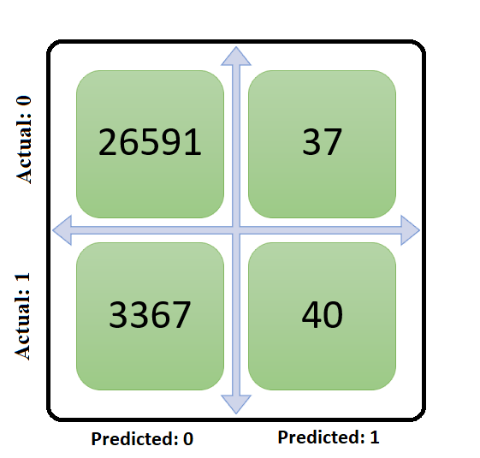
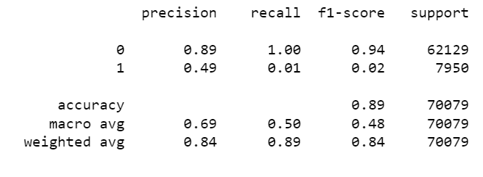
BASE MODEL
Logistic Regression
Classification Report:
Confusion Matrix
Training Accuracy Score --0.886528
Testing Accuracy Score –0.886666
Accuracy score :- 0.886666
Roc_AUC Score :- 0.505176
Precision_Score :- 0.519481
Recall_Score :- 0.011741

Slide 16

MODEL BUILDING & ALGORITHM
Parameters:
Sensitivity or recall, F1 Score, ROC_AUC, Accuracy Score, Precision Score
The primary solution is to predict whether the patient comes back or not. For that reason we’re using some algorithms to make models for the predictions.
Classification Algorithms Used:
Logistic Regression : Estimates the probabilities of events.
Decision tree: Flowchart like tree structure for predictions.
XG Boost classifier: Allow models to be treated like classifiers or regressors.
Gradient boost Classifier: Combines many weak learning models to create a strong predictive model.
Random Forest: Fits several decision tree classifiers on various sub-samples to improve the predictive accuracy.
Ada Boost with RFC: Fits a classifier on the original dataset and the copies of the with proper weight classifications.
Light GBM Classifier: It leverages if there is any native weight for data instance in GBDT.

Slide 17
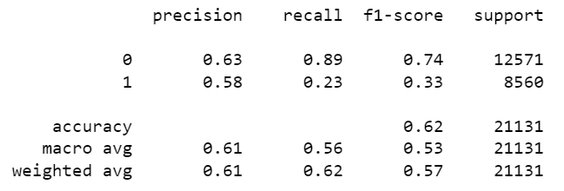
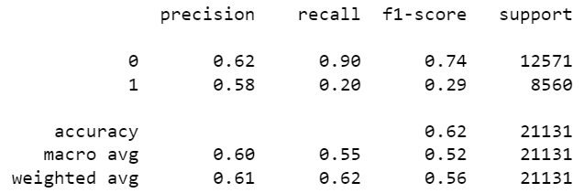
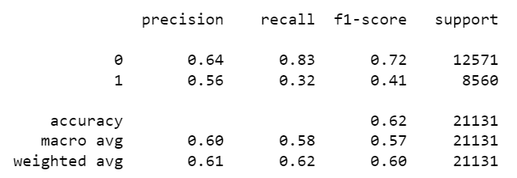
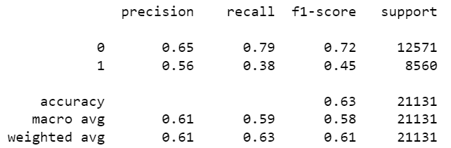
RESULTS
Logistic Regression
Grid Search for Decision Tree
ROC_AUC Score: 0.5583052002941052
ROC_AUC Score: 0.550364667009145
Random Forest Classifier
ADA Boost with Random Forest Classifier
ROC_AUC Score: 0.5750170155014843
ROC_AUC Score: 0.5876106936897488

Slide 18
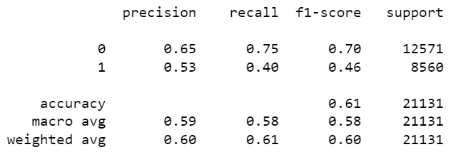
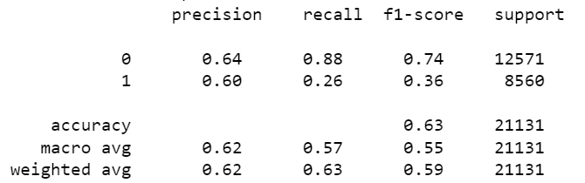
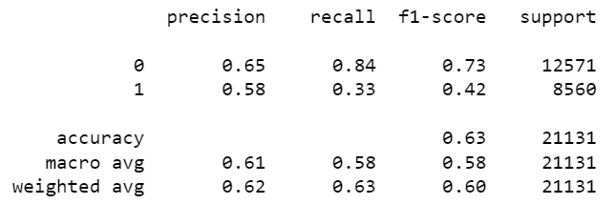
XGBoost Classifier
Gradient Boost Classifier
ROC_AUC_Score:0.5780413001813252
ROC_AUC_Score:0.5721495735995248
Cross Validation
All the models are overfitting, so we have done Cross Validation for controlling.
After checking all the models, the best fitting models comes out is, Light GBM Classifier.
Light GBM Classifier
ROC_AUC Score: 0.5837595913157192

Slide 19
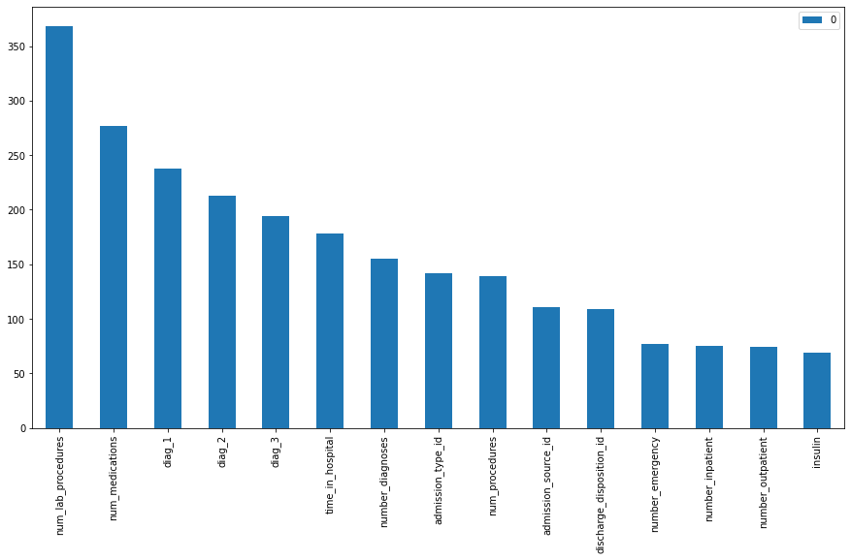
CONCLUSIONS
Important Features:
Important features for the prediction.

Slide 20
Business Inference
In our best performing model (Light GBM Classifier)
We have got Precision of 58%, which indicates that out of total predicted positive 58% are true.
Positive Recall of 63%, which indicates that out of total actual positives ,. 63% are predicted are true positive
F1_score, which is harmonic mean of precision and recall is around 42%.
Limitation:
After doing grid search and Cross validation also still the data is imbalance
We have less data so it is challenging.
Future work:
Since the data is imbalance, we can come to better insights using deep learning.
Deployment of the model.

Slide 21
for u in range (0,1000):
print (‘Thank You!’)
THANK YOU

