Slide 1
Operating system for Media

Slide 2
Top 5 workflows
Workflow definition | Workflow Target | Workflow Type
AI Content Creation (Image, Audio, Video, Avatars) | Customer-focused | Execution Workflow
Personalized Recommendations (Content) | Customer-Focused | Execution Workflow
Audience Segmentation (Demographics) | Business-Focused | Efficiency Workflow
Content Summarization | Customer-Focused | Efficiency Workflow
Content Moderation | Operation-Focused | Exception Workflow

Slide 3
Next 5 workflows
Workflow definition | Workflow Target | Workflow Type
Content Monitoring | Business-Focused | Execution Workflow
Fraud or Fake Detection | Operation-Focused | Exception Workflow
Behavior-Driven User Connections | Customer-Focused | Expansion Workflow
Real-Time Translation and Subtitling/Dubbing | Customer-Focused | Execution Workflow
Ad Performance Prediction | Business-Focused | Efficiency Workflow

Slide 4
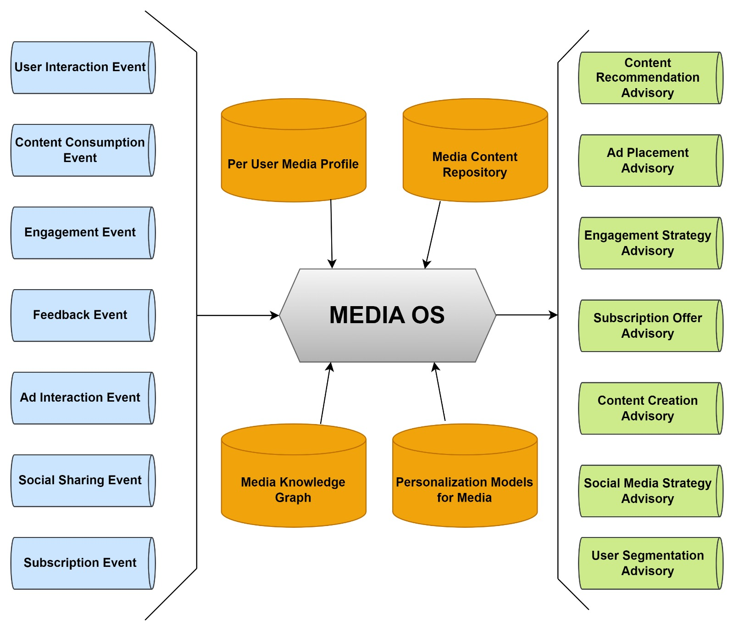
MEDIA OPERATING SYSTEM

Slide 5
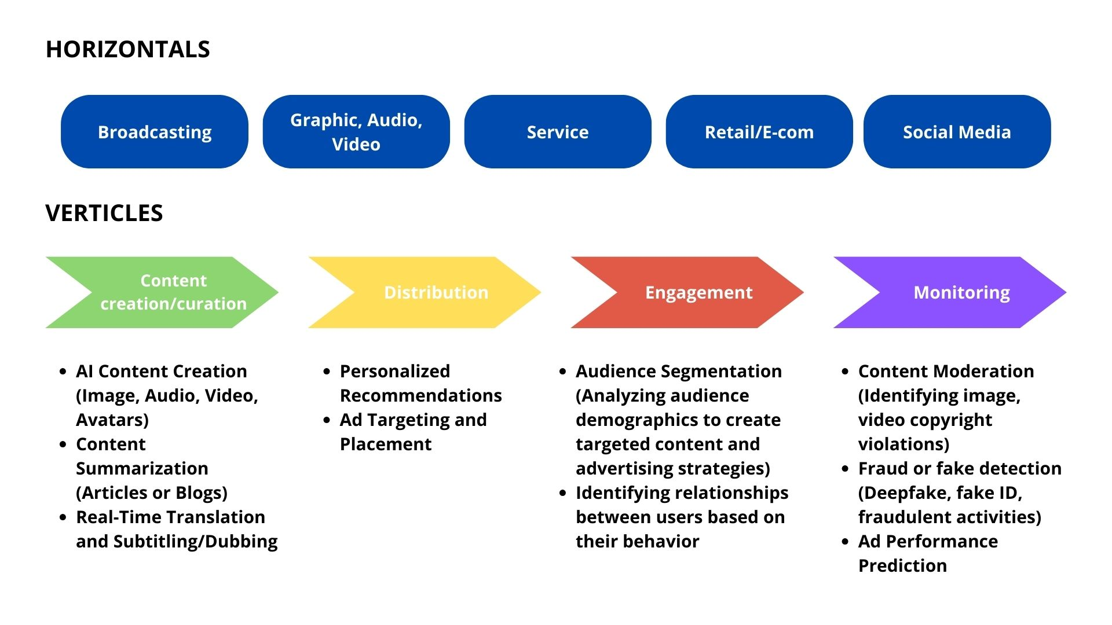
HORIZONTALS
VERTICALS

Slide 6
Workflow 1: AI Content Generation
(Metrics)
Customization Time: Measure how quickly AI avatars can be tailored to specific needs.
Performance Accuracy: Evaluate how precisely the AI avatar follows the provided script.
Realism Score: Assess the believability of the avatar’s appearance and behavior.
Content Approval Rate: Track how often AI-generated content is approved without changes.
User Satisfaction: Gauge user satisfaction with the avatar's final output.

Slide 7
Workflow 1: AI Content Generation
(Decision)
Avatar Selection: Choose the best avatar model for the content.
Customization Approvals: Approve or modify avatar customizations.
Script Execution: Decide whether to proceed with or revise the avatar’s scripted performance.
Performance Review: Approve or request changes to the avatar’s performance.
Final Content Approval: Make the final decision on content readiness for release.

Slide 8
Workflow 1: AI Content Generation
(Models)
Machine Learning: Avatar selection and customization.
NLP: Understanding and executing scripts.
Deep Learning: Enhancing realism in avatar performance.
Reinforcement Learning: Continuous improvement through feedback.

Slide 9
Workflow 1: AI Content Generation
(Data)
Avatar Models: Pre-designed digital avatars.
Customization Inputs: Client preferences and specifications.
Scripts: Textual content for avatar performance.
Performance Logs: Records of avatar actions and accuracy.
User Feedback: Insights for refining avatar and workflow.

Slide 10
Workflow 2: Personalized Recommendations
(Metric)
Engagement Rate: Measures how often users interact with recommended content.
Click-Through Rate (CTR): Percentage of recommended items that are clicked.
Conversion Rate: Percentage of recommendations leading to a desired action (purchase, sign-up).
Recommendation Accuracy: Measures how well recommendations align with user preferences.
Session Duration: Length of time users spend on the platform after receiving recommendations.
User Retention Rate: Measures how many users return after receiving recommendations.

Slide 11
Workflow 2: Personalized Recommendations
(Decision)
Content Selection: Determining which items to recommend.
Timing of Recommendations: Deciding the best time to deliver recommendations.
Frequency of Recommendations: How often recommendations should be updated or delivered.

Slide 12
(Models)
Workflow 2: Personalized Recommendations
Collaborative Filtering Models: To predict user preferences based on similar users.
Content-Based Filtering: To recommend similar content based on what the user has interacted with.
Reinforcement Learning: For optimizing recommendations over time based on user feedback.

Slide 13
Workflow 2: Personalized Recommendations
(Data)
Static Data: User profiles, content metadata.
Dynamic Data: User interaction data, historical recommendation performance.

Slide 14
Workflow 3: Audience Segmentation
(Metric)
Segmentation Accuracy: How accurately the AI groups users into meaningful segments.
Reach: The number of users within each segment.
Engagement by Segment: Interaction levels for each segment.
Conversion Rate by Segment: How well each segment converts.

Slide 15
(Decision)
Workflow 3: Audience Segmentation
Segment Definition: Identifying key segments based on behavior and demographics.
Targeting Strategy: Determining how to target each segment.
Content Personalization: Customizing content based on segment characteristics.

Slide 16
Workflow 3: Audience Segmentation
(Models)
Clustering Algorithms: K-Means, Hierarchical Clustering for grouping users.
Supervised Learning: Classification algorithms to predict user segment based on features.
Unsupervised Learning: Discovering new segments without predefined labels.

Slide 17
(Data)
Workflow 3: Audience Segmentation
Static Data: Demographic data, user registration details.
Dynamic Data: Interaction history, purchase behavior, content preferences.

Slide 18
Workflow 4: Content Summarization​
Model Type | Algorithm | Data Collected | Feature Generated | Data Source
Summarization | Extractive Summarization | Articles, News Reports | Key Sentences, Keywords | News Websites, RSS Feeds
Summarization | Abstractive Summarization | Transcripts of Interviews | Abstract Summaries | TV Channels, Podcast Platforms
Sentiment Analysis | Lexicon-Based Approach | Social Media Posts, Comments | Sentiment Scores | Social Media APIs, Comment Sections
Topic Modeling | Latent Dirichlet Allocation (LDA) | News Articles, Blogs | Dominant Topics | Media Websites, Blogs
Summarization | BERT, GPT-Based Models | Full-length Podcasts, Videos | Summarized Points | Streaming Services, Media Libraries

Slide 19
Workflow 4: Content Summarization​​
Model Type | Algorithm | Input | Output | Business Metric
Summarization | Extractive Summarization | Full Text of Articles | Concise Summary of Key Points | Reader Engagement, Time Spent on Page
Summarization | Abstractive Summarization | Transcripts of Interviews | Shortened, Rephrased Summary | Viewer Retention, Click-Through Rate (CTR)
Sentiment Analysis | Lexicon-Based Approach | Text from Posts and Comments | Sentiment Labels (Positive, Negative, Neutral) | Brand Sentiment, Customer Satisfaction
Topic Modeling | Latent Dirichlet Allocation (LDA) | Collection of Documents | Topics with Probabilities | Content Relevance, Click-Through Rate (CTR)
Summarization | BERT, GPT-Based Models | Transcripts or Audio of Content | Brief Key Takeaways, Summary | User Retention, Playback Time

Slide 20
Workflow 4: Content Summarization
(Metric)
Readability Score: Measures how easily users can understand summarized content.
Engagement Rate: Tracks user interaction with sumarized content (clicks, shares).

Slide 21
Workflow 4: Content Summarization
(Decision)
Automate Summarization Processes: Use AI to automatically generate summaries for large volumes of content.
Optimize Content Length: Adjust the length of summaries to maximize readability and engagement.

Slide 22
Workflow 4: Content Summarization
(Models)
Natural Language Processing (NLP) Models: Utilize models like GPT-4 for summarizing articles, blogs, and reports.
Sentiment Analysis: Analyze summarized content to ensure it maintains the intended tone and sentiment.

Slide 23
Workflow 4: Content Summarization
(Data)
Text Data: Full-length articles, blogs, and other textual content for summarization.
User Feedback: Data on user satisfaction with AI-generated summaries.

Slide 24
Workflow 5: Content Moderation​
Model Type | Algorithm | Data Collected | Feature Generated | Data Source
Text Classification | Support Vector Machines (SVM), Naive Bayes | User-Generated Text (Comments, Posts) | Classification Labels (e.g., Spam, Offensive) | Social Media Platforms, Forums, Blogs
Image Classification | Convolutional Neural Networks (CNN) | User-Uploaded Images | Image Labels (e.g., NSFW, Violent) | Social Media, Image Hosting Platforms
Audio Analysis | Recurrent Neural Networks (RNN), Transformer Models | Audio Clips (Podcasts, Voicemails) | Audio Content Labels (e.g., Profanity) | Streaming Services, Voice Messaging Apps
Video Classification | CNN + RNN, 3D CNN | User-Uploaded Videos | Video Labels (e.g., Violent, Hate Speech) | Video Hosting Platforms, Social Media
Named Entity Recognition (NER) | BERT, CRF | Text from Comments, Posts | Entities (e.g., Persons, Organizations) | Online Communities, Social Media
Sentiment Analysis | Lexicon-Based, Transformer Models | Text from User Feedback | Sentiment Scores | Review Platforms, Feedback Forms
Spam Detection | Logistic Regression, Random Forest | Text from Messages, Comments | Spam Probability Score | Email Platforms, Messaging Apps
Toxicity Detection | BERT, DistilBERT | Text from Online Interactions | Toxicity Score | Online Communities, Comment Sections
Anomaly Detection | Autoencoders, Isolation Forest | User Interaction Data | Anomalous Behavior Flags | Social Media Activity Logs, User Behavior Analytics

Slide 25
Workflow 5: Content Moderation​​
Model Type | Algorithm | Input | Output | Business Metric
Text Classification | SVM, Naive Bayes | User-Generated Text (Comments, Posts) | Labels (Spam, Offensive, Neutral) | Reduced Harmful Content, Improved User Trust
Image Classification | CNN | User-Uploaded Images | Image Labels (NSFW, Violent) | Reduced Inappropriate Content, User Safety
Audio Analysis | RNN, Transformer Models | Audio Clips (Podcasts, Voicemails) | Content Labels (Profanity, Hate Speech) | Compliance with Regulations, User Retention
Video Classification | CNN + RNN, 3D CNN | User-Uploaded Videos | Video Content Labels (Violent, Hate Speech) | Viewer Satisfaction, Policy Compliance
Named Entity Recognition (NER) | BERT, CRF | Text from Comments, Posts | List of Named Entities | Accurate Content Filtering, Brand Protection
Sentiment Analysis | Lexicon-Based, Transformer Models | Text from User Feedback | Sentiment Scores | Customer Satisfaction, Brand Perception
Spam Detection | Logistic Regression, Random Forest | Text from Messages, Comments | Spam or Not Spam | Reduction in Spam, User Engagement
Toxicity Detection | BERT, DistilBERT | Text from Online Interactions | Toxicity Score | Improved Community Health, Reduced Churn
Anomaly Detection | Autoencoders, Isolation Forest | User Interaction Data | Anomalous Behavior Flags | Fraud Prevention, Account Security

Slide 26
Workflow 5: Content Moderation
(Metric)
Detection Accuracy: Measures the accuracy of AI in identifying copyrighted or inappropriate content.
Moderation Speed: Tracks the time taken to detect and moderate content.

Slide 27
Workflow 5: Content Moderation
(Decision)
Enhance Moderation Algorithms: Improve AI models to increase detection accuracy and speed.
Automate Content Review: Implement AI to automatically review and flag content before publication.

Slide 28
Workflow 5: Content Moderation
(Models)
Image and Video Recognition: Use AI models like CNNs for identifying copyrighted or inappropriate content.
NLP Models: Detect inappropriate text content using models trained on vast datasets.

Slide 29
Workflow 5: Content Moderation
(Data)
Content Data: Images, videos, and text to be moderated.
Violation Records: Historical data on previously flagged content to train AI models.

