Slide 1
YouTube Comments Spam Detection

Slide 2
INTRODUCTION
YouTube has more than 2 Billion users.
Every Minute – 500 Hours of videos are uploaded
Everyday – 43,200,000 hours of videos are uploaded.
Many videos are uploaded on YouTube on daily basis and a handsome amount of comments posted on that videos are spam that is people trying to promote their channel or market their product. To tackle this problem In this project we needed to identify the class of the YouTube video comments that it belongs to spam or ham.

Slide 3
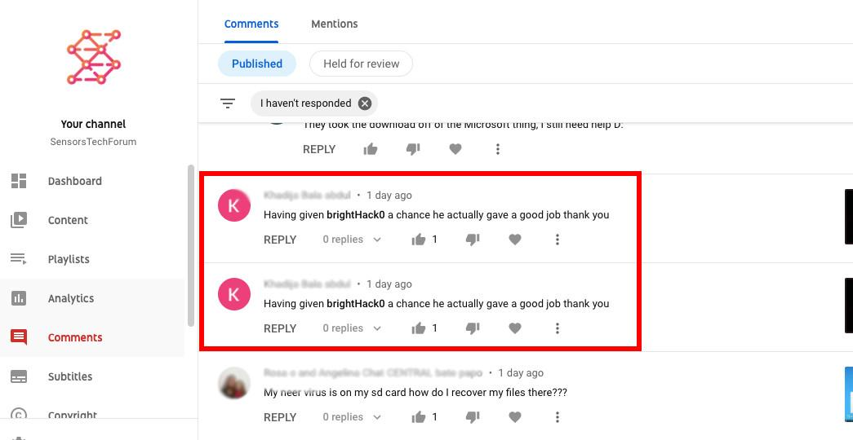
SPAM Comments

Slide 4
Methodology
Data Acquisition
Data Cleaning & Sampling
Feature Extraction
Machine Learning Classifiers
[Models]

Slide 5
Data Acquisition
Dataset consists of 5 Most watched videos from 2015
Dataset contains Comment ID, Date, Author, Content and Class.
1956 total Comments
Link to DataSet

Slide 6
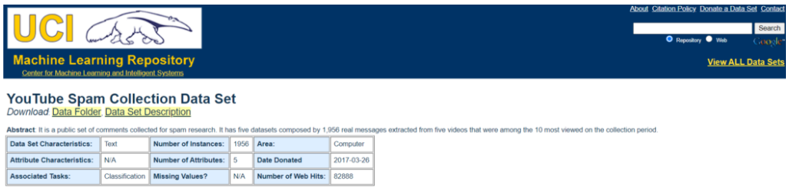
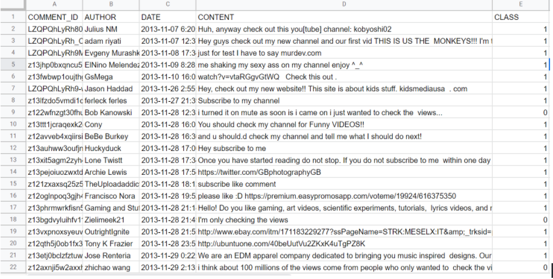

Slide 7
Data Cleaning and Sampling
Dropped unnecessary columns
Expanded contractions
Removed HTML tags
Removed URLs
Converted text to lowercase
Removed numeric digits and words with digits
Removed punctuations
Removed encoding
Removed Extra Spaces

Slide 8
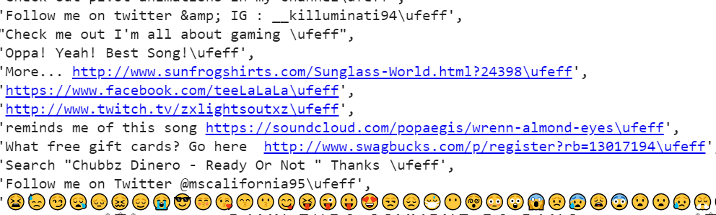
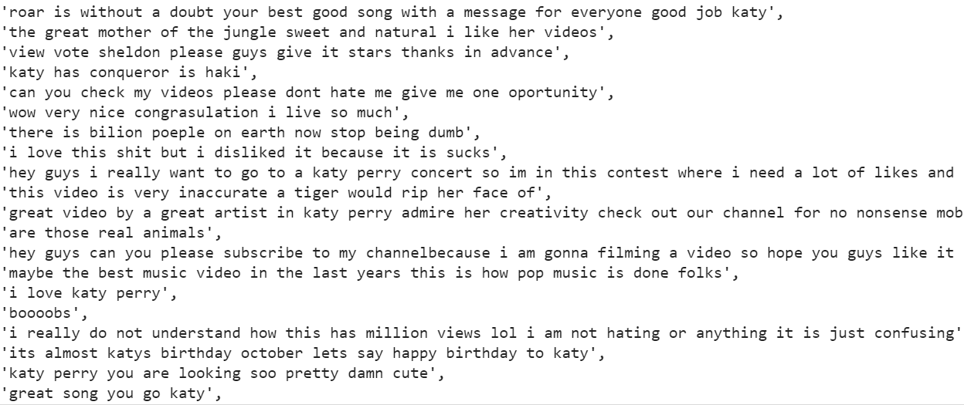
Data before Cleaning
Data after Cleaning

Slide 9
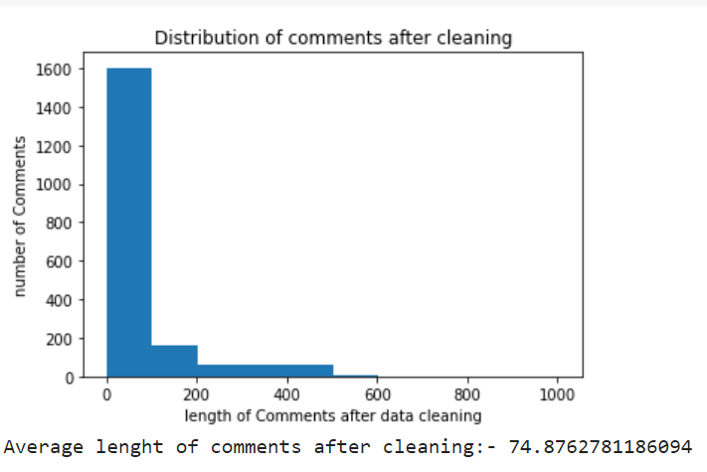
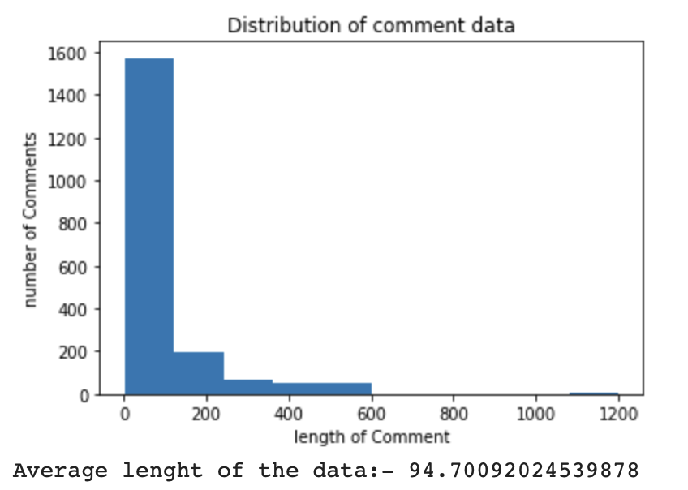
Data before Cleaning
Data after Cleaning

Slide 10
Feature Extraction
Tokenization
Lemmatization
Count Vectorizer
Term Frequency & IDF

Slide 11
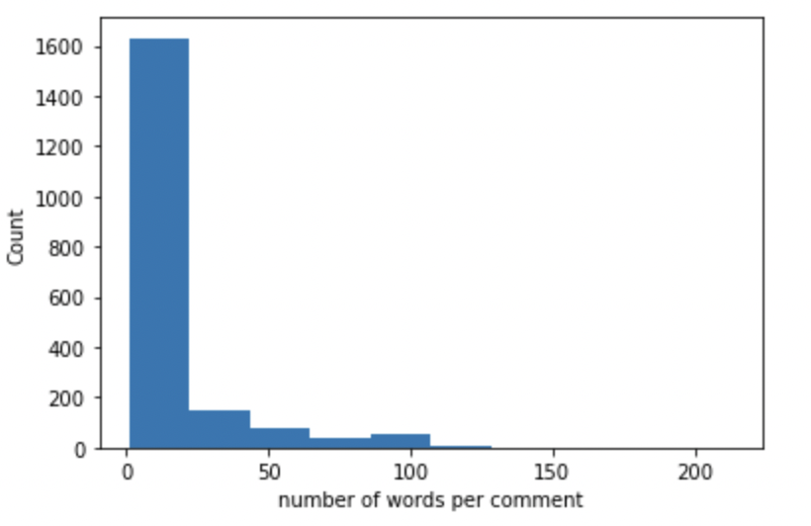
Tokenization
Tokenization is the act of breaking up a sequence of strings into pieces such as words, keywords, phrases, symbols and other elements called tokens. Tokens can be individual words, phrases or even whole sentences.
Tokenization is used in computer science, where it plays a large part in the process of lexical analysis.

Slide 12
Mapping Text To Vectors
Classification Algorithms expects numerical input features as we have text data we need to convert text data to numeric vectors.
Scikit-learn Count Vectorizer and TF-IDF Vectorizer are used to convert to numerical values.
Scikit-learn Count vectorizer is used to convert a collection of text documents to a vector of word counts.
Scikit-learn TF-IDF vectorizer considers overall weight of words in the whole document.

Slide 13
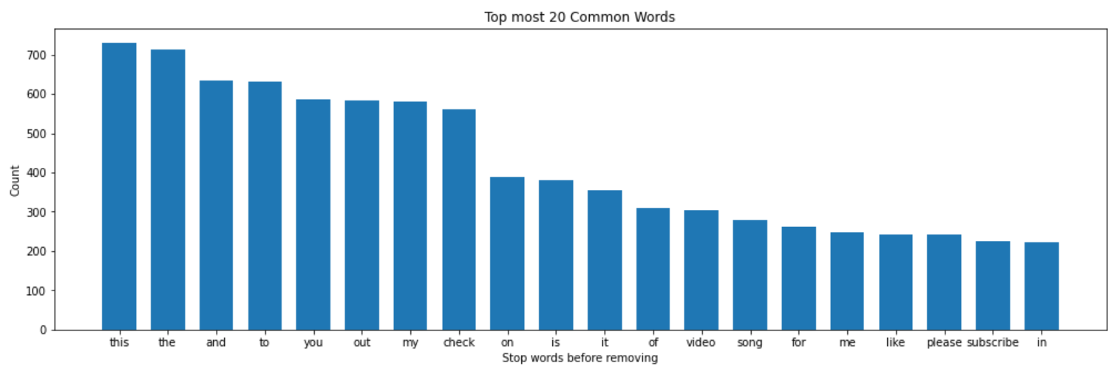
TOP 20 Most repeating words in the data

Slide 14
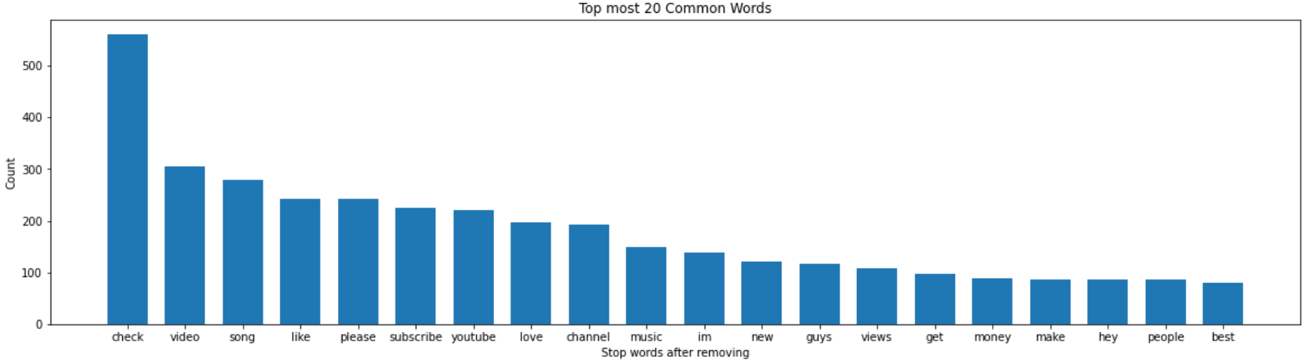
TOP 20 Most repeating words in the data

Slide 15
Lemmatization
Lemmatization is the method to normalize the text documents.
The main goal of the text normalization is to keep the vocabulary small and remove the noise(unwanted stuff), reduce derivationally related forms of a word to a common base form, which helps to improve the accuracy of many language modeling tasks.
am, are, is => be
car, cars, car’s, car’s => car

Slide 16
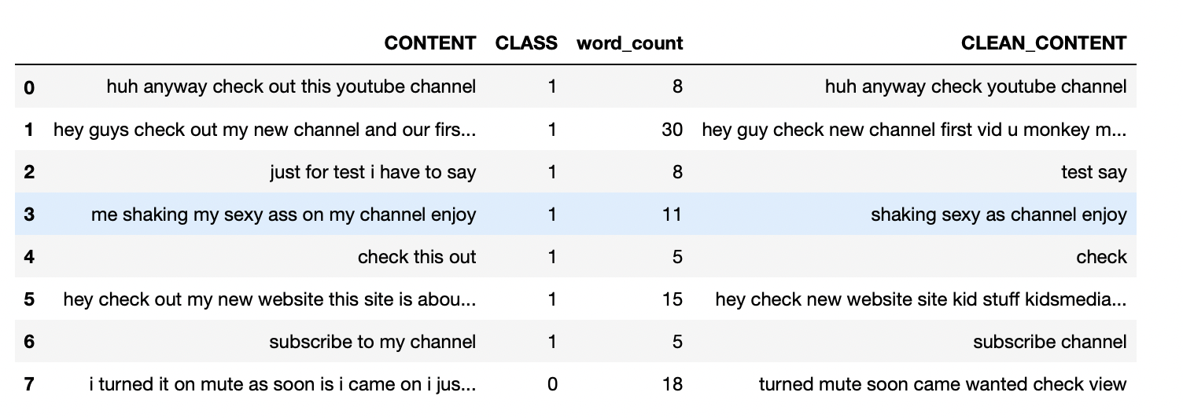
Lemmatization

Slide 17
Machine Learning Classifiers [Models]

Slide 18
Logistic Regression
In statistics, the logistic model is used to model the probability of a certain class or event existing such as pass/fail, win/lose, alive/dead or healthy/sick.
In Layman terms, a model used to predict the happening of an event with respect to other events.
Scikit Logistic Regression Model is used. Train Data - 80% and Test Data - 20%
Tuning Hyper Parameters as:
max_iter : 200
Learning_Rate : 0.005
Accuracy obtained – 88%

Slide 19
Naïve Bayes
A Naïve Bayes Classifier is a probabilistic machine learning model that is used for classification task.
Used Multinomial Naïve Bayes Classifier.
Accuracy obtained – 86%

Slide 20
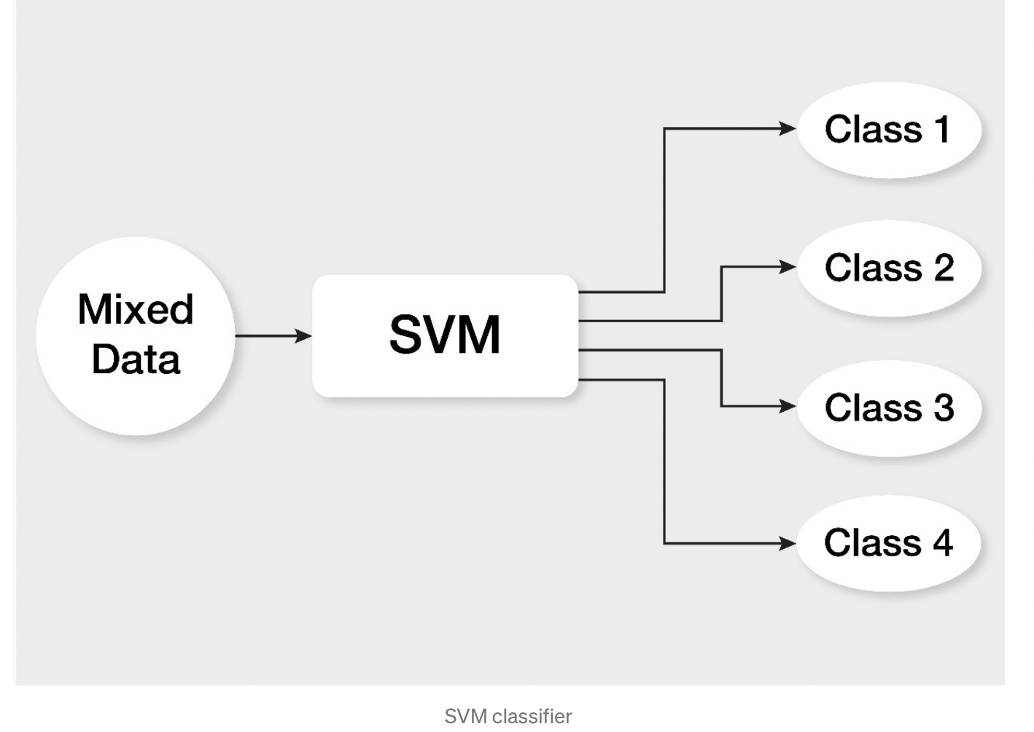
Support Vector Machine
Support Vector Machine is a linear model for classification and regression problems.
The idea of SVM is simple: The algorithm creates a line or a hyperplane which separates the data into classes.
The kernel used in this SVM is Linear.
Used Stochastic Gradient Descent Classifier with 5 iterations and Learning_Rate 0.003.
Accuracy obtained – 91%

Slide 21
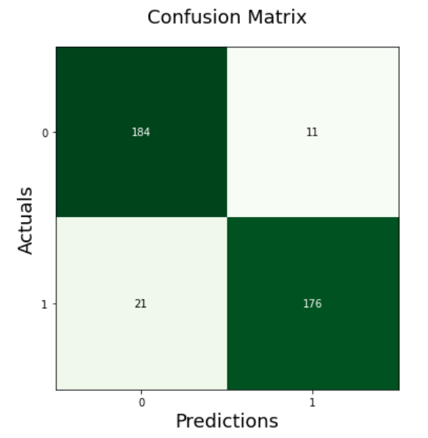
CONFUSION MATRIX

Slide 22
Random Forest Classifier
A random forest is a collection or ensembles of decision trees. Each tree is trained on a random subset of the attributes.
Randomly generated trees values are stored an done with the best possible highest value is selected as a result.
Scikit Random Forest Model is used. Train Data - 80% and Test Data - 20%
Accuracy - 86%

Slide 23
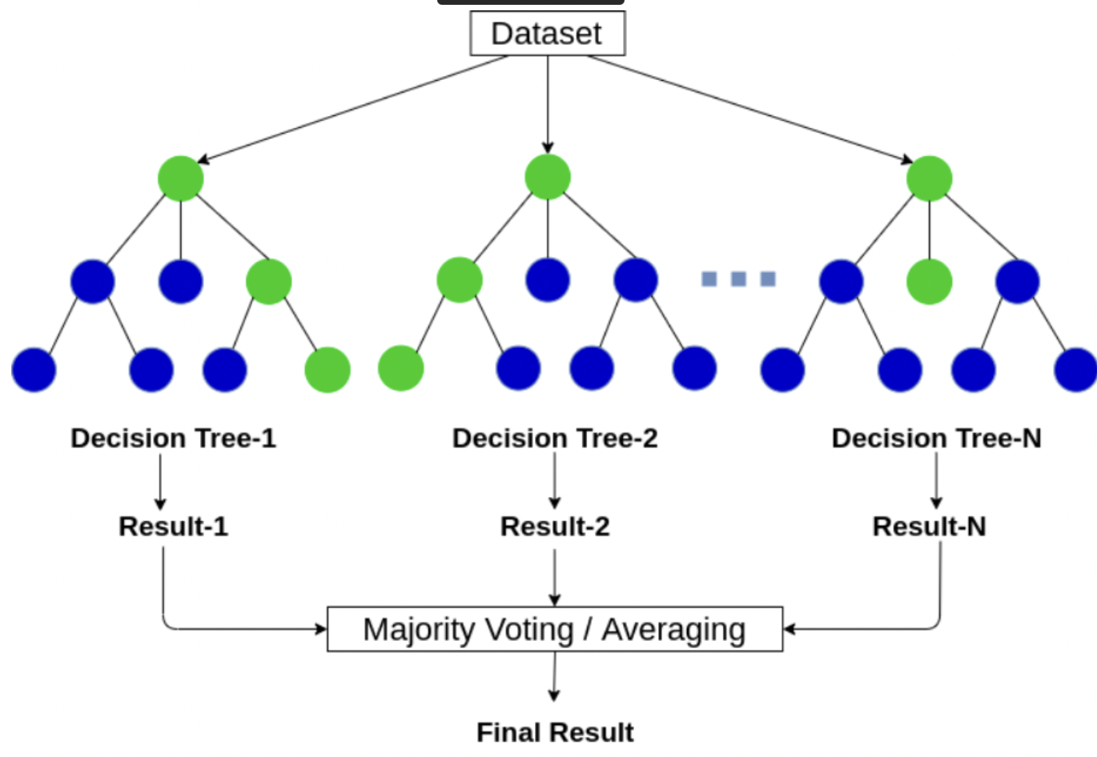
Random Forest Classifier

Slide 24
Conclusion
SVM gave the best accuracy followed by Logistic Regression, Naïve Bayes and Random Forest.
Tasks to be Done – Model to be Implemented Convolutional Neural Network

Slide 25
Team -
Indra Sai Kiran Valluru [ UIN-652537989 ]
Giri Madhav []
Shiva Praveen []
Rahul Sai []

Slide 26
THANK YOU!
Any questions?

