Slide 1
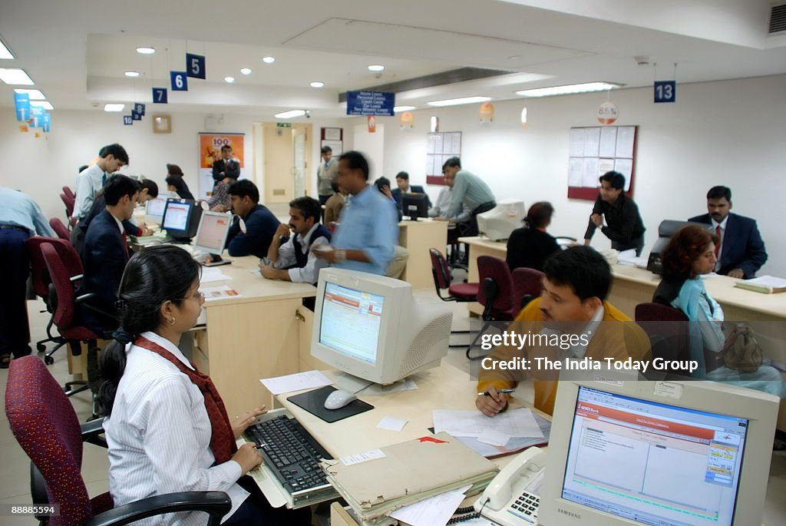
Introduction: The Power of Image in Banking
- Understanding the importance of image for bank success. Setting the stage for personal and professional branding.

Slide 2
Financial Impact of Branding: The Pia Wurtzbach Example
- Case study: Pia Wurtzbach's brand and its influence. How strong branding translates to financial success for individuals and organizations. Linking this to the bank's bottom line.

Slide 3

Branding Your Personal Image: First Impressions Matter
- Professional attire and grooming. Positive body language and communication skills. Maintaining a consistent online presence.

Slide 4

Workplace Etiquette and Netiquette: Professionalism in Action
- Proper phone etiquette (answering calls professionally). Email and online communication best practices. Maintaining a respectful and professional demeanor in all interactions.

Slide 5

Interactive Activity: Rocking the Bank's Image
- Brainstorming session: Ideas to improve the bank's image. Group discussion and feedback. Actionable steps for implementation.

Slide 6

Customer Stress Management Techniques: Prioritizing Self-Care
- Techniques for handling difficult customers. Strategies for managing stress and maintaining composure. The importance of self-care for providing excellent customer service.

