Slide 1
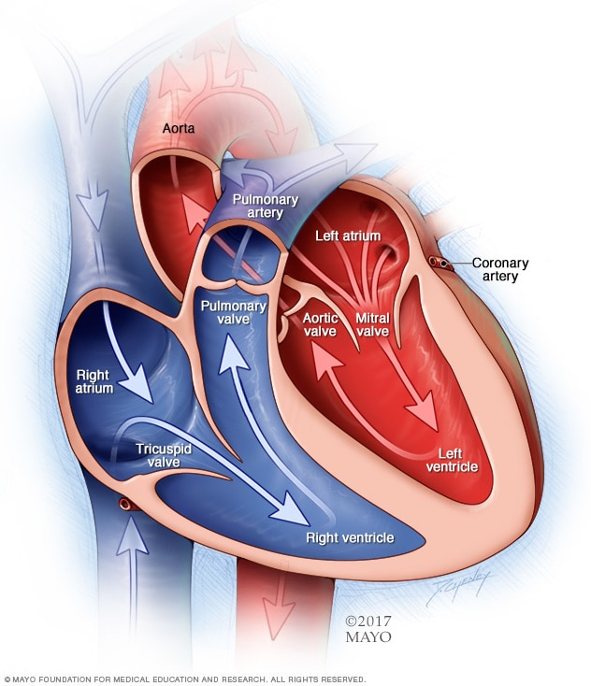
What is the Heart?
- The heart is a vital organ that pumps blood throughout the body. It's a muscular organ located in the chest, slightly to the left of the center.

Slide 2
How the Heart Works
- The heart has four chambers: two upper chambers (atria) and two lower chambers (ventricles). Blood enters the heart through the atria and is pumped out to the body through the ventricles.

Slide 3
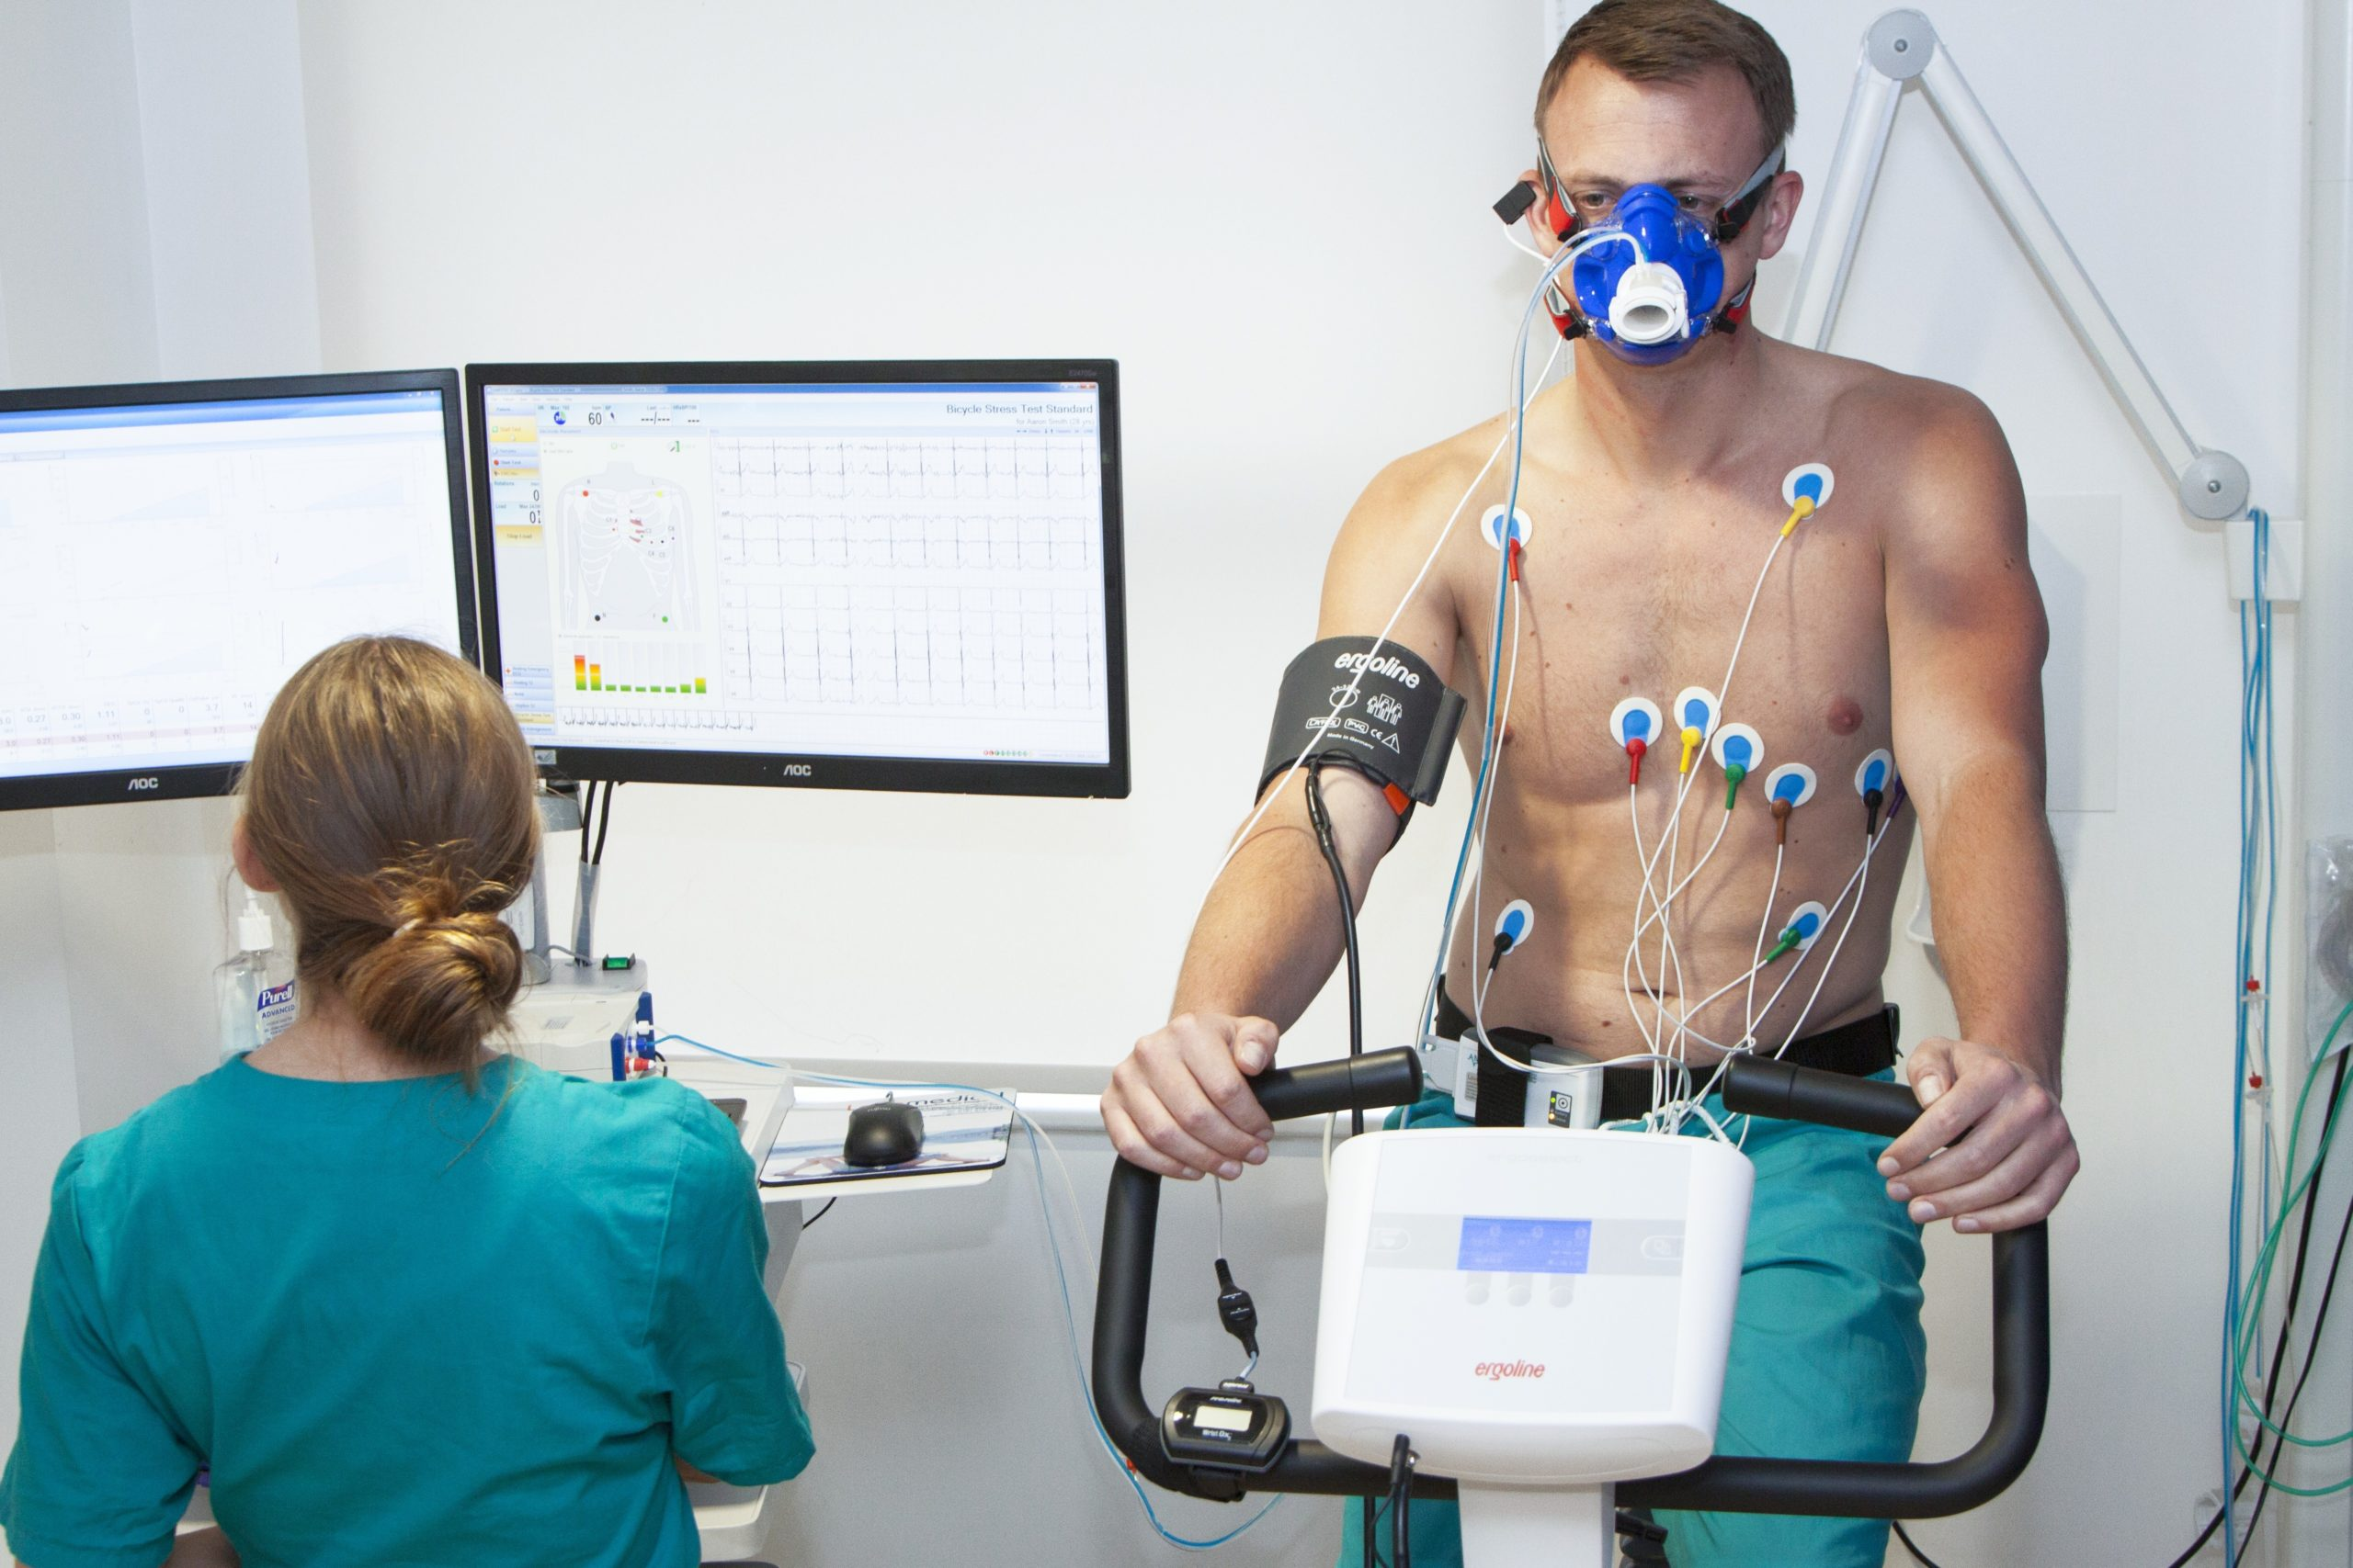
Uses of the Heart
- The heart's primary function is to circulate blood, delivering oxygen and nutrients to the body's cells. It also removes waste products like carbon dioxide.

Slide 4
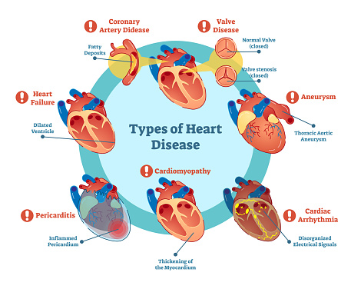
What Happens When the Heart Isn't Healthy?
- Heart disease is a major health concern, affecting millions of people worldwide. Common heart conditions include heart attacks, strokes, and heart failure.

Slide 5
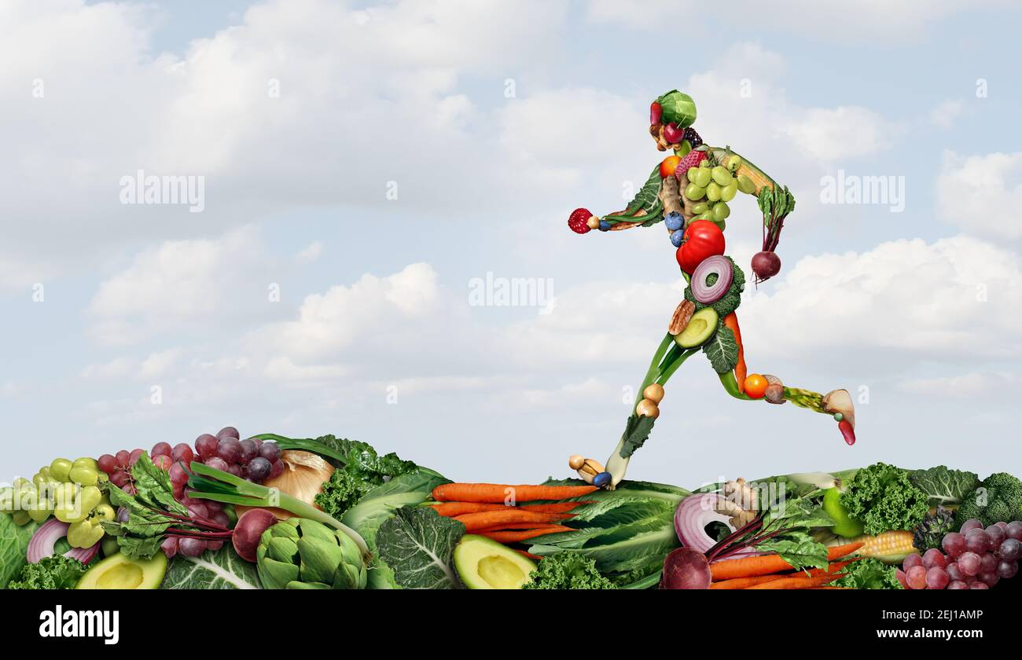
How to Keep Your Heart Healthy
- Maintain a healthy diet low in saturated fat and cholesterol. Get regular exercise. Manage stress. Avoid smoking.

Slide 6

Questions and Answers
- This is a time for you to ask any questions you may have about the heart. We'll do our best to answer them.

Slide 7

Thank You
- Thank you for joining us today. We hope you learned something new about the heart.

