Slide 1
Hypertension and Hyperlipidemia: An Overview
- Hypertension, also known as high blood pressure, is a condition where the force of blood against the artery walls is consistently too high. Hyperlipidemia, or high cholesterol, refers to elevated levels of lipids (fats) in the blood, particularly LDL (bad) cholesterol.

Slide 2

Causes of Hypertension
- Lifestyle factors: - Unhealthy diet high in sodium and saturated fats - Lack of physical activity - Excessive alcohol consumption - Smoking Underlying medical conditions: - Kidney disease - Thyroid disorders - Sleep apnea

Slide 3

Causes of Hyperlipidemia
- Genetics: Family history of high cholesterol can increase your risk. Lifestyle factors: - Unhealthy diet high in saturated and trans fats - Lack of physical activity - Obesity Underlying medical conditions: - Diabetes - Hypothyroidism - Kidney disease

Slide 4
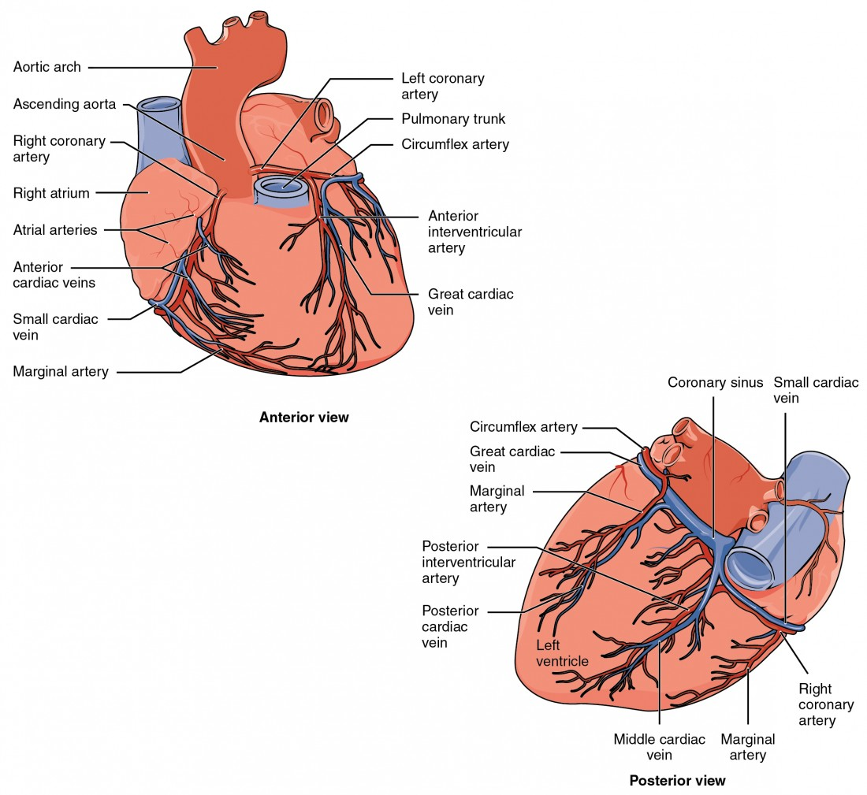
Complications of Hypertension
- Heart disease: Increased risk of heart attacks and strokes Kidney disease: Damage to blood vessels in the kidneys Eye problems: Damage to blood vessels in the eyes, leading to vision loss Aneurysm: Weakening and bulging of blood vessels

Slide 5
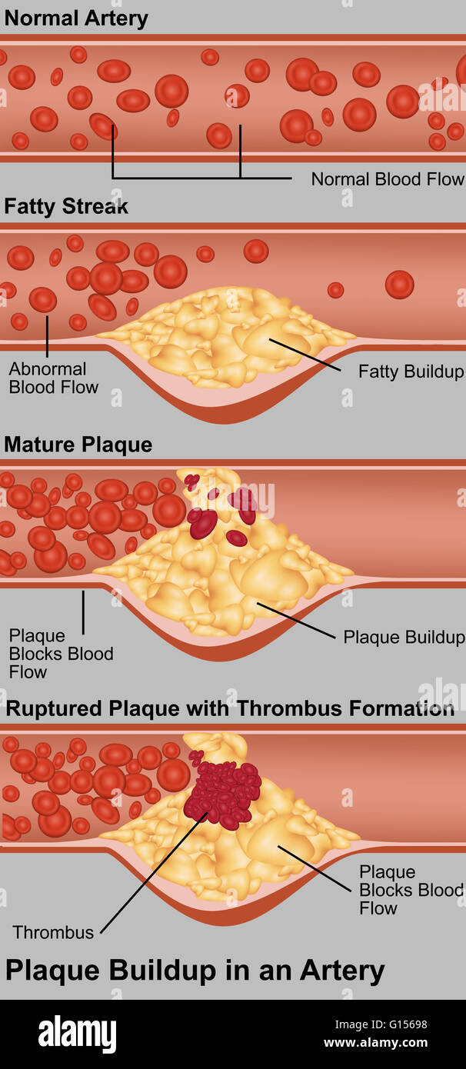
Complications of Hyperlipidemia
- Heart disease: High LDL cholesterol contributes to plaque buildup in arteries, increasing the risk of heart attacks and strokes Stroke: Blockage of blood vessels in the brain Peripheral artery disease: Narrowing of arteries in the legs and feet Atherosclerosis: Hardening and narrowing of arteries

Slide 6
Managing Hypertension and Hyperlipidemia
- Lifestyle modifications: - Healthy diet low in sodium and saturated fats - Regular physical activity - Weight management - Quitting smoking - Limiting alcohol consumption Medications: - Blood pressure medications - Cholesterol-lowering medications

Slide 7

Conclusion
- Hypertension and hyperlipidemia are serious conditions that can have significant health consequences. Early detection and management are crucial for preventing complications. Lifestyle modifications and medications can effectively control these conditions.

