Slide 1
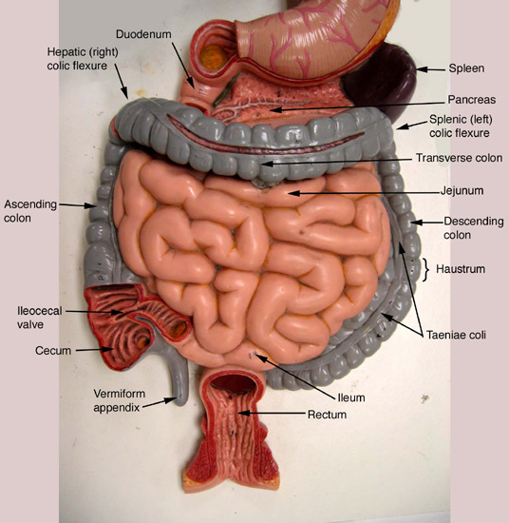
Introduction to Digestion
- Digestion is the process of breaking down food into smaller molecules that the body can absorb.,This process begins in the mouth and ends in the small intestine.,It involves both mechanical and chemical processes.

Slide 2
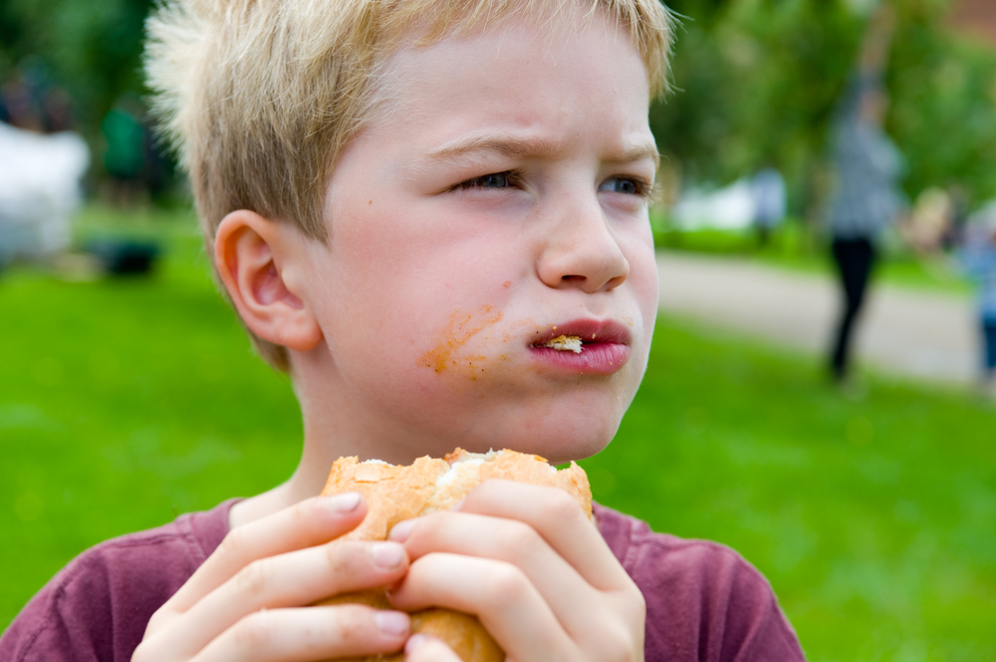
The Mouth
- The mouth is where digestion begins. Teeth mechanically break down food into smaller pieces. Saliva, produced by salivary glands, contains enzymes that begin chemical digestion.

Slide 3
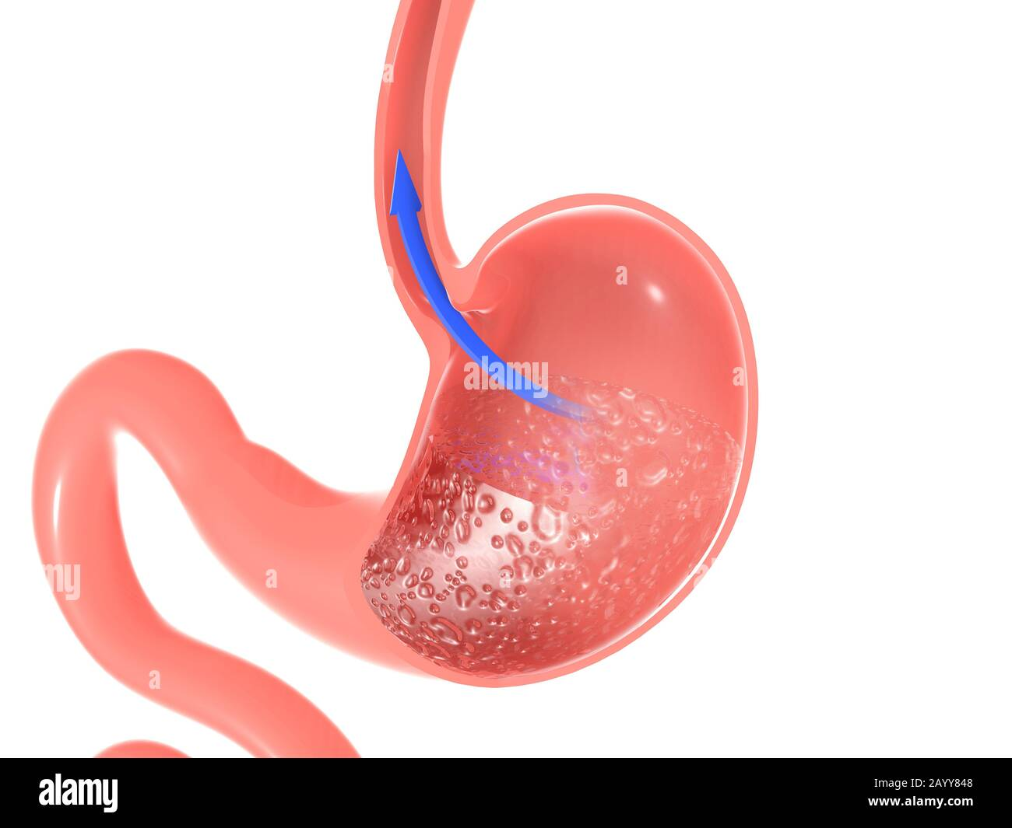
The Esophagus
- The esophagus is a muscular tube that connects the mouth to the stomach.,Peristalsis, rhythmic muscle contractions, move food down the esophagus.

Slide 4
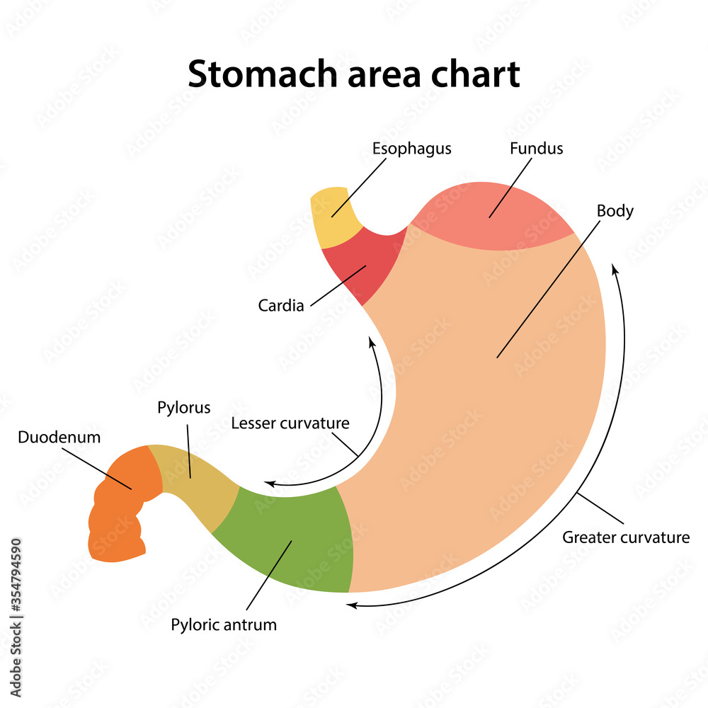
The Stomach
- The stomach is a muscular organ that churns and mixes food with gastric juices. Gastric juices contain enzymes that break down proteins. The stomach also produces hydrochloric acid, which helps kill bacteria.

Slide 5
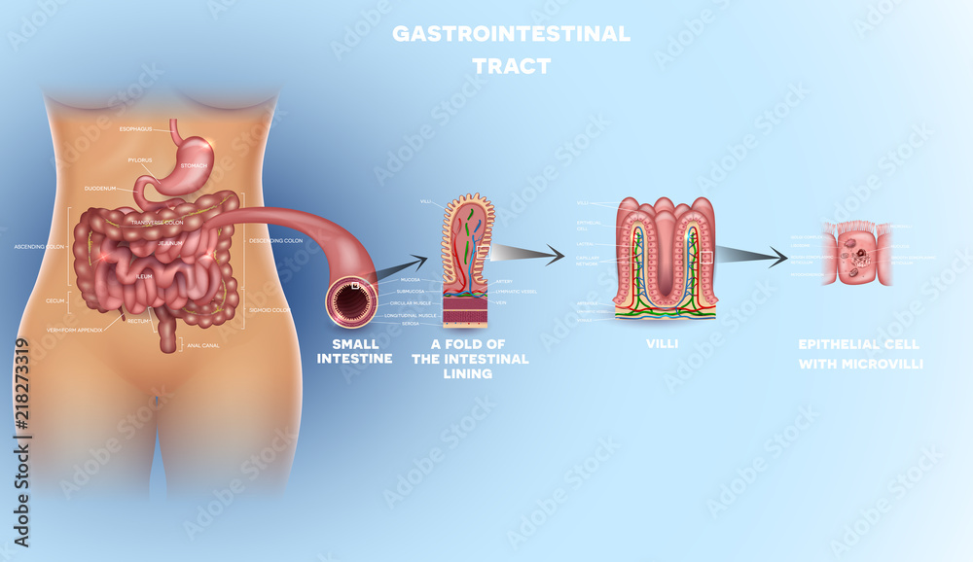
The Small Intestine
- The small intestine is the longest part of the digestive system. It is where most nutrient absorption takes place. Enzymes from the pancreas and bile from the liver help break down food further.

Slide 6
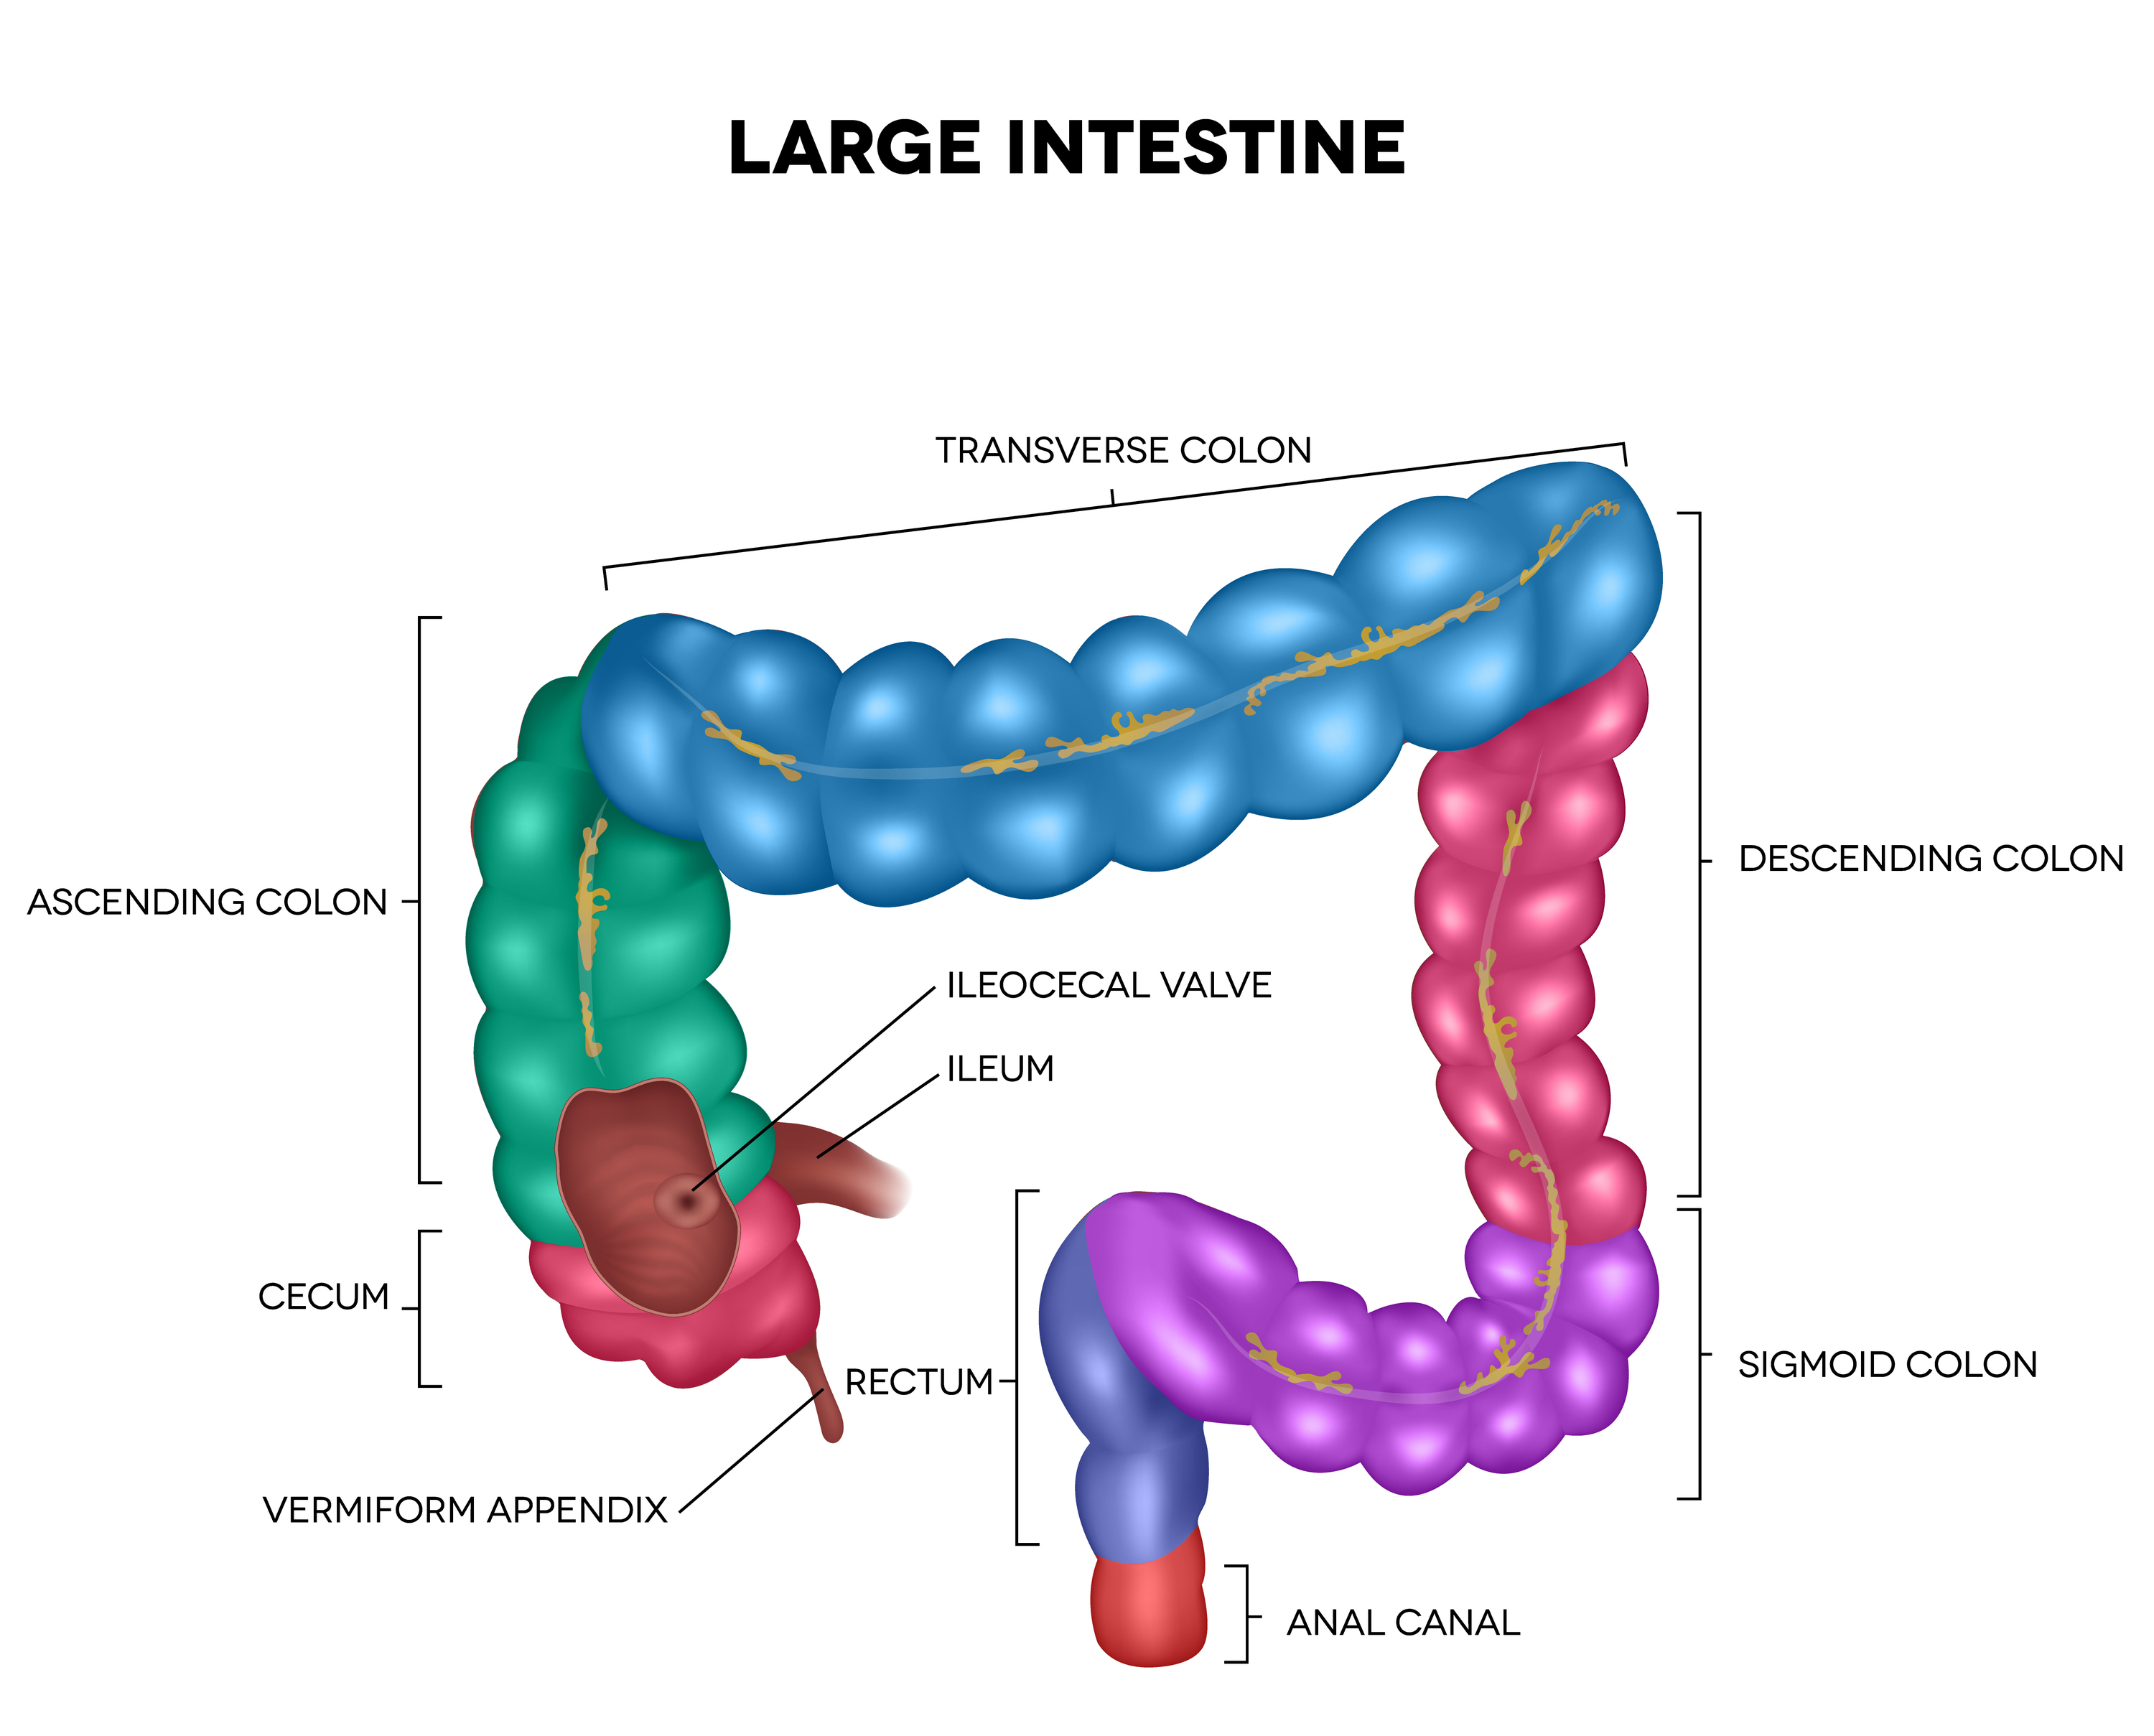
The Large Intestine
- The large intestine absorbs water and electrolytes from undigested food. It also houses bacteria that help break down fiber. Waste products are compacted into feces and eliminated from the body.

Slide 7
Conclusion
- Digestion is a complex process that involves many organs and systems. It is essential for breaking down food into nutrients that the body can use. A healthy digestive system is crucial for overall health and well-being.

