Slide 1
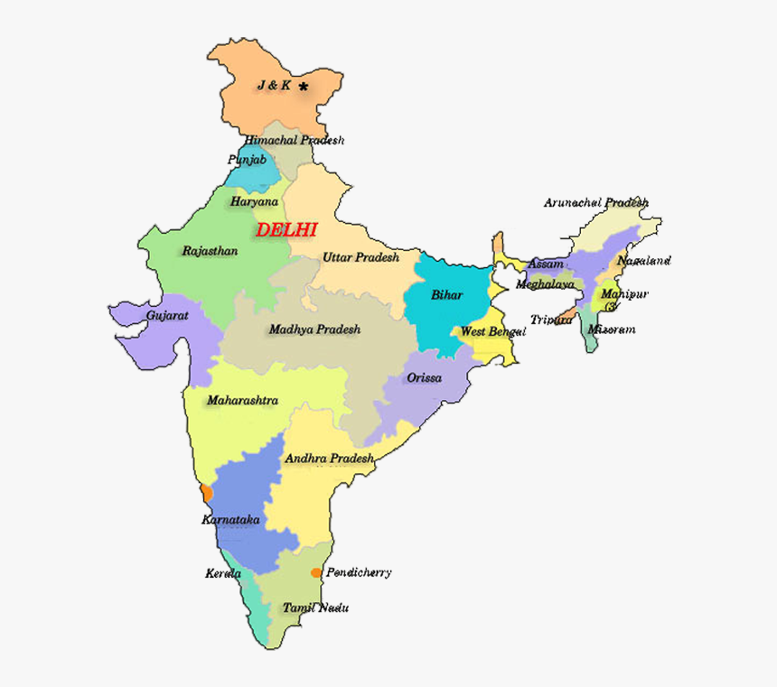
India's Diverse Tribes
- India is home to a vast array of tribal communities, each with their unique culture, traditions, and languages. These tribes represent a significant part of India's rich cultural heritage.

Slide 2
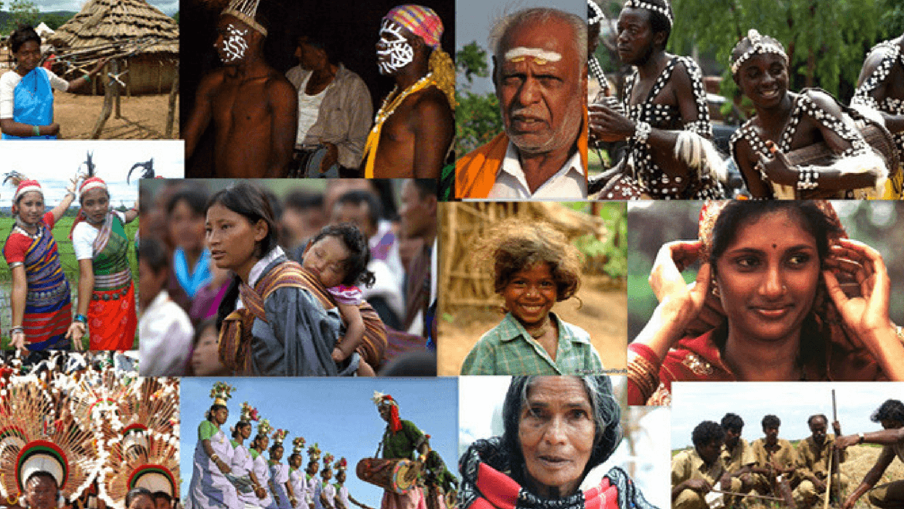
Major Tribal Groups
- North-East India: The Naga, Kuki, and Mizo tribes are prominent in this region. Central India: The Gond, Bhil, and Santhal tribes are found here. South India: The Toda, Chenchu, and Irular tribes are located in this region.

Slide 3
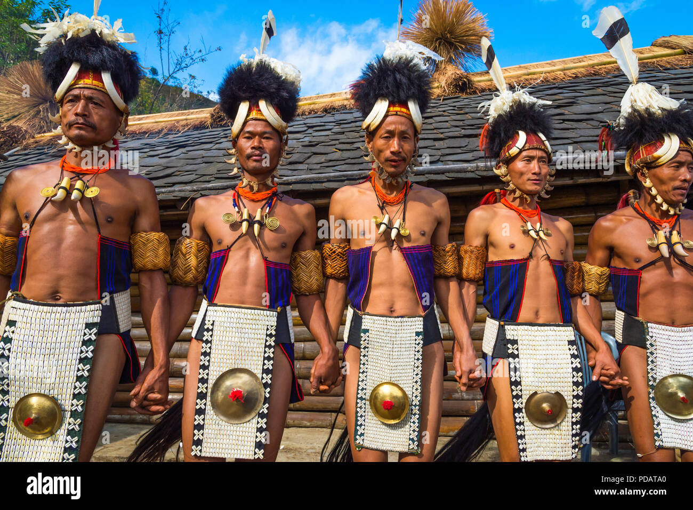
The Naga Tribe
- The Naga tribe is known for its vibrant culture, traditional attire, and unique headwear. They are primarily found in the state of Nagaland, with some communities residing in neighboring states. The Naga people are known for their strong warrior traditions and their love of music and dance.

Slide 4
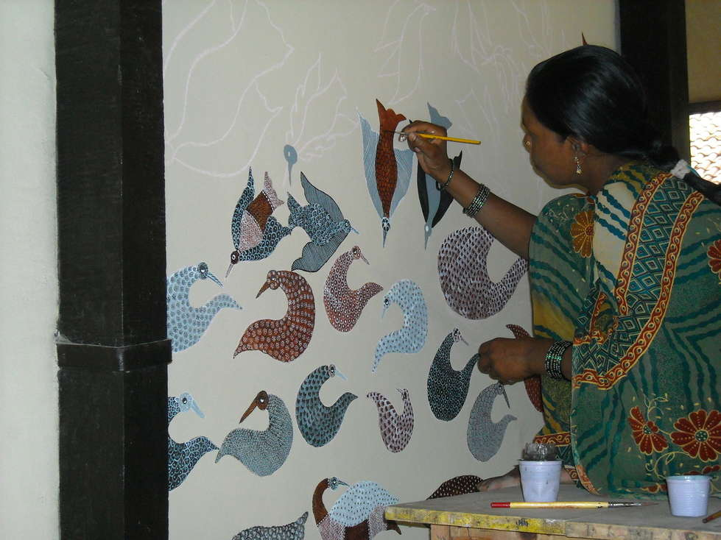
The Gond Tribe
- The Gond tribe is one of the largest tribal groups in India, found mainly in central India. They are known for their rich oral traditions, intricate art forms, and their connection to the forest. The Gond people have a strong belief in nature and their deities, which is reflected in their art and rituals.

Slide 5
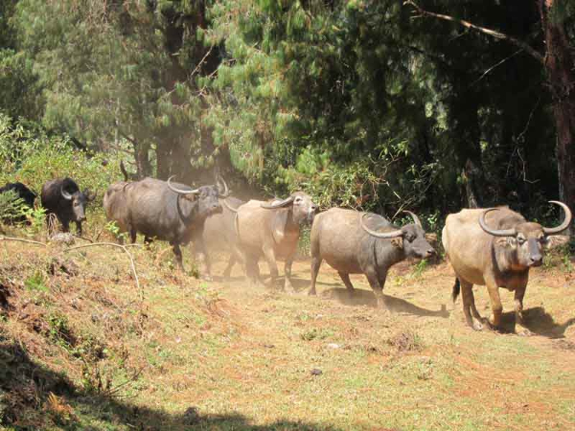
The Toda Tribe
- The Toda tribe is a unique community found in the Nilgiri Hills of South India. They are known for their pastoral lifestyle, their distinctive buffalo-herding practices, and their traditional wooden houses. The Toda people have a strong sense of community and a deep respect for their traditions.

Slide 6
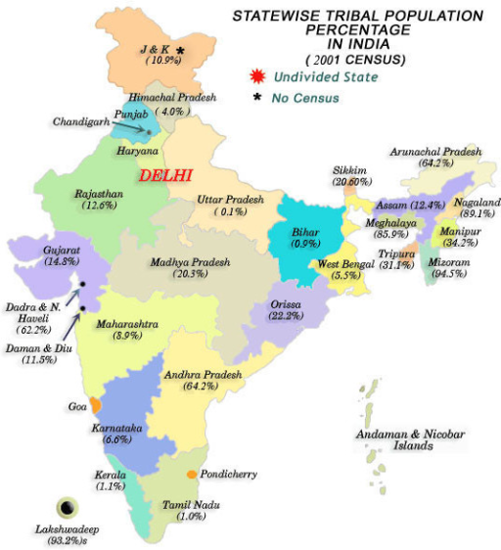
Tribal Population and Challenges
- India's tribal population is estimated to be around 104 million, representing a significant portion of the country's population. Many tribal communities face challenges such as poverty, lack of access to education and healthcare, and displacement due to development projects.

Slide 7
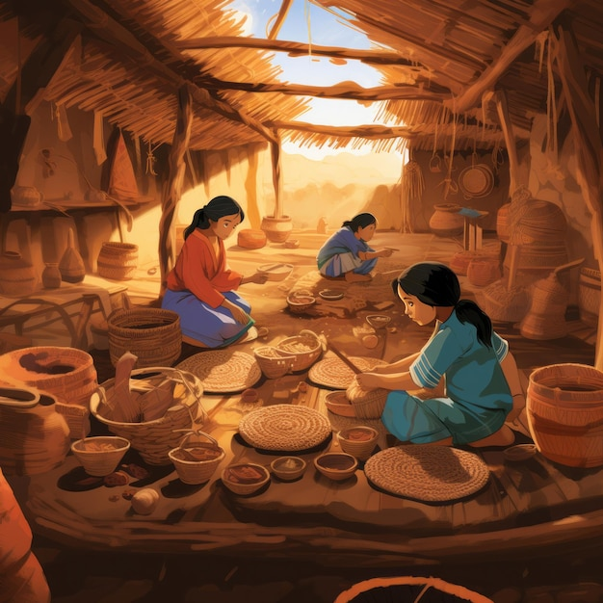
Protecting Tribal Heritage
- Efforts are being made to protect tribal culture and traditions through initiatives like: - Preservation of tribal languages and art forms. - Promoting tribal tourism to support their livelihoods. - Empowering tribal communities through education and skill development.

