Slide 1
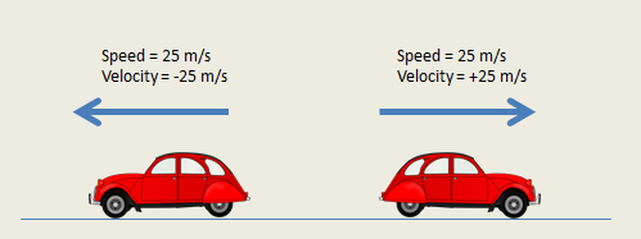
Introduction to Equations of Motion
- Equations of motion describe the movement of objects. They relate position, velocity, acceleration, and time. There are three main equations of motion for constant acceleration.

Slide 2
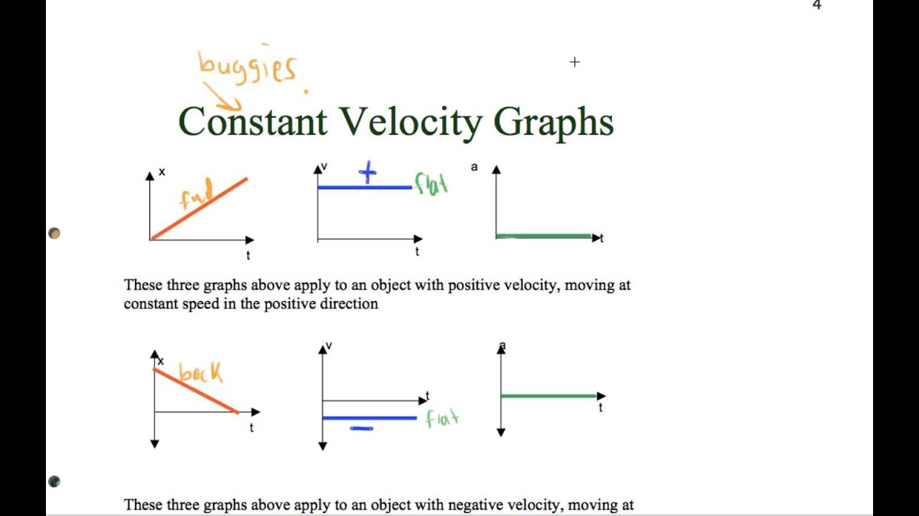
First Equation of Motion
- v = u + at v: final velocity u: initial velocity a: acceleration t: time

Slide 3
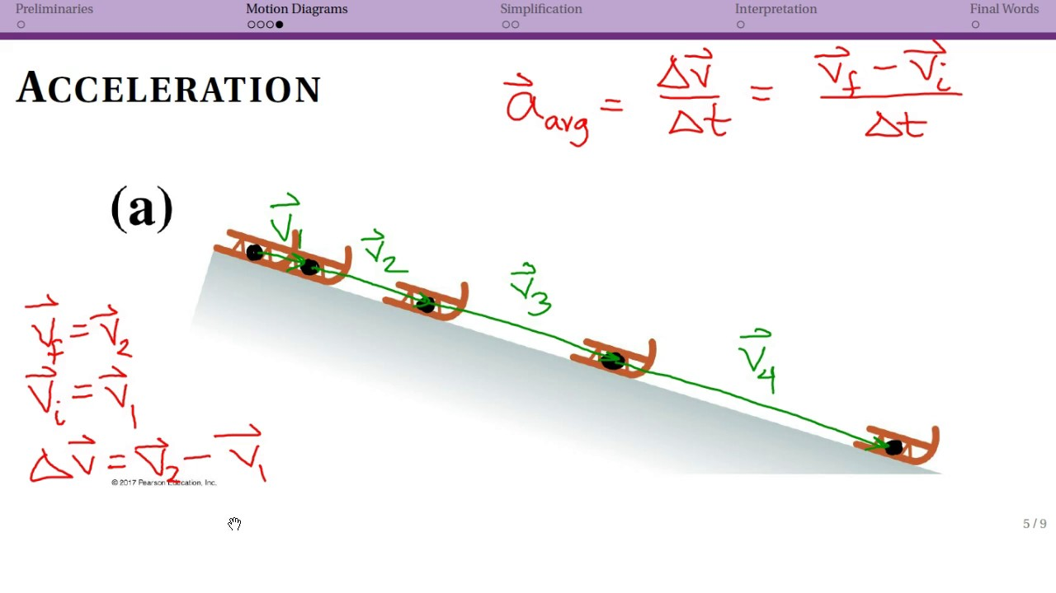
Second Equation of Motion
- s = ut + (1/2)at² s: displacement u: initial velocity a: acceleration t: time

Slide 4
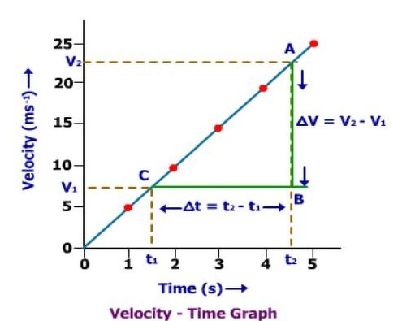
Third Equation of Motion
- v² = u² + 2as v: final velocity u: initial velocity a: acceleration s: displacement

Slide 5

Applications of Equations of Motion
- Calculating the distance traveled by a car. Predicting the trajectory of a projectile. Designing the motion of a rocket.

Slide 6

Conclusion
- Equations of motion are fundamental to understanding motion. They provide a mathematical framework for describing and predicting movement. They have wide applications in various fields.

