Slide 1

Higher Education Institutions Expand Their Online Learning Programs
- Higher education institutions are experiencing a high demand for online courses. This is due to the flexibility and convenience of online learning. More local schools are offering online courses to enable students to stay within their communities.

Slide 2
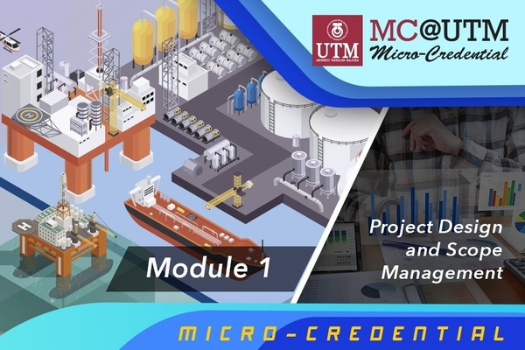
MOOCs Partner with Educational Institutions to Focus on Micro-credentials
- MOOCs (Massive Open Online Courses) are experiencing a surge in enrollment. MOOCs are partnering with educational institutions to offer stackable micro-credentials. Micro-credentials are becoming increasingly popular, with governments worldwide encouraging their use.

Slide 3

Learners Empowered Through Mobile Learning and Microlearning
- Mobile learning is becoming increasingly popular due to its portability and accessibility. Microlearning, which delivers content in small bursts, is a key aspect of mobile learning. Microlearning can help learners engage with content, retain information, and learn on demand.

Slide 4

AI Provides Personalized Learning Pathways
- AI is being used in education to personalize learning pathways. AI-powered systems can track student progress and recommend resources based on their needs. Personalized learning pathways can help students stay engaged, motivated, and on track.

Slide 5
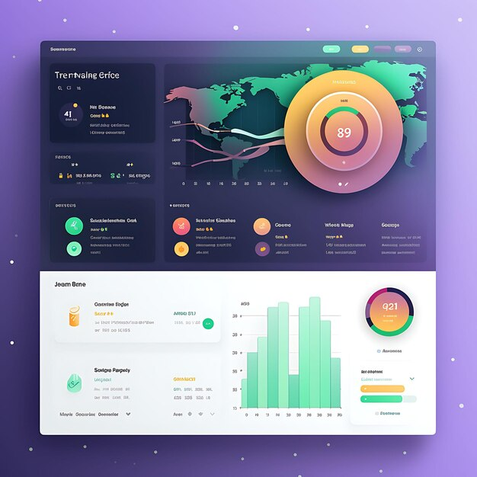
Learning Analytics Help Enhance Learning Outcomes
- Learning analytics is being used to understand and optimize learning outcomes. Learning Management Systems (LMS) provide data-driven insights into student performance. Learning analytics can help educators identify areas for improvement and make informed decisions.

Slide 6

Video-based Learning Expands to Maximize the Impact of Mobile Learning
- Video-based learning is becoming increasingly popular, particularly among younger generations. Interactive video-based learning is emerging as a more engaging and effective format. Video-based learning can be used as a stand-alone learning material or as a supplement to traditional instruction.

Slide 7

5G Stimulates Immersive Learning Experiences
- 5G technology is expected to revolutionize immersive learning experiences. 5G will enable more flexible learning, immersive lessons with AR & VR, and efficient feedback gathering. 5G will also enhance the user experience with video-based learning.

Slide 8

OER Continues to Gain Widespread Adoption
- Open Educational Resources (OER) are becoming increasingly popular as the cost of higher education rises. OER provides free and openly licensed educational materials. OER is gaining widespread adoption in the US and other countries.

Slide 9

Gamification and Serious Games Gain Momentum in The Academe
- Gamification and serious games are being used to increase learner engagement and motivation. Gamification strategies, such as badges and leaderboards, can encourage student participation and social engagement. Serious games can be used to teach specific skills and concepts in a fun and engaging way.

Slide 10
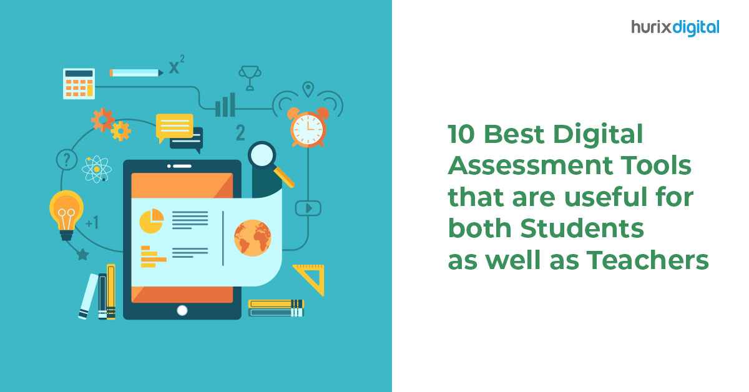
Technology-Powered Tools Become the Future of Assessment
- Technology-powered assessment tools are becoming the future of assessment. These tools provide immediate feedback, increase efficiency, and integrate formative and summative assessments. AI-enabled assessment tools are also emerging, providing personalized and adaptive assessments.

