Slide 1
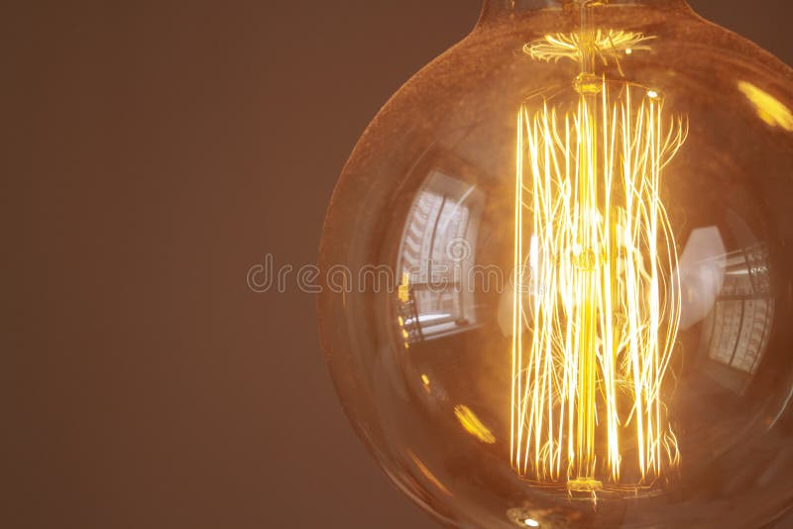
The Light Bulb
- Invention revolutionized lighting. Provided safer, brighter illumination. Led to advancements in technology.

