Slide 1
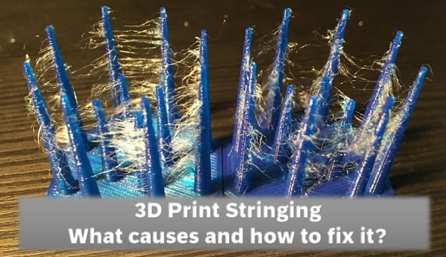
Introduction to 3D Printing Defects
- 3D printing defects are common. Understanding causes and solutions is key to success. We'll cover 13 common defects.

Slide 2
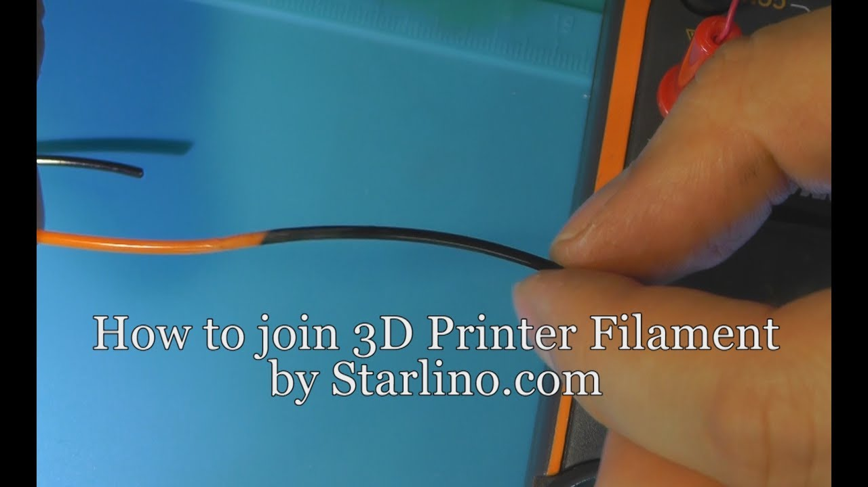
Stringing (Oozing)
- Thin strands of filament between parts. Caused by insufficient retraction or high print temperature. Solutions: Increase retraction, lower temperature.

Slide 3
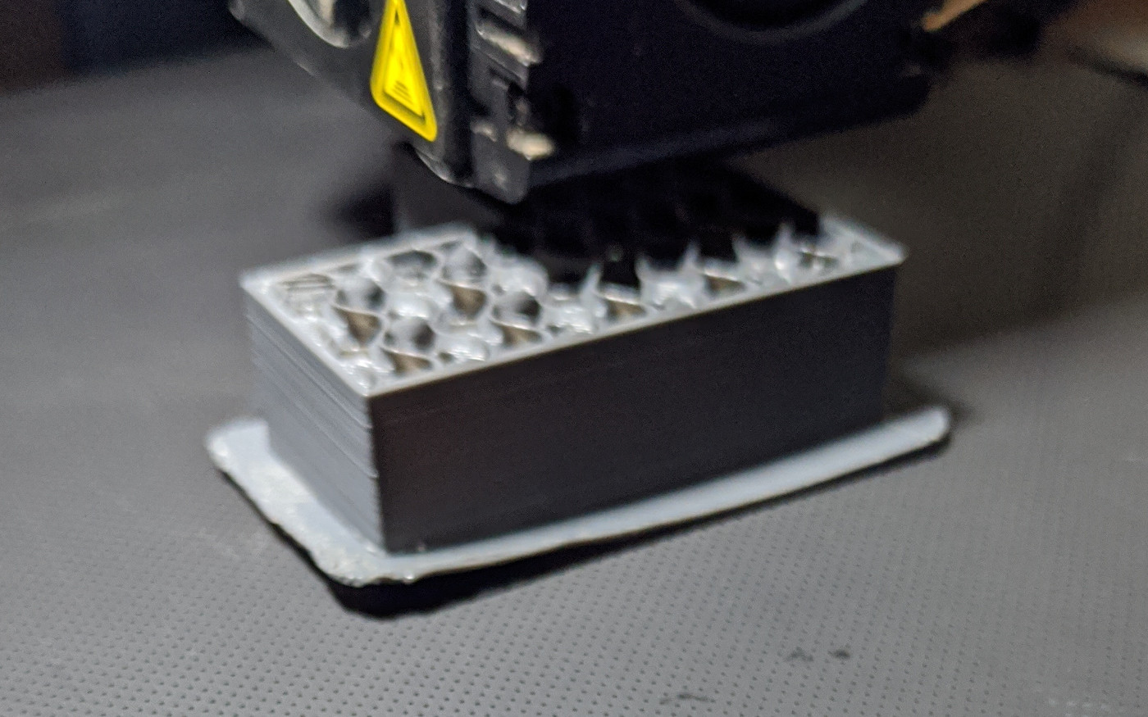
Warping
- Corners of the print lift from the bed. Caused by uneven cooling or poor bed adhesion. Solutions: Heated bed, adhesive, brim or raft.

Slide 4
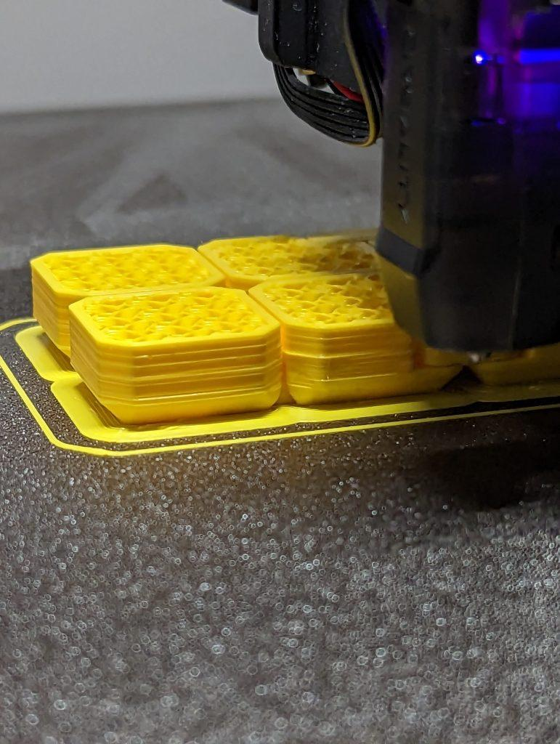
Layer Shifting
- Layers are misaligned, creating a stepped look. Caused by loose belts or stepper motor problems. Solutions: Tighten belts, reduce print speed.

Slide 5
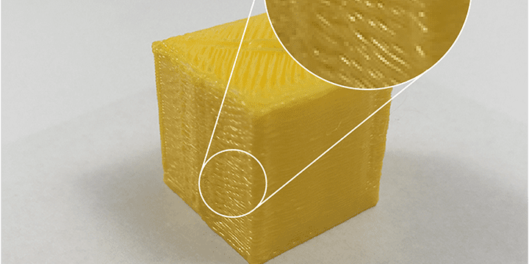
Under-Extrusion
- Thin or incomplete layers. Caused by a clogged nozzle or low extrusion settings. Solutions: Clean the nozzle, increase flow rate.

Slide 6
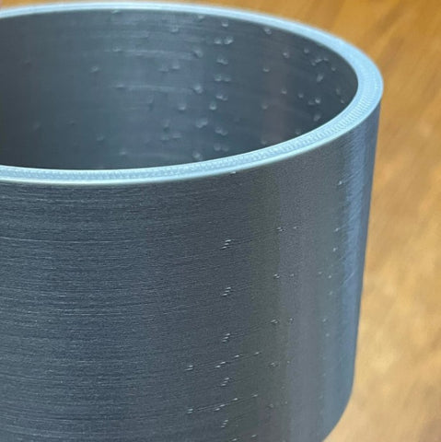
Over-Extrusion
- Excess filament, causing blobs and rough surfaces. Caused by high extrusion settings. Solutions: Decrease flow rate.

Slide 7
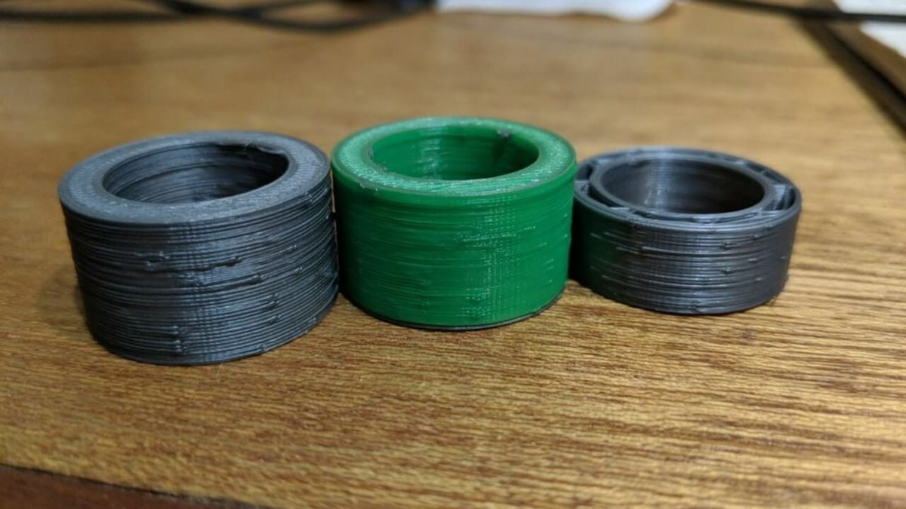
Zits and Blobs
- Small bumps on the print surface. Caused by inconsistent retraction or start/stop points. Solutions: Optimize retraction, use Z-seam alignment.

Slide 8
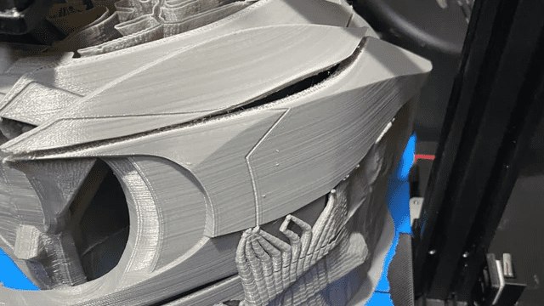
Layer Separation (Delamination)
- Layers split apart or don't bond. Caused by low temperature, insufficient cooling, or poor material. Solutions: Increase temperature, use a heated enclosure.

Slide 9
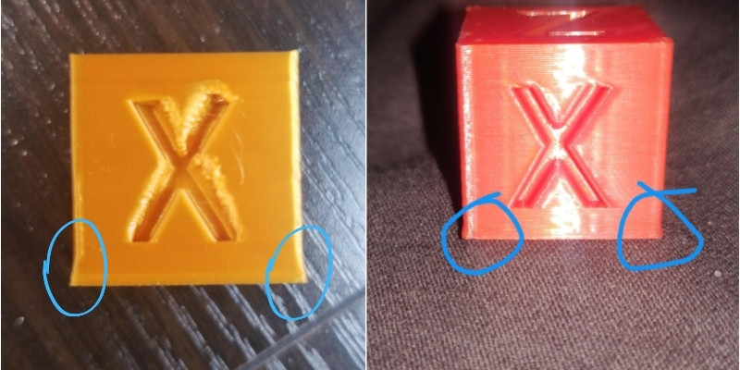
Elephant's Foot
- Bulging at the base of the print. Caused by excessive bed temperature or a squished first layer. Solutions: Lower bed temperature, adjust Z-offset.

Slide 10
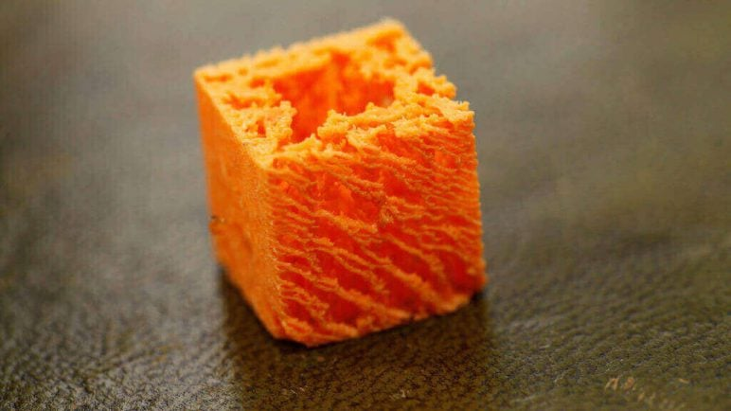
Stringy or Brittle Layers
- Weak or inconsistent layer bonding. Caused by low temperature or poor filament quality. Solutions: Increase temperature, use high-quality filament.

Slide 11
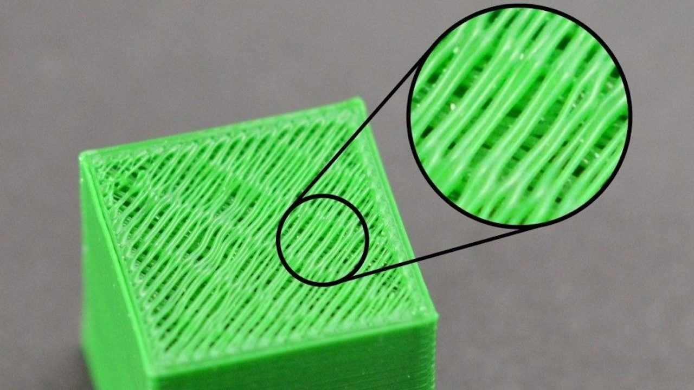
Gaps in Top Layers
- Holes or thin areas on the top surface. Caused by low infill or insufficient top layers. Solutions: Increase infill, add more top layers.

Slide 12
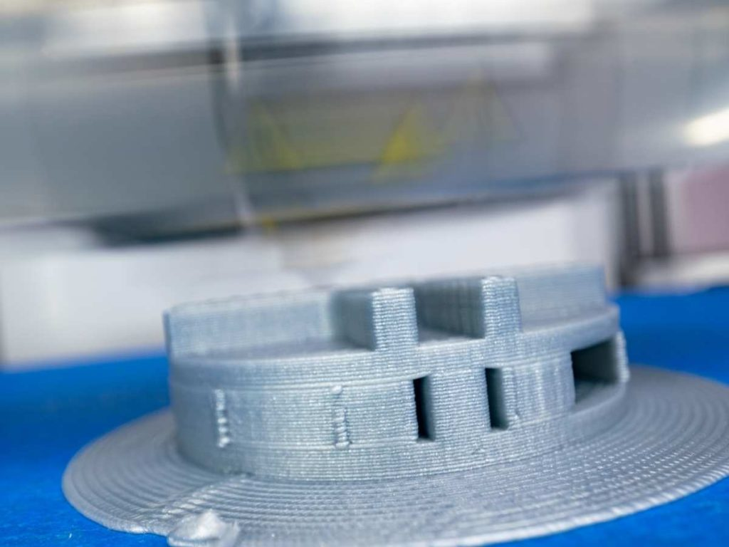
Bridging Issues
- Sagging or uneven filament in bridge sections. Caused by insufficient cooling or high print speed. Solutions: Enhance cooling, reduce print speed.

Slide 13
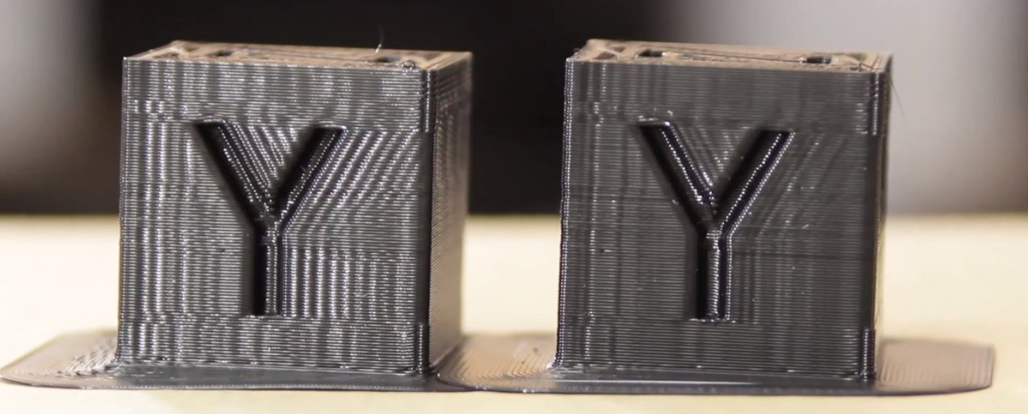
Ghosting (Ringing)
- Ripple-like patterns near edges. Caused by vibrations or high speed/loose belts. Solutions: Reduce speed, ensure printer stability.

Slide 14
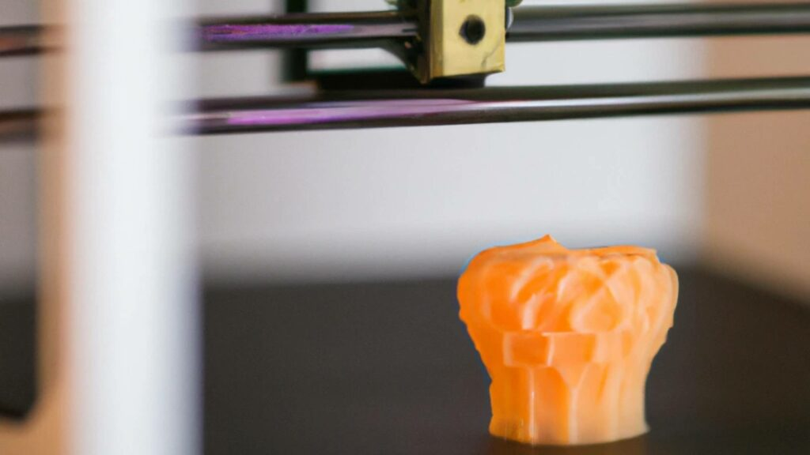
Overheating
- Slumped or melted details. Caused by high temperature or inadequate cooling. Solutions: Reduce temperature, improve cooling.

Slide 15
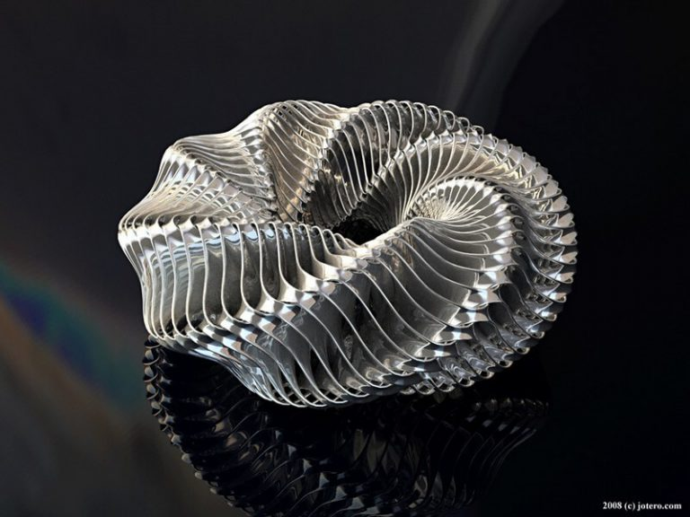
Conclusion
- Troubleshooting is iterative. Experiment to find optimal settings. Happy printing!

