Slide 1
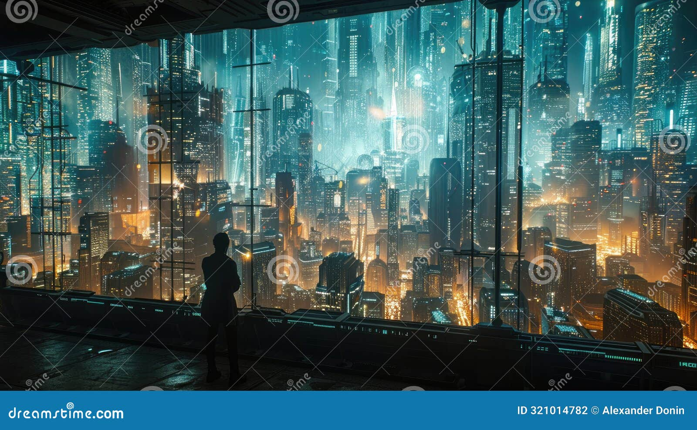
Introduction
- This video will explore the world of text-to-video AI apps. We'll discuss their capabilities, benefits, and potential applications.

Slide 2

What are Text-to-Video AI Apps?
- Text-to-video AI apps use artificial intelligence to transform written text into video content. They analyze the text, generate visuals, and even add sound and music.

Slide 3

Benefits of Text-to-Video AI Apps
- Time-Saving: Create videos quickly and efficiently without the need for complex video editing software. Cost-Effective: Reduce the cost of video production by automating some of the processes. Accessibility: Enable anyone to create professional-looking videos, regardless of their technical skills.

Slide 4

Applications of Text-to-Video AI Apps
- Marketing and Advertising: Create engaging video ads and product demos. Education and Training: Develop interactive and engaging learning materials. Entertainment: Generate short videos for social media platforms and storytelling.

Slide 5

The Future of Text-to-Video AI
- Expect further advancements in AI technology, leading to even more realistic and sophisticated videos. The potential for personalized and interactive video experiences is vast.

Slide 6
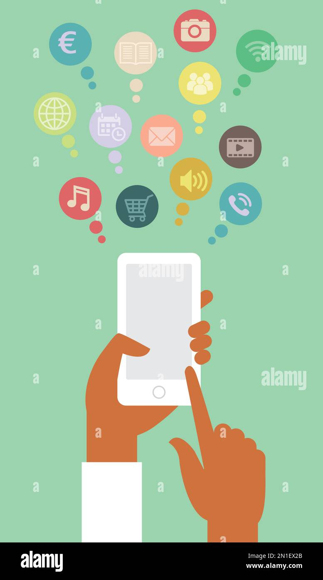
Conclusion
- Text-to-video AI apps are transforming the way we create and consume video content. They offer a powerful and accessible tool for anyone looking to create engaging and impactful videos.

