Slide 1

Introduction to Immunyfit
- Pioneering healthcare initiative for autoimmune and gut disorders. Automated, data-driven, personalized digital platform. Collaboration with healthcare professionals for enhanced care.

Slide 2

Immunyfit's Mission
- Empower individuals to reclaim control over their health. Personalized plans for symptom alleviation and improved quality of life. Holistic interventions for better health outcomes.

Slide 3
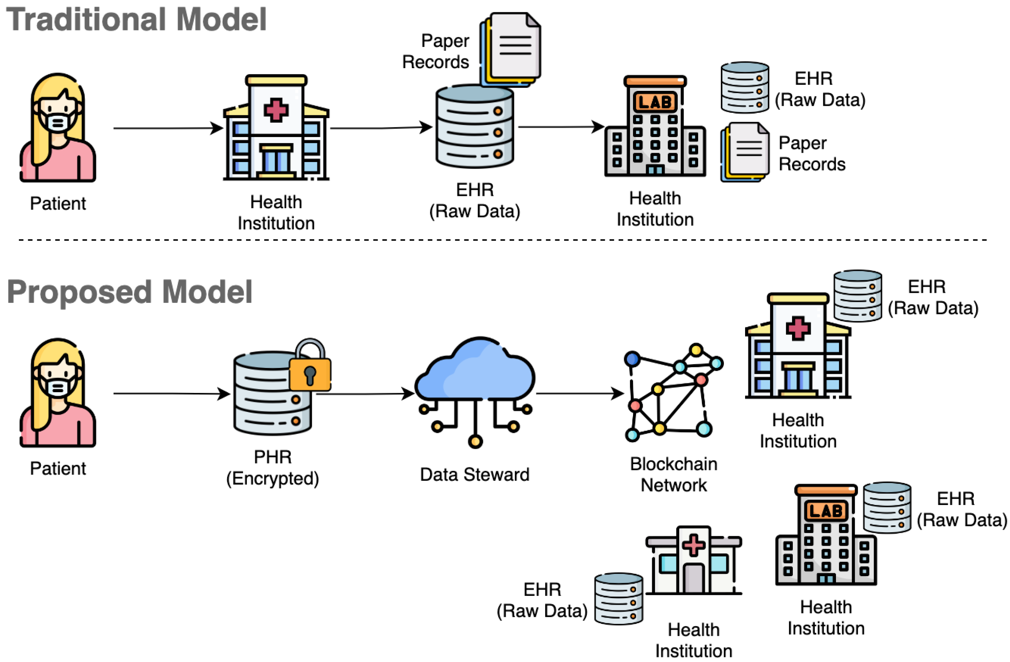
The Immunyfit Platform
- Personalized data-driven assessments and management strategies. Utilizes systems biology and structured scientific knowledge. Collaboration with rheumatologists, immunologists, and gastroenterologists.

Slide 4

Key Features of the Platform
- Personalized Digital Health Assessments. Integrated Care Pathways. Nutraceuticals and Lifestyle Interventions. Clinician Support.

Slide 5

How the Platform Works
- Consultation with board-certified specialists. Personalized data collection (genetics, treatment history, etc.). Systems biology platform integrates data for holistic picture. Personalized treatment plan within 90 days.

Slide 6

The Immunyfit Team
- Scientists, doctors, and experienced patients. Nearly two decades of experience in disease management.

