Slide 1
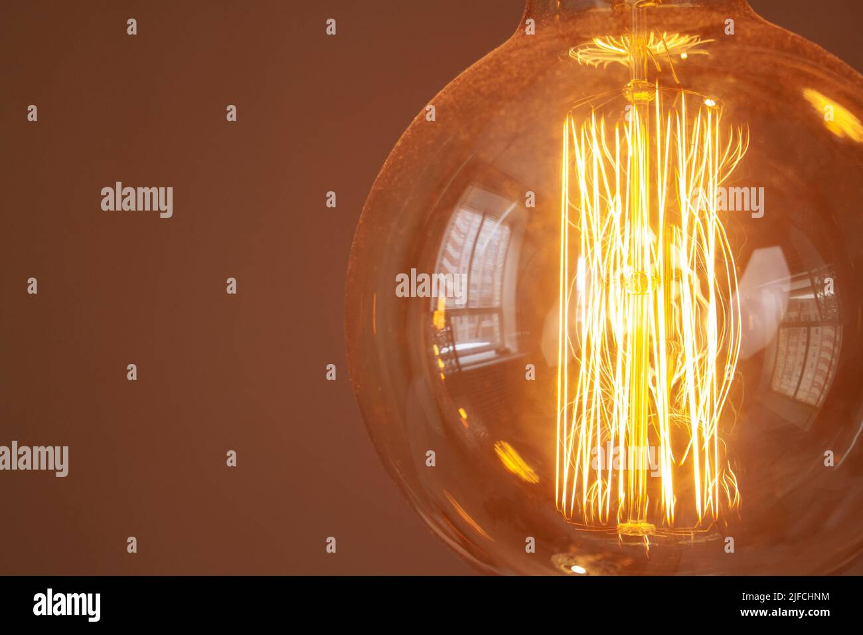
The Amazing Light Bulb
- Invented by Thomas Edison (though others contributed). Revolutionized lighting and daily life. Enabled longer working hours and safer nighttime activities.

