Slide 1
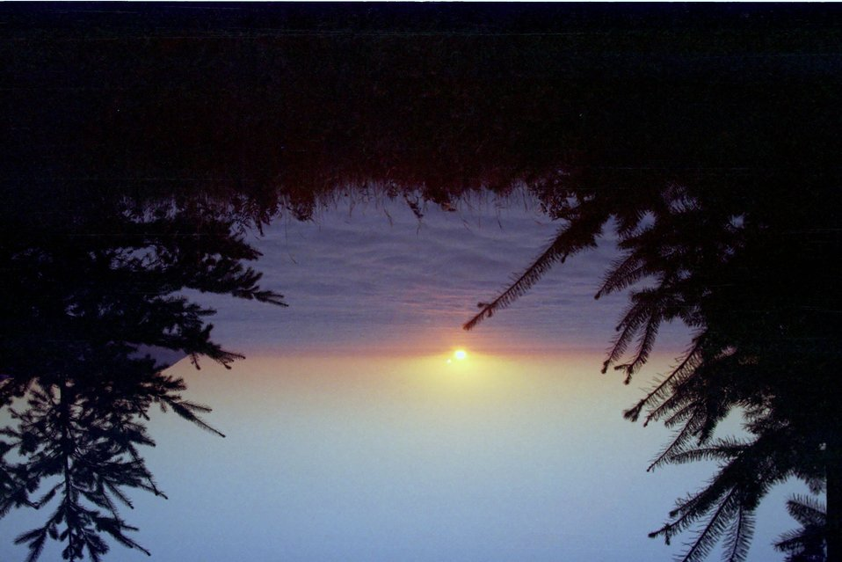
Money
- Money is a medium of exchange. It is used to buy goods and services. [Image Description in english only: A photo of various currencies from around the world, including coins and bills.]

