Slide 1
Introduction to L-Section Matching Networks
- L-section matching networks are the simplest type of matching network. They use two reactive elements to match an arbitrary load impedance to a transmission line. There are two possible configurations for this network, depending on the location of the normalized load impedance on the Smith chart.

Slide 2

L-Section Network Configurations
- If the normalized load impedance is inside the 1 + jx circle on the Smith chart, use the configuration with the series reactance followed by the shunt susceptance. If the normalized load impedance is outside the 1 + jx circle on the Smith chart, use the configuration with the shunt susceptance followed by the series reactance.

Slide 3
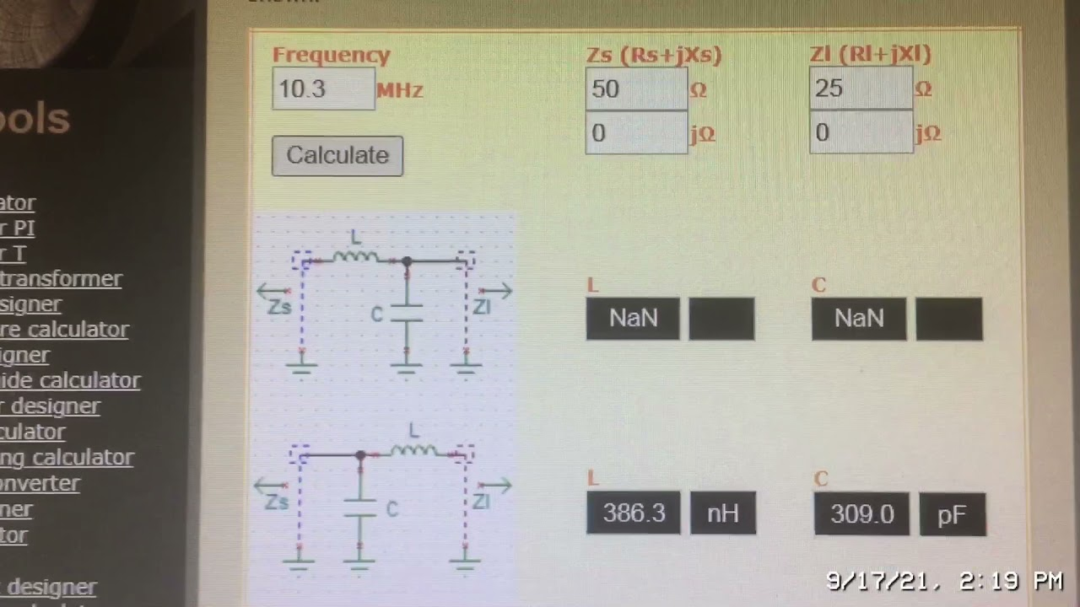
Determining the Reactive Elements
- The reactive elements in the L-section network can be either inductors or capacitors, depending on the load impedance. There are eight distinct possibilities for the matching circuit for various load impedances. Analytic expressions can be derived for the matching network elements.

Slide 4

Analytic Solution for the L-Section Network
- The impedance seen looking into the matching network, followed by the load impedance, must be equal to Z0 for an impedance-matched condition. This leads to two equations for the two unknowns, X and B, which represent the series reactance and shunt susceptance, respectively. Solving these equations gives expressions for X and B in terms of the load impedance and the characteristic impedance.

Slide 5

Smith Chart Solution for the L-Section Network
- The Smith chart can be used as a graphical tool to design L-section matching networks. The process involves finding the load impedance on the Smith chart and then moving it to the desired impedance point (Z0) using the appropriate L-section network configuration. The values of the reactive elements can be read directly from the Smith chart.

Slide 6
Example of L-Section Matching Network Design
- Consider a load impedance of ZL = 200 - j100 ohms and a characteristic impedance of Z0 = 100 ohms. The Smith chart can be used to find two possible L-section matching networks. The reflection coefficient magnitude versus frequency can be plotted to compare the bandwidth of the two solutions.

Slide 7
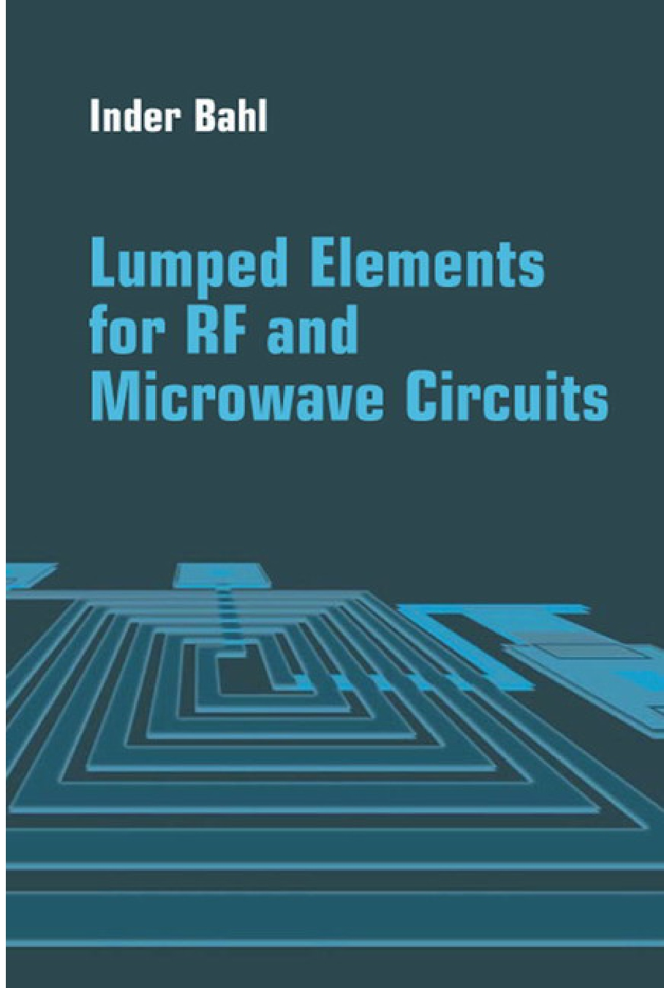
Lumped Elements for Microwave Integrated Circuits
- Lumped R, L, and C elements can be practically realized at microwave frequencies if the length of the component is very small relative to the operating wavelength. However, the characteristics of such elements are far from ideal, requiring that undesirable effects such as parasitic capacitance and inductance, spurious resonances, fringing fields, loss, and perturbations caused by a ground plane be incorporated in the design.

