Slide 1
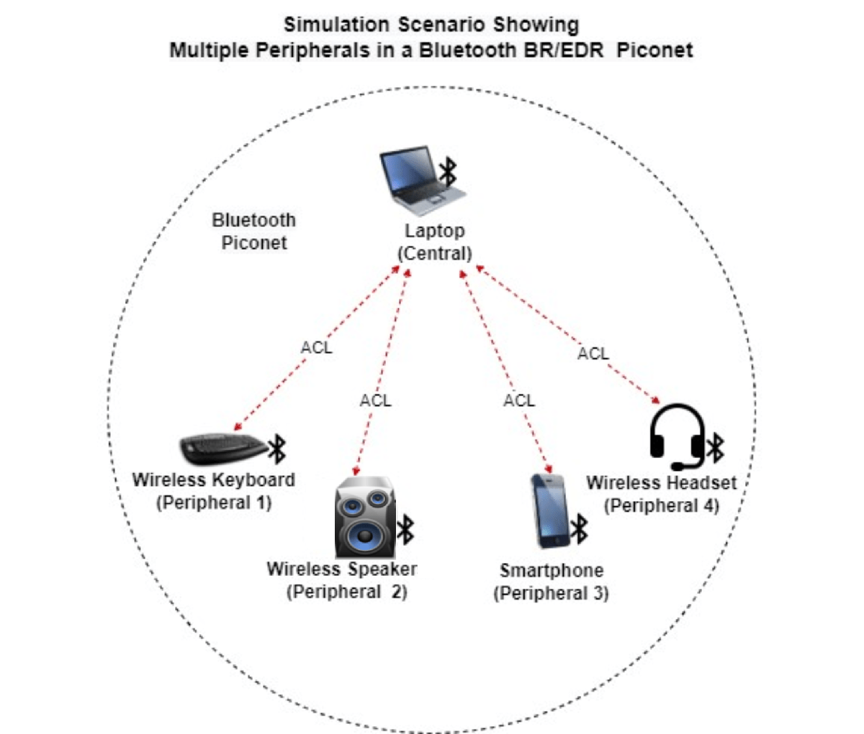
Bluetooth: Wireless Communication
- Bluetooth is a wireless communication technology that allows devices to connect and exchange data over short distances. It uses radio waves in the 2.4 GHz band, which is unlicensed and widely available. Bluetooth is a popular technology for connecting a wide range of devices, including: - Smartphones - Laptops - Headphones - Smartwatches - Printers - Speakers - Car systems

