Slide 1

What is AI?
- Artificial intelligence (AI) is the simulation of human intelligence processes by computer systems. These processes include learning, problem-solving, and decision-making.

Slide 2
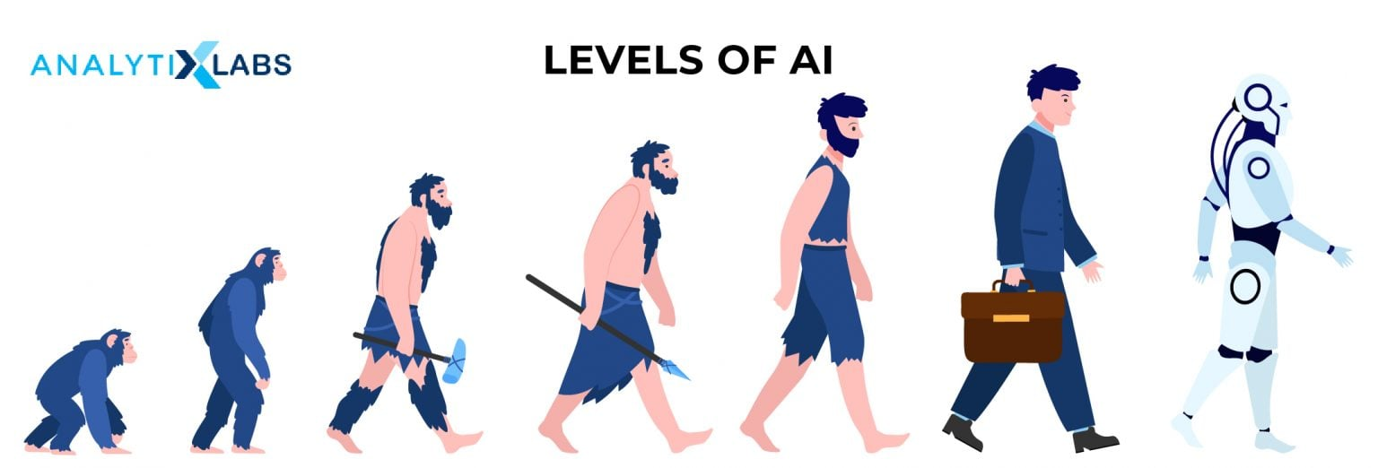
Types of AI
- Narrow AI: Designed for specific tasks, like playing chess or recognizing faces. General AI: Aims to create machines with human-level intelligence capable of performing any intellectual task. Super AI: Hypothetical AI surpassing human intelligence in all aspects.

Slide 3
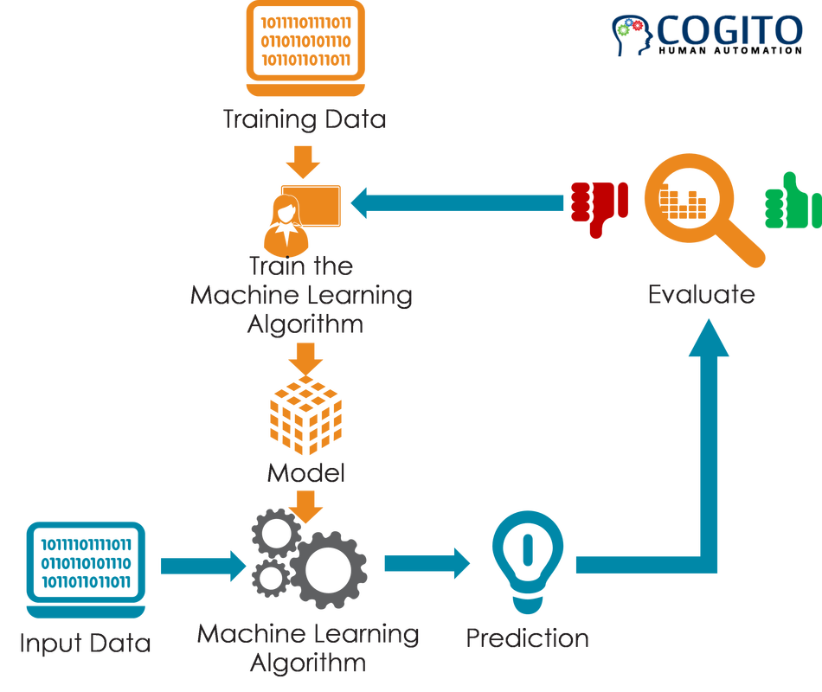
How AI Works
- Machine Learning: AI systems learn from data without explicit programming. Deep Learning: A subset of machine learning using artificial neural networks inspired by the human brain. Natural Language Processing (NLP): Enables computers to understand and process human language.

Slide 4
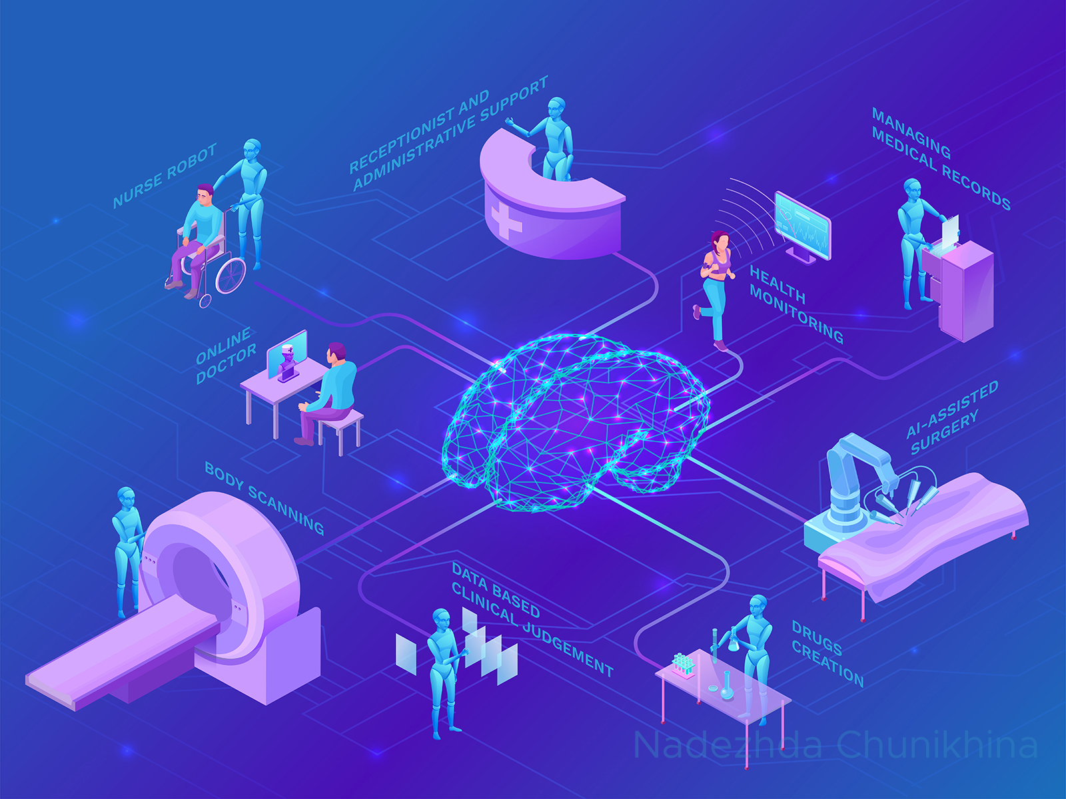
Applications of AI
- Healthcare: Diagnosing diseases, developing personalized treatments. Finance: Fraud detection, risk assessment, automated trading. Transportation: Self-driving cars, traffic optimization. Entertainment: Recommending movies, creating realistic video games.

Slide 5
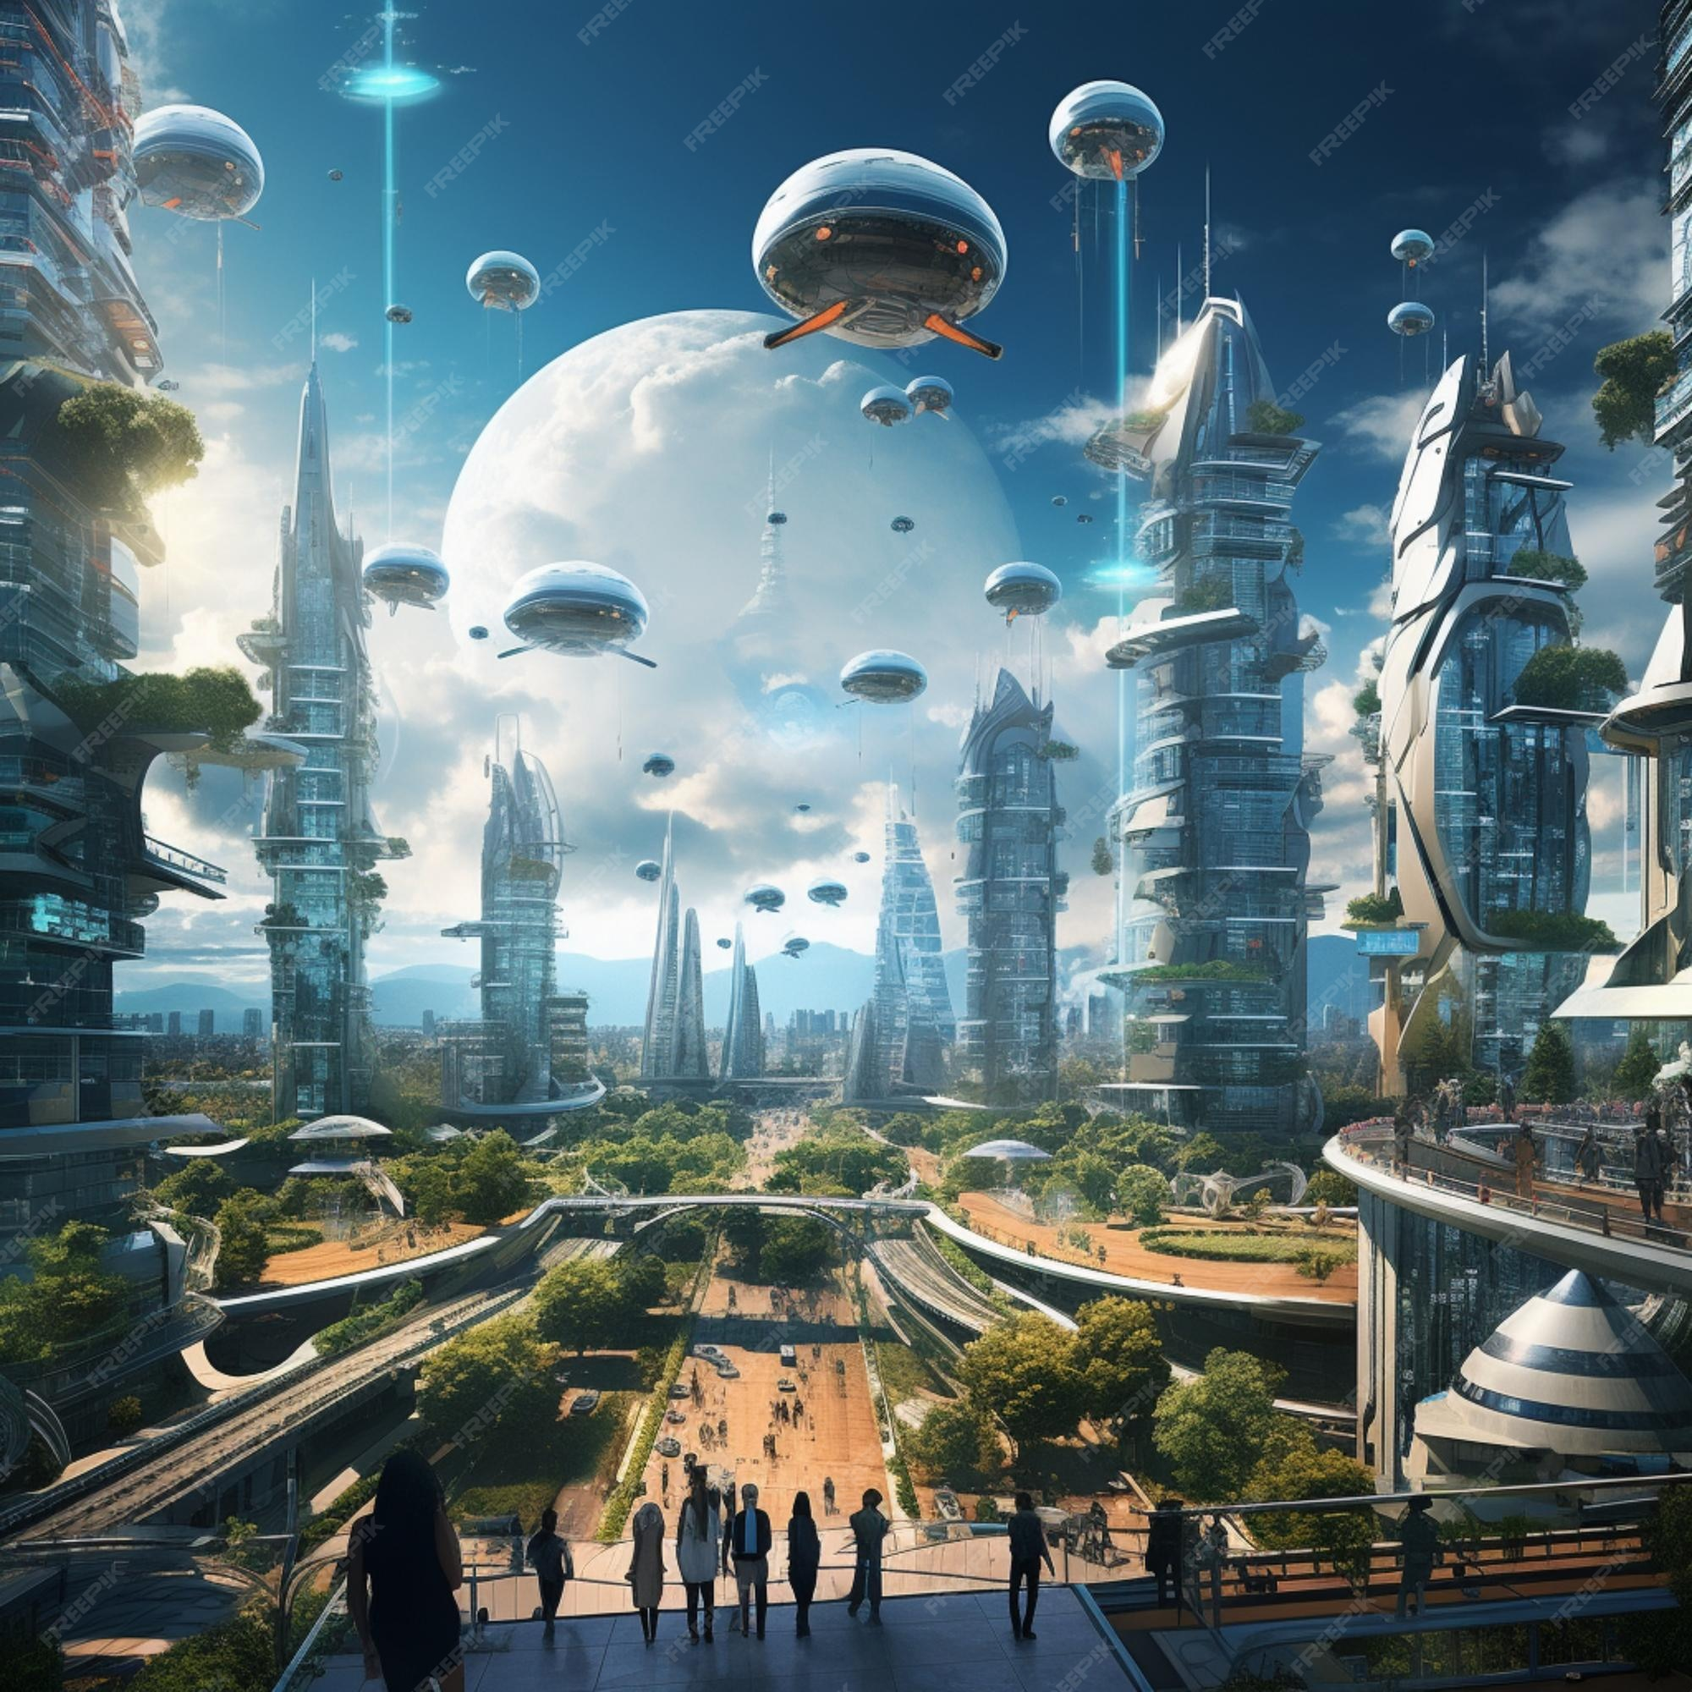
The Future of AI
- AI is rapidly evolving, with new breakthroughs happening all the time. It has the potential to revolutionize many industries and aspects of our lives. However, it's important to consider the ethical implications of AI and ensure its responsible development.

Slide 6

Conclusion
- AI is a powerful tool with the potential to solve complex problems and improve our lives. It's important to stay informed about AI and its developments.

