Slide 1
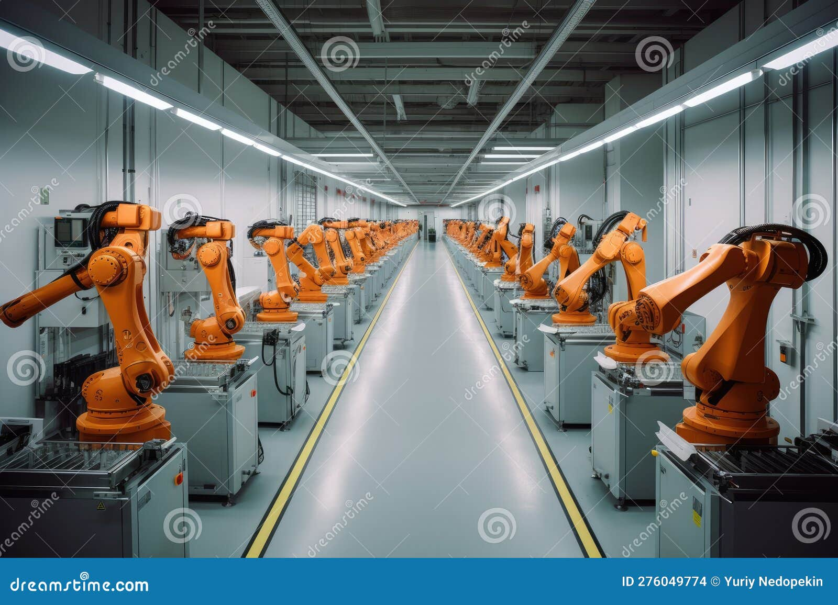
Introduction to Swarm Robotics
- Swarm robotics is a field of robotics that studies the collective behavior of multiple robots. These robots, often called agents, are simple and autonomous, but can achieve complex tasks through cooperation. The inspiration for swarm robotics comes from natural systems like ant colonies and bird flocks.

Slide 2
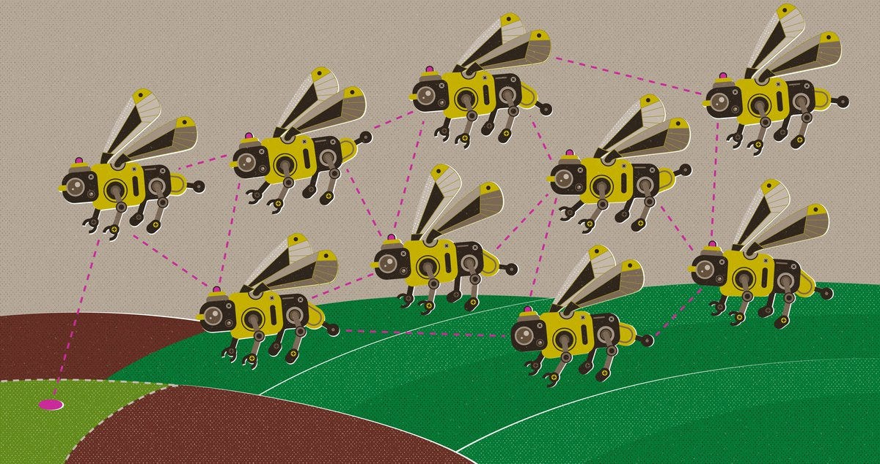
Key Concepts in Swarm Robotics
- Decentralization: Each robot operates independently, making decisions based on local information. Self-Organization: Robots emerge into complex patterns and behaviors without central control. Robustness: The system is resilient to failures, as the loss of individual robots doesn't significantly impact the overall task. Scalability: The system can be easily scaled by adding or removing robots.

Slide 3

Applications of Swarm Robotics
- Search and Rescue: Robots can work together to explore disaster zones and locate survivors. Environmental Monitoring: Robots can be deployed to monitor air quality, water pollution, or wildlife populations. Manufacturing and Logistics: Robots can be used for tasks like assembly, transportation, and inventory management. Agriculture: Robots can assist with tasks like planting, harvesting, and pest control.

Slide 4

Challenges in Swarm Robotics
- Coordination and Communication: Designing effective communication and coordination strategies for robots to work together. Robot Design: Developing robots with the right capabilities for specific tasks and environments. Task Allocation: Assigning tasks to robots efficiently and dynamically. Real-world Deployment: Adapting swarm robotics systems to real-world complexities and uncertainties.

Slide 5

Future of Swarm Robotics
- Continued research and development in areas like AI, sensor technology, and communication will lead to more sophisticated swarm robotics systems. Applications in areas like healthcare, space exploration, and personalized robotics are expected to emerge. Swarm robotics has the potential to revolutionize how we interact with technology and solve complex problems.

