Slide 1
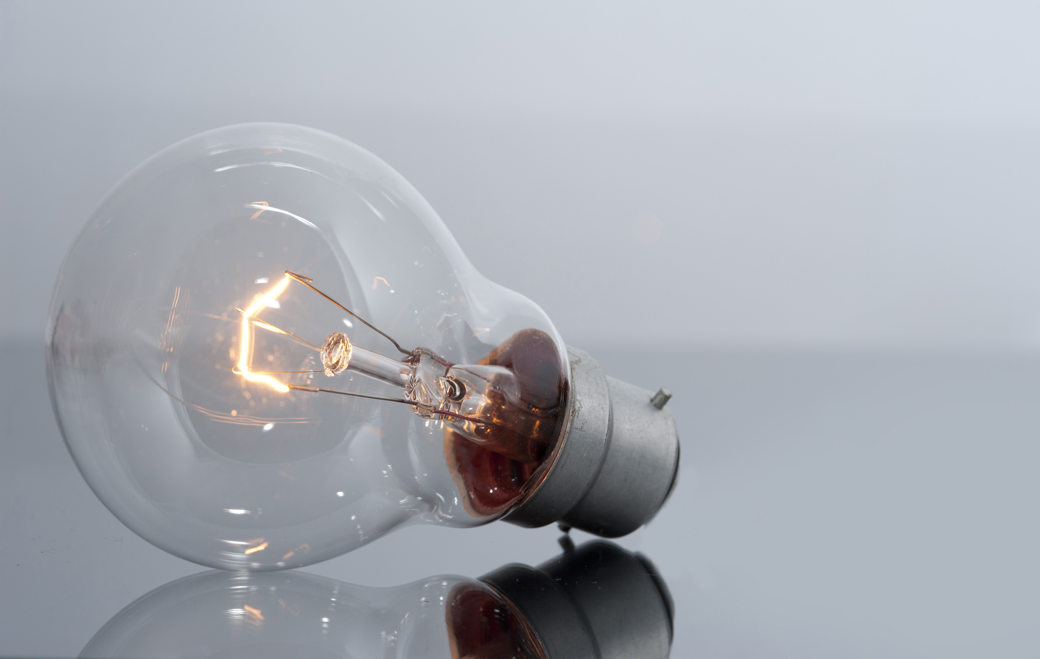
The Amazing Light Bulb
- Invention that changed the world. Provides illumination at night. Different types exist (incandescent, fluorescent, LED).

