Slide 1
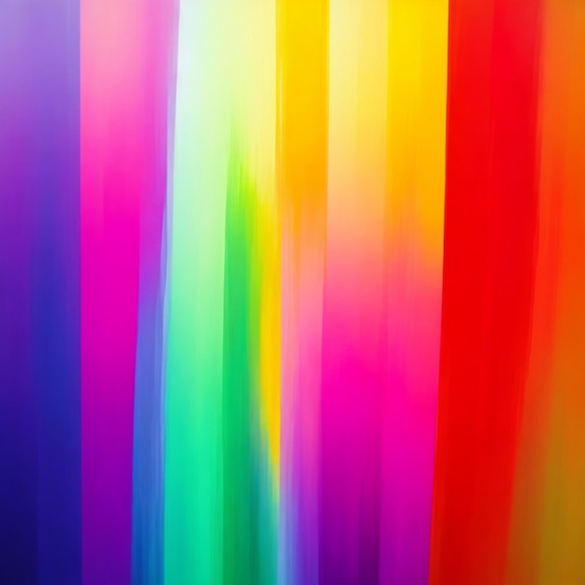
The Wonders of Light
- Light enables us to see. Light is a form of energy. Light travels in waves.

