Slide 1
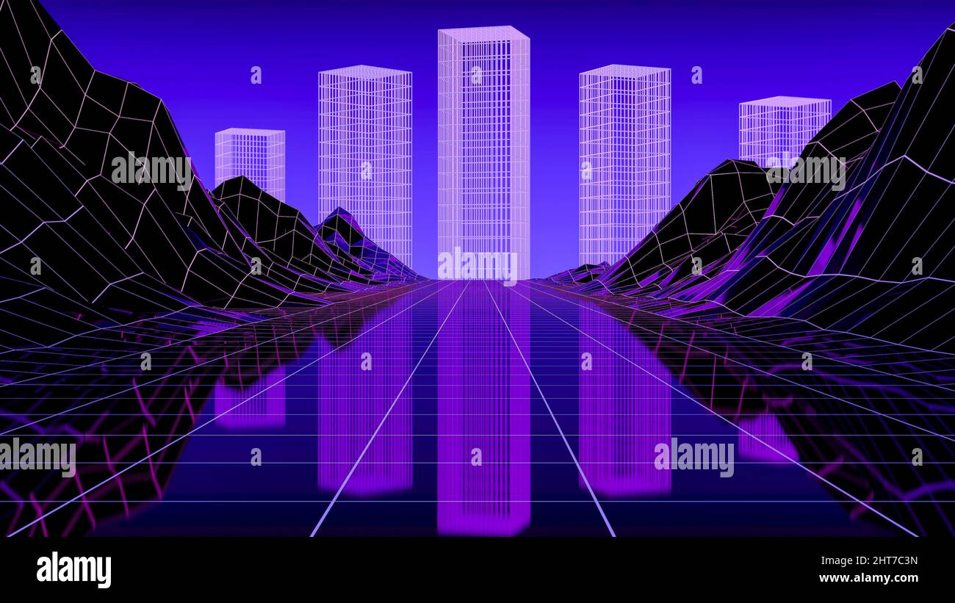
Electricity: The Power Behind Our World
- Electricity is the flow of electric charge. It powers our homes, industries, and transportation. Understanding electricity is crucial for modern life.

