Slide 1
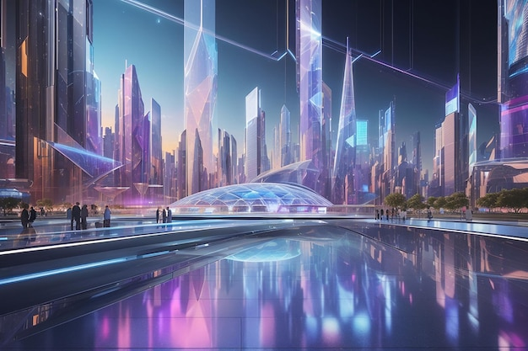
AI & HR in 2025
- Exploring the impact of AI on Human Resources by 2025. Key trends and applications. Potential benefits and challenges.

Slide 2
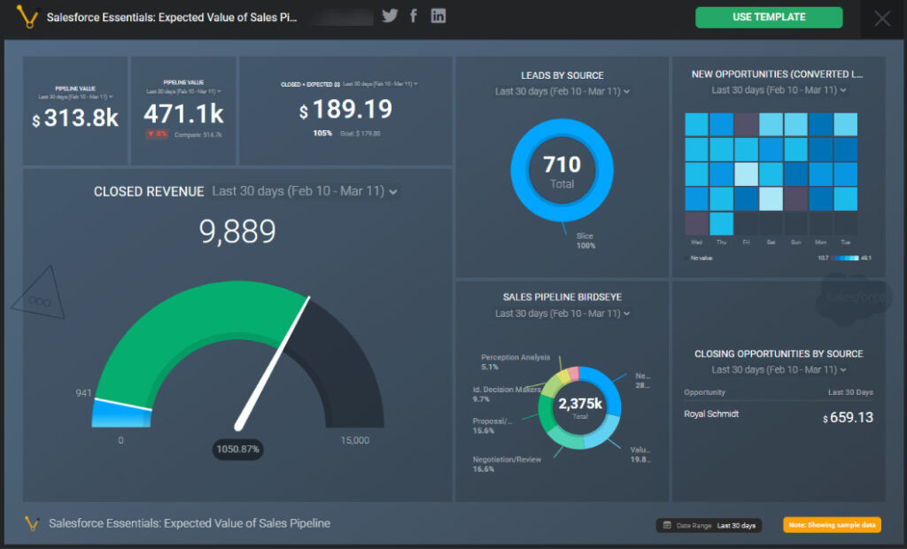
AI-Powered Recruitment
- Automated candidate screening and sourcing. AI-driven interview scheduling and analysis. Improved candidate matching and diversity initiatives.

Slide 3
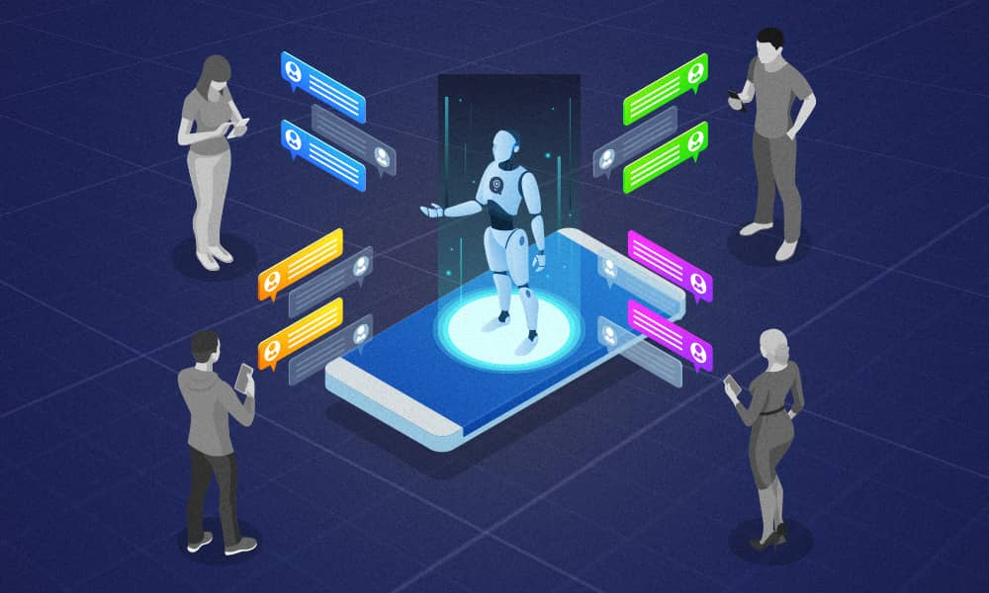
Employee Onboarding and Training
- Personalized onboarding experiences using AI chatbots. AI-powered learning platforms for customized training. Automated performance tracking and feedback systems.

Slide 4
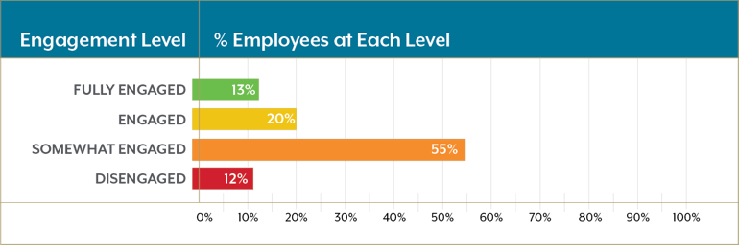
Employee Engagement and Wellbeing
- AI-driven sentiment analysis of employee feedback. Predictive analytics to identify potential burnout risks. Personalized wellness programs based on individual needs.

Slide 5
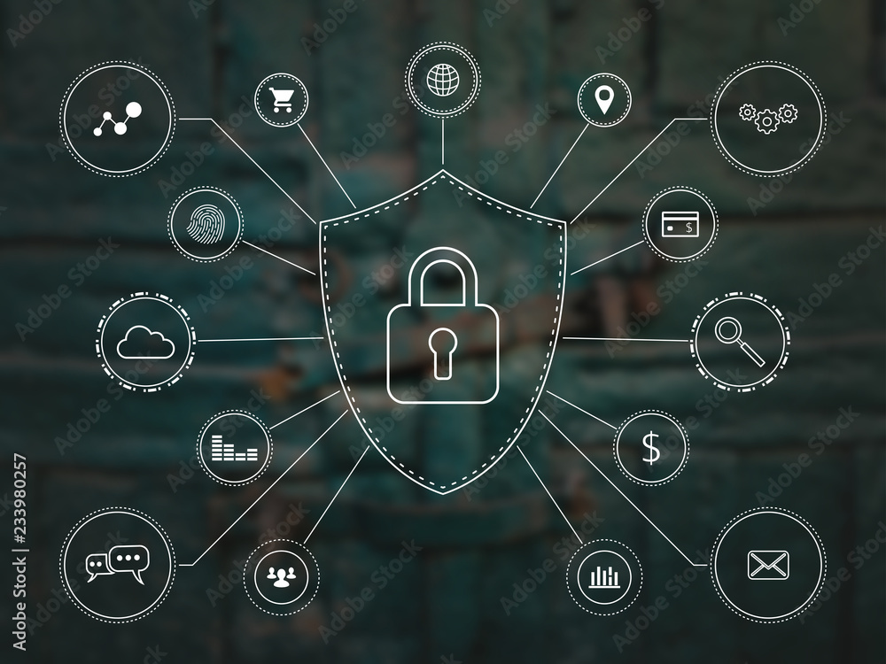
Challenges and Ethical Considerations
- Data privacy and security concerns. Algorithmic bias and fairness. The need for human oversight and ethical guidelines.

Slide 6
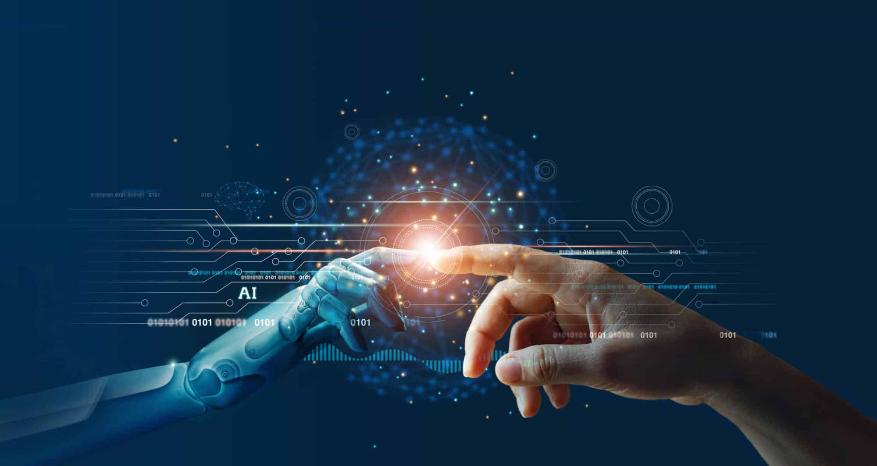
The Future of AI in HR
- Continued evolution and integration of AI tools. Increased focus on human-AI collaboration. A more strategic and data-driven HR function.

