Slide 1
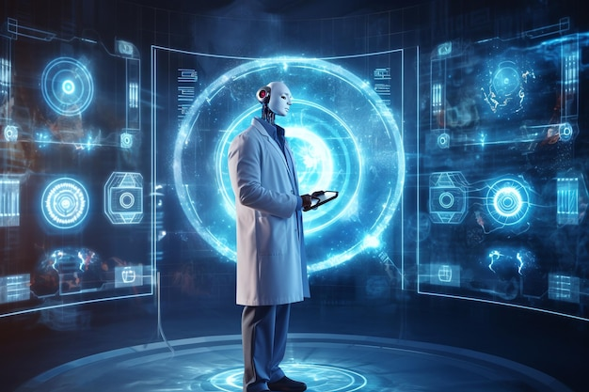
Introduction to AI in Healthcare
- AI is rapidly transforming healthcare. Improved diagnostics, personalized medicine, and drug discovery are key areas of impact. Increased efficiency and reduced costs are also significant benefits.

Slide 2
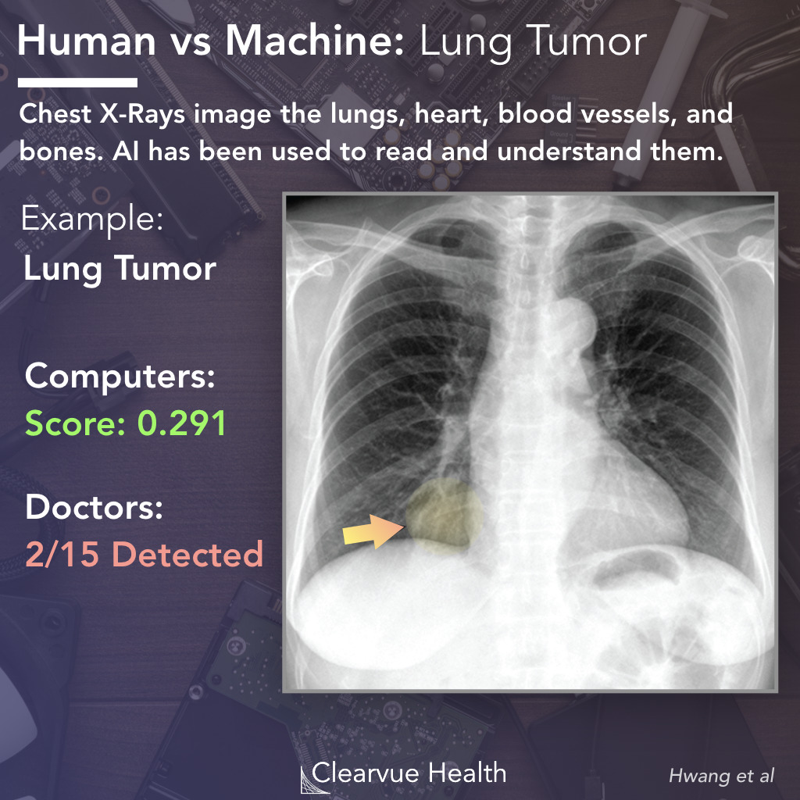
AI-Powered Diagnostics
- Faster and more accurate disease detection. Early detection of diseases like cancer and heart conditions. Analysis of medical images (X-rays, CT scans, MRIs) for improved accuracy.

Slide 3
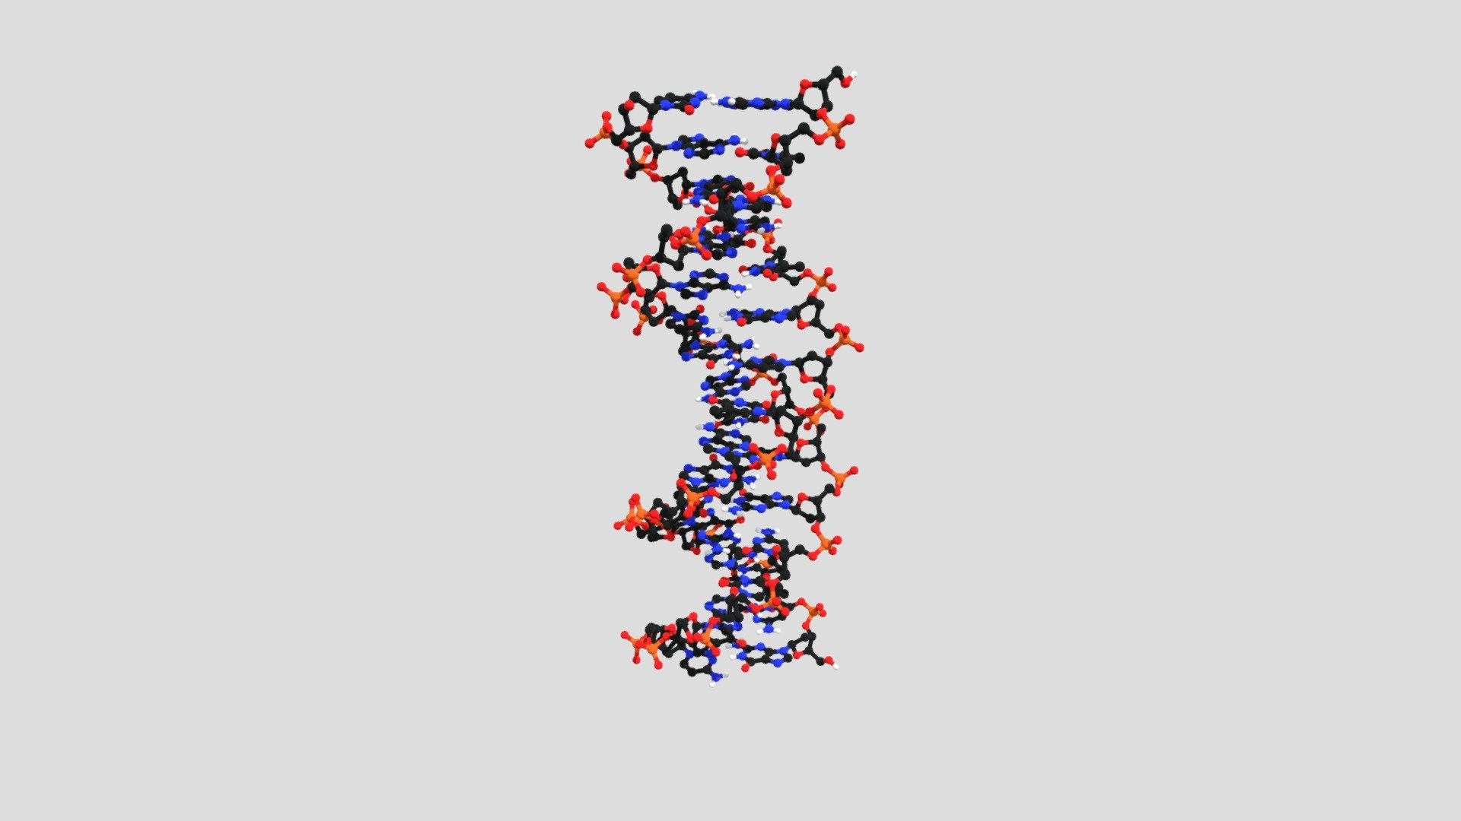
Personalized Medicine with AI
- Tailored treatments based on individual patient data. Prediction of treatment response and potential side effects. Development of personalized drug therapies.

Slide 4
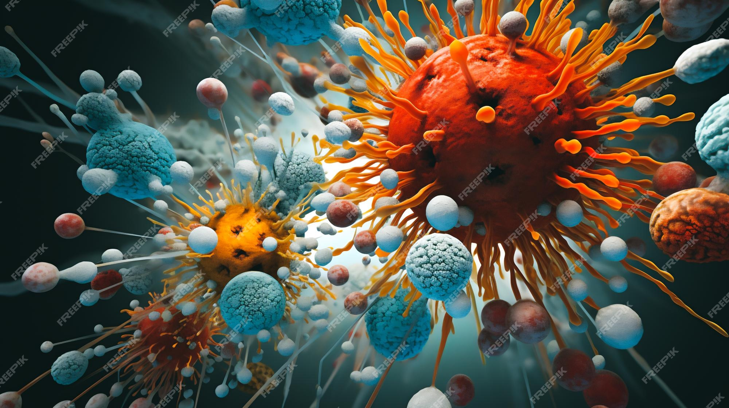
AI in Drug Discovery and Development
- Accelerated drug discovery process. Identification of potential drug candidates. Prediction of drug efficacy and safety.

Slide 5
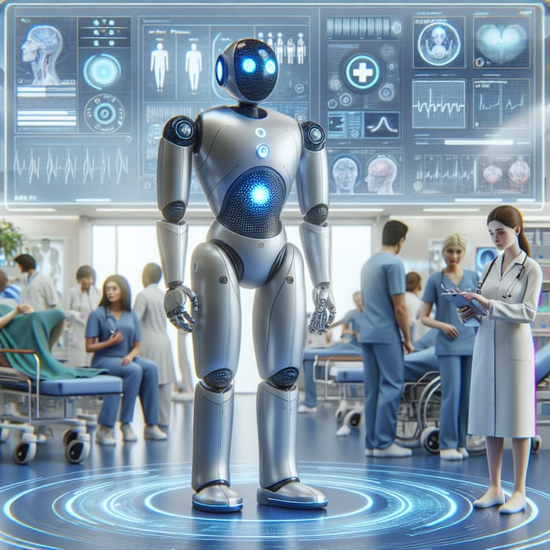
The Future of AI in Healthcare
- Continued advancements in AI algorithms and computing power. Integration of AI into various healthcare systems. Ethical considerations and responsible AI development.

