Slide 1

Introduction
- Prosthetic hands have evolved from simple mechanical devices to advanced robotic systems. The latest innovation: mind-controlled prosthetic hands that respond to a user's thoughts. These devices use brain signals to perform tasks, offering a seamless connection between thought and movement.

Slide 2
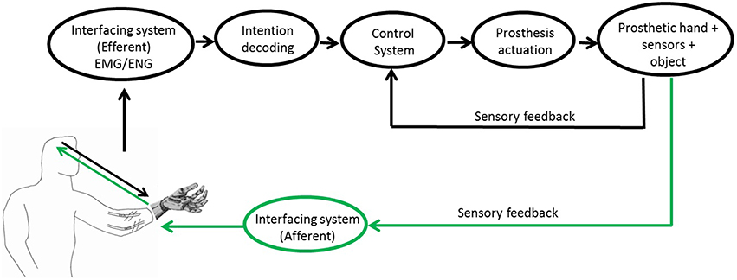
How It Works
1. Brain-Computer Interface (BCI): - Electrodes placed on the scalp (non-invasive) or directly on the brain (invasive). - These sensors detect electrical signals generated by the brain when a person thinks about moving their hand. 2. Signal Processing: - Brain signals are sent to a computer, which decodes the intention behind the thought (e.g., grasping, pointing). - The computer translates these signals into commands that control the prosthetic hand's movements. 3. Prosthetic Hand Mechanics: - Made of lightweight materials and robotic components. - Can replicate basic hand movements like opening, closing, and grasping objects. - Advanced models can perform precise and fine motor tasks.

Slide 3
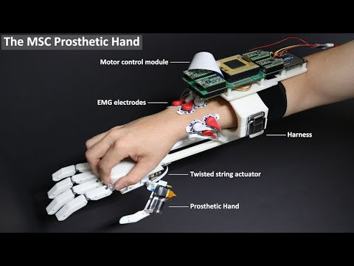
Key Technologies
- Electromyography (EMG): Measures muscle activity from the residual limb to assist in movement. Machine Learning Algorithms: Used to improve the accuracy of interpreting brain signals. Haptic Feedback: Provides sensory feedback to the user, allowing them to feel pressure or texture through the prosthetic.

Slide 4
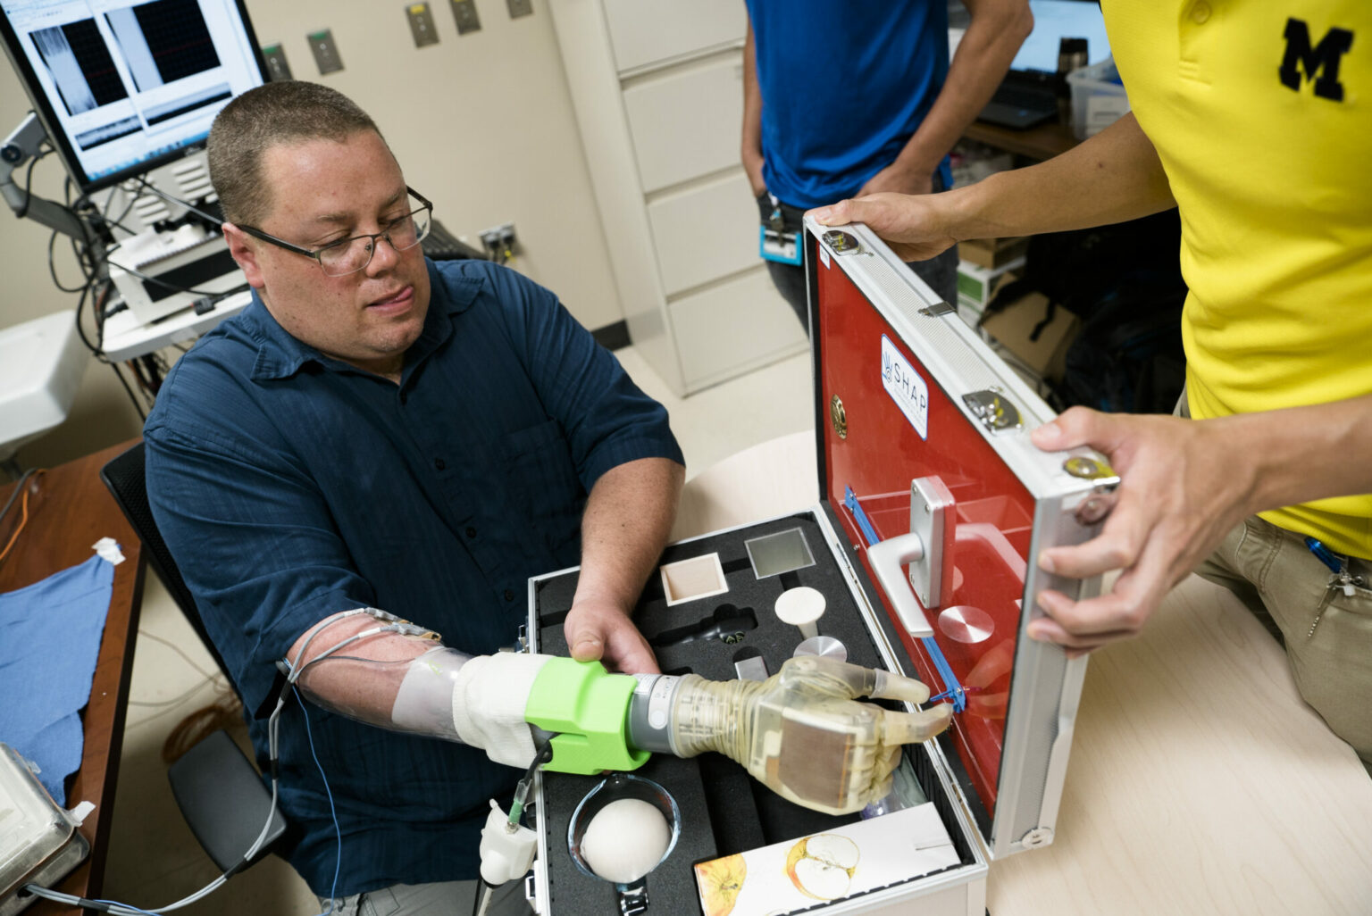
Benefits
- Improved Independence: Enables users to perform daily tasks such as eating, typing, or picking up objects. Natural Movement: The prosthetic responds directly to thought, making the interaction more intuitive and fluid. Reduced Phantom Limb Pain: For some users, controlling a prosthetic with their brain can reduce the discomfort of phantom limb sensations.

Slide 5
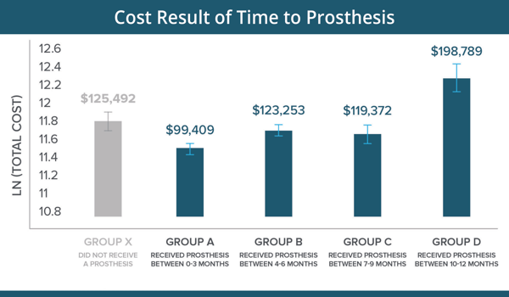
Challenges
- Cost and Accessibility: These devices are currently expensive and may not be widely available. Learning Curve: Users need time and training to effectively use mind-controlled prosthetics. Signal Interference: Brain signals can be affected by fatigue, stress, or external factors, leading to inconsistent control.

Slide 6
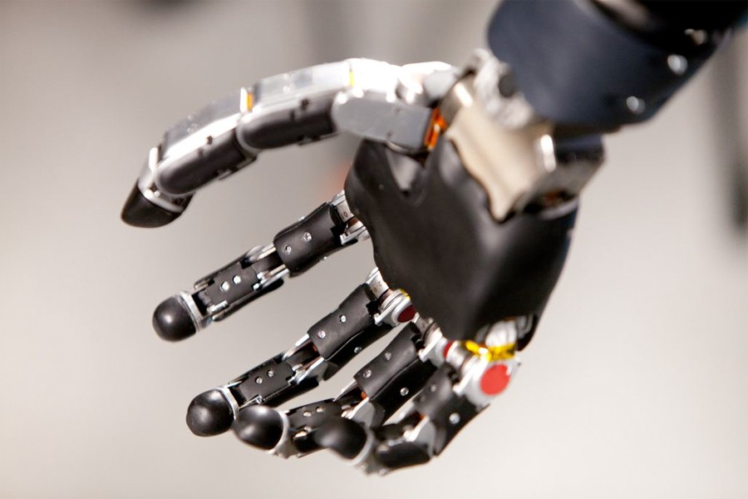
Future Directions
- Miniaturization of BCIs: Making the technology more comfortable and easier to use without bulky equipment. Full Sensory Feedback: Developing prosthetics that can provide more detailed feedback, such as temperature or fine textures. Integration with AI: Enhancing the predictive capability of prosthetics to anticipate user needs and optimize control.

Slide 7
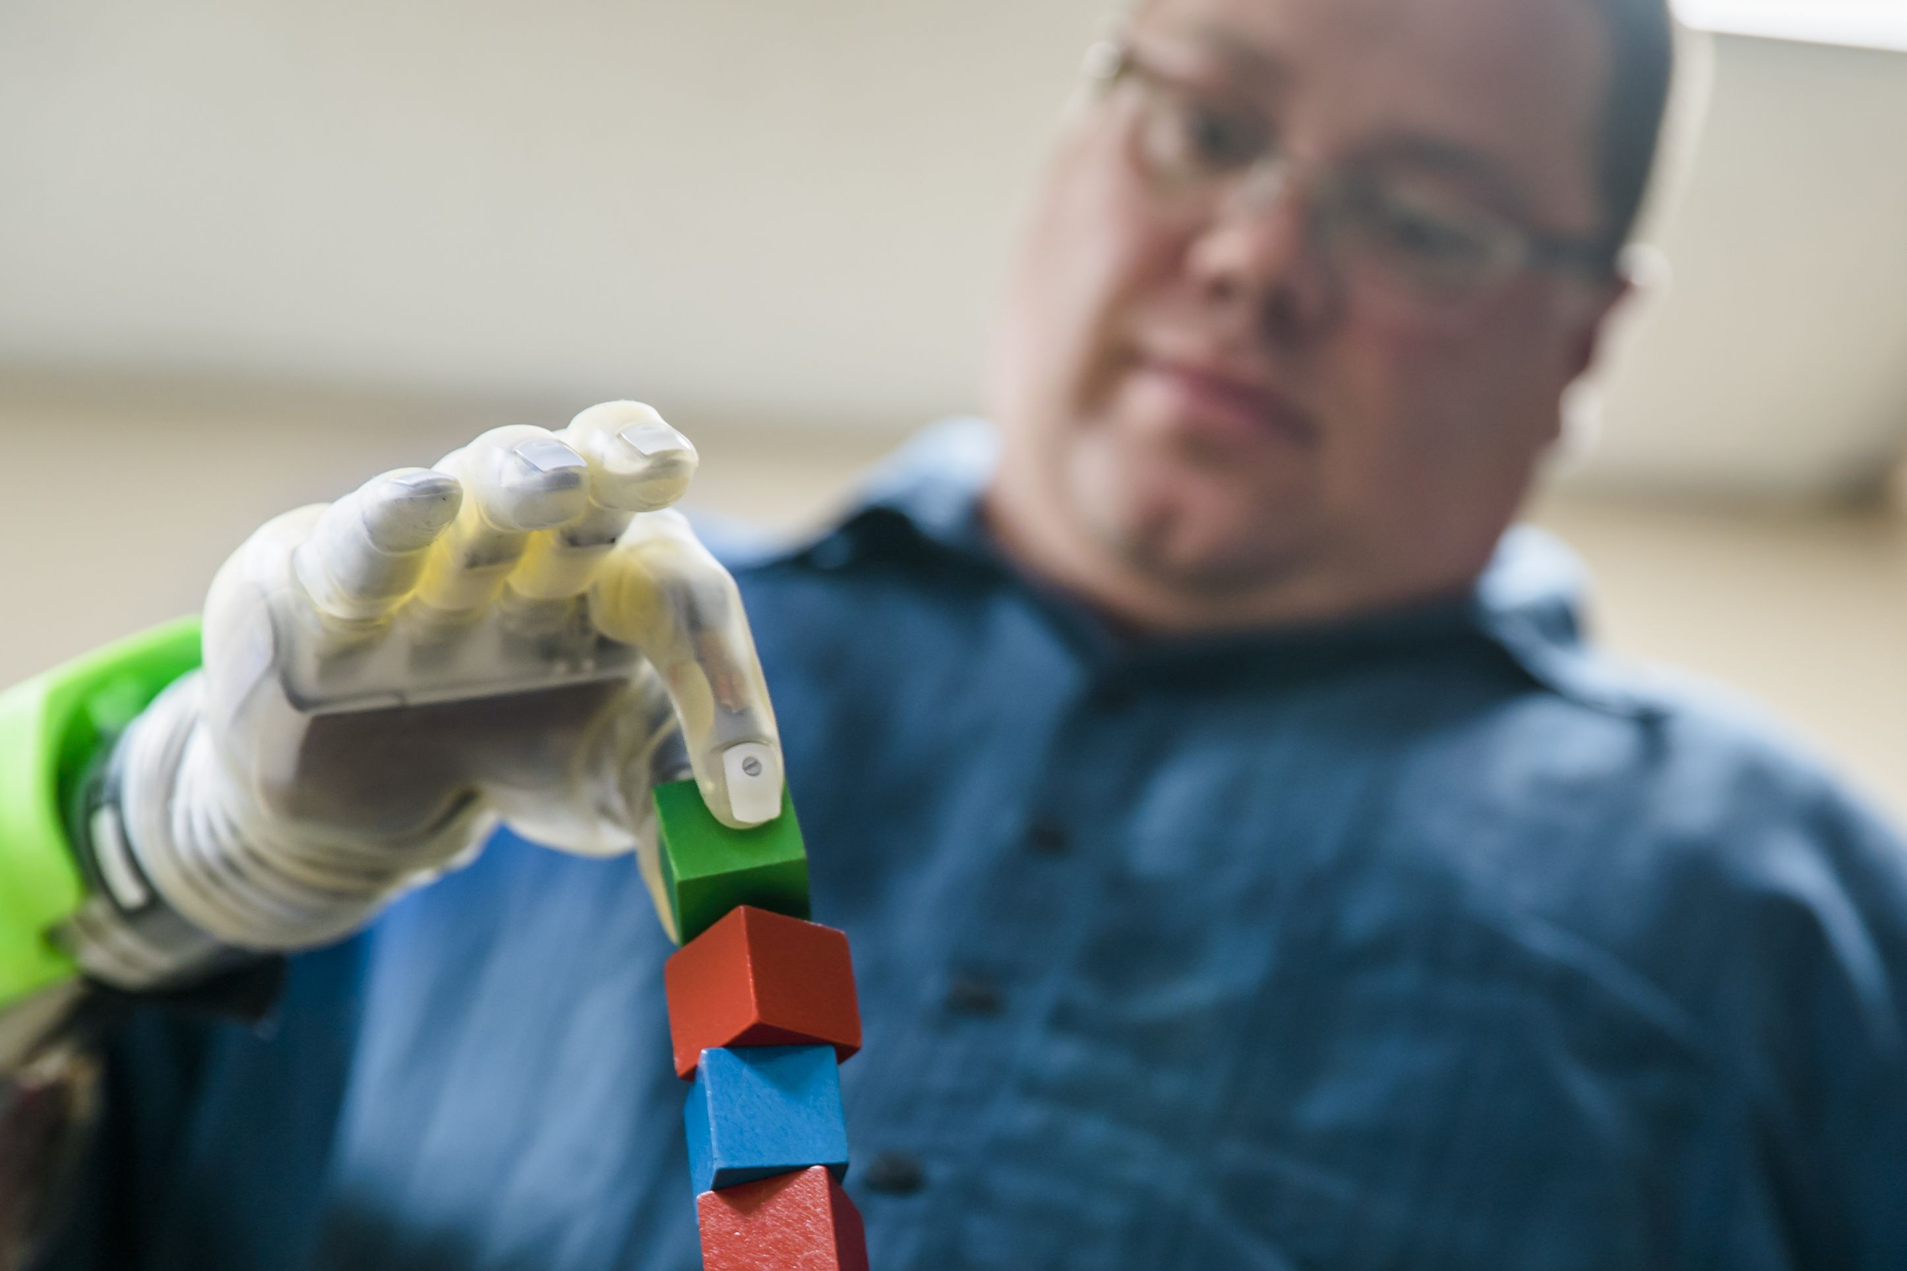
Conclusion
- Mind-controlled prosthetic hands represent a significant leap forward in assistive technology. Continued advancements in brain-computer interfaces, AI, and robotic design will further enhance the quality of life for individuals with limb loss.

