Slide 1
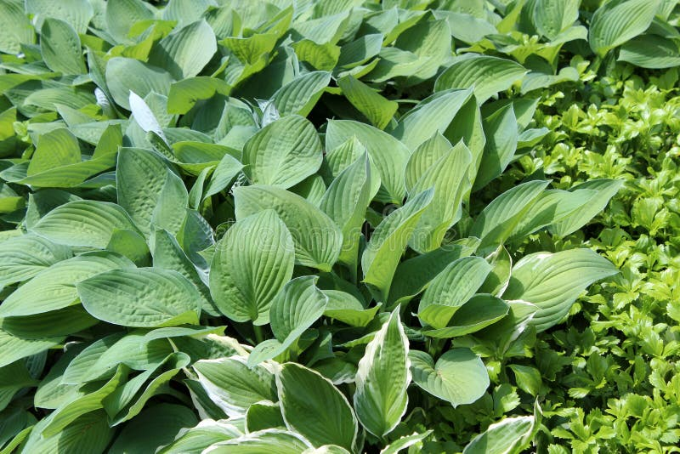
Sunlight Use
- hi, sunlight important for plants. hi, sunlight helps vitamin D production.

