Slide 1
Property Registration on Blockchain – Government of Karnataka 09/08/2021
Project Overview

Slide 2

Agenda
Agenda
1
Problem Statement and Proposed Solution
2
Project Ecosystem and PwC Scope of Work
3
Project Financials and Resourcing
4
Annexure : Select Project Collaterals
2

Slide 3

Problem Statement and Proposed Solution

Slide 4
Common Challenges and Risks in IT systems for Registration of Properties…
Challenges | Risks
Centralized storage of property registration data and documents | Creates Single Point of Failure
Unauthorized access to property records from back-end | Possible tampering of property records from backend
No process for digitally recording the consent of the seller | Potential for fraudulent property sales
Manual process of admission of deed transaction by SRO | Possibilities of impersonation
Tedious process of ownership verification because of lack of transaction trail | Creates scope for middlemen which increases the cost of transactions
Incomplete and Inefficient encumbrance verification | Possibility of sale of property with encumbrance without buyer’s knowledge

Slide 5




Proposed Strategic Initiatives to mitigate the challenges…
Through a combination of Aadhaar based identity authentication, cryptography and blockchain technology, key challenges of impersonation and tampering of documents can be mitigated:
Identity Verification
Digital Consent Recording
Immutable Storage of Deed Documents
Identity Verification of both buyer and seller through Aadhaar based biometric authentication supported by PKI enabled Property Card Verification
Recording of seller’s admission through digital signing of transaction using the PKI enabled Property Card.
Blockchain decentralises Property Record Storage, into more than one location and makes the records immutable and traceable.

Slide 6
Our Approach for Design and Implementation of the initiatives…
AS-IS Study
To-Be Report : SRS and FRS
Development of Blockchain Layer and Integration
Mapping of all processes currently being followed registration of various deeds related to immovable property
Documentation of current technology stack and architecture
Stakeholder consultation for validating and summarizing the identified common challenges
Development of process flows for blockchain application
Development of functional flows with integration points with current system
Specifications for Property Cards, Card Reader and Aadhaar biometric hardware
Mapping to list of articles of immovable property for validation
Development of blockchain application layer and smart contracts for encoding PPK in property card, mapping of Aadhaar profile and registration of documents
Integration with existing system
Integration Testing, Functional Testing and UAT
Training of Users
Pilot Launch
Full Scale Launch
Preparation of training collaterals and training aids
Delivery of training to users for seamless usage of system
Feedback from users and incorporation of feedback, if needed
Launch of pilot in select locations
Operational support for Pilot
Study of pilot against benchmarked KPIs
Incorporation of feedback and changes to
system
Training of users in the entire registration ecosystem
Estimation and Procurement of required hardware
Hardware and Software set-up in locations
Go-Live for full scale launch

Slide 7
Project Ecosystem and PwC Scope of Work

Slide 8


Project Ecosystem : Kaveri Blockchain…
Registration of Individual, Institutional and Part sale transactions for :
Project Ecosystem for Pilot
Department of Stamps and Registration, GoK | User Department and Project Owner
Centre for e-Governance, GoK | Project Management and Blockchain software owner
CRUBN, IIT Kanpur | Blockchain Application Developer and Hosting of blockchain node
STQC Directorate | Functional Testing Partner
C-DAC | Kaveri Application Integration & Customisation
Watchdata | Partner for design and manufacturing of smart Cards
e-MUDRA | e-KYC for RSA DSC Dongles
KSDC | Security Testing and Hosting of blockchain application and nodes
STPI | Hosting of blockchain node
PwC | Consulting and Project Management Partner
Articles for Pilot Launch
Absolute Sale Deed | Agreement of Sale of Immovable Property (Possession not given)
Cancellation of Sale Deed | Lease of Immovable Property
Gift Deed | Memorandum of deposit of title deed
Rectification Deed | Mortgage with Possession
Agreement of Sale of Immovable Property (Possession given/agree to be given) | Mortgage without Possession
Discharge Deed | Reconveyance Deed
Surrender of Lease | Release Deed
Pilot Location
Tumkur and Dharwad

Slide 9
PwC Scope of Work : Kaveri Blockchain…
Operational
Planning
Cost
Planning
Proof
Of
Concept
Pilot
Rollout
Program
Management
Strategy
Planning
Stages
Functional Requirements Specification Document
Technical Architecture Document
Infrastructure Needs Assessment
Draft a training and awareness plan
Procurement Plan
Cost-benefit analysis Report
Detailed costing sheet
Measure the achievement of the objectives set against the PoC
Lessons learnt document
Detailed User Acceptance Test Cases
User Acceptance Test results report
KPIs document
Project Closure Document
Deliverables
Timelines (in Weeks)
Start
T
T+4 weeks
T+ 5
T+ 10
T+ 7
T+ 10
T+ 5
T+ 12
T+ 12
T+ 14
T+ 14
T+ 27
End

Slide 10
PwC Team Structure for Kaveri Blockchain Pilot..
Cost Structure
S. No. | Team Members | Role | Experience | Rate | Man Months | Amount in INR
1 | Saurabh Bhattacharya/ Christy Sunny | Team Lead | 19 years (4 years Blockchain) | 388,000 | 3 | 11,64,000
2 | Deepa Menon/ Talha Wahid | Principal/Senior Consultant | 7.8 years (2 years Blockchain) | 302,400 | 6 | 18,14,000
3 | Nakulan Narayanan | Senior Consultant | 4 years (2 years Blockchain) | 270,000 | 6 | 16,20,000
Total |  |  |  |  |  | 45,98,400

Slide 11
Annexures : Select Project Collaterals

Slide 12
Process Flows

Slide 13
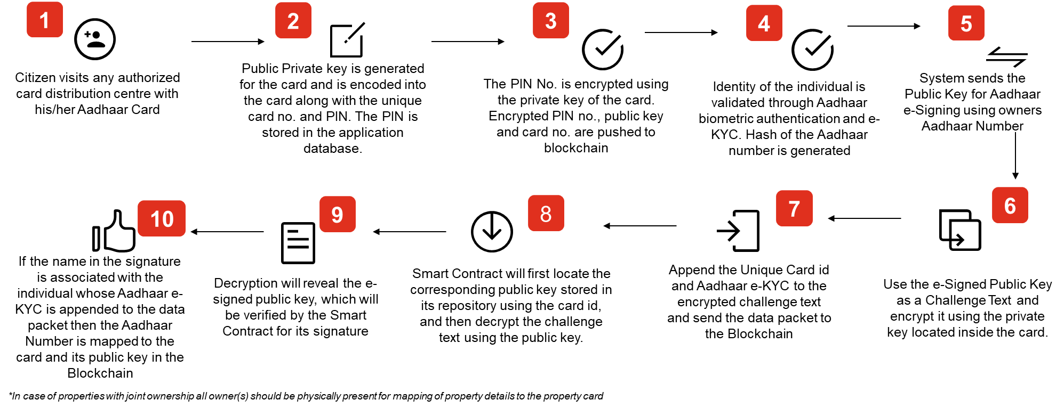
Distribution of Property Cards(1/3)
Encoding PPK and mapping Aadhaar
Process of writing Public Private Key into the card is envisioned to be performed through a secure application. The application will be made available to authorized officials at SRO/CSC who will encrypt the PPK pair into every card who will also map Aadhaar e-KYC details to the card

Slide 14
Distribution of Property Cards(3/3)
Mapping of Property details
While issuing of card and mapping of profile can happen in multiple distribution centres, mapping of property details can be performed only at the SRO office
4
1
2
3
Citizen visits SRO with original/ notarized copy of the deed/document, Aadhaar card and property card.
Authorised SRO official performs identity authentication via Aadhaar e-KYC and Aadhaar hash is generated.
Details obtained via e-KYC is compared with the physical card as well as deed/document produced by the citizen
Authorized SRO official retrieves the registered deed/document and its index data from Kaveri Online and compares with the hard copy produced
8
7
6
5
Upon successful verification, details of the registered deed/document is entered into the ledger mapped with the Aadhaar hash and public key of the card holder.
Smart Contract is executed to fetch public key & Aadhaar hash stored against the property card id. Aadhaar hash generated during e-KYC is matched with stored hash, and the encrypted text is decrypted using the public key.
Hash of the Aadhaar, unique number of the card, encrypted e-KYC text generated using the private key, and the property Deed details are signed using the SROs DSC and the application software.
Property card is read by the card reader. Aadhaar hash stored in the card against it is retrieved and matched against hash generated during e-KYC to confirm the mapping between the Aadhaar holder and the Card.
*In case of joint ownership, the process will be repeated for every owner i.e.. one property can have multiple public-private key pairs. In future, when transactions must be executed on the property, smart contract shall ensure consent of every owner by checking the number of public keys stored against a property.

Slide 15
Verification of Ownership of Property using Property Card(1/2)
Data Packet Creation
On receipt of an application for registration of a document, the (DEO) at the SRO office would first verify in the Blockchain system whether the executant has rights over the property to perform the transaction
1
2
3
4
Executant presents Property Card to DEO to check whether it is mapped to the concerned property
DEO punches the card in the card reader attached to his computer using USB
DEO opens the desktop application of Blockchain system to invoke a form to read the property card
Executant is prompted to present his Aadhaar Number, upon which an Aadhaar e-KYC is triggered
8
7
6
5
Encrypted text and successfully verified Aadhaar number as a hash, along with the unique hash property identifier mapped to the card is converted to a data packet*
Executant is presented with a list of unique property identifiers, stored in the card from which he can select the one to verify
Property holder’s personal details received using e-KYC is encrypted using private key stored in the property card
Upon successful authentication, PIN based PKI authentication is triggered, for which PIN number of the card holder will be sought
*This will be thereafter signed with the DSC of the desktop application and then sent to the Blockchain system.
**In case of a joint ownership, each owner should have a property card and the steps from (4) to (8) will be repeated. The data packet will have the combined details of all joint owners inside it but the property identifier that will become part of the data packet should be there in all the cards presented to the desktop application

Slide 16
Verification of Ownership of Property using Property Card(2/2)
Execution
of Smart Contract
The Blockchain system upon receiving the packet, will execute a Smart Contract through steps (1) to (4)
1
2
3
4
Upon successful decryption of the text using associated public key in Blockchain, match the Aadhaar e-KYC details stored in the property record
Verify the signature over the data packet to ascertain that the packet was sent by an authentic software installed at an SRO
Fetch the property record from Blockchain whose unique identifier is part of the data packet
Upon successful match, all details in the Blockchain record is displayed with a green tick to confer Blockchain’s confirmation about ownership of the property by the card holder
7
6
5
The desktop application will provide a final confirmation by displaying on a screen a green tick with details of property, and owner name and details as recorded in Blockchain
Post successful match, DEO shall proceed with other formalities of registration.
The DEO should visually match details provided by the desktop application with that of the document presented for registration
In case of joint ownership, the property record mapped with the property identifier that was part of the data packet in the Blockchain will have multiple public keys as well as multiple owner details mapped. For confirmation on the ownership of the property , each public key should have successfully decrypted at least one encrypted text that was part of the data packet. The contents thus decrypted should have matched with at least one owner detail associated with the property record

Slide 17

Process of locating property in blockchain using property identifier (1/2)
Search for Property in Blockchain
The blockchain application searches the ledger using the property identifiers sent by Kaveri. The property identifier can be current identifier used for the property in Kaveri or old identifier used for the property in Kaveri
1
2
3
Search the Blockchain for all Current Numbers for the given Current Number Type using the Current Number & Current Number Type provided in the request. If a single match is returned, then search is terminated, or else next step is pursued.
Search the Blockchain for all Previous Numbers for the given Previous Number Type using the Previous Number & Previous Number Type provided in the request. If a single match is returned, then search is terminated, or else next step is pursued.
Search the Blockchain for all Current Numbers for the given Current Number Type using the Previous Number & Previous Number Type provided in the request. If a single match is returned, then search is terminated, or else next step is pursued.
4
The previous steps are repeated for each Unique Property Identifier that is provided as part of the request.

Slide 18

Process of locating property in blockchain using property identifier (2/2)
Search for Property in Blockchain
When no property is returned in the previous steps, then the following additional searches are done to ascertain whether the property exists in blockchain or not. Basis the search results and SRO’s discretion, new blockchain property identity is created whenever this search also returns no result.
1
2
3
4
SRO will have the choice to accept or reject the assertion
Take the values in Current No. and Previous No. tags to perform localised search over blockchain to identify whether any property record with identifiers exist
If there is a match intimate SRO with all the data associated with the property
If the SRO rejects the assertion of blockchain, then a new property entry will be created, and the claimant(s) card will be mapped with it in the system through Steps mentioned in Process 5.
5
If the SRO accepts the assertion, then next steps would be followed by considering this as an existing property and seeking correct executant and claimant details for performing e-KYC and card-based authentication of the executant(s) as mentioned in Process 5.

Slide 19
Process of locating property in blockchain using property identifier : Summary
Search the blockchain ledger for the property using current property identifier in previous type of identifier
If search returns blank
Search the blockchain ledger for the property using previous property identifier in previous type of identifier
If search returns blank
If search returns blank
Create New Blockchain Property Identifier
Search the blockchain ledger for the property using current property identifier and type
Localised search in blockchain using current and previous numbers tags for any property record with this identifier
If search returns blank
Property Located
Present results to SRO
SRO accepts Blockchain's assertion
SRO rejects Blockchain's assertion

Slide 20





Process 1 : Registration of Document in Blockchain System (1/4)
Applicable to:
Absolute Sale Deed, Cancellation of Sale Deed, Gift Deed, Rectification Deed
1
2
3
4
Kaveri System
Recording of claimant(s) and executant(s) details in Kaveri
Picking up of corresponding Blockchain Property Id, if any, and generation of unique request number in Kaveri
Invoke Blockchain application by clicking a button in Kaveri system
Index details, party details, unique blockchain property identifier (if present), other property identifier and unique request number are sent to blockchain
5
6
7
8
Receive the index data, party details, unique blockchain property identifier (if present),other property identifier and request number
Send confirmation to Kaveri upon successful receipt of details mentioned in Step 5
Aadhaar Authentication of executant(s) and claimant(s) through biometric authentication and create Aadhaar e-KYC records
Digitally sign the Aadhaar e-KYC data of executant(s) using their private key(s) stored in the property card(s), move to reading of public key of claimants
Blockchain Application
9
10
11
Append the blockchain property identifier to the signed e-KYC details
Upload the data packet to Blockchain
Smart Contract is triggered upon receipt of the packet

Slide 21
Process 1 : Registration of Document in Blockchain System (2/3)
12
13
14
15
Fetch property record from blockchain whose unique identifier is part of the data packet
Use the public key in blockchain to verify the signed text of the executant(s)
Match the decrypted Aadhaar No. hash with the corresponding Aadhaar stored in blockchain*
After successful match, send success message to blockchain application
Smart Contract
16
17
18
19
Blockchain Application
Receive the success message from Smart contract
After successful match, proceed to reading public key(s) of claimant(s)
Create a data packet of Aadhaar e-KYC of claimant(s), executant(s), digitally signed property index data using private key of all executant(s) and public key of claimant(s) and store it
After creation of data packet, send success message to Kaveri when status check request is received from Kaveri
In case of multiple executants and claimants, the process will be repeated to match the e-KYC details of every executant.

Slide 22
Process 1 : Registration of Document in Blockchain System (3/4)
20
21
22
23
24
25
Kaveri System
Receive success message from Blockchain
Final signature on summary sheet by claimant(s), executant(s) and witness
Generation of unique number for the document and document is added to Book 1
Imprints of photographs and signature are printed
Document is signed by SRO, original document is scanned and uploaded to the system
Blockchain application is invoked and unique request number along with scanned copy is sent to blockchain
26
27
28
29
Blockchain System
Blockchain receives the data
Retrieves the data packet created in Step 18 by matching the unique request number
Append the data received in Step 26 to the data packet retrieved in Step 27
Data packet created in Step 28 will be digitally signed by SRO
30
31
Signed data packet is sent to Blockchain
Smart Contract triggered upon receipt of the packet

Slide 23

Process 1 : Registration of Document in Blockchain System (4/4)
32
33
34
35
Verify the SRO’s signature over the data packet
Fetch property record from blockchain whose unique identifier is part of data packet. In case of new property entry, skip this step and jump to Step 36
Use the public key in blockchain to verify the signed text of the executant(s)
Match the decrypted Aadhaar number with the Aadhaar stored in blockchain*
Smart Contract
36
37
38
39
Only a successful match establishes right of executant(s) to transact. After successful match, check public key of claimant(s) for existence and correctness
Use the public key in ledger to verify the signed text of claimant(s)
Match the decrypted Aadhaar number with with the Aadhaar stored in blockchain*
Upon successful match i.e., demographic match, data received from desktop application is appended as a new record
40
41
42
Smart Contract adds the property details from the previous record in blockchain along with the hash pointer to previous record of same property
New record with same property identifier and encumbrance details as before is created with the new property details received via the packet**
Success Message is sent to Kaveri system which records it along with Blockchain Property Id and the registration process is completed
*In case of multiple executants and claimants, the process will be repeated to match the e-KYC details of every claimant and executant.
** There will be cases where more than one property will be registered through a single deed transaction, in which case the executant(s) and the claimant(s) will remain the same. Under such circumstances, <PropertyDetails> tag will have more than one property mentioned. For each such property in the <PropertyDetails> tag, a separate Blockchain property entry will be created with a different Blockchain Property ID in each entry. All these entries though will have same executant(s) and claimant(s).

Slide 24
Process 2 : Registration of Encumbrance Document in Blockchain System (1/4)
Applicable to:
Registration Process for Recording of Encumbrance ; Agreement of Sale of Immovable Property, Lease of Immovable Property, Memorandum of deposit of title deed, Mortgage
1
2
3
4
Kaveri System
Recording of claimant(s) and executant(s) details in Kaveri
Picking up of corresponding Blockchain Property Id, if any, and generation of unique request number in Kaveri
Invoke Blockchain application by clicking a button in Kaveri system
Index details, party details, unique blockchain property identifier (if present), unique request number, reason & type of encumbrance are sent to blockchain
5
6
7
8
Receive the index data, party details, unique blockchain property identifier (if present),other property identifier and request number
Send confirmation to Kaveri upon successful receipt of details mentioned in Step 5
Aadhaar Authentication of executant(s) and claimant(s) through biometric authentication and create Aadhaar e-KYC records
Digitally sign the Aadhaar e-KYC data of executant(s) using their private key(s) stored in the property card(s), move to reading of public key of claimants
Blockchain Application
9
10
11
Append the blockchain property identifier to the signed e-KYC details
Upload the data packet to Blockchain
Smart Contract is triggered upon receipt of the packet

Slide 25
Process 2 : Registration of Encumbrance Document in Blockchain System (2/3)
12
13
14
15
Fetch property record from blockchain whose unique identifier is part of the data packet
Use the public key in blockchain to verify the signed text of the executant(s)
Match the decrypted Aadhaar No. hash with the corresponding Aadhaar stored in blockchain*
After successful match, send success message to blockchain application
Smart Contract
16
17
18
19
Blockchain Application
Receive the success message from Smart contract
After successful match, proceed to reading public key(s) of claimant(s)
Create a data packet of Aadhaar e-KYC of claimant(s), executant(s), digitally signed property index data using private key of all executant(s) and public key of claimant(s) and store it
After creation of data packet, send success message to Kaveri when status check request is received from Kaveri
In case of multiple executants and claimants, the process will be repeated to match the e-KYC details of every executant.

Slide 26
Process 2 : Registration of Encumbrance Document in Blockchain System (3/4)
20
21
22
23
24
25
Kaveri System
Receive success message from Blockchain
Final signature on summary sheet by claimant(s), executant(s) and witness
Generation of unique number for the document and document is added to Book 1
Imprints of photographs and signature are printed
Document is signed by SRO, original document is scanned and uploaded to the system
Blockchain application is invoked and unique request number along with scanned copy is sent to blockchain
26
27
28
29
Blockchain System
Blockchain receives the data
Retrieves the data packet created in Step 18 by matching the unique request number
Append the data received in Step 26 to the data packet retrieved in Step 27
Data packet created in Step 28 will be digitally signed by SRO
30
31
Signed data packet is sent to Blockchain
Smart Contract triggered upon receipt of the packet

Slide 27
Process 2 : Registration of Encumbrance Document in Blockchain System (4/4)
32
33
34
35
Verify the SRO’s signature over the data packet
Fetch property record from blockchain whose unique identifier is part of data packet. In case of new property entry, skip this step and jump to Step 36
Use the public key in blockchain to verify the signed text of the executant(s)
Match the decrypted Aadhaar number with the Aadhaar stored in blockchain*
Smart Contract
36
37
38
39
Only a successful match establishes right of executant(s) to transact. After successful match, check public key of claimant(s) for existence and correctness
Use the public key in ledger to verify the signed text of claimant(s)
Match the decrypted Aadhaar number with with the Aadhaar stored in blockchain*
Upon successful match i.e., demographic match, data received from desktop application is appended as a new record
40
41
42
Property data in blockchain is copied with only the encumbrance fields getting updated with new encumbrance reason and claimant’s public key
Hash pointer to the previous record is updated with the pointer to the old record. In case this is first entry for property in blockchain, then a new record is created using the index II data
Success Message is sent to Kaveri system which records it along with Blockchain Property Id and the registration process is completed
*In case of multiple executants and claimants, the process will be repeated to match the e-KYC details of every claimant and executant.

Slide 28
Process 3 : Removal of Encumbrance Document in Blockchain System (1/4)
Applicable to:
Registration Process for Removing of Encumbrance; Reconveyance and Discharge Deed, Surrender of Lease, Release Deed
1
2
3
4
Kaveri System
Recording of claimant(s) and executant(s) details in Kaveri
Picking up of corresponding Blockchain Property Id, if any, and generation of unique request number in Kaveri
Invoke Blockchain application by clicking a button in Kaveri system
Index details, party details, unique blockchain property identifier (if present), unique request number, reason & type of encumbrance are sent to blockchain
5
6
7
8
Receive the index data, party details, unique blockchain property identifier (if present),other property identifier and request number
Send confirmation to Kaveri upon successful receipt of details mentioned in Step 5
Aadhaar Authentication of executant(s) and claimant(s) through biometric authentication and create Aadhaar e-KYC records
Digitally sign the Aadhaar e-KYC data of executant(s) using their private key(s) stored in the property card(s), move to reading of public key of claimants
Blockchain Application
9
10
11
Append the blockchain property identifier to the signed e-KYC details
Upload the data packet to Blockchain
Smart Contract is triggered upon receipt of the packet

Slide 29
Process 3 : Removal of Encumbrance Document in Blockchain System (2/3)
12
13
14
15
Fetch property record from blockchain whose unique identifier is part of the data packet
Use the public key in blockchain to verify the signed text of the executant(s)
Match the decrypted Aadhaar No. hash with the corresponding Aadhaar stored in blockchain*
After successful match, send success message to blockchain application
Smart Contract
16
17
18
19
Blockchain Application
Receive the success message from Smart contract
After successful match, proceed to reading public key(s) of claimant(s)
Create a data packet of Aadhaar e-KYC of claimant(s), executant(s), digitally signed property index data using private key of all executant(s) and public key of claimant(s) and store it
After creation of data packet, send success message to Kaveri when status check request is received from Kaveri
In case of multiple executants and claimants, the process will be repeated to match the e-KYC details of every executant.

Slide 30
Process 3 : Removal of Encumbrance Document in Blockchain System (3/4)
20
21
22
23
24
25
Kaveri System
Receive success message from Blockchain
Final signature on summary sheet by claimant(s), executant(s) and witness
Generation of unique number for the document and document is added to Book 1
Imprints of photographs and signature are printed
Document is signed by SRO, original document is scanned and uploaded to the system
Blockchain application is invoked and unique request number along with scanned copy is sent to blockchain
26
27
28
29
Blockchain System
Blockchain receives the data
Retrieves the data packet created in Step 18 by matching the unique request number
Append the data received in Step 26 to the data packet retrieved in Step 27
Data packet created in Step 28 will be digitally signed by SRO
30
31
Signed data packet is sent to Blockchain
Smart Contract triggered upon receipt of the packet

Slide 31
Process 3 : Removal of Encumbrance Document in Blockchain System (4/4)
32
33
34
35
Verify the SRO’s signature over the data packet
Fetch property record from blockchain whose unique identifier is part of data packet. In case of new property entry, skip this step and jump to Step 36
Use the public key in blockchain to verify the signed text of the executant(s)
Match the decrypted Aadhaar number with the Aadhaar stored in blockchain*
Smart Contract
36
37
38
39
Only a successful match establishes right of executant(s) to transact. After successful match, check public key of claimant(s) for existence and correctness
Use the public key in ledger to verify the signed text of claimant(s)
Match the decrypted Aadhaar number with with the Aadhaar stored in blockchain*
Upon successful match i.e., demographic match, data received from desktop application is appended as a new record
40
41
42
Property data in blockchain is copied with only the encumbrance fields getting updated with removal of encumbrance reason and claimant’s public key
Hash pointer to the previous record is updated with the pointer to the old record. In case this is first entry for property in blockchain, then a new record is created using the index II data
Success Message is sent to Kaveri system which records it along with Blockchain Property Id and the registration process is completed
*In case of multiple executants and claimants, the process will be repeated to match the e-KYC details of every claimant and executant.

Slide 32
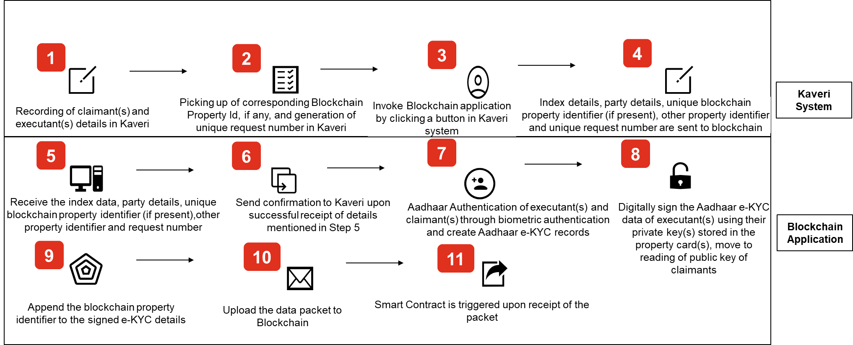
Process 4 : Registration and Recording of Power of Attorney…(1/4)

Slide 33
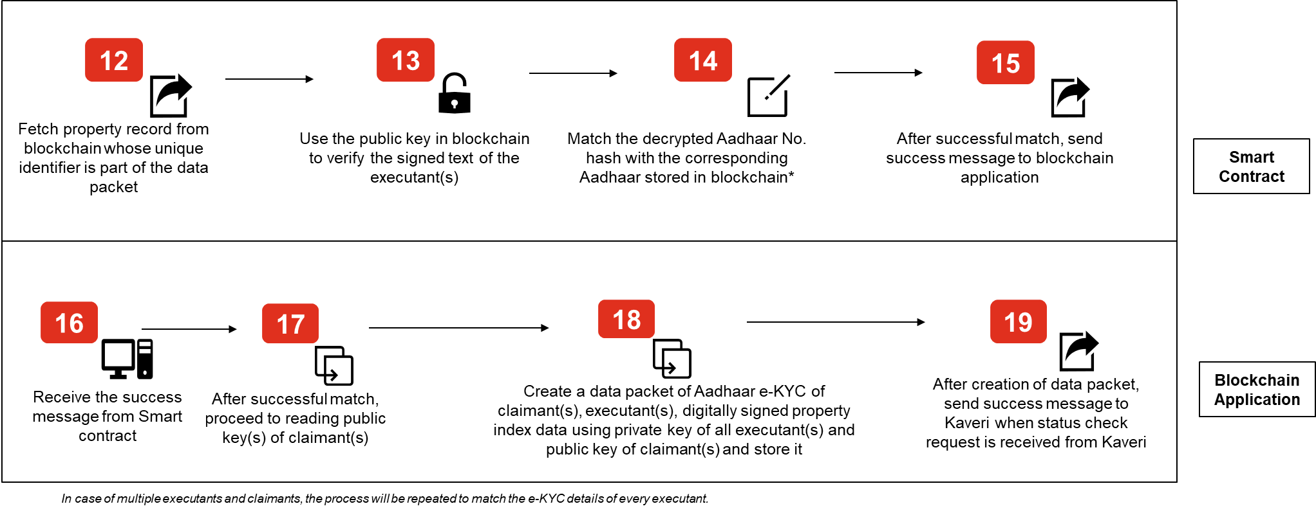
Process 4 : Registration and Recording of Power of Attorney…(2/4)

Slide 34
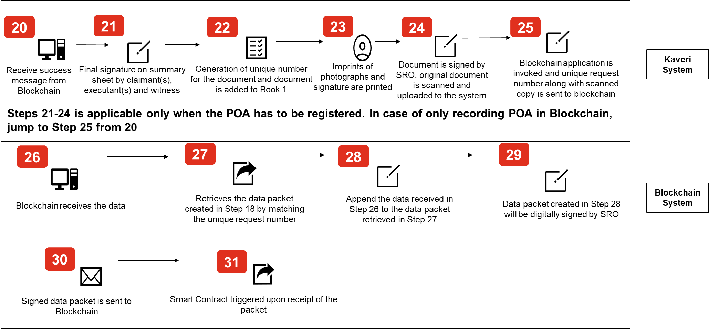
Process 4 : Registration and Recording of Power of Attorney…(3/4)

Slide 35
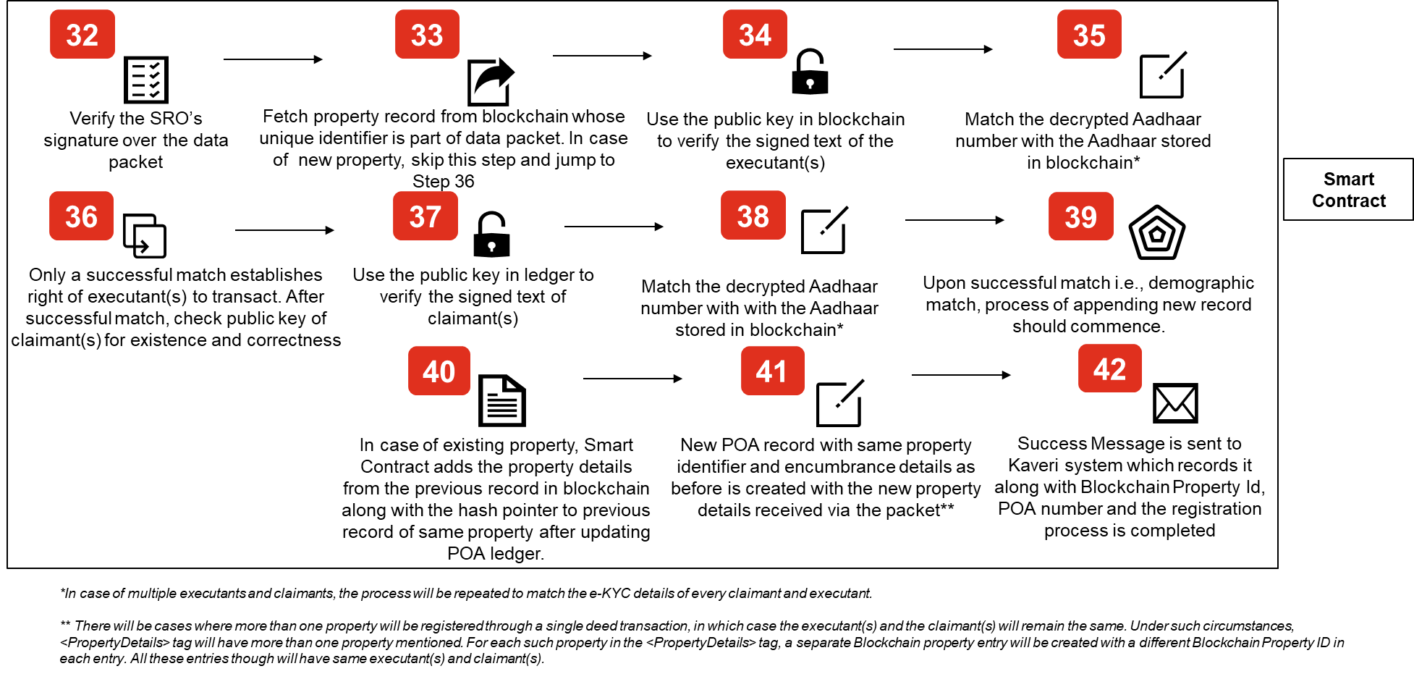
Process 4 : Registration and Recording of Power of Attorney…(4/4)

Slide 36
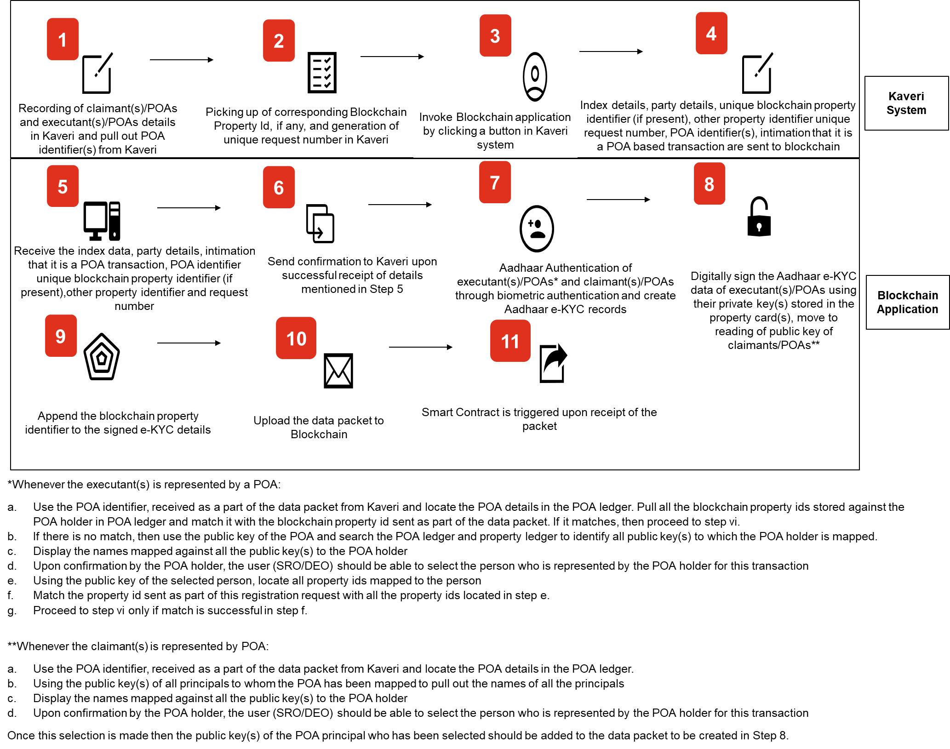
Process 5 : Registration through Power of Attorney…(1/4)

Slide 37

Process 5 : Registration through Power of Attorney…(2/4)

Slide 38
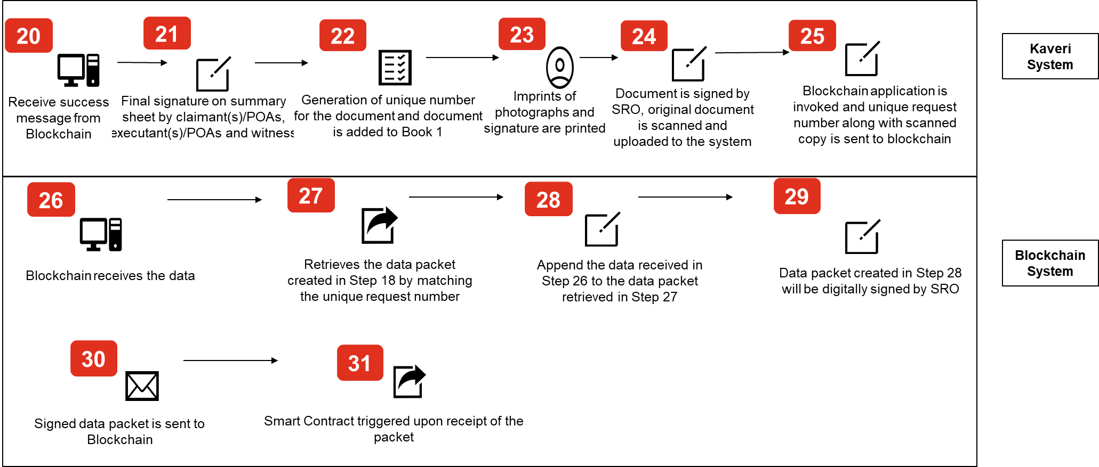
Process 5 : Registration through Power of Attorney…(3/4)

Slide 39
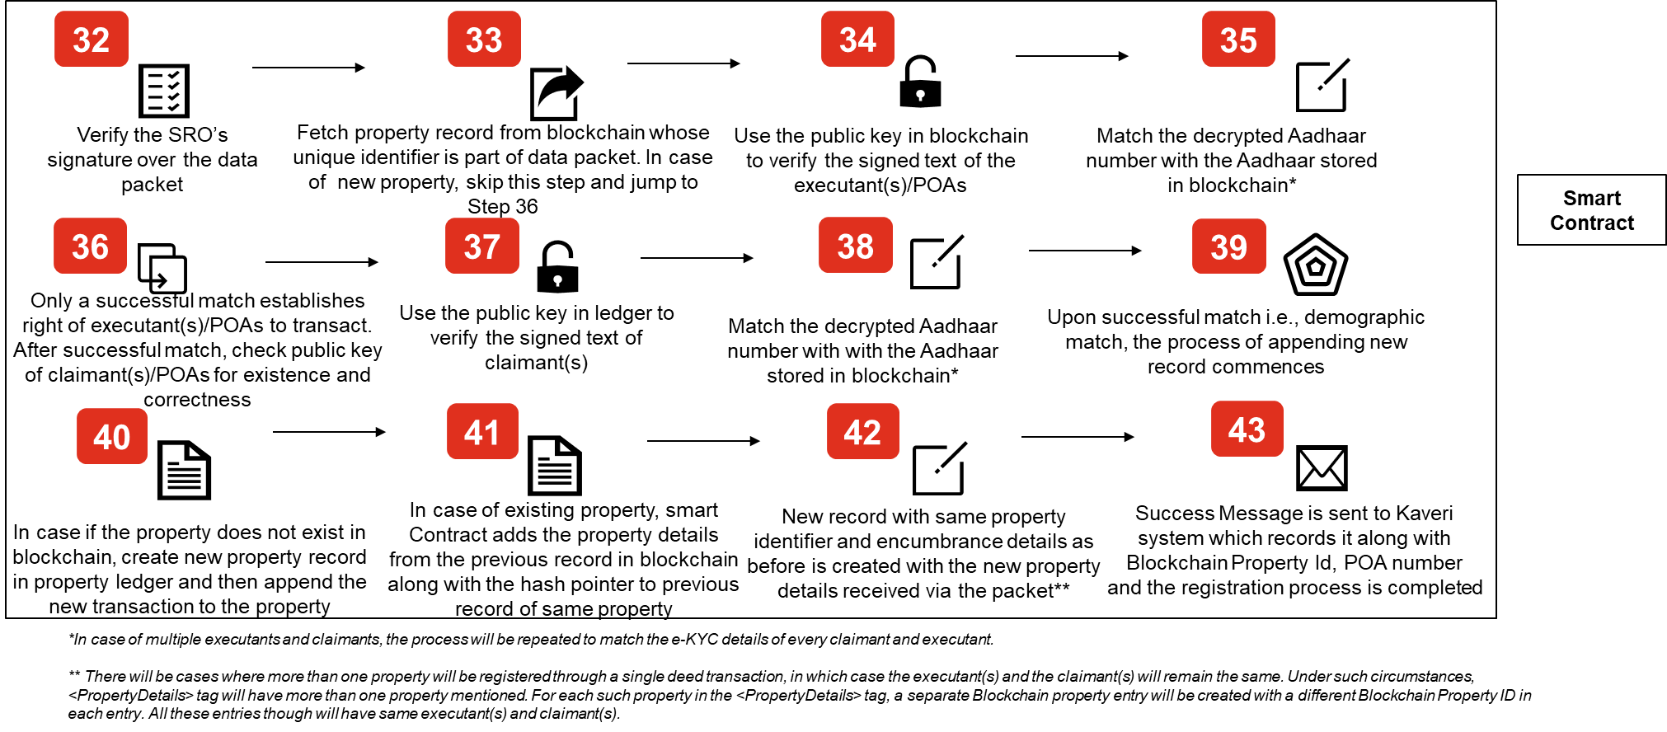
Process 5 : Registration through Power of Attorney…(4/4)

Slide 40
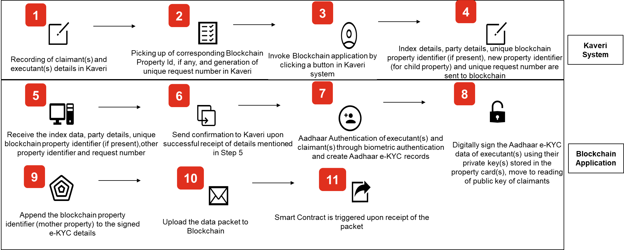
Process 6 : Registration of Partition Deed…(1/4)

Slide 41
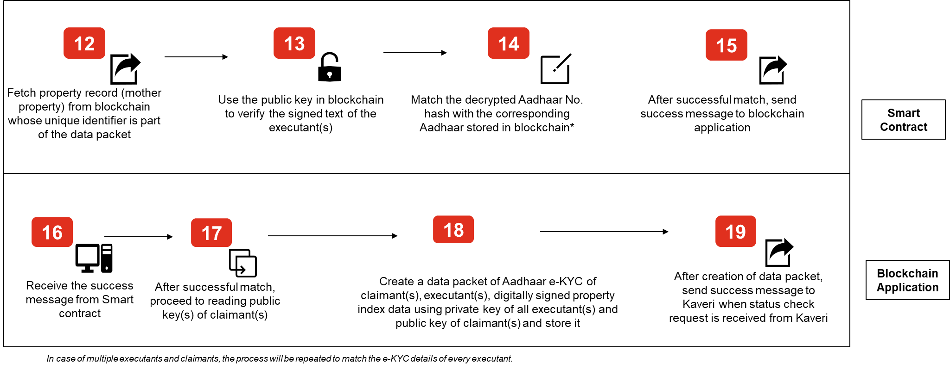
Process 6 : Registration of Partition Deed…(2/4)

Slide 42
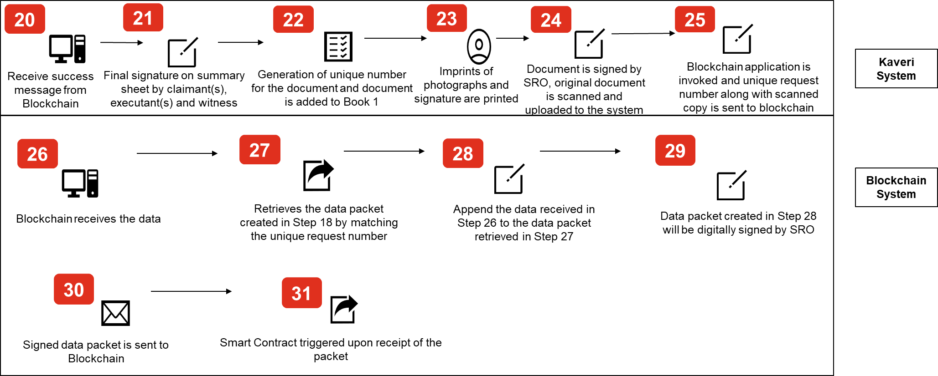
Process 6 : Registration of Partition Deed…(3/4)

Slide 43
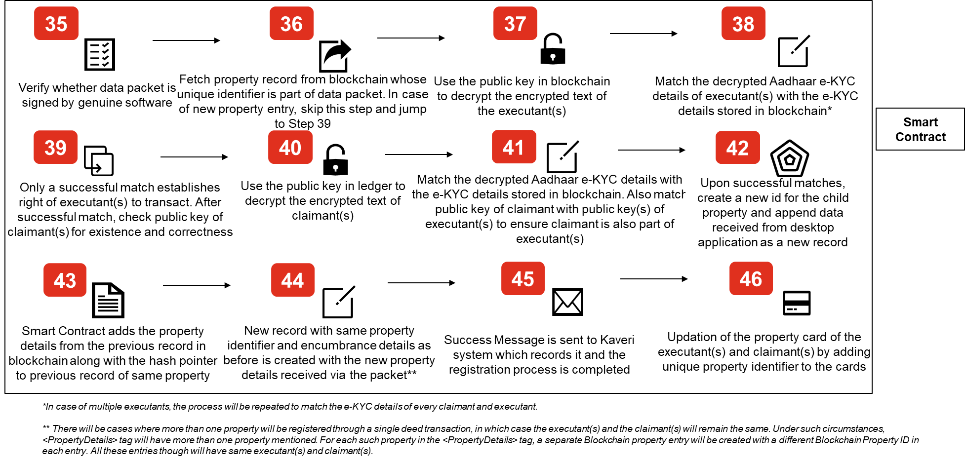
Process 6 : Registration of Partition Deed…(4/4)

Slide 44
Importance of Property Cards

Slide 45


Benefits Envisaged : Advantages of using Blockchain(1/3)…
Immutability
Verification and
Validity of Transactions
Any addition of new data over Blockchain is done using a check called consensus where multiple servers execute the same logic in different environments to validate the correctness and authenticity of the data being sought for addition.
Data is recorded in blockchain only through execution of smart contracts. As every record is linked to the previous record, data entered in the blockchain cannot be altered.
This ensures that any property registration data, once written on Blockchain, can never be modified, or deleted. Only new record can be added on top of the previous record.
Any property updates, be it transfers or addition of claims, will always get thoroughly validated before it gets added to Blockchain using a check called consensus, thus safeguarding the system against any hacking or other malicious activities.
3

Slide 46


Benefits Envisaged : Advantages of using Blockchain(2/3)…
High Availability of Data with no need for CD storage
User Consent Recording
Blockchain requires use of user wallets to create a record on it. These wallets are cryptographic keys hosted on a physical device with the user, which links that person to his/her data record that exists in Blockchain.
Data in Blockchain is stored across multiple servers with mirroring of contents across multiple locations, the possibility of losing data because of any untoward incident is completely minimized
Since the data in Kaveri Blockchain will be mirrored across multiple locations across India, the property records thus stored is extremely safe thus de-necessitating the need to use CDs to backup registration data, as is the current practice.
This empowers the user by ensuring that without his/her prior consent any data record that is linked with him/her cannot be modified. In property registration, any property record connected with its owner using such wallets will ensure that any fraudulent attempt to sell the property, by adding any new updates without the owner’s consent will fail.
4

Slide 47

Benefits Envisaged : Advantages of using Blockchain(3/3)…
Traceability of Transactions and
Simplified EC Generation
Each data record created in Blockchain is connected to the previous record and since the records are never deleted as such the transactions happening in Blockchain are traceable.
In property registration database, such traceability will simplify the process of encumbrance certificate generation.
5

Slide 48


Benefits Envisaged : Advantages of using Kaveri Cards(1/2)…
Kaveri Cards are physical devices that store the user wallet. These cards are smart cards secured using a chip and a PIN (personal identification number), which stores within it, cryptographic keys that creates association between the user and the property record hosted in the Blockchain.
A user can carry a Kaveri card with himself/herself with an assurance that unless the card is presented to the sub-registrar, the associated property cannot be transacted upon.
Traceability
Locating the Property
A link is established between the card and the record on Blockchain through which a complete trace of a property starting from its current possessor is established.
Card simplifies location of a property in the Blockchain ledger and the Kaveri database, without necessitating performance of any complex search.
Hence, prospective buyers can easily relate the card possessor with a particular property and its history of transactions thus creating an easy to very encumbrance certificate.
Kaveri card not only simplifies the location process by removing the necessity of search, but it also ensures that the output of such a process is comprehensive & complete.
6

Slide 49

Benefits Envisaged : Advantages of using Kaveri Cards (2/2)…
Secured Transactions
Establishes authenticity
of the parties
to transact on the property
Kaveri card also stores digital signature of the card owner, and the blockchain system is designed to ensure that all transactions are digitally signed through the card.
The card and its cryptographic contents relate to the Blockchain in a manner that any consensus process would require presentation of the card and the PIN by the card possessor to the system.
The Blockchain system is designed in a manner that rights over a property can get transferred from one card to another by the explicit consent of the original owner. This facilitates mutability of rights over a property, upon recording the consent of the original right holder.
This ensures that any transaction done over a property on the Blockchain system, can be digitally signed by the owner thus ensuring non-repudiation of transactions done by the person.
7

Slide 50
Property Card Data Structure
Data
Secure Zone
Non Secure Zone
Application Code
File Storage
Application Code
File Storage
Encryption of Data
Change PIN No.
Read
Receives request for sending the Public Key/Aadhaar Number
Returns sought data
Aadhaar Number or Hash of the number
Public Key
Card No.
Public Key
Private Key
PIN
Card No
Receives data for encryption along with PIN
Validates the PIN by matching it with the data stored in its file repository
Upon match of the PIN, encrypts the received data using the Private Key
Returns the encrypted data
Receive Card No., PIN and Public Key
Match Card No.
Match Public Key
Modify the PIN with new PIN

