Slide 1
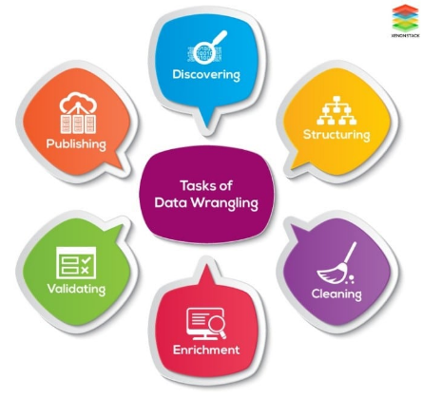
PROJECT-1
Data wrangling methods
Submitted by:
Rahul Saraswat
Contact No: 9354935833
Email ID: er.rahulsaraswat@gmail.com

Slide 2
Project-1- Data Wrangling
Introduction:
Data wrangling is the process of transforming and structuring data from one raw form into a desired format with the intent of improving data quality and making it more useful for analytics or machine learning.
Object:
This project is pertaining to perform data wrangling on set of 3 datasets related to user ride rentals. The datasets have many ambiguities which need to be identified and applying different data-wrangling techniques to get a dataset for further usage.
Technical Skills:
Data Acquisition
Data Wrangling

Slide 3
Project-1- Data Wrangling
Methods used:
Below techniques are used for data wrangling at provided data sets.
Merge datasets
Identify unique values
Drop unnecessary columns
Check the dimensions of the dataset
Check the datatype of the dataset
Check datatype summary
Treat missing values
Validate the correctness of the data at the primary level

Slide 4
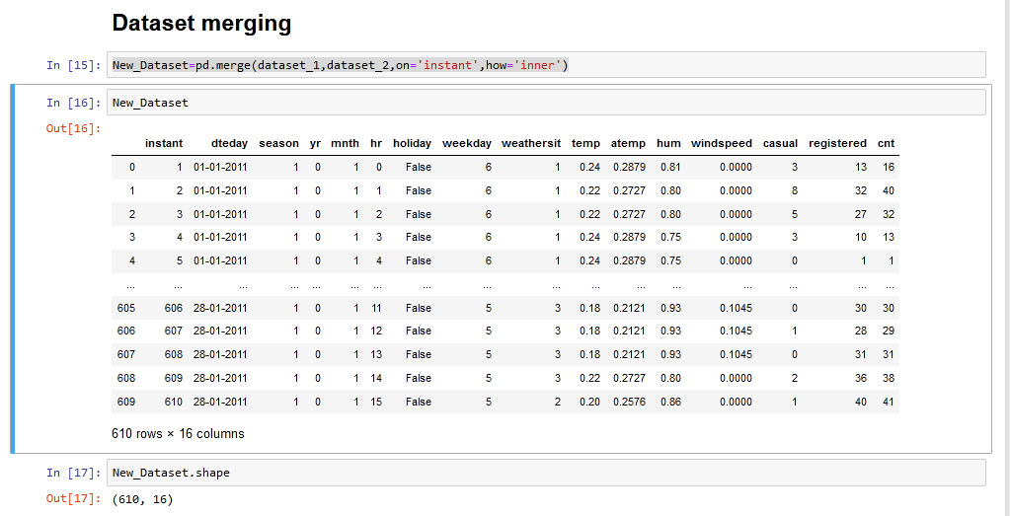
Project-1- Data Wrangling
Merging data sets:
Dataset 1 and dataset 2 merging performed after removing unused column(s) by using below code.
New_Dataset=pd.merge(dataset_1,dataset_2,on='instant',how='inner')

Slide 5
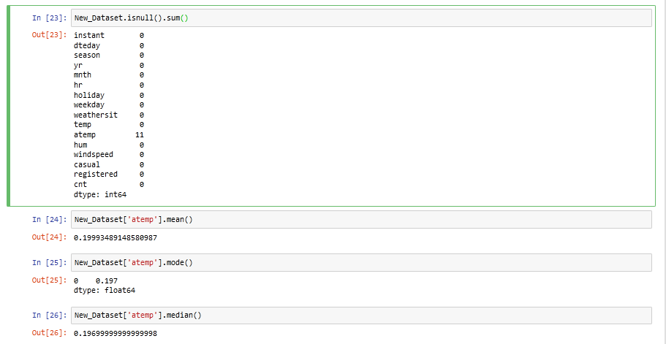
Project-1- Data Wrangling
Identification of missing values:
Missing values identified in merged dataset. And central tendency checked to use against missing values.

Slide 6
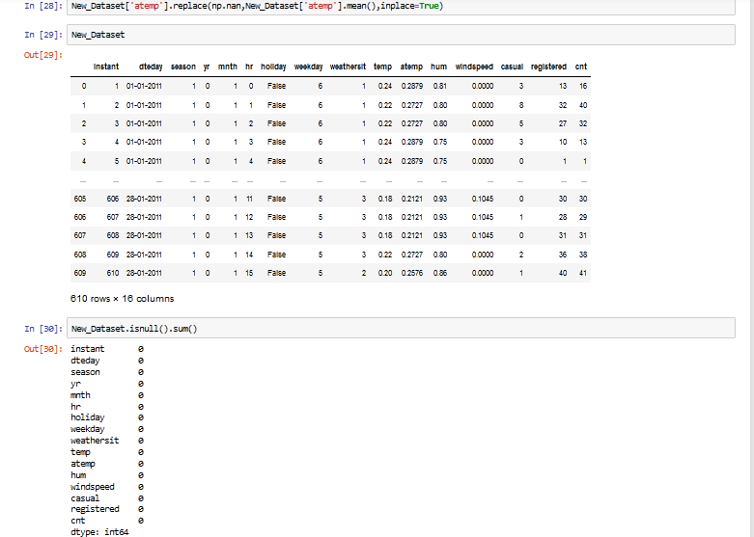
Project-1- Data Wrangling
Handling missing values by using central tendency:
Used ‘mean’ value to fill blank cells of data set in column ‘atemp’

Slide 7
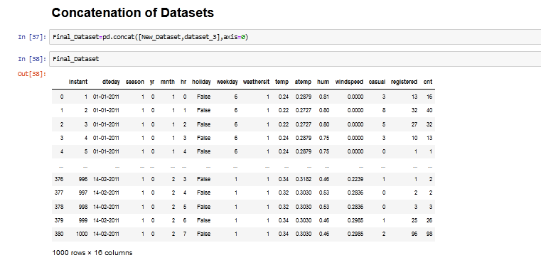
Project-1- Data Wrangling
Concatenation of data sets:
Concatenation of merged data set with data set_3 to create final data for further use. Final data set is attached.

Slide 8
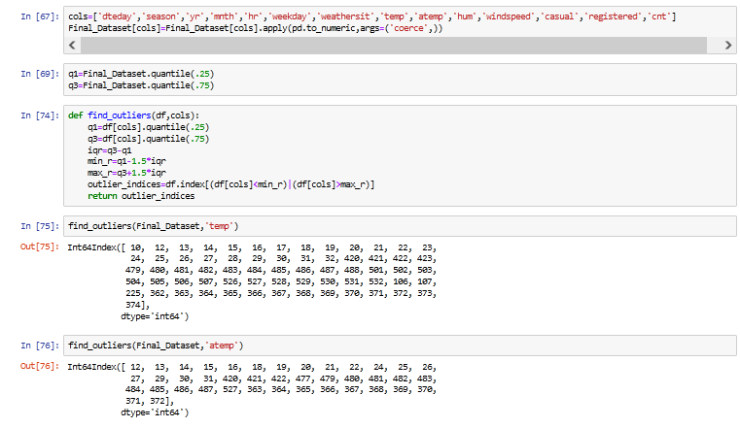
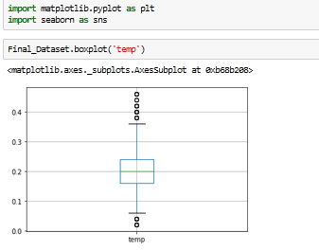
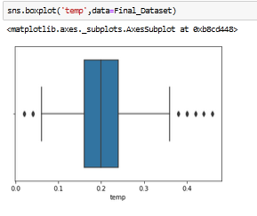
Project-1- Data Wrangling
Identify outliers and box plot:

Slide 9
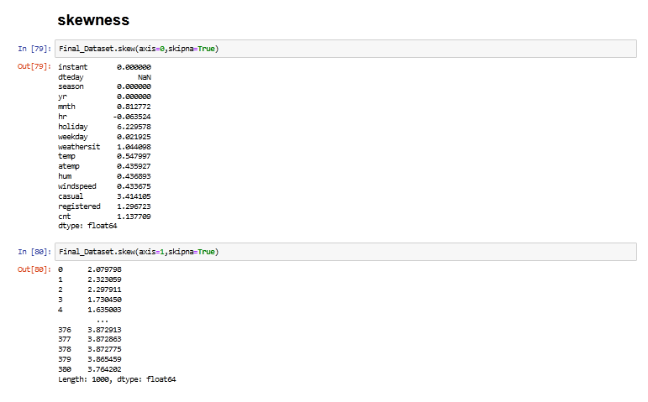
Project-1- Data Wrangling
Checking skewness:

Slide 10
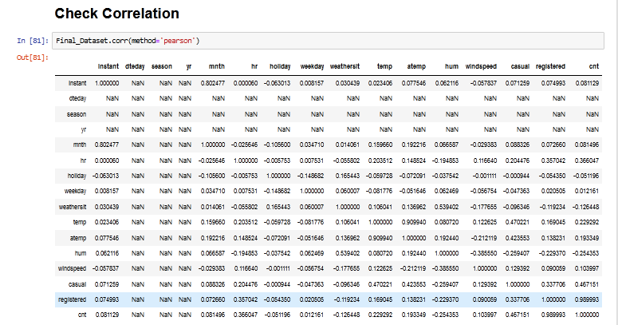
Project-1- Data Wrangling
Checking correlation: Pearson method

Slide 11
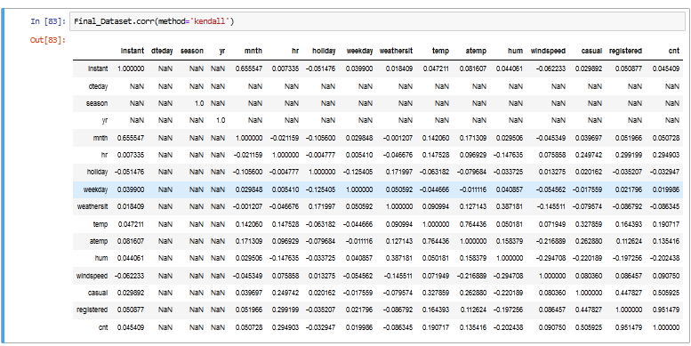
Project-1- Data Wrangling
Checking correlation: Kendall method

Slide 12
Project-1- Data Wrangling
Conclusion:
Finally a cleaned data set is created by using different data wrangling techniques which consist details of registered and unregistered user rentals initiated w.r.t. total rides.
This final dataset can be utilized for further evaluation and analysis.

Slide 13
Thank you !

