Slide 1



IC Hack 2.0
Climate Change

Slide 2

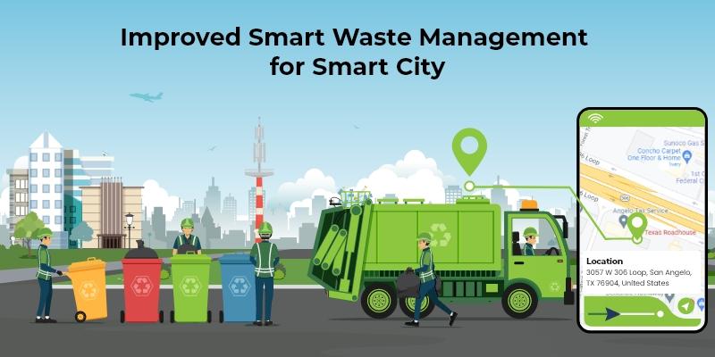
Problem Statement
The Goal is to re-imagine and redefine global mobility, addressing not only safety concerns but also the broader environmental impact. We are encouraged to think beyond conventional boundaries and contribute ideas that can revolutionize the way we move and connect.

Slide 3


IDEA OVERVIEW
What if we could turn waste into a solution for climate change?
Can our trash become the treasure that saves our planet?
Greenhouse gases (GHGs) have a significant impact on the environment, ecosystems, and human societies.
The clock is ticking, and the need for action has never been more pressing.
To combat climate change, we must rethink waste management from the ground up.
We need groundbreaking strategies to tackle the intertwined issues of climate change and waste

Slide 4

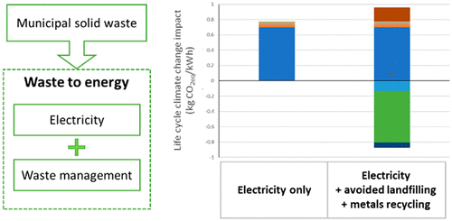
Impact
Climate change has far-reaching and profound impacts on our environment.
It affects ecosystems, weather patterns, and natural resources.
Increasing frequency and intensity of extreme weather events (e.g., hurricanes, wildfires).
Rising sea levels, leading to coastal flooding and erosion.
A steady global temperature increase, disrupting ecosystems and weather stability.
The case study shown in the figure shows the Climate change impact at waste-energy facility.

Slide 5


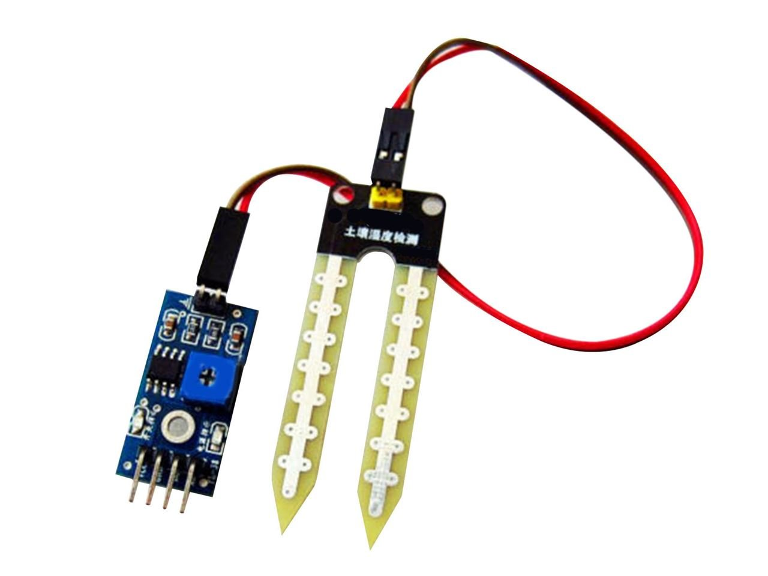
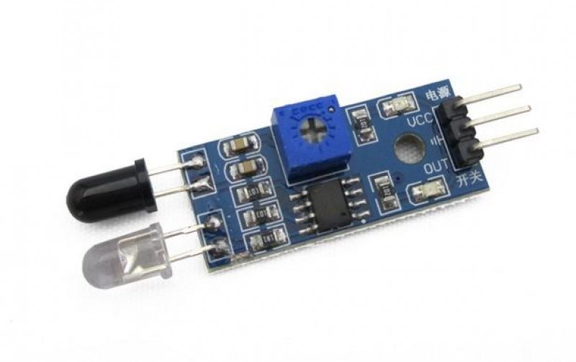
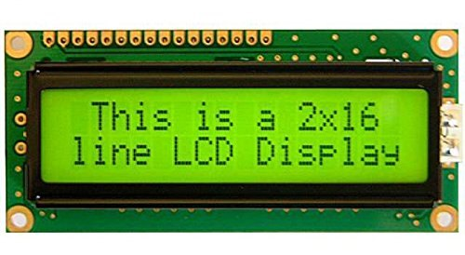
Tech Driven Management
HC-SR04
Use of HC-SR04 Arduino Ultrasonic Sensor and micro sensors.
Auto transmit signals to the authorities when the bins are nearly full.
Minimize environmental harm, by preventing unnecessary pickups.
Prevent the False Triggering of the sensors using advance sensor quality, dual sensor redundancy and consider weather conditions impact.
Reliable internet connectivity for real time signal transfer.
Use of IOT sensors to monitor the levels of waste in real time.
Moisture Sensor
IR Sensor
LCD Display

Slide 6
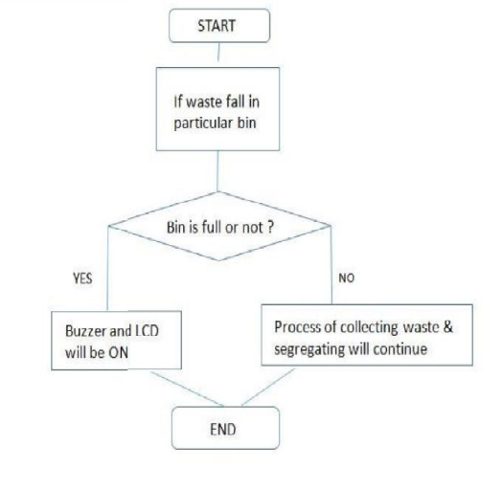
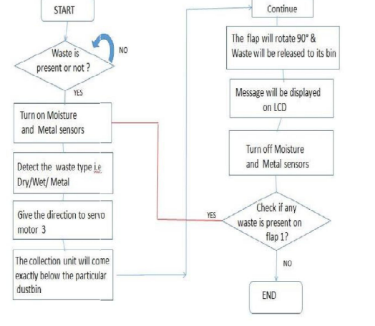
Working Flowchart/Technical Overview

Slide 7

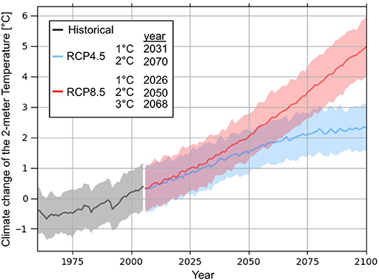
Scaling Sustainable Solutions
Scalability is essential in waste management solutions for their effectiveness.
Expand recycling initiatives city-wide for broader reach.
Large composting facilities offer substantial agricultural benefits.
Growth charts and visuals to depict scalability's potential.
Scalable projects often demonstrate economic viability and create jobs.
Scalability helps reduce greenhouse gas emissions and conserves resources.
Scalable solutions can be adapted worldwide to address waste challenges.

Slide 8
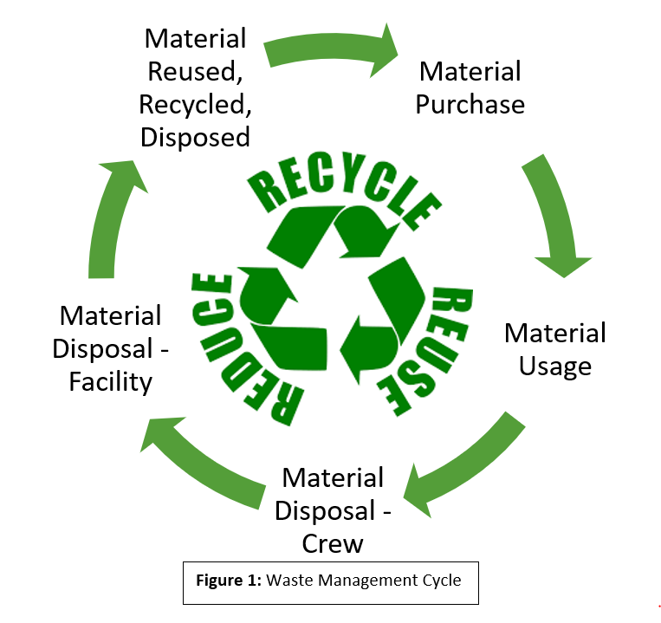
Market Prospect / Business Model
Collaborate with local businesses, recycling centers, and waste processing facilities to create mutually beneficial partnerships. This can reduce operational costs and expand your service offerings.
Implement sustainable practices in your waste management process, such as recycling and composting. This can attract environmentally-conscious customers and government contracts.
This model involves collecting waste materials, processing them into new, useful products, and selling these products.
This model involves collecting organic waste, like food scraps and lawn clippings, and turning it into nutrient-rich compost. It can help sequester carbon in soil, reducing greenhouse gas emissions.

Slide 9

Execution / Business Strategy
Marketing and Promotion: Develop a marketing strategy to raise awareness of your services and reach potential customers.
Partnerships: Collaborate with local authorities, recycling facilities, and environmental organizations to strengthen your waste management network.
Smart Bin Sales: Manufacture and sell smart waste collection bins and containers to municipalities, waste management companies, and businesses looking to upgrade their existing waste infrastructure.
Advertisement and Partnerships: Partner with local businesses and advertisers to place advertisements on waste collection bins or in the waste management app. Generate revenue through advertising fees.

Slide 10
Thank You

